Slide 1
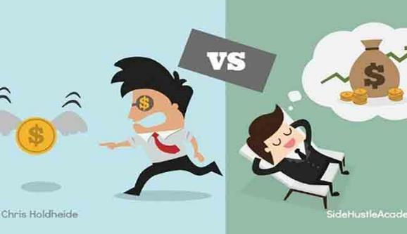
Welcome to my class

Slide 2
The Passive
Introduction
MD. ABDUR RAZZAK
Head Teacher
Dhalahara westpara Secondary Girls’ School
E-mail: abdurrazzakmt@gmail.com
Phone number: 01721588402
Class:9 & 10
U-12, page-180
Time: 50 min
Md. Abdur Razzak, Head teacher, Dhalhara Poshcimpara Secondary Girls’ School, Sadar, Magura, phone number: 01721588402

Slide 3
Observe, imagine and say
active for dollar
totally
inactive
This one is?
And this one is ?
How many types of sentences are here?
two types
Passive Voice
Active Voice
Md. Abdur Razzak, Head teacher, Dhalhara Poshcimpara Secondary Girls’ School, Sadar, Magura, phone number: 01721588402

Slide 4
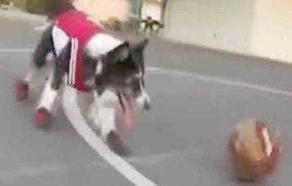
Let’s enjoy a video clip
Would you enjoy the video ? If so, follow the sentences below
The funny dog is seen to play football.
Football is played by the funny dog is enjoyable.
So, let the dog be played football.
passive voice
Would you tell me what type of voice they are ?
Md. Abdur Razzak, Head teacher, Dhalhara Poshcimpara Secondary Girls’ School, Sadar, Magura, phone number: 01721588402

Slide 5
Could you guise what is today’s lesson?
Lesson declaration
THE PASSIVE
Md. Abdur Razzak, Head teacher, Dhalhara Poshcimpara Secondary Girls’ School, Sadar, Magura, phone number: 01721588402

Slide 6
Learning outcomes
After the end of the lesson the learners will be able to---
1.
define the passive.
2.
differentiate between active and passive form.
3.
use passive form of verb in their real life.
Md. Abdur Razzak, Head teacher, Dhalhara Poshcimpara Secondary Girls’ School, Sadar, Magura, phone number: 01721588402

Slide 7
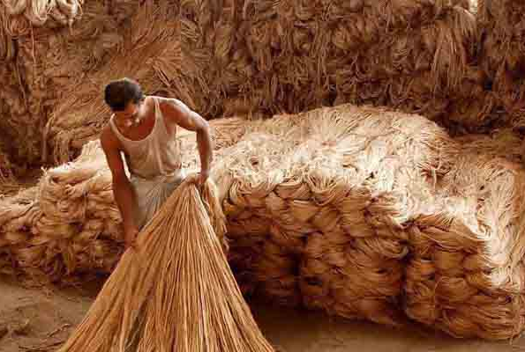
Observe the following sentences
Let’s do some work on it.
Jute is called the golden fibre.
be verb
past participle form of verb (pp)
The work is done by the subject.
Passive voice
Grammar point: We use passive when object is more important than subject and passives are more used in formal situation such as media report and public information. As: we never call people call jute the golden fibre.
People call jute the golden fibre.
no be verb, no pp
subject does the work
Active voice

Slide 8
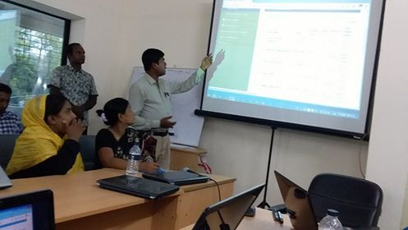
Tajmahal has been built in India.
but
auxiliary verb
be
pp
sub. V. agreement
used both in A/P
used only in passive
A/P= active/passive
Teachers’ have been given training on ICT.
auxiliary verb
be
pp
sub. V. agreement
used both in A/P
used only in passive
Md. Abdur Razzak, Head teacher, Dhalhara Poshcimpara Secondary Girls’ School, Sadar, Magura, phone number: 01721588402

Slide 9
Structure of Passive
be + pp
be , am/is/are, was/were, being, been
base | past | past participle
go play put sit solve make see eat do know begin | went played put sat solved made saw ate did knew began | gone played put sat solved made seen eaten done known begun
The above verbs are be verb and they are 8 in number.

Slide 10
Passive structure
be verb
be + pp
form | be verb | used
base | be | with let, shall, will, Can, could, may, might, ought to, am /is/are going to etc.
present tense | am, is are | with present tense
Past tense | was, were | with past tense
Continuous tense | being | passive=be+pp(v) and as pp of v in passive so, ing+be= being
perfect tense | been | with have, has, had
Let the dog be slept. Proper rest should be taken. Time is going to be done something.
She is called Salma. Students are given homework.
Doctor’s advice was followed. Medicines were taken properly.
Homework is being done. Lessons are being delivered. I am being taught.
Patient has been taken to hospital. Nurses have been given training properly.

Slide 11
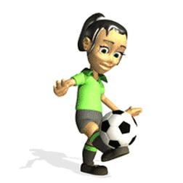
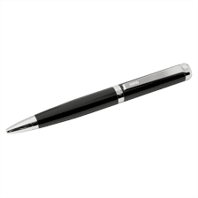
Observe the following sentences.
Active: The boy is playing football.
auxiliary verb
transitive verb/action verb
Passive: Football is being played by The boy.
But
be
vt. pp
passive
auxiliary verb
I have a pen.
intransitive v. /non action./linking/principal v.
not possible to make passive
Note: Only action/transitive verb can be turned into passive.

Slide 12
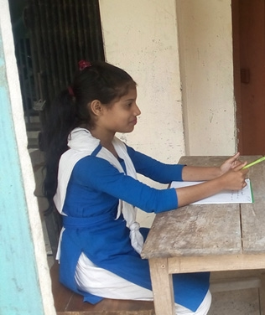
Individual Work 3 min.
click left side writing to check
What is active form?
subject does the work
What is passive form?
work done by the subject
Number of “be verb” ?
8
Which verb can be turned into passive?
Transitive/action
Passive form of verb “ know” (present ind.) ?
is known

Slide 13
Things that are important to know
Tense wise passive form
tense | active | passive
present ind. | write | am/is/are written
past ind. | wrote | was/were written
future ind. | shall/wii/ can/may(etc.) write | [shall/wii/can /may(etc.) ] be written
tense | active | passive
present perfect | have/has written | [have/has] been written
past perfect | had written | [had] been written
Note: The words written in pink colour are auxiliary verb. So, they are subject verb agreement. Students have to remind that ---------- passive
=be+past participle form of verb. auxiliaries are not the condition of passive.
present continuous | am/is/are writing | [am/is/are] being written
past continuous | was/were writing | [was/were] being written
present indicating Future | am/ is/ are going to write | [am/is/are going to] be written

Slide 14
Tense wise more examples
Active: He knows me.
Active
Passive: I was known to him.
Passive
Active: The boys drew pictures.
Active
Passive: Pictures were drawn by the boys.
Passive
Active: The boys will/can draw pictures.
Active
Passive: Pictures will/can be drawn by the boys.
Passive
Active: The boys are going to draw pictures.
Active
Passive: Pictures are going to be drawn by the boys.
Passive
Md. Abdur Razzak, Head teacher, Dhalhara Poshcimpara Secondary Girls’ School, Sadar, Magura, phone number: 01721588402

Slide 15
Active: The baby is drawing pictures.
Active
Passive: Pictures are being drawn by the baby.
Passive
Active: The boy was drawing pictures.
Active
Passive: Pictures were being drawn by the boys.
Passive
Active: The boy has drawn pictures.
Active
Passive: Pictures have been drawn by the boys.
Passive
Active: The boy had drawn pictures.
Active
Passive: Pictures had been drawn by the boys.
Passive
Note: When we do active to passive object turns into subject and subject turns into object and so does the passive to active.

Slide 16
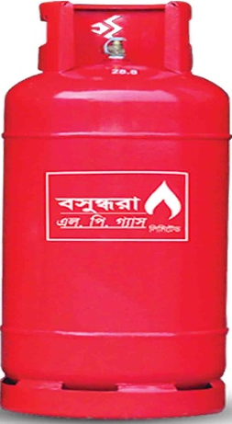
A million dollar secrecy
Always Passive
Subject inanimate
Gas is used for cooking.
Inani. Sub.
passive
At present flowers are being cultivated commercially.
But animate subject used as object
Passive
Bright students are given stipend.
Ani.sub. used as obj.
Passive
But some subs. seem to be inani. but aniate. As:
1. wind blows, 2. River flows.
So, these are always used as active.
Md. Abdur Razzak, Head teacher, Dhalhara Poshcimpara Secondary Girls’ School, Sadar, Magura, phone number: 01721588402

Slide 17
Pair work 5 min
Complete this story about a journey using the past simple passive or past continuous passive form of the verbs in the bracket below.
Click
Md. Abdur Razzak, Head teacher, Dhalhara Poshcimpara Secondary Girls’ School, Sadar, Magura, phone number: 01721588402

Slide 18
Passive of double objects
Active: Mr. Rajib teaches us English.
Passive: We are taught English by Mr. Rajib.
Passive: English is taught us by Mr. Rajib.
Active: I gave her a dress.
Passive: She was given a dress by me.
Passive of present participle
Passive of quasi passive
Active: I saw her dancing.
Active: Honey tastes sweet.
Passive: She was seen dancing by me.
Passive: Honey is tasted sweet.
Active: Nipa feels the wind blowing .
Active: The house is building.
Passive: The house is being built.
Passive: The wind is felt blowing by Nipa.
Md. Abdur Razzak, Head teacher, Dhalhara Poshcimpara Secondary Girls’ School, Sadar, Magura, phone number: 01721588402

Slide 19
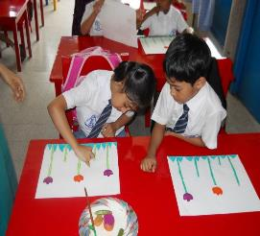
Passive of Interrogative sentence
Active: Do they draw pictures? (interrogative)
Active: They draw pictures. (assertive)
Passive: The pictures are drawn by them. (assertive)
Passive: Are the pictures drawn by them? (interrogative)
Similarly-
Active: Are you writing the article? (interrogative)
Active: You are writing the article. (assertive)
Passive: The artic le is written by you. (assertive)
Passive: Is the article written by you? (interrogative)
Md. Abdur Razzak, Head teacher, Dhalhara Poshcimpara Secondary Girls’ School, Sadar, Magura, phone number: 01721588402

Slide 20
Some more examples
Active: Had he done the work?
Passive: Had the work been done by him?
Active: Am I going to conduct the class ?
Passive: Is the class going to be conducted by me?
Examples using Wh words
Active: Who did the sum ? (interrogative)
Sub
v
obj
Passive: The sum was done by whom ? (assertive)
The sum
was
done
by whom
Obj as sub
be
sub as obj
Obj as sub
be
pp
pp
sub as obj
Passive: ? (interrogative)
By whom
the sum
sub as obj
Obj as sub

Slide 21
Similarly
Active: Whom are you talking to? (interrogative)
obj
sub
v
Passive: Who was being talked to by you? (interrogative)
sub
be
pp
obj
Active: What does he need?
Passive: What is needed by him?
Active: How had he done the work?
Passive: How had the work been done by him?
Active: Why can’t she solve the problem?
Passive: Why can the problem not be solved by her?
What does he need? (Active)
What is needed by him? (Passive)

Slide 22
Passive of Imperative sentence
Active: Read the book.
In imperative sentence sub. (you) is always understood. Sometimes so does the modal and also other word. At the same time verb in these sentences asks permission (to allow) to take action. So, Let is used in passive formin that case.
verb
object
Active: You read the book.
sub
verb
object
Passive: Let the book be read (by you).
allow
obj-sub
be
pp
Active: Let the boy play footnball.
sub
verb
object
Passive: Let football be played by the boy.
allow
obj-sub
be
pp
sub-obj
Md. Abdur Razzak, Head teacher, Dhalhara Poshcimpara Secondary Girls’ School, Sadar, Magura, phone number: 01721588402

Slide 23
Active: Love the mother land.
verb
obbject
Active: (You should) love the mother land.
verb
obbject
Passive: The mother land should be loved.
obj-sub
be
pp
Exceptions
Active: Keep your word .
Passive: Your word should be kept.
Active: Please post the letter.
Passive: You are requested to post the letter.
Active: Give me a pencil.
Passive: Let a pencil be given for me.
Md. Abdur Razzak, Head teacher, Dhalhara Poshcimpara Secondary Girls’ School, Sadar, Magura, phone number: 01721588402

Slide 24
Group work 10 min
Rewrite the following newspaper headlines in complete sentence in passive form.
a. Theft of valuable things at Dhanmondi. 2 killed. 3 injured
b. War criminals hanged in Bangladesh. People rejoice.
c. 10 killed in Dhaka Aricha highway.
d. Polithine seized, 10 shop owners arrested.
e. 5,00,000 saplings planted for roadside afforestation.
Md. Abdur Razzak, Head teacher, Dhalhara Poshcimpara Secondary Girls’ School, Sadar, Magura, phone number: 01721588402

Slide 25
Evaluation
Tick ($√$) the correct passive form of verb from alternatives.
1. I may (sell) the pen .
(b) be sold
(a) sold
$√100$%
$$×$$
(d) selling
(c) sell
$$×$$
$$×$$
2. My pen has (lost).
(a) loss
(b) lose
$$×$$
$$×$$
(c) been lost
(d) lost
$√$100%
$$×$$

Slide 26
3. I (saw) him reading.
(a) seen
(b) was seen
$$×$$
$√100$%
(c) saw
(d) sing
$$×$$
$$×$$
4. By whom the pen was (steal)?
(a) steal
(b) steals
$$×$$
$$×$$
(c) stolen
(d) stealing
$√$100%
$$×$$
5. Let the work (do).
(a) done
(b) did
$$×$$
$$×$$
(c) be done
(d) do
$√$100%
$$×$$

Slide 27
Home work
Write ten sentences about corona virus using passive form.
Md. Abdur Razzak, Head teacher, Dhalhara Poshcimpara Secondary Girls’ School, Sadar, Magura, phone number: 01721588402

Slide 28
See you next class

