Slide 1
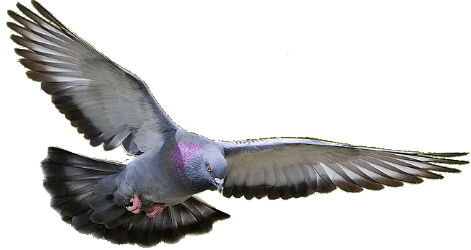
Welcome to HD PPT Presentation.
Notes:
Welcome slide

Slide 2
Introduction
Teacher
Lesson
Hirendra Debnath
MA(English),Bed
Assistant Teacher(English)
Puran Bazar Girls’ High School
01789-916684
Hirendra Debnath
hirendra0501@gmail.com
English Grammar and Composition
Class : VI-X

Slide 3
Do it.
Let it be done.
Is the dog liked by you?
Do you like the dog?
Whom does the dog like?
Who is liked by the dog?
Let him shut the door.
Let the door be shut by him.
Notes:
Suspension to lead the lesson.

Slide 4
What have you followed by the sentences?
Voice change of Interrogative
&
Imperative sentence

Slide 5
Let us discuss about the voice change
of Interrogative & Imperative
sentence in our today’s class.
Notes:
Lesson declaration.

Slide 6
Learning outcomes
At the end of the lesson , the ss will be able to—
a) identify interrogative & imperative sentence
b) identify their categories
c) identify the structure of changing into passive
d) make passive from active.
Notes:
These are the targets of the lesson.

Slide 7
Follow
Do you follow your teachers?
Who loves you most in the earth?
Interrogative sentence is
divided into two categories
Yes/No question
Do you respect your mother?
‘Wh’ question
What do you want?
Notes:
Two categories of interrogative sentences.

Slide 8
Voice change of Interrogative with ‘yes/no’ question.
Active : Did Rahim break the glass?
Active assertive : Rahim broke the glass.
Passive assertive : The glass was broken by Rahim.
Passive : Was the glass broken by Rahim?
Active : Will he buy the book?
Active assertive : He will buy the book.
Passive assertive : The book will be bought by him.
Passive : Will the book be bought by him?

Slide 9
Activities
1. Do you say your prayer regularly?
2. Have you completed your homework?
3. Did you perform your job yesterday?
4. Does he follow his parents?
5. Had he made his lessons in the last class?
Notes:
Evaluation on active into passive of interrogative sentence.

Slide 10
Voice change of ‘Wh’ word.
‘Wh’ word may be interrogative pronoun, interrogative adjective and interrogative adverb.
Interrogative pronoun and interrogative adjective sit in the sentence as both subject and object.
On the other hand, interrogative adverb sits in the sentence as extension.
If interrogative pronoun refers to ‘subject’
Active : Who broke the glass?
Passive assertive : The glass was broken by whom.
Passive : By whom was the glass broken?

Slide 11
If interrogative pronoun refers to ‘object’
Active : Whom did Rahim help?
Active assertive : Rahim helped whom.
Passive : Who was helped by Rahim?
If interrogative adjective refers to ‘subject’
Active : Which boy broke the glass?
Passive assertive : The glass was broken by which boy.
Passive : By which boy was the glass broken?

Slide 12
If interrogative adjective refers to ‘object’
Active : Which shirt did Rahim buy?
Active assertive : Rahim bought which shirt.
Passive : Which shirt was bought by Rahim?
If interrogative adverb sits as an extension ---
Active : When did he buy the book?
Active assertive : He bought the book when.
Passive assertive : The book was bought when by him.
Passive : When was the book bought by him?

Slide 13
Activities
Change into passive
1. Who taught you English?
2. Whom did you call?
3. Which student did not learn his lessons?
4. Which book will you buy?
5. How did you do it?

Slide 14
Follow
Open your book.
Let us drop the matter.
Imperative sentence is
divided into two categories
Imperative without ‘Let’
Listen to me what I say.
Imperative with ‘Let’
Let us have a picnic.
Notes:
Categories of imperative sentence sentences. Learning outcomes No-2 is focused here.

Slide 15
Voice change of Imperative without ‘Let’.
Follow my advice.
Let my advice be followed.
Let + (not) + object + be + V₃ + extension (if there is.)
Never tell a lie.
Let never a lie be told.
Or, Let not a lie ever be told.
Give me a pen.
Let a pen be given to me.
Notes:
Learning outcomes No-3 is focused here.

Slide 16
Tell him to go.
Let him be told to go.
Activities
Change them into passive voice
1. Do the sum.
2. Read the book attentively.
3. Don’t mix with bad boys.
4. Pluck me a flower.
5. Tell him to call in a doctor.

Slide 17
Let me show my dance.
Let my dance be shown by me.
Notes:
Suspension to lead learning outcomes No-3.

Slide 18
Voice change of Imperative with ‘Let’.
Let me do it.
Let it be done by me.
Let + object + be + V₃ + by + indirect object (person) + extension (if there is.)
If ‘please’ or ‘kindly’ is found in an imperative sentence, passive will be as follows
Please stay home.
You are requested to stay home.
Notes:
Learning outcomes No-3 is focused here.

Slide 19
Activities
Change them into passive voice
1. Let him say something
2. Let us solve the problem.
3. Let me handle the matter.
4. Let them do their job.
5. Please help me.

Slide 20
Evaluation
Change the sentences into passive
1. Enjoy the waterfall.
2. Let us enjoy the waterfall.
3. Visit waterfall when you get time.
4. Let me observe the waterfall.
5. Let them see the waterfall.
Notes:
Evaluation on the topic. Learning outcomes No-4 is focused here.

Slide 21
This is all for today.
Notes:
Ending slide

