Slide 1
GOOD MORNING
DEAR STUDENTS.

Slide 2
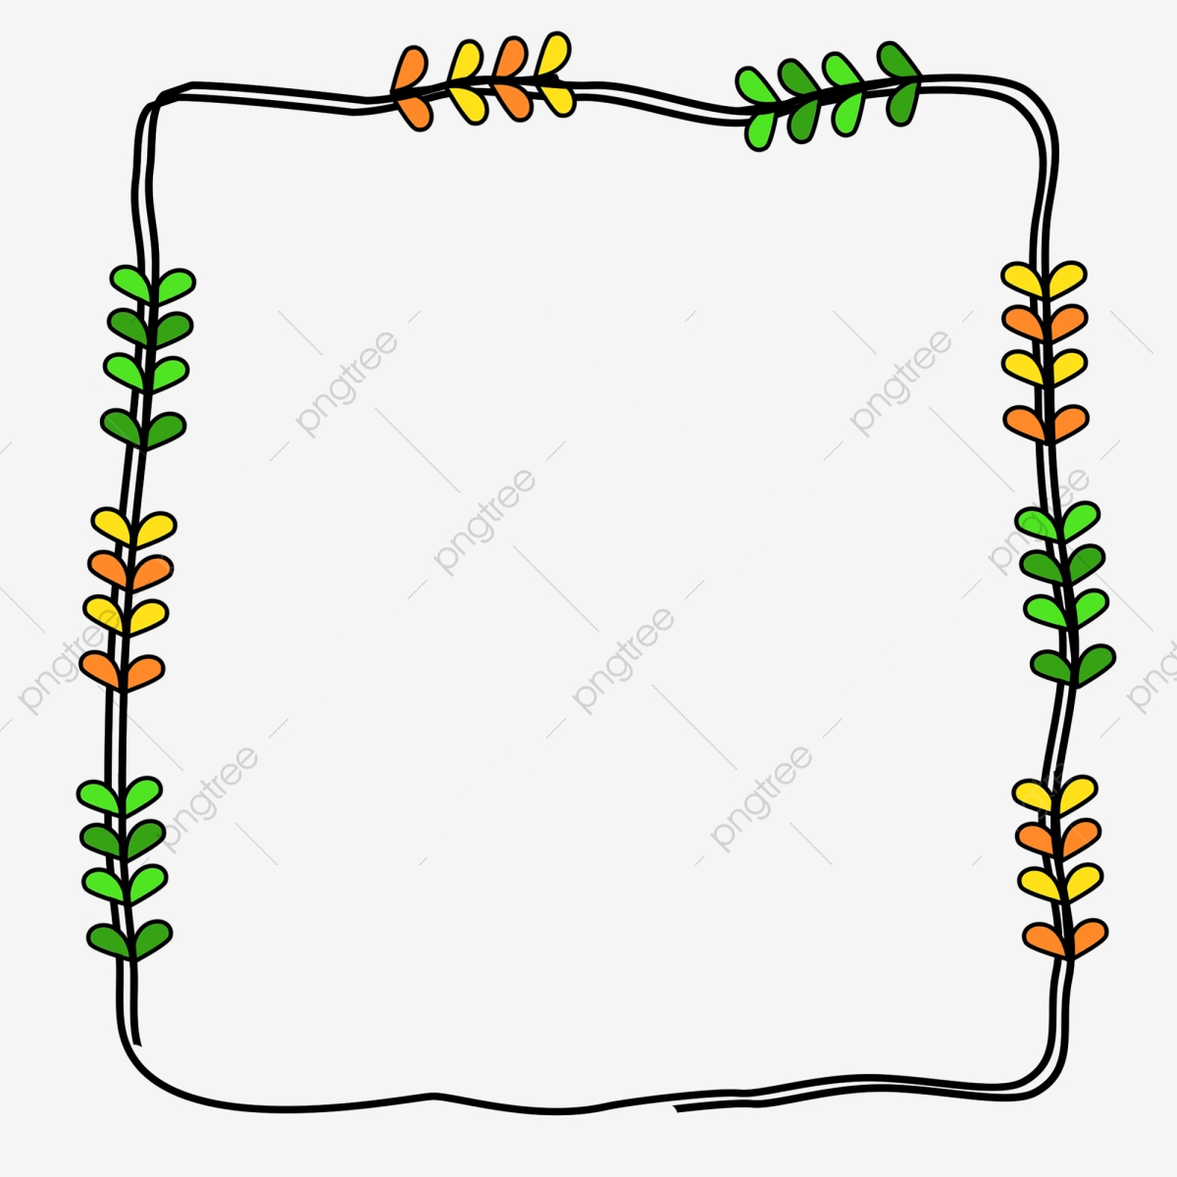
TEACHERS IDENTITY.
MUHAMMAD SHAHJAHAN MULLA
ASSISTANT TEACHER
BORABDA SHAH GPS
CHUNARUGHAT,HABIGONJ
email:shahjahanmulla77@gmail.com

Slide 3
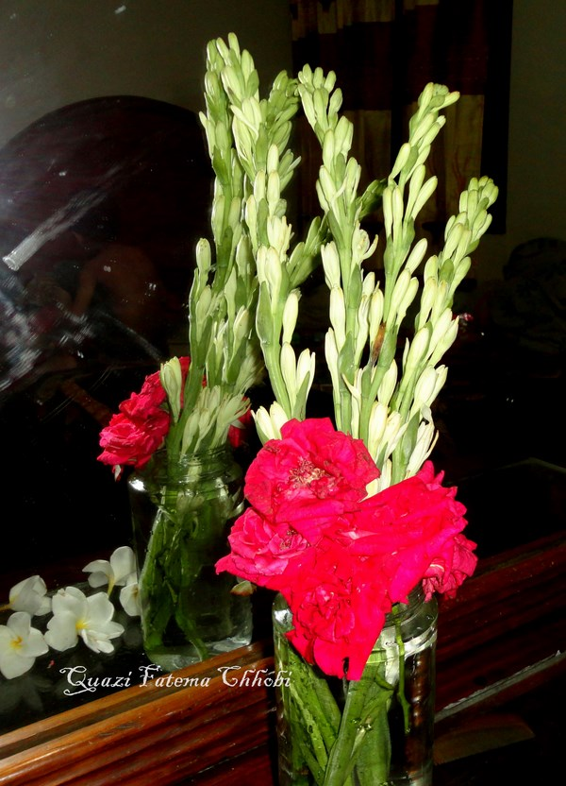
SUBJECT IDENTITY
SUBJECT:ENGLISH
CLASS:TWO
TIME:40 MINUTES.

Slide 4
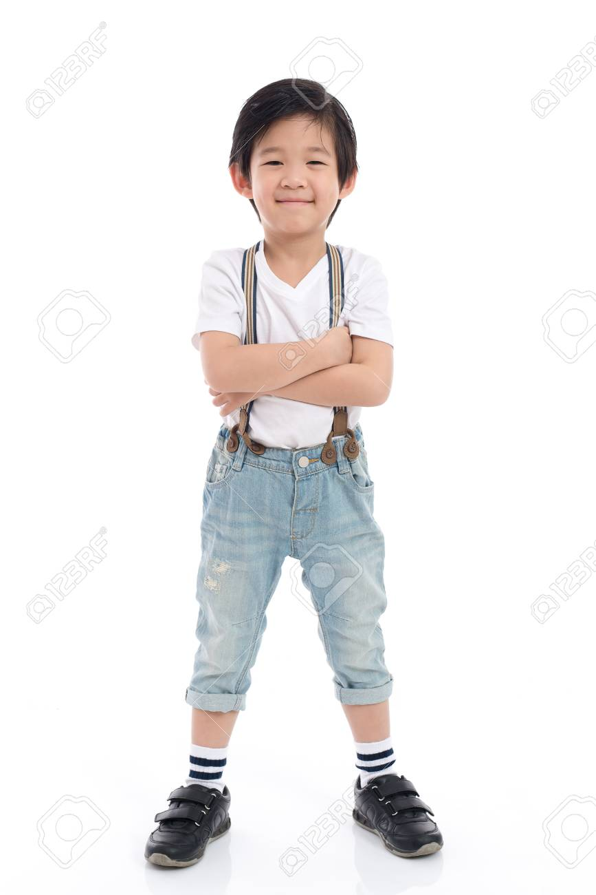
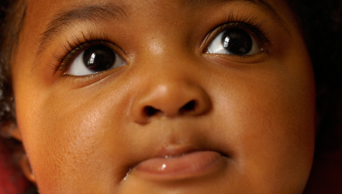
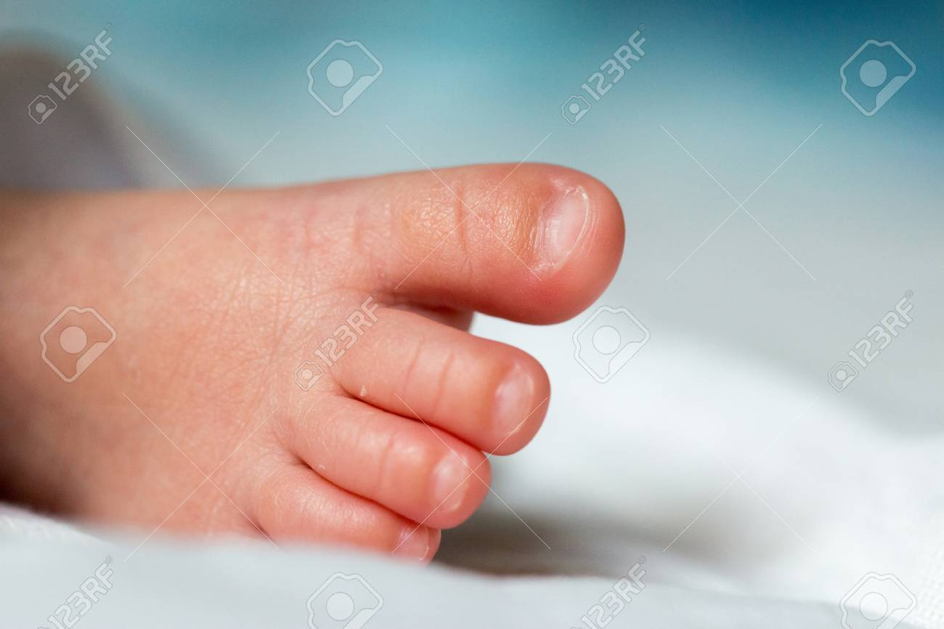
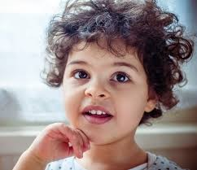
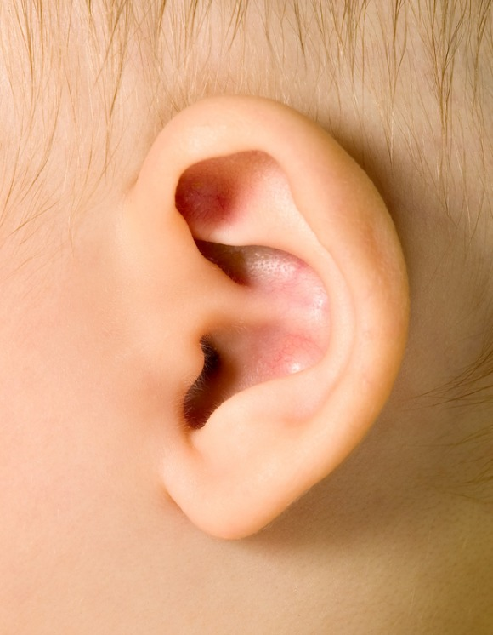
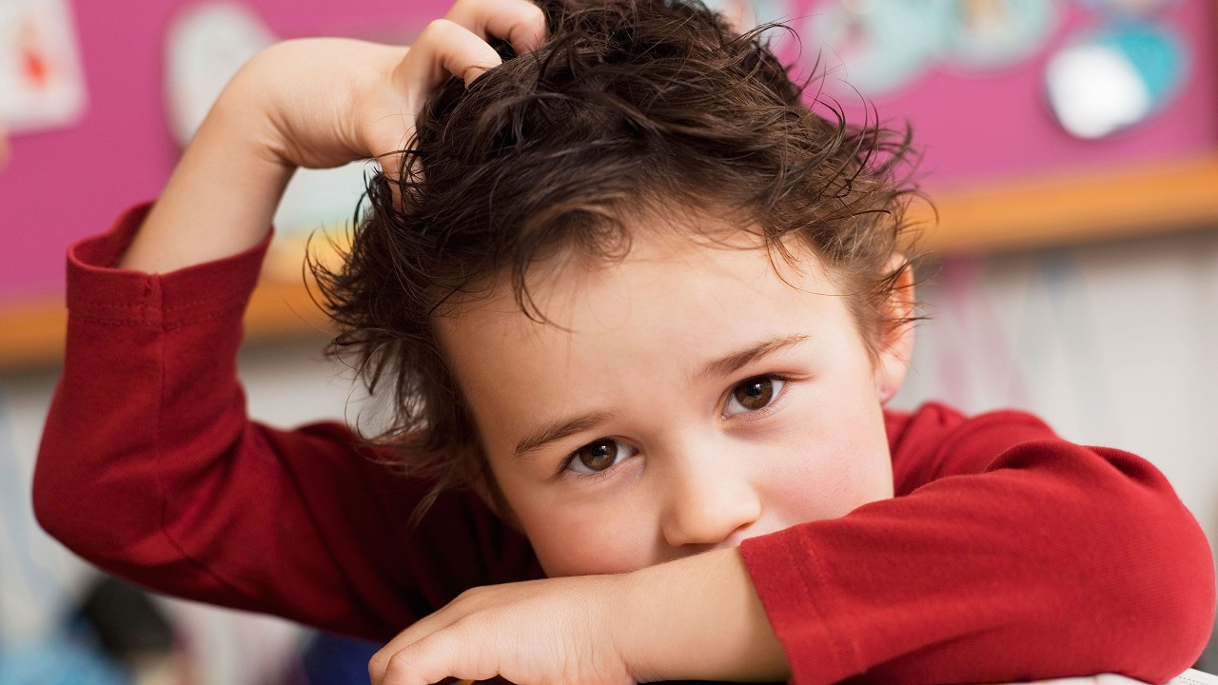
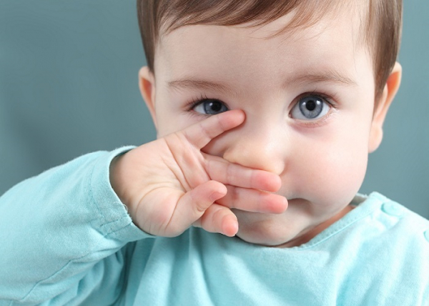
Come on,now we can see some pictures.

Slide 5
WCW
There is a boy and some human body parts.
Whats are the pictuers ?
IW
Niha,touch your head.

Slide 6
Todays Lessons.
Unit:11
Lessons:1-3(A)
Head and Shoulders.

Slide 7
Learning Outcomes.
By the end of the lessons,the students will be able to----------.
Lesting:1.1.1-become familiar with Einglish sound by listening to common English words.2.1.1-follow simple commands and instructions.3.1.1/1.2-Understands simple questions and ststemants about them and about familiar objects.4.1.1-enjoy the rhythm and music of simple rhymes.
Speaking:1.1.1-repeat after the teachers simple words and phrases with proper sound and stress.
Reading1.3.1-recognize and read the names of objects having the some inatial and final sounds.1.4.1-read words and phrases with help of visual clues(about 30 new words)and simple sentences.

Slide 8
Open at page 22.
See attentively.
wcw

Slide 9
I read the lessons, you are all listen attentively.
wcw

Slide 10
I read the lessons, you are all match your finger correctly.
wcw

Slide 11
I read the lessons, you are all repeat with me.
wcw

Slide 12
Now you are all read the lessons with proper sound and intonation.
wcw

Slide 13
One students read one word and other students listen attentively(one after another).
PW

Slide 14
One students touch his selected body parts and other students say their name.
PW
Such as---------
Whats this---?
It,s head.
Whats this---?
It,s toes.

Slide 15
PW
Whats this---?
It,s eyes.
Whats this---?
It,s knee.
Whats this---?
It,s ear.

Slide 16
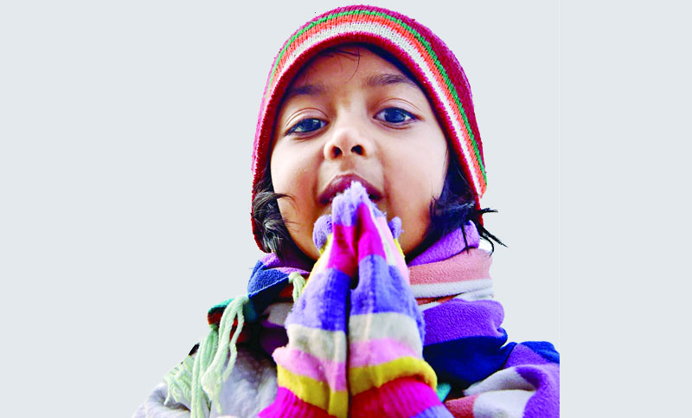
PW
Whats this---?
It,s mouth.
Whats this---?
It,s shoulder.

Slide 17
PW
Whats this---?
It,s nose.

Slide 18
Now we match the body parts with their name(left side with right side).
head
eyes
nose
ear
mouth
shoulder
knee
toes

Slide 19
IW
Now we more discuss the lessons.
Whats this ?
Kalam,stand up.
Whats this ?
Shuva,stand up.
Whats this ?
Babul,stand up.

Slide 20
Tomorrow you are all write this lessons on your khata.
Goodbye
Students
See you tomorrow.

