Slide 1
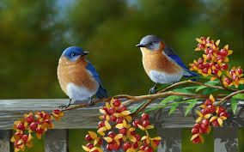
WELCOME

Slide 2
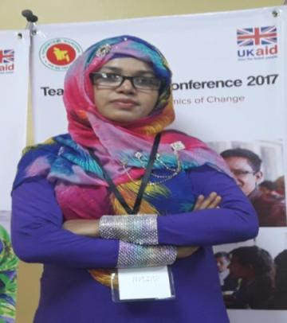
INTRODUCING MYSELF
*SALMA BEGUM (Diba)
*Assistant Teacher
*Purbo Charpata Government Primary School
* Raipur, Lakshmipur.

Slide 3
Identity of the content
Class :Four
Subject : English
Unit : 15
Lessons :1-3

Slide 4
By the end of the lesson students will be able -
to recognize which syllable in a word is stressed.(1.2.1)
to repeat after the teacher and say words, phrases and sentences with proper sounds, stress and intonation.(1.1.1)
to read silently with understanding paragraphs, stories and other texts.(5.1.1)
to write a short composition about one self, family, friends and other familiar topics.(10.2.1)

Slide 5
‘Hello’ Song
Hello! Hello! Hello!
My friends!
Happy to meet you!
Happy to meet you!
Hello! Hello! Hello!
My friends!
Happy to meet you!
Happy to meet you, today!

Slide 6
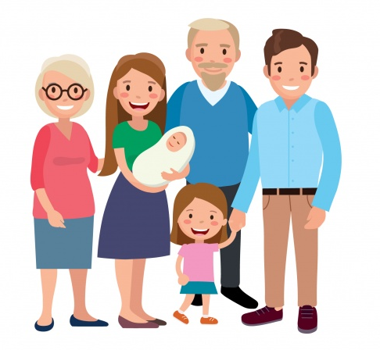
What are you seeing in the picture?
A Family

Slide 7
Sagar and His Family

Slide 8
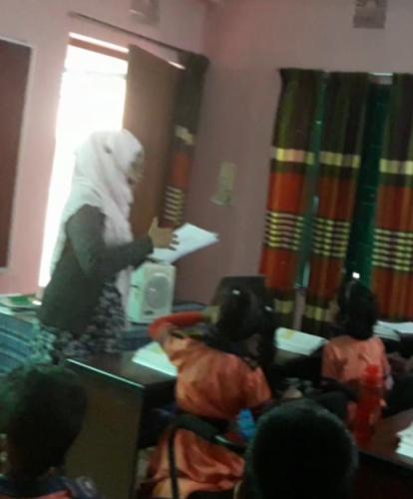
Teacher’s reading

Slide 9
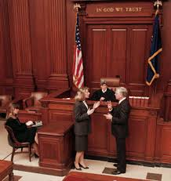
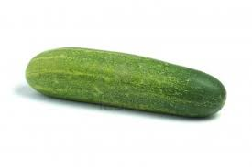
New words
lawyer
cucumbers
Neighbourhood

Slide 10
Make sentences
Sagar’s father is a lawyer.
lawyer
housewife
She is a housewife.
We have a flower’s garden.
garden

Slide 11
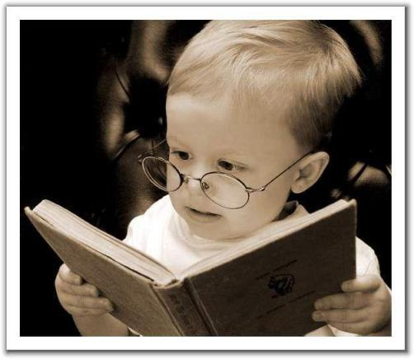
Silent reading

Slide 12
Group Work
Fill in the Blanks with correct word
years
Sagar is nine………… old.
Sagar’s………….. is a lawyer.
He has a……… sister.
Sagar’s grandpa was a…………teacher.
Sagar is very …… of his mother’s garden.
father
little
school
proud

Slide 13
Answer the following questions:
What does Sagar’s father do?
Ans. Sagar’s father is a lawyer.
2.What does grandma make?
Ans. Grandma makes the best pithas in the world.
3. Why does Sagar feel proud?
Ans. Sagar is very proud of his mother’s garden.

Slide 15
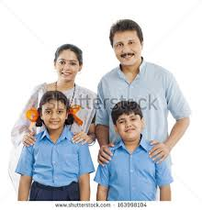
Write five sentences about your family in your notebook.

Slide 16
Home work
Write five sentences about your friend’s family.

Slide 17
Thank you.

