Slide 1
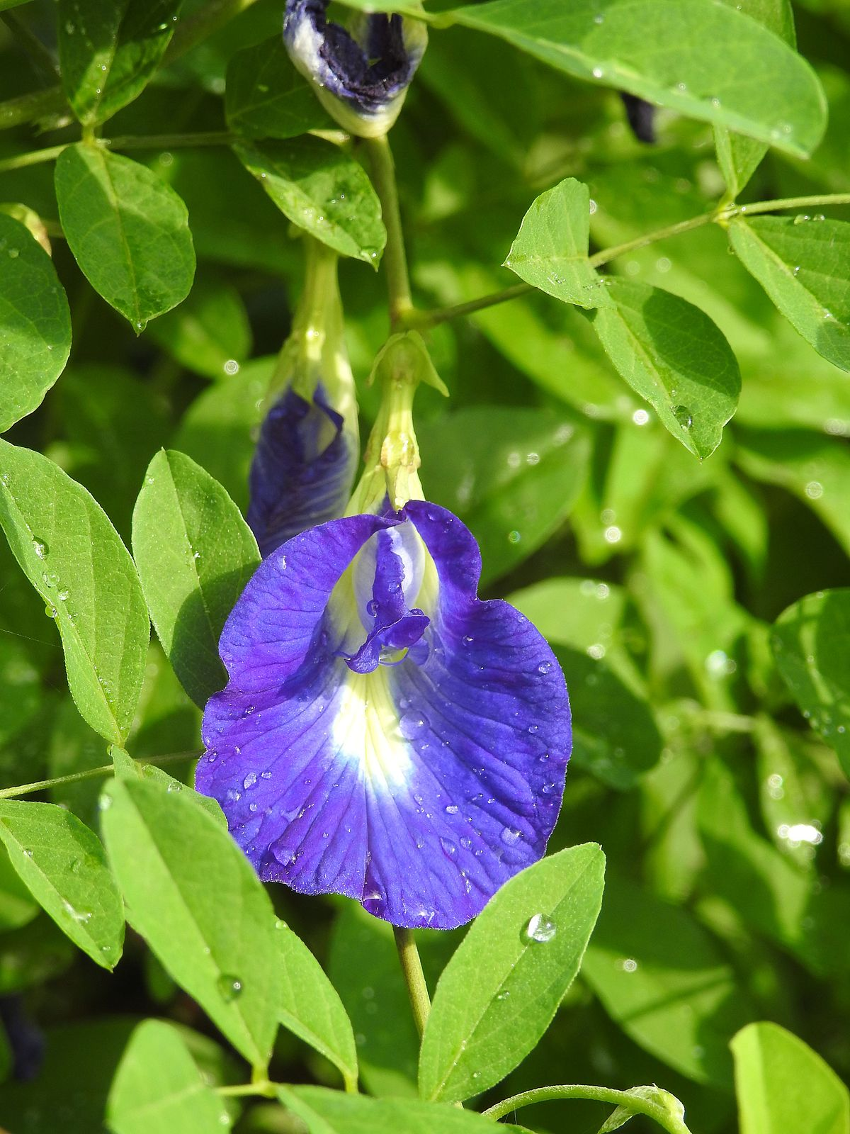
Wellcome

Slide 2
Presented by
Name: Binay Bikash Chakma
Assistant Teacher
Manikchhari Muslim Para Govt Primary School.
Manikchhari, Khagrachhari.
E-mail: binoychakrmt@gmail.com
01820040162.

Slide 3
Lesson Introduction
Subject: English
Class: two
Unit: 14
Lesson:1-3, (Activity A).

Slide 4
Learning Outcomes
Students will be able to...
1.1.1 become familiar with English souds by listening to common English words.
1.1.1repeat after the teacher simple words and phrases with proper sounds and stress.

Slide 5
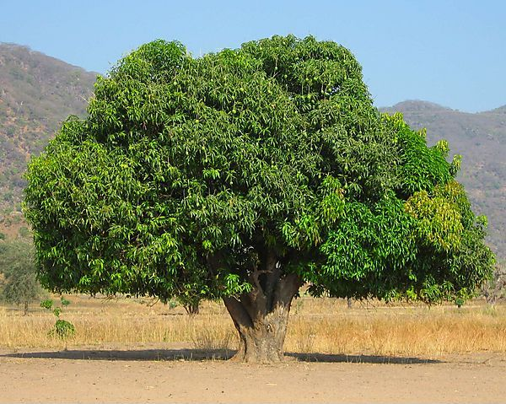
আম গাছ
A mango Tree

Slide 6
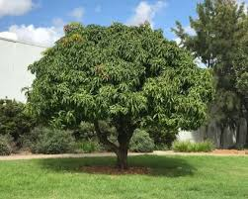
আগের চেয়ে আরো বড় হলো।
চারা গাছটি একটু বড় হলো।
আমের বীজ থেকে চারা গজাচ্ছে।
একটি বড় গাছে পরিণত হয়েছে।

Slide 8
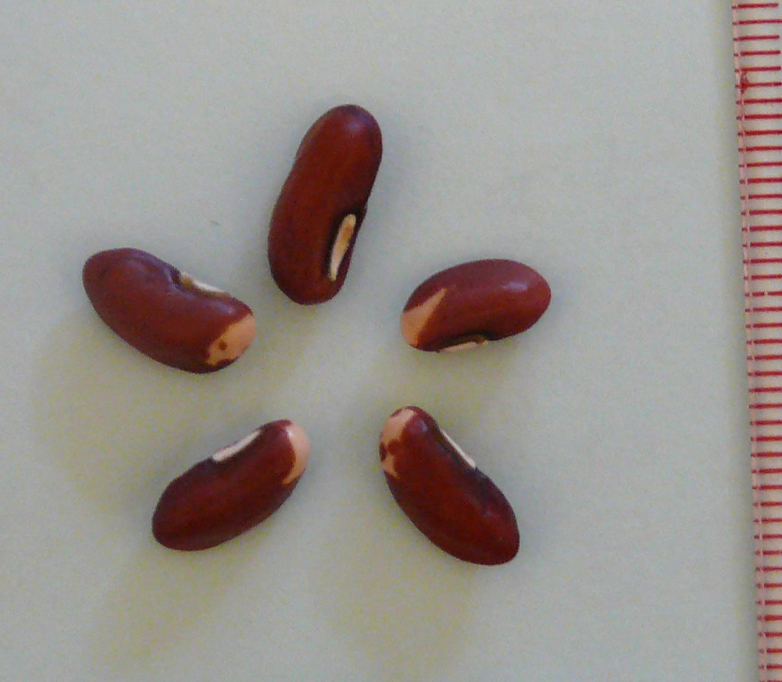
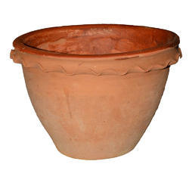
What do see you in the picture?
Seed
Tub

Slide 9
What do see you in the picture?
Sun
Plant

Slide 12
Meaning of the words in Bengali/ শব্দের অর্থ
বীজ/বিচি
টব
সূর্য
চারা গাছ

Slide 13
Match the words with pictures
Sun
Seed
Plant
Tub

Slide 14
Home Work
Write these Words in your notebook
Seed, Tub, Sun,plant.

Slide 15
Good bye

