Slide 2
TEACHERS IDENTITY
Biplob Kumar Das
Assistant teacher
Lutia Govt G P S
Lohagara,Narail.

Slide 3
Lessons identity
Class-5
Heading-Life is beautiful
Part Of the Lesson-(It’s a beautiful---was born.)
Unit:20,Lesson:(1-2)
Time:50 minutes

Slide 4
Learning outcomes
At the end of todays lessons students will be able to
Listening: 4.2.1 understand and enjoy simple stories.
1.1.1 Speaking: say words ,phrases and sentences with proper sounds and stress.
1.5.1 Reading: read words phrases and sentences in the text with proper pronunciation , stress and intonation.
10.2 Writing: write short description of object.

Slide 5
Review
of
Previous
lessons
1 Babul and his family live on the island of Dublar Char.
T
2. Babul’s Mother Worked at Dairy Firm.
F
3. Babul’s father had a grocery shop .
T
4. Then Babul was 8 years old.
5. Everyone was afraid. T
F

Slide 6
Let us, we sing a song
Good morning good morning

Slide 7
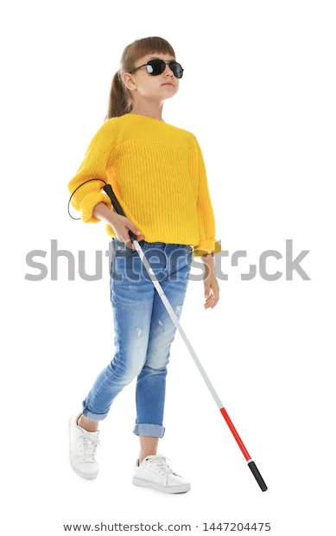
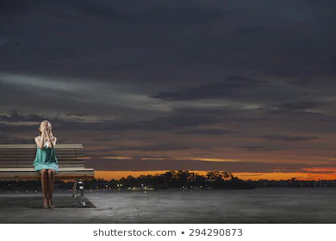
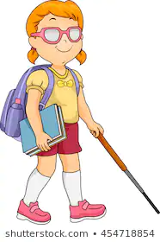
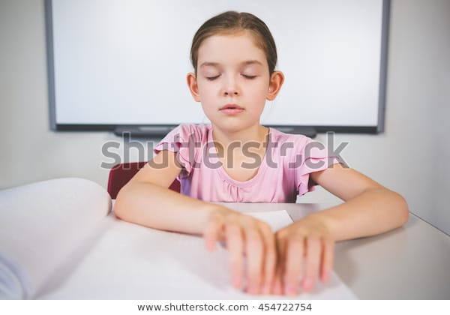
What can you see in these pictures?

Slide 8
So
Todays lesson is
Life is beautiful!

Slide 9
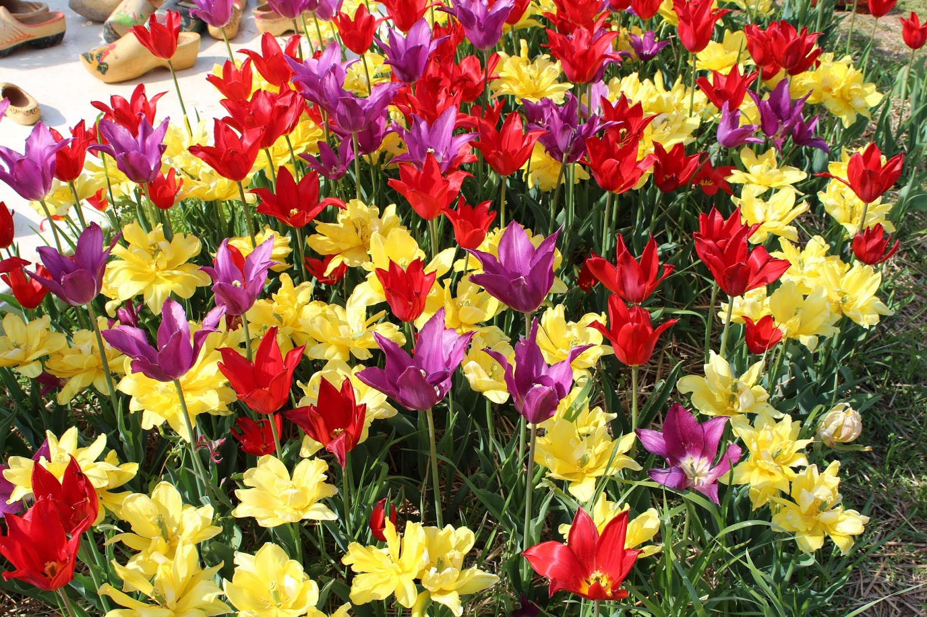
It’s a beautiful spring day. Maria getes up early feeling happy.

Slide 10
She knows that it’s a nice day because she puts her hand on the glass of the window.It is very warm.

Slide 11
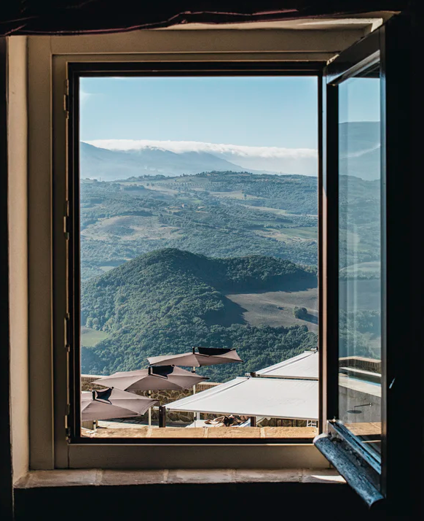
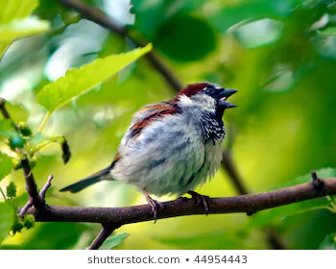
She opens the window and the singing of the birds fills the room.

Slide 12
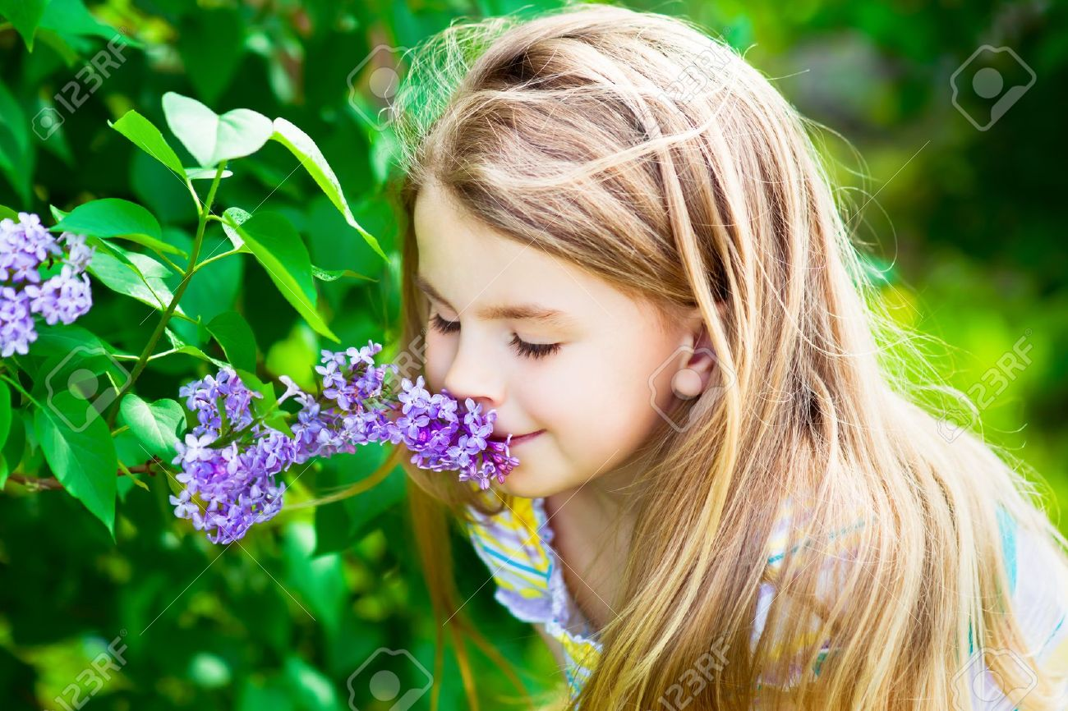
She can smell the flowers outside her room.They smell sweet and fresh.

Slide 13
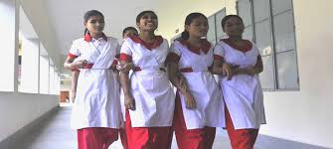
After Maria gets dressed and has her breakfast,she puts her books in her bag.She is ready for school.

Slide 14
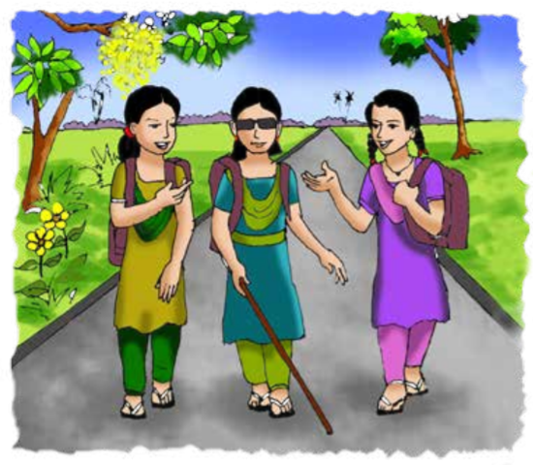
Maria is a lot like any other students in her neighbourhood. She goes to school and likes to be with her friends.

Slide 15
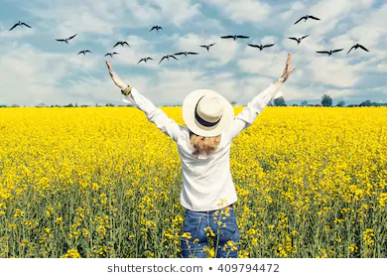
But Maria cannot see the beautiful spring day. She can’t see the flowers,the blue sky,or the singing birds.

Slide 16
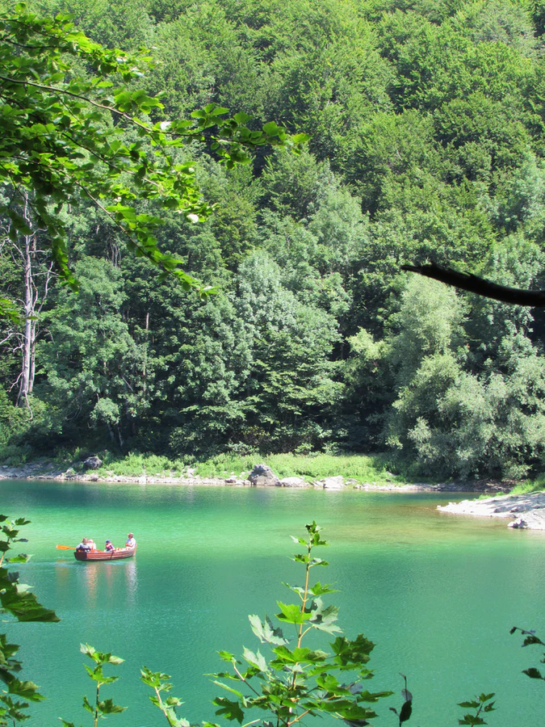
She can’t see the new green
leaves on the trees.she can’t see these because she is visually impaired

Slide 17
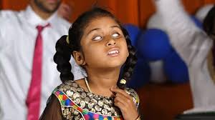
She has been unable to see since she was born.

Slide 18
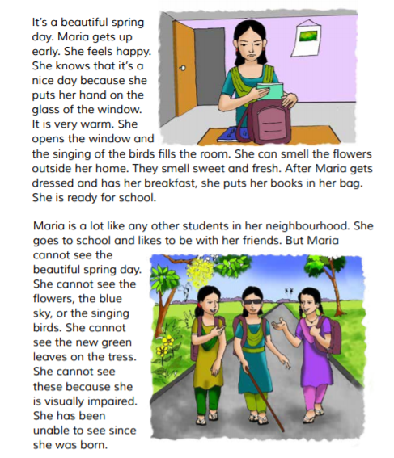
Teacher’s reading
Open at page 74 and follow me.
Put your finger under the lines.

Slide 19
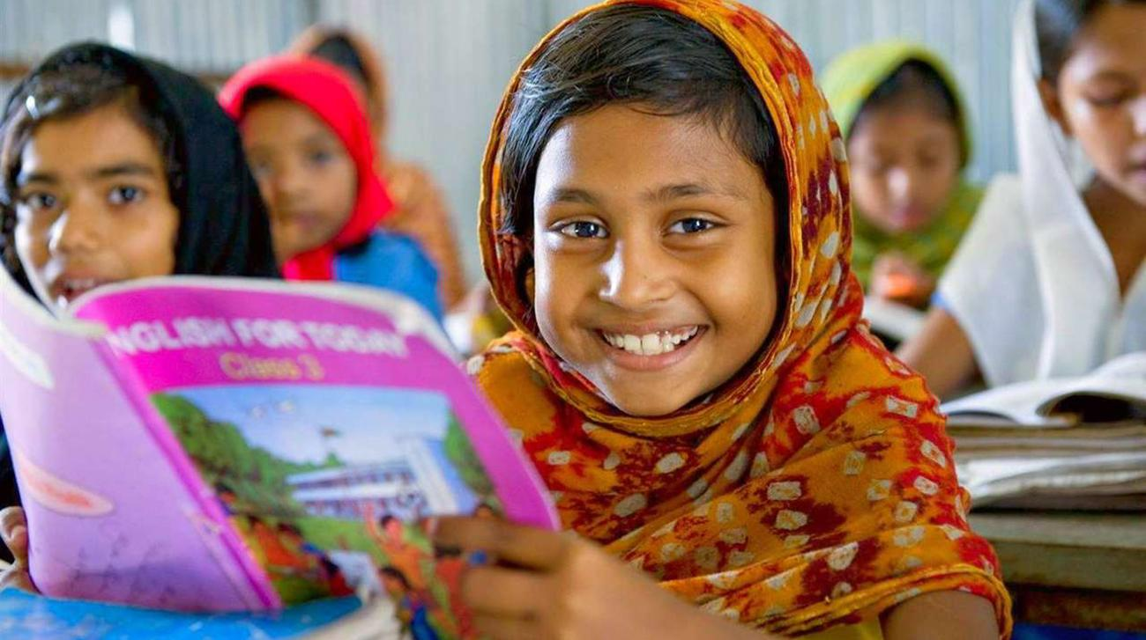
Student’s reading
Follow him/her and put your
finger under the lines.

Slide 20
New words & word meaning
Lets see some
Beautiful
Nice to look at.
Spring
Name of a season.
Visually impaired
Cannot see anything.
Neighbourhood
The area that you are in.
Warm
High temperature.

Slide 21
Fill in the gaps with the bellow words. Extra one is given.
smell | nice | see | feel | impaired
She knows that it is a ………… day.
(ii) She can ……...…. the flowers.
(iii) She cannot see these because she is visually…….......
(iv) Maria can not ………… the spring day.
nice
smell
impaired
see

Slide 22
Ask and answer:
1.How is day?
Ans: It’s beautiful spring day.
2. Why can’t Maria see?
Ans: Because she is visually impaired.
3. How does Maria feel a nice day?
Ans: Because she can smell the flowers and feel soft warmth of the sun.

Slide 23
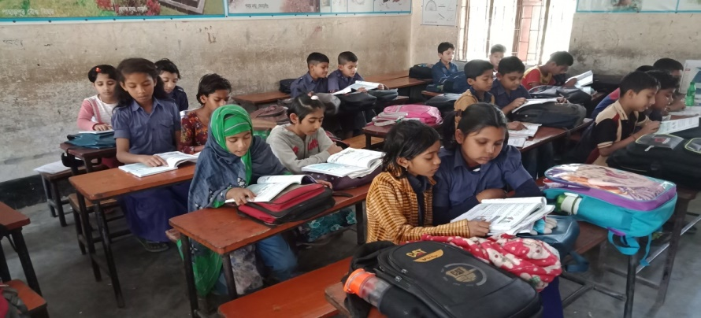
Pair Work
Rearrange the sentences:
1. beautiful, it’s a ,day,spring.
2. is, very,it,warm.
3. can, smell,she,flowers the.
4.ready,school,she, for,is.
5. has, to ,she, been,unable, see.

Slide 24
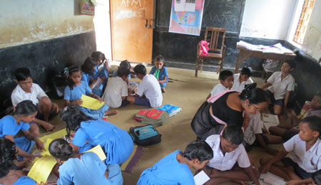
Group Work
Make sentences with the bellow words.
Group A- beautiful, happy
Group B - Smell, nice
Group C – leaves, colours

Slide 25
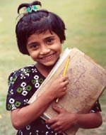
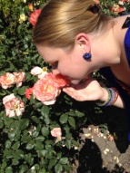
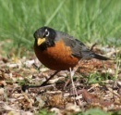
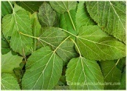
Group A
Beautiful – It’s a beautiful bird.
Happy - I am very happy.
Group B
Answer sheet of group work
Smell - She can smell flowers.
Nice - It is a nice bird.
Group C
Leaves - These are green leaves.
Colours - These colour pencils are good.

Slide 26
Evaluation
Fill in the blanks:
1.It’s a beautiful ----------------day.
2.It is very--------------.
3.She can smell the------------outside her room.
4.She likes to be ----------- her friends.
5.She has been -------------- to see since she was born.

Slide 28
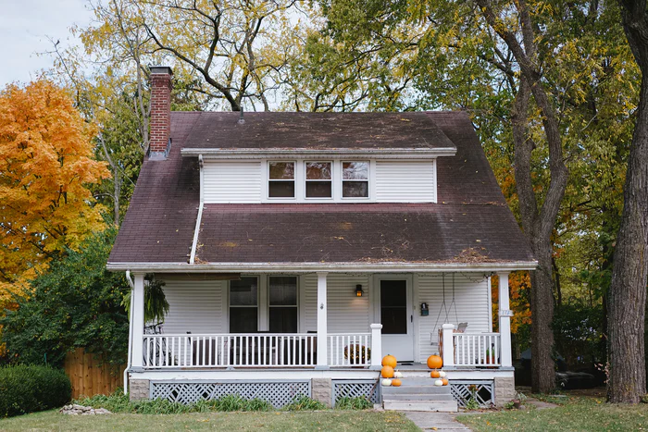
Home Work
Write a short composition about
a visually impaired.

