Slide 1
GOOD MORNING STUDENTS.
How are you.

Slide 2
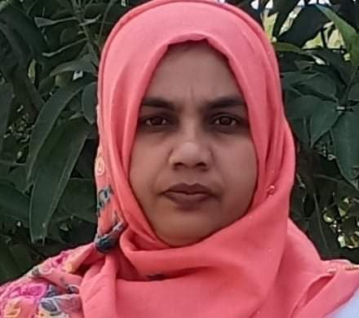
Teacher introduction
Azmira Akter
Assistant teacher
Rajbari Model Govt.Primary School.
Manikchari, Khagrachari.
E-mail: azmiraakter786@gmail.com

Slide 3
Learning Outcomes……..
1.Able to understand the word meaning.
2. Able to discuss about picture.
3. Able to read the word.
4. Able to write this word.

Slide 4
What do you see at your village?
Tree, house, cow, plant, cat, dog, hen, river, pond, goat

Slide 5
Todays lesson

Slide 6
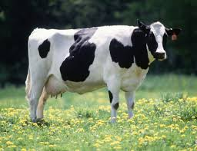
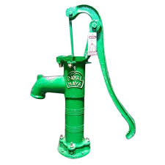
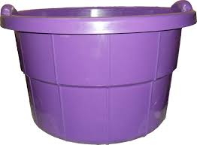
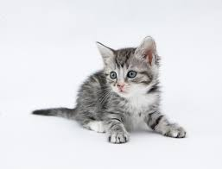
I will show you a some picture. try to answer me.ok
COW
TUBLEWELL
TUB
KITTEN

Slide 7
Think ,what thigs do you see outside your house?

Slide 8
I will ask some students.

Slide 9
One student ask another student.

Slide 10
I will say them to open their textbook at the page number 44.
Indicate these picture I will ask them ,what’s this.

Slide 11
We see all these things in the village.

Slide 12
Thank you.
Good bye students.

