Slide 2
Teacher’s Identity
Lutfor Rahman
Assistant Teacher,
Kundarampur, Government Primary school School,
Ghoraghat, Dinajpur.
E-mail: mlutfor81@gmail.com

Slide 3
Lesson Introduction
Subject:English
Unit:19(The Liberation War Museum)
Lesson: 1st Para Page: 74
Topic: On 14 December……independence
Time:40 minutes
Date:00/00/2020

Slide 4
Learning Outcomes
Students will be able to-----------
Listening:
1.3.1 recognize which words in a sentence are stressed.
3.4.1 understand statements made by the teacher and students.
4.2.1 understand and enjoy simple stories.
Speaking:
1.1.1 Say words, phrases and sentences with proper sounds and stress.
6.2.1 talk about people, objects, events etc.
Reading:
1.5.1 read words, phrases and sentences in the text with proper pronunciations, stress and intonation.
1.7.1 read paragraphs, dialogues stories, letters and other texts.

Slide 5
Let`s See a video
Click the video below:
What do you see in the video?

Slide 6
Today we are going to read the story
A visit to the liberation war museum

Slide 7
Presentation
Key words Meaning and pronunciations
Word | Bangla Meaning | English Meaning
Field trip
Liberation
Guide
Exhibits
A visit made by students to study
মাঠ ভ্রমণ
মুক্তিযুদ্ধ
Freedom
পথ প্রদর্শক
A person who shows the way
To something publicly
প্রদর্শিত হওয়া

Slide 8
Teacher’s Reading
Dear students,
open your book at page 74. Say after me.

Slide 9
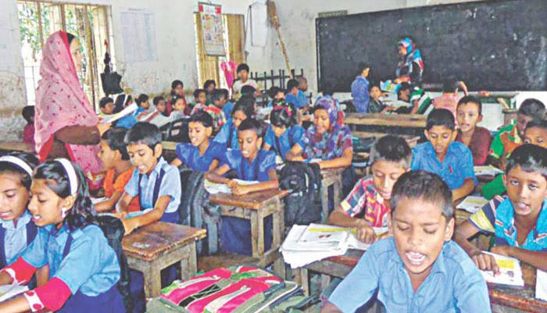
Individual Work
Dear students, open your book at page 74 and read the text loudly.

Slide 10
Let`s listen the text
On 14 December, our class went on a field trip to the liberation war museum at SegunBagicha, Dhaka. The trip was planned as part of our Bangladesh and Global Studies course. Our bus reached the museum at 10 am. A guide was waiting for us. He welcomed us warmly and took us on a quick tour of the different galleries and exibits of the museum.

Slide 11
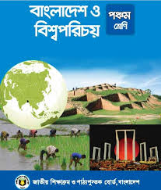
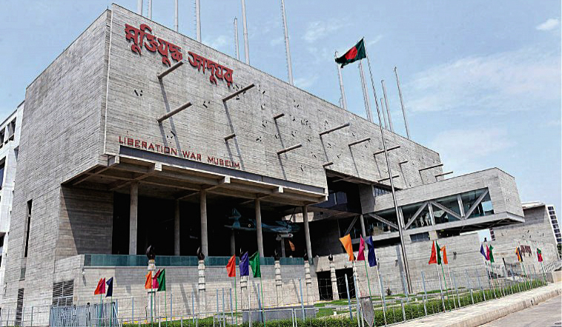
Look at the picture and read the text
On 14 December, our class went on a field trip to the liberation war museum at SegunBagicha, Dhaka. The trip was planned as part of our Bangladesh and Global Studies course.

Slide 12
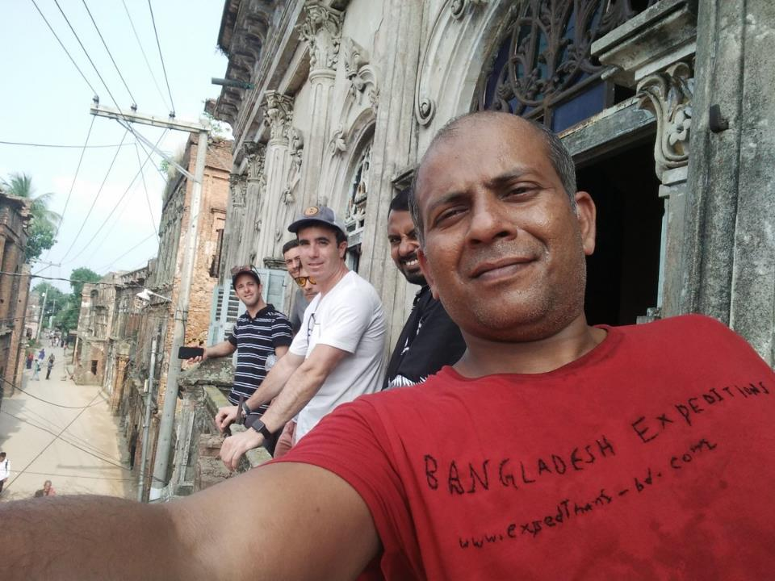
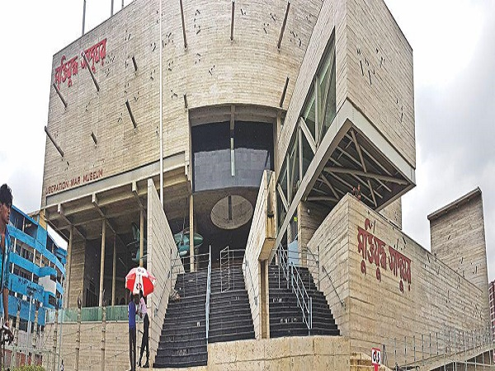
Our bus reached the museum at 10 am. A guide was waiting for us. He welcomed us warmly and took us on a quick tour of the different galleries and exhibits of the museum.

Slide 13
Pair Work
Say ‘True’ for correct statement or ‘False’ for incorrect statement.
a) On 14 November, our class went on a field trip to the liberation war museum at SegunBagicha
b) The trip was planned as part of our science course.
False
c) A guide was waiting for us.
False
True
d) Our bus reached the museum at 10 am.
True

Slide 14
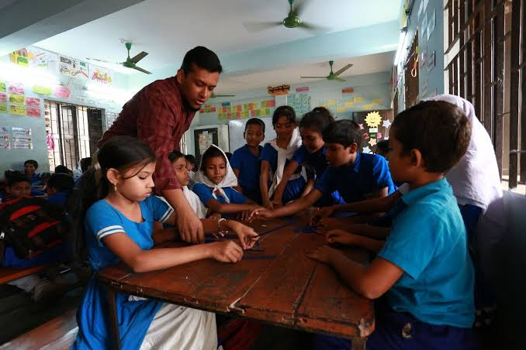
Group Work
Answer the following questions
Where did the students go on a field trip?
When did the bus reach the museum?
c) Who was waiting for them?
d) How did the guide welcome them?

Slide 15
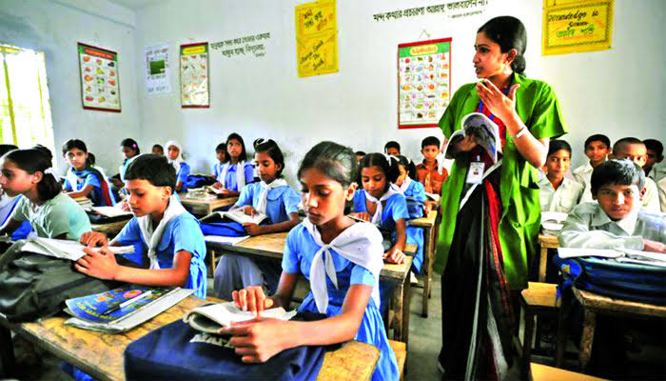
Silent Reading
Dear students, read the text silently.

Slide 16
Checking Learning
a) Where is the Liberation war museum?
b) How did the guide welcome them?
c) What did reach the museum at 10?
d) What was the trip planned about?

Slide 17
Home work
Write a short composition about“ The Liberation War Museum” in 5 sentences.

Slide 18
Thank You

