Slide 2
Welcome dear students.

Slide 3
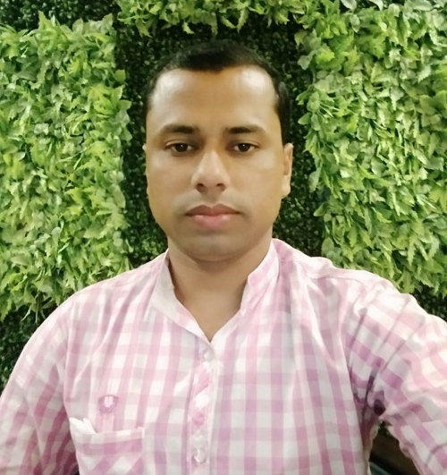
Identity
Khalidur Rahman Manik
Assistant Teacher
Khasgaon GPS
Chhatak, Sunamganj
Sub:English
Class:5
Unit:8
Lesson:4-5
Activity:D&E

Slide 4
Good morning students.
How are you today?
Let’s sing the good morning song
together with clap.

Slide 5
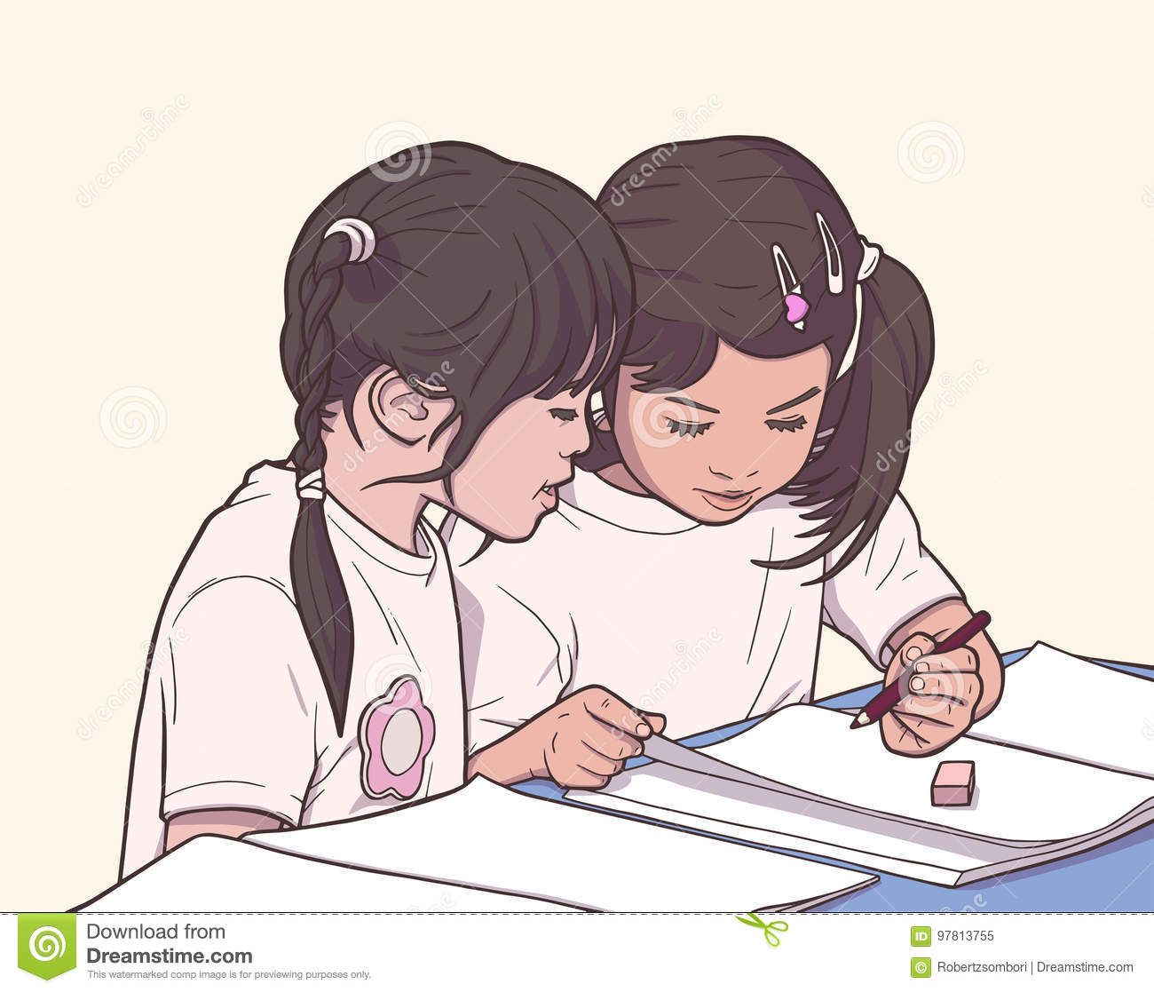
Recalling previous lesson.
Answer the following questions:-
What should we do when we are sick?
Ans: We should stay at home.
What shouldn’t we do when we are sick?
Ans: We shouldn’t go to school or work.

Slide 6
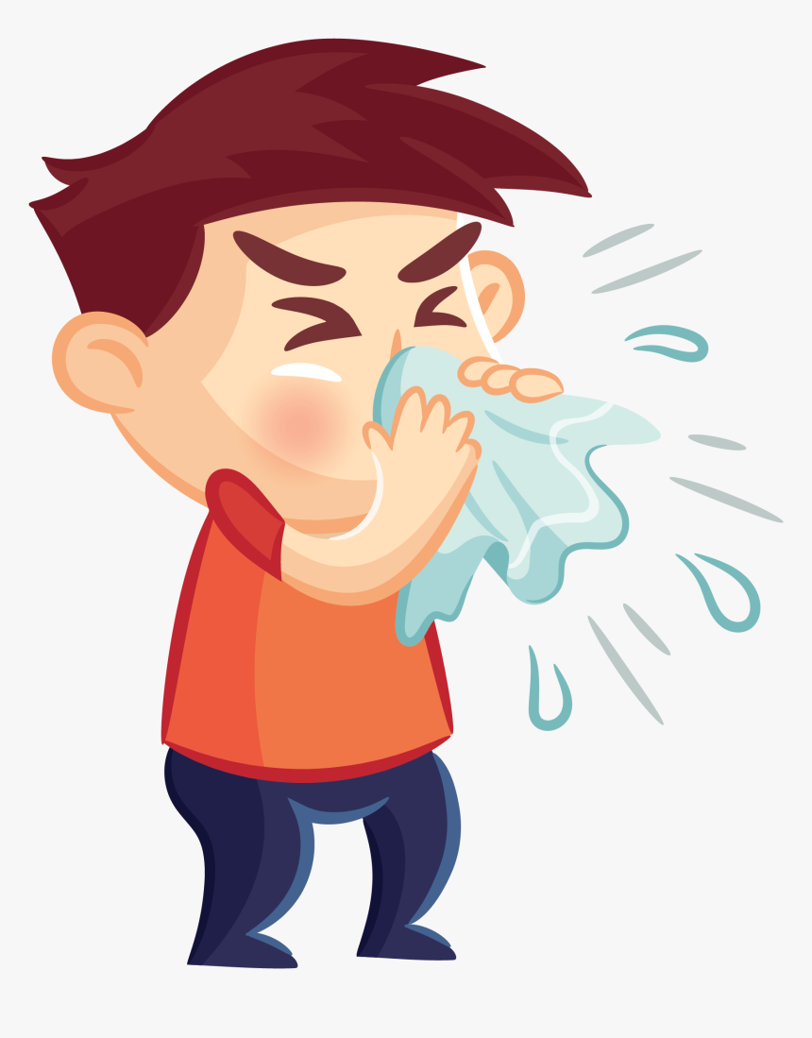
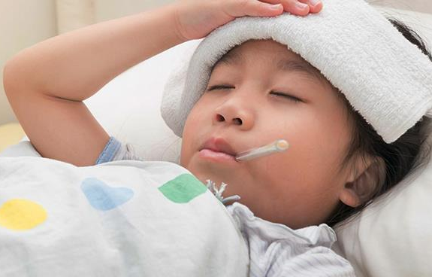
Look and say.
Some symptoms of illness.
Yes, it’s Lesson: 5-6 of Unit: 8
What do you see in these pictures?
So, can you guess what’s our today’s lesson?

Slide 7
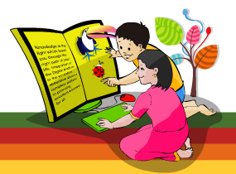
Learning outcomes
Students will be able to…
recognize which syllable in a word is stressed;
say words, phrases and sentences with
proper sounds and stress;
say what the speaker is doing;
say what others are doing;
talk about people, objects, events etc.

Slide 8
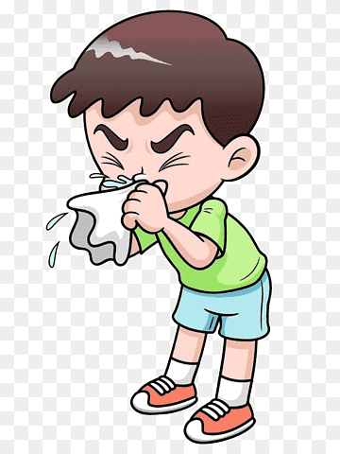
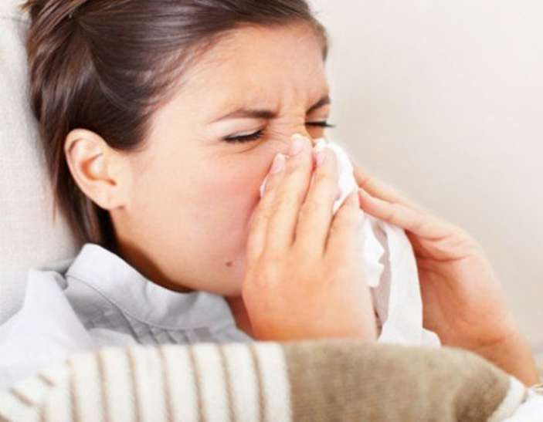
Look at the pictures and read.
runny nose.
runny nose.
What are they suffering from?

Slide 9
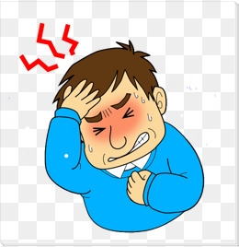
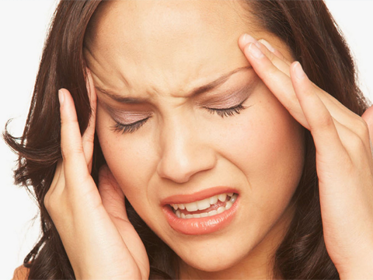
Look at the pictures and read.
headache
headache
What are they suffering from?

Slide 10
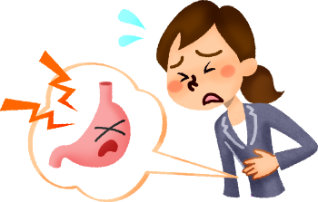
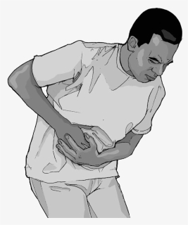
Look at the pictures and read.
stomach ache
stomach ache
What are they suffering from?

Slide 11
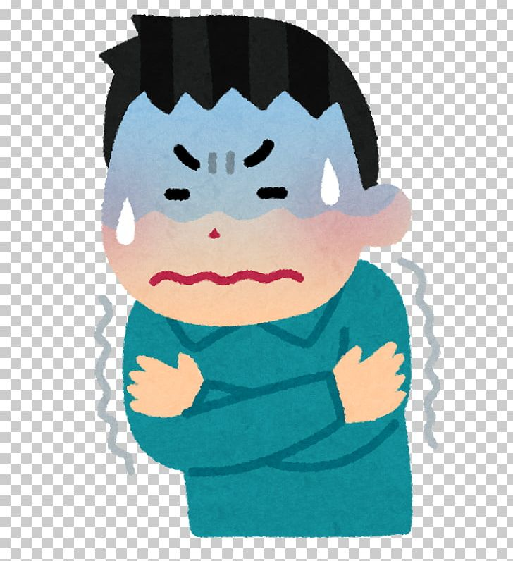
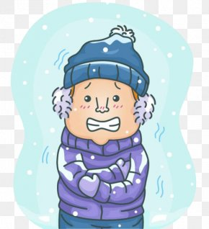
Look at the pictures and read.
chills
chills
What are they suffering from?

Slide 12
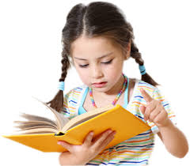
Individual Work
Match the words with their meaning.
Column A | Column B
runny nose | concern
headache | snivel
Stomach ache | severe cold
chills | pain in belly

Slide 13
Listen to the audio carefully.
Listen and repeat after the audio.

Slide 14
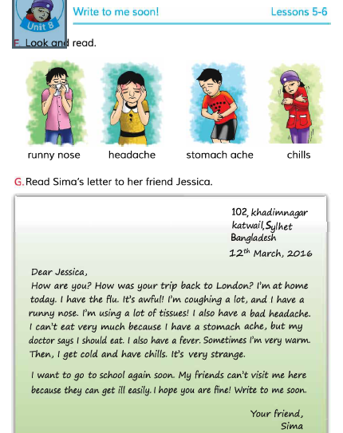
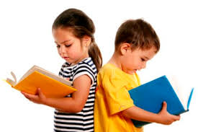
Open at page 32 and read the situations in pairs.
Pair Work

Slide 15
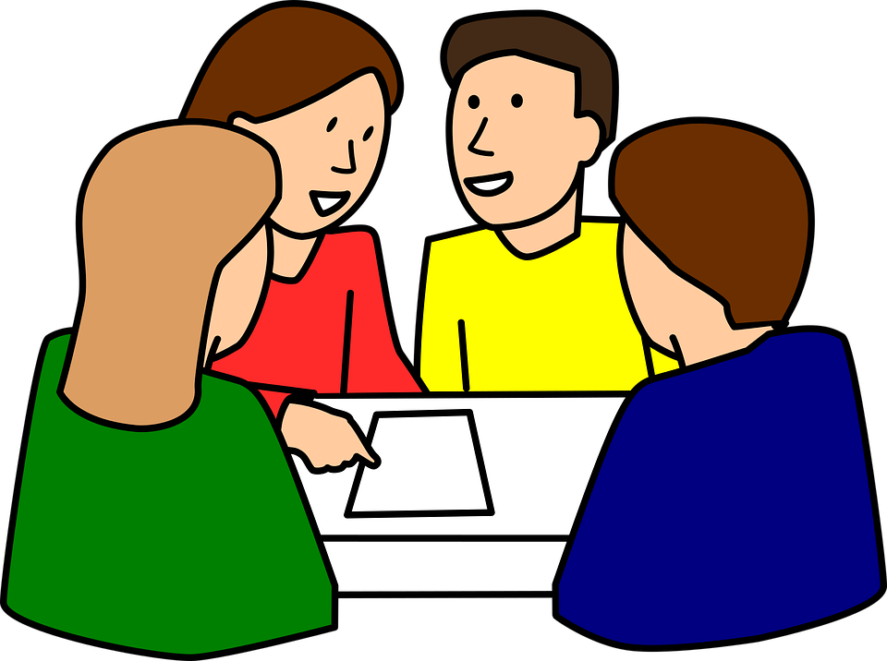
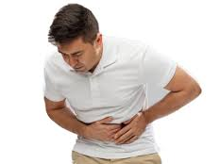
Group Work
Act out the following actions.
runny nose
headache
stomach ache
chills

Slide 16
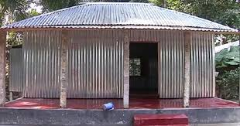
Homework
runny nose,
chills.
headache,
stomach ache,
You will make 4 sentences with
the above words / phrases.

Slide 17
Thank you.

