Slide 1
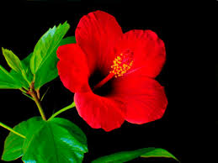
WELCOME

Slide 2
Fatema Akter
Assistant Teacher
Dholiya govt. primary school.
Matiranga,khagrachari

Slide 3
Learning Outcomes:Student will be able to
1.3.1-Recognise which words in asentence are stressed .
3.1.2-Understand questions about family and friends of students.
1.1.1-say words ,pharases and sentences with proper sounds and stress.
3.1.1-Ask and answer Wh questions.

Slide 4
Let’s see a video

Slide 5
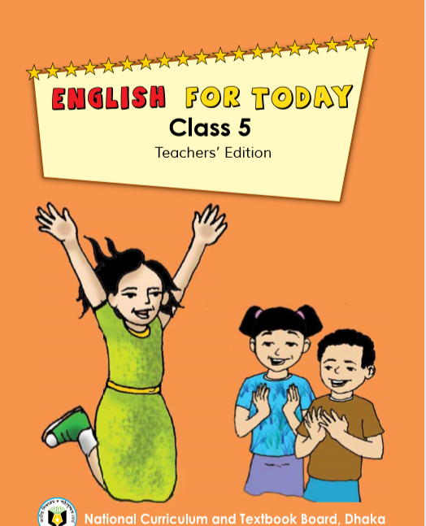
Today’s lesson is……
Leisure time
Class -5
Unit-4 ,Lesson-1-2,
Page No-14,

Slide 6
Word Meaning(English)
Reporter-
Correspondent
Magazine-
Journal
Question-
Quaere
Leisure-
Vacation
Connected-
Attached
Especially-
Particularly

Slide 7
Word Meaning(বাংলা)
Bengali Meaning:
Funny-হাস্যকর।
Reporter –প্রতিবেদক।
Magazine-ম্যাগাজিন।
Often-প্রায়ই।
Leisure-অবসর।
Connected-সংযুক্ত রাখা।
Especially-বিশেষভাবে

Slide 8
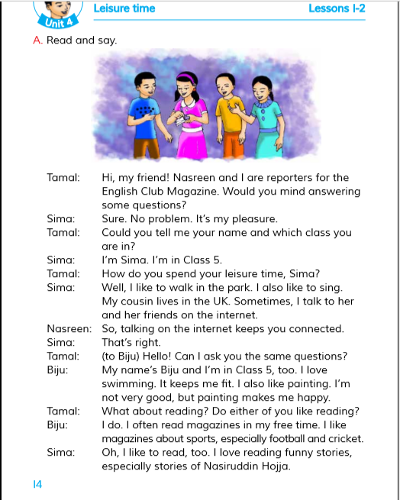
Teachers Reading

Slide 9
Notice that....(grammer focus)
ওপরের সংলাপে অনুরোধ সহকারে কিছু জানতে Would you…../Could you….. ব্যবহার করা হয়েছে।সাধারণত বিনীত অনুরোধ,প্রস্তাব,আমন্ত্রণ বুঝাতে Would you/Could you ব্যবহার করা হয়।
Structure:Would you/Could you+Please +মুল verb এর base form+Extension+?Example:Would you please me your name?
tell

Slide 10
Match the word in column A with their meanings that are mentioned in the text in column B.
A type of thin book which contains articles and photographs.
Reporter
Magazine
particularly
Question
Joined together.
Leisure
A person who makes news for a newspaper or television.
Connected
A sentens or phrase that asks for information.
Especially
Time when we are not working.

Slide 11
Ask and answer the question:
Who are the reporters?
Ans:Tamal and Nasreen are the reporters.
Which magazine are they reporting for?
Ans:They are reporting for the English Club Magazine .
Who are answering the reporters ‘questions?
Ans:In his leisure time,Biju likes to go swimming and do painting .Painting makes him happy.

Slide 12
What does Biju do in his leisure time?
Ans:Sima and Biju are answering the reporters ‘questions.
What is another way to say leisure time?
Ans:”Free time” is another way to say leisure time.

Slide 13
She like to sing.
She like walk in the park.
Sima’s free time
She talk to her friends on the internet.

Slide 14
Biju;s free time
He love swimming.
He like painting.
Reading magazine about cricket.
Reading magazine about football.

Slide 15
One day One word
Swimming-
সাঁতার কাটা
I like swimming.

Slide 16
Homework
Say what you do in your free time and why you do it?(write in 5 sentence.)

Slide 17
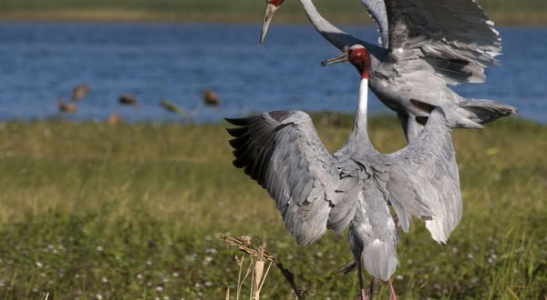
Goodbye Today

