Slide 2
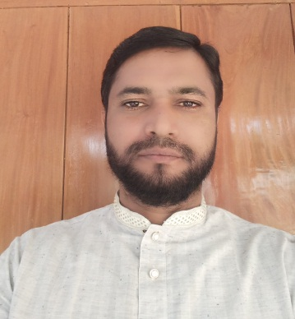
Identity
Class : Six
English For Today
MD. MONSUR AHMED (M.A- B.Ed) ASSISTANT TEACHER CHANDPUR NURIA HIGH SCHOOL PURAN BAZAR, CHANDPUR. MOB: 01673341343 E-mail: monsuratc@gmail.com

Slide 3
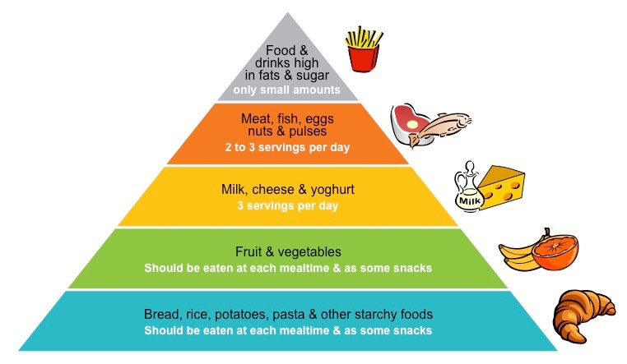
Look at the picture
What do you see in the picture ?
Food pyramid and a healthy man.
Notes:
Teacher will show the slide for eliciting lesson declaration.

Slide 4
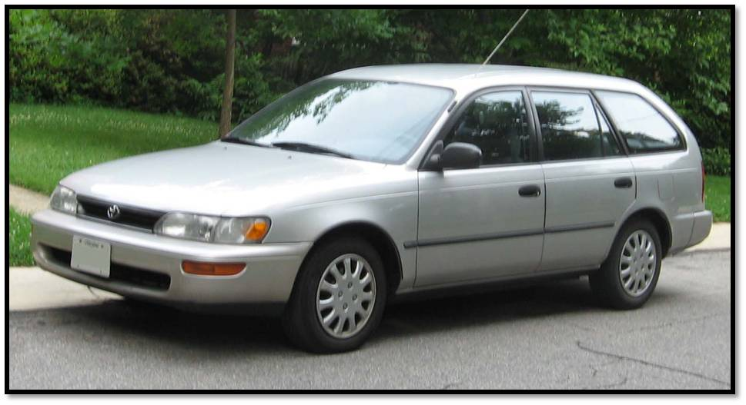
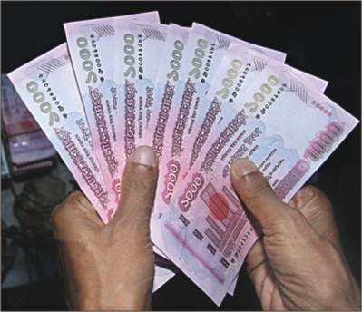
Look at the pictures
Car
House
Cash
What do you see in the picture ?
These are wealth.
Notes:
Teacher will show the slide for eliciting lesson declaration.

Slide 5
Lesson Declaration
So, today we`ll discuss about
Health is wealth
( Class- six, Lesson – 9 )

Slide 6
Learning outcomes
After completing this lesson students will be able to -
familiar with some rules of good health.
ask and answer questions
read and understand texts
write paragraph, dialogue , etc.

Slide 7
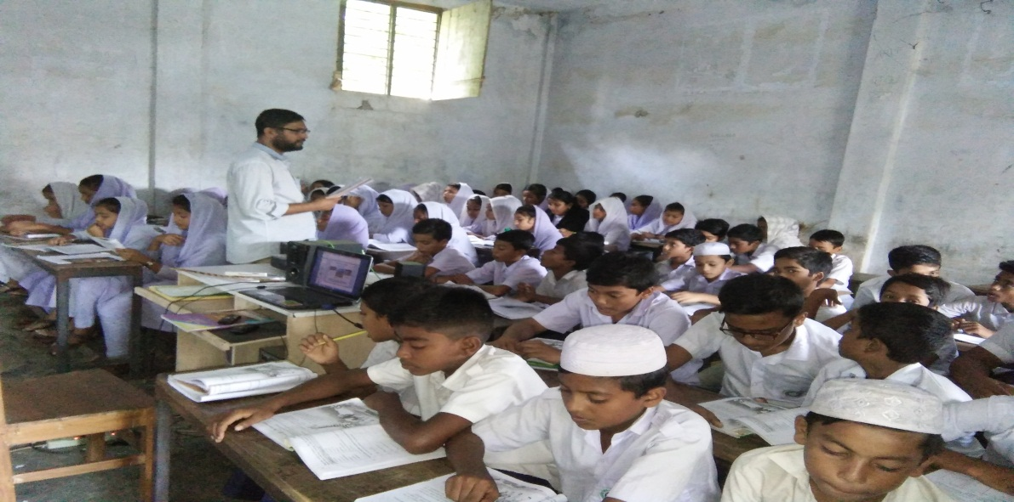
Model reading by the teacher.
Listen to me attentively then answer the following questions.
What do you mean by hygiene?
What are essential for good health?
What do we mean by balanced diet?
What are the rules of personal hygiene?
Notes:
With reading teacher can discuss the topics.

Slide 8
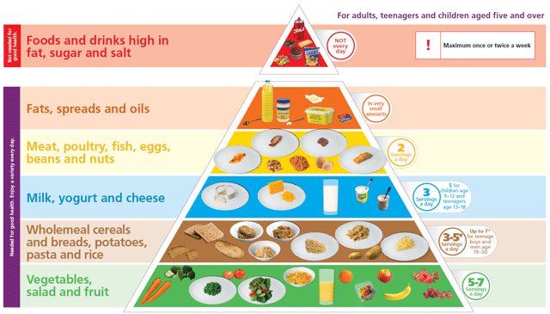
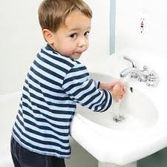
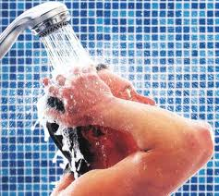
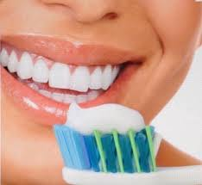
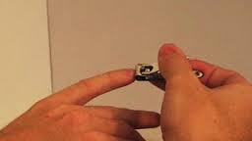
Some important rules of good personal health are as follows.
Balanced diet :
Our food should contain correct proportion of carbohydrates, fat, protein, vitamins, minerals and water in it.
b. Personal hygiene :
We should follow the personal health practices, such as,
wash your hands before eating.
Bathe regularly and wear clean cloths.
Brush your teeth regularly.
Brush hair, clean eyes, ears and nails.

Slide 9
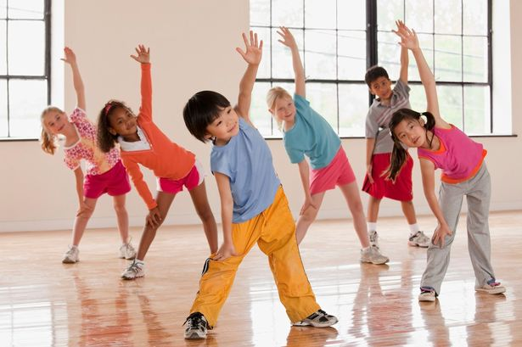
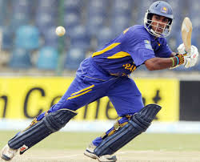
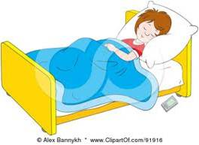
e. Taking regular exercise :
We should take part games and sports and take physical exercise regularly.
f. Taking regular sleep and rest :
We should sleep properly and take proper rest.

Slide 10
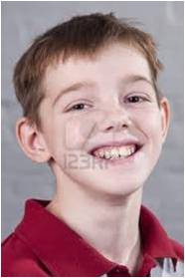
Healthy
Sagor is a healthy boy.
Meaning
(Click here)
In good physical shape
Notes:
First, the word will be shown, SS will be asked to pronounce the word. If it needed teacher will help. Then the picture will be shown and asked to guess the meaning. After that the meaning will be shown. Then they will be asked to make sentence. Teacher will show the students for the feedback. Slide 12,13,14,15 and 16.

Slide 11
Cheerful
Minu is very cheerful today.
Meaning
(Click here)
Jolly/ happy/ joyful condition.

Slide 12
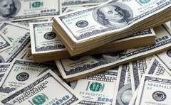
Wealth
Money, car, house are our wealth.
Meaning
(Click here)
Cash / land / house

Slide 13
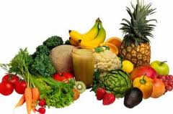
Fresh
We should eat fresh vegetables
Meaning
(Click here)
Clean / new / unsullied

Slide 14
Hygiene
The rules and practices of keeping are called hygiene.
Meaning
(Click here)
Practices of keeping good health.

Slide 15
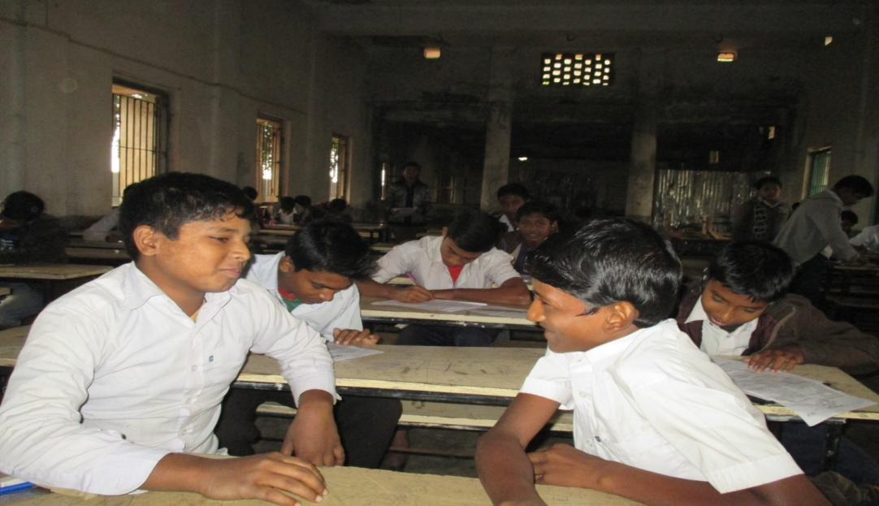
Go to section –F, listen to the conversation and practise saying it in pairs.

Slide 16
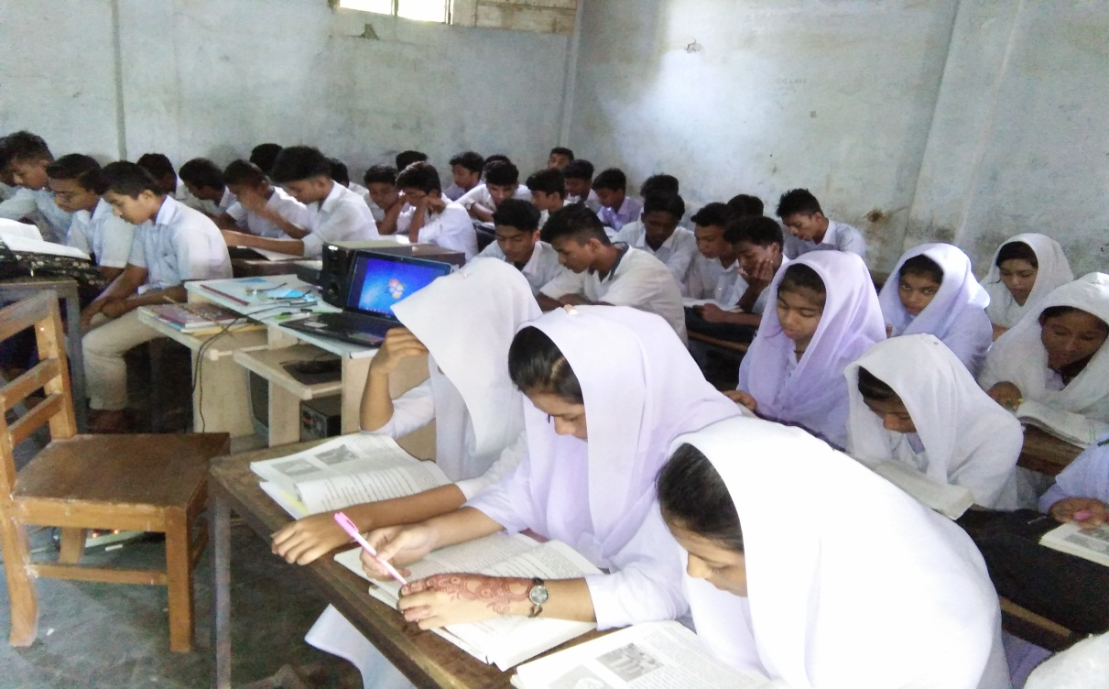
Silent reading
Go to section –F2 and read what Sumon says about his physical exercise program e.
Now write about what you usually do or would you like to do to keep yourself fit.

Slide 17
Pair Works
Choose the best answer :
“Health is wealth’’. Who many noun are there ?
i. one ii. Two iii. Three iv. No noun is there.
b. An unhealthy person is full of ----
Dream ii. Happiness iii. Disease and anxiety iv. Tension
c. Body organs are ------ related to good health ?
i. Not ii. Much iii. Directly iv. Nicely
d. Who are inactive, cheerless and unhappy ?
i. healthy people ii. Unhealthy people
iii. Hygienic people iv. Bad people.
e. Personal hygiene means -----
A. keeping oneself neat and clean B. Keeping household clean
C. having physical exercise
Which of the above answers is/are correct ?
i. A and B ii. B and C iii. A, B and C iv. A.

Slide 18
Individual Work
Make five sentences from the substitution table:
A healthy man | Can | An indispensible part of good health.
He | Implies | Be practiced strictly.
Hygiene | Should | Free from disease and anxiety.
It | Is | Also be helpful for society.
 |  | The rules and practices of good health.
Answer:
A healthy man is free from disease and anxiety.
He can also be helpful for society.
Hygiene is an indispensible part of good health.
It implies the rules and practices of good health.
e. It should be practiced strictly.

Slide 19
Home work
Write a short paragraph on the rules of good health.

