Slide 1
Welcome everyone

Slide 2
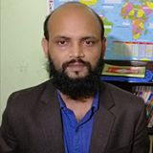
Nurul Aziz
Assistant Teacher (English)
Krishnakumari City Corp. Girls’ High School,
Nandankanan,Chittagong
E-mail : naziz13.na@gmail.com
Mobile : 01843773924
English For Today
Class : 7
Time : 45 Minutes
Date : 18/05/2020

Slide 3
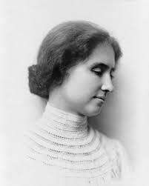
1) Who is the woman in the picture?
2) What is she famous for?

Slide 4
Our Today’s lesson is on……
Helen Keller (1)
Unit : 5, Lesson: 3
English For Today (Page: 47)

Slide 5
Learning outcomes
After the end of the lessons students will be able to…
ask and answer questions
talk about people
read and understand texts
match words and write true or false
choose the best answer

Slide 6
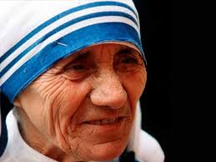
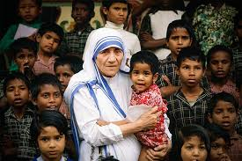
Vocabulary
Humanitarian (adj.)
charitable, caring
Mother Teresa was a great humanitarian lady.

Slide 7
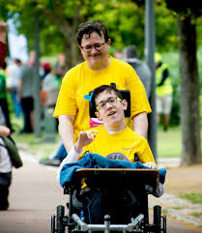
Vocabulary
disabled (adj.)
immobilized , inactivated
We should take care of disabled people.

Slide 8
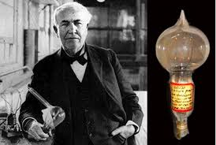
Vocabulary
Inventor (noun)
discoverer, maker
Adison was a great inventor.

Slide 9
Vocabulary
Plantation (noun)
garden, cultivation
Our country observe tree plantation week in June.

Slide 10
Pair Work
Match the words with their meanings
Words
Meanings
humanitarian
a large area of land where crops like sugar, banana etc. are grown
Inventor
a person who has discovered something
plantation
making people’s sufferings less and improving their living conditions
disabled
Unable to use a part of the body easily or completely because of illness, injury etc..

Slide 11
Section B: Read the text and answer the questions.

Slide 12
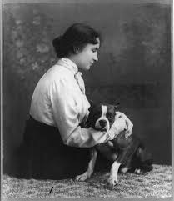
Helen Keller
Born
in 1880
in Tuscumbia
became disabled in 1882
had a high fever in 1882

Slide 13
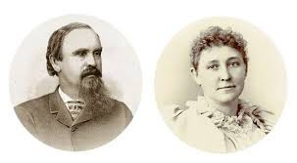
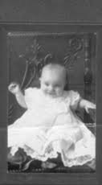
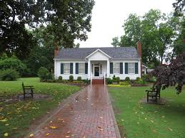
Helen Keller’s parents
Helen as a child
Helen Keller’s house

Slide 14
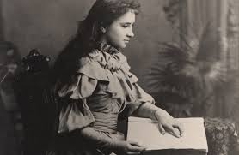
blind
deaf
dumb
Helen Keller was …

Slide 15
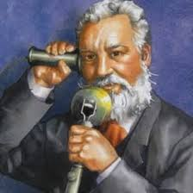
Alexander Graham Bell

Slide 16
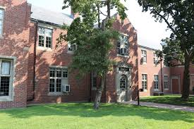
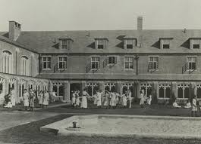

Slide 17
Braile system

Slide 18
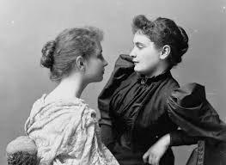
Helen Keller with Annie Sullivan

Slide 19
Individual Work
E) Tick the correct answer.
1. Helen Keller worked for
a) women’s rights
b) disabled people
c) poor people
2. Alexander Graham Bell invented
a) the mobile phone
b) the internet
c) the telephone
3. Bell also worked for the people who could not
a) see
b) hear
c) speak

Slide 20
Evaluation
D. True or false. If false, give the correct answer.
1. Helen always helped the suffering people.
Ans. True.
2. She came from a rich family.
Ans. False, Correct Ans. She came from a poor family.

Slide 21
3. She was born blind , deaf and dumb.
Ans. False, Correct Ans. She was born healthy.
4. Alexander Graham Bell was both an inventor and social worker.
Ans. True.
5. Annie Sullivan was a good teacher of Helen Keller.
Ans. True

Slide 22
Home Work
Write five sentences on ‘Helen Keller as a great humanitarian lady.’

Slide 23
Please stay at home. Protect yourself, protect family.”

