Slide 1
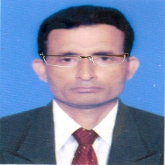
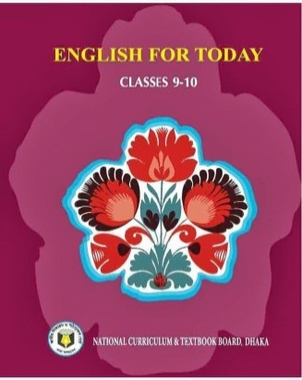

Slide 2
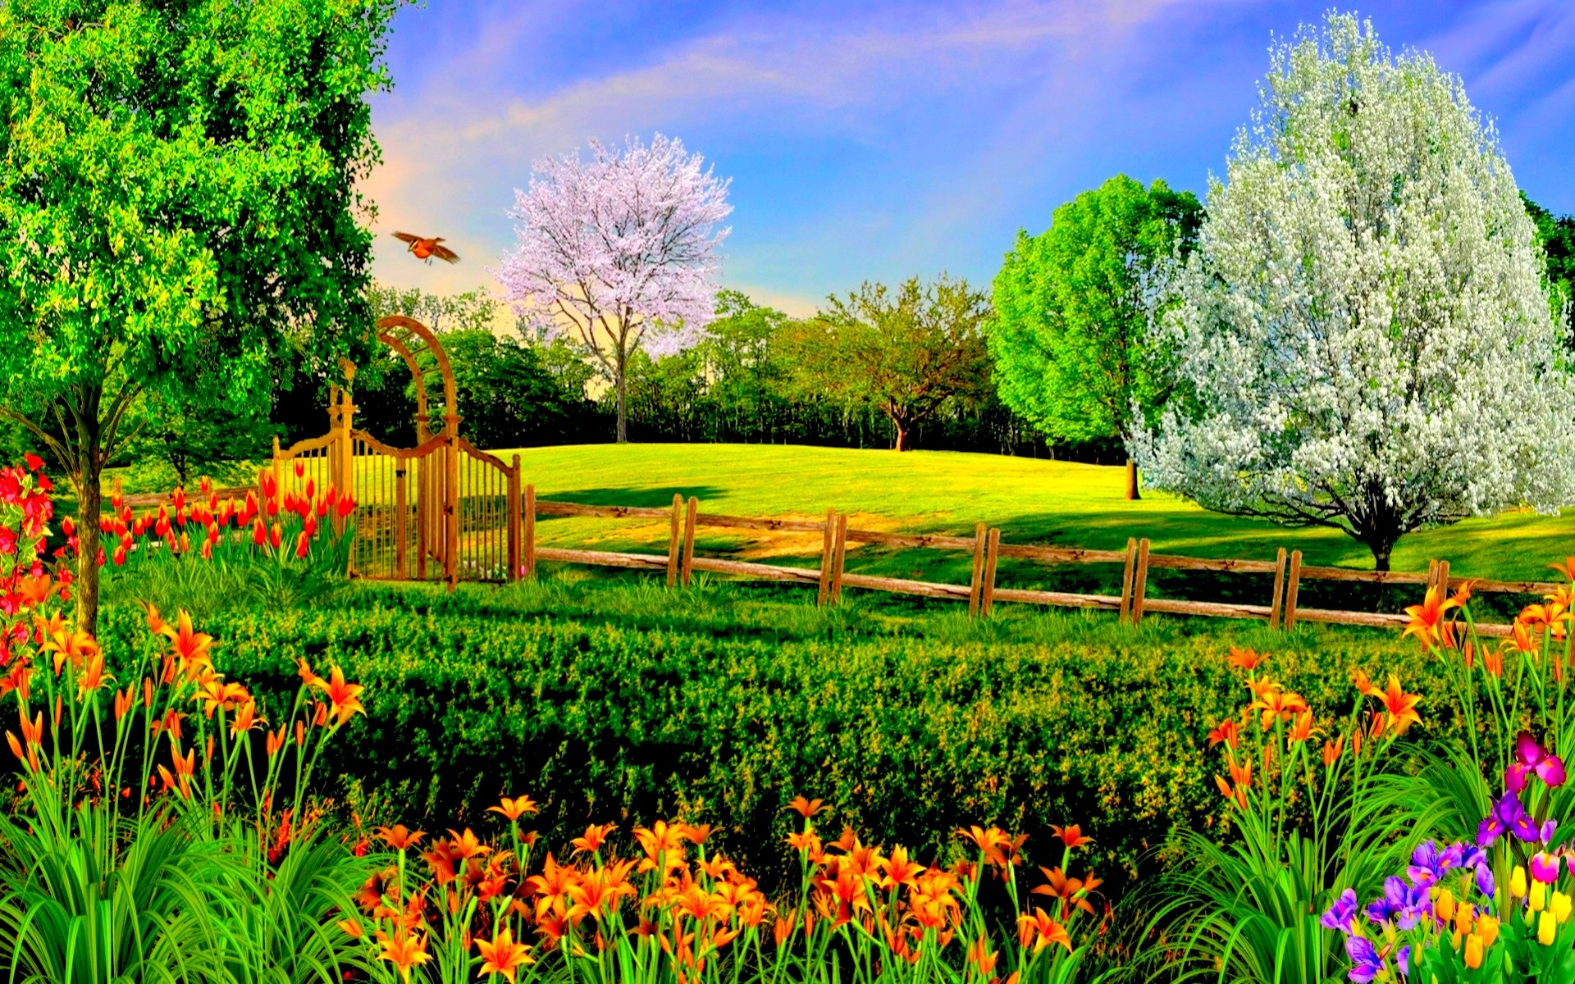
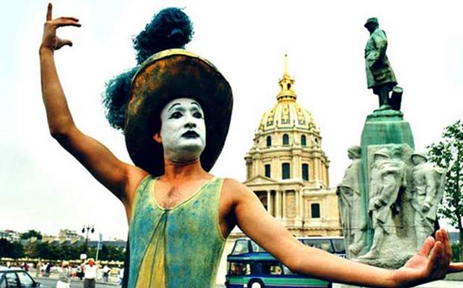

Slide 3
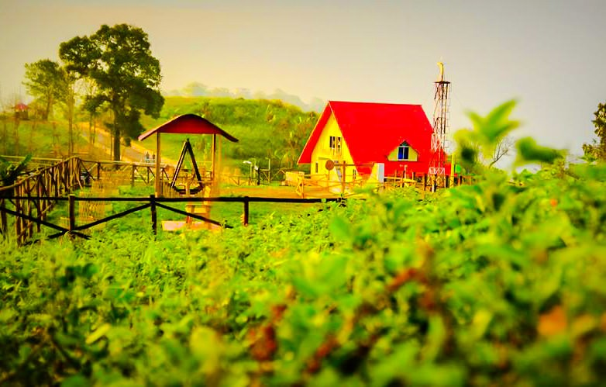
Manik Chandra Majumder
Senior Teacher
Gazirhat High School
Senbag, Noakhali.
Mobile No: 01717155169
Email: manikmajumder01@gmail.com
Class : Nine-Ten
Subject : English 1st paper

Slide 4
Let’s Observe a video clip.
https://www.youtube.com/watch?v=3QutjfBkq6o
Partha Pratim Majumder is now 55 years old. He is recalling his childhood memories. This is flash back.

Slide 5
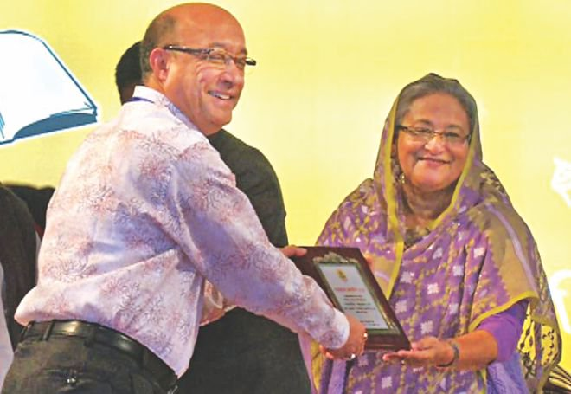
Can you guess about our today’s lesson ?
Flash back
Unit : Seven
Lesson : Three
Page : 98

Slide 6
Learning Outcomes
After completing this lesson students will be able to…
read, comprehend and summaries texts,
make sentences by matching column,
transform statements into questions,
describe the beginning of an artist.

Slide 7
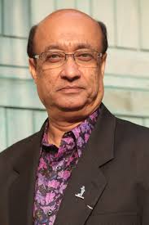
Born in 1954 in Pabna in a family of artistes.
took lessons on mime from Jogesh Dutta’s mime Academy in kolkata from 1966 to 1972.
Let’s Know some information about
won the world’s highest award in mime –Moliere Award.
showed a solo performance in Bangladesh Shilpakala academy in 1979.
got scholarship from the French Govt. 1981.
Partha Protim
Majumder
won Ekushey Padok- 2010

Slide 8
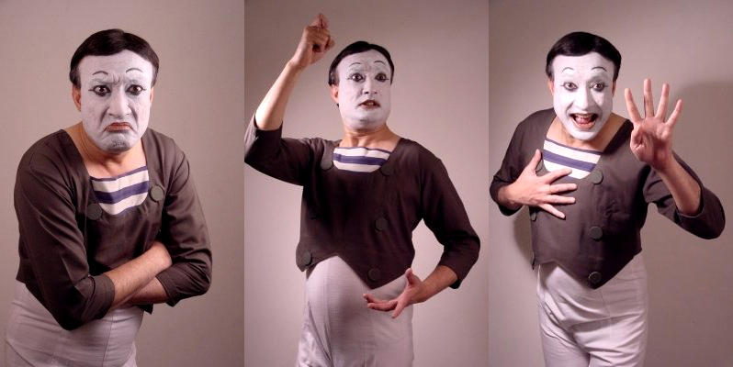
Vocabulary and sentence making
Word: Utter
Meaning : Speak, Tell , make vocal sound
Sentence : Majumder does not utter a single word in his performance.

Slide 9
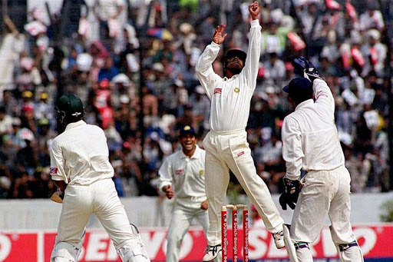
Word : Spellbound
Meaning :Enchanted , Fascinated
Sentence :The viewers are watching game being spellbound.

Slide 10
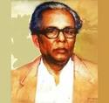
Word :Appreciate
Meaning : Praise, Respect, be grateful for
Sentence : Zainul Abedin is widely appreciated over the world .

Slide 11
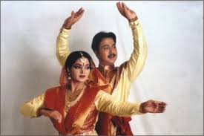
Word : Artiste
Meaning : Actor, performer
Sentence : Nipa and Shibli are legendary artistes.

Slide 12
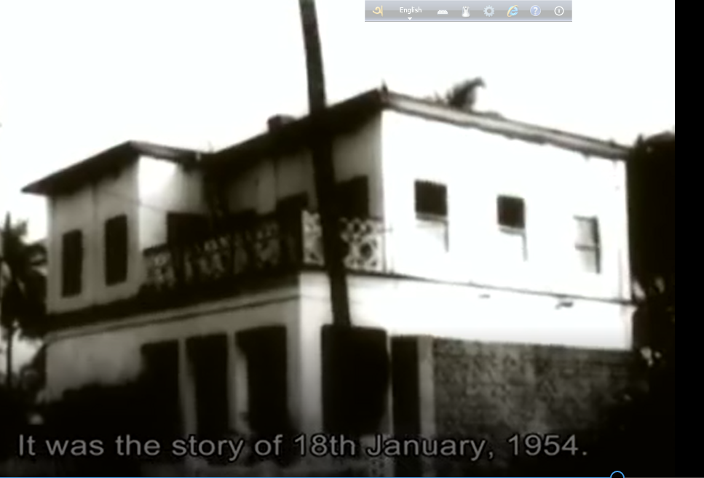
Word : Ancestral
Meaning : Familial ,Parental, previous generation
Sentence : Majumder passed his early years in his ancestral home.

Slide 13
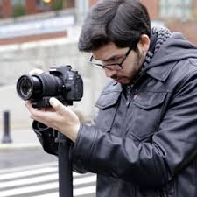
Word : Photographer
Meaning :Who takes photography as profession
Sentence : Majumder’s father was a professional photographer.

Slide 14
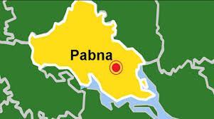
Read the text and match column A with Column B
Partha Pratim Majumder was born in 1954 in Pabna to a family of artistes. He spent most of his early years in his big ancestral home, situated in a small locality known as Kalachandpara.

Slide 15
At that time Kalachandpara was well known for its cultural activities. There were festivals and various types of cultural shows round the year. Majumder’s father, a photographer by profession was an art lover. He taught and inspired his son to appreciate different forms of art. Majumder went to live with his aunt in Chandernagar, 30 kilometers away from Kolkata in 1966. It was there that he first came across a mime artiste named Jogesh Dutta. The way Dutta narrated stories without uttering a single word, left Majumder spellbound. He took lessons on mime from Dutta in Jogesh Dutta's mime academy in Kolkata from 1966 to 1972.

Slide 16
Make meaningful sentences matching column ‘A’ with ‘B’
Column A | Column-B
1. Majumder was very much impressed | a. loved art
2. He spent most of his childhood | b. him value all forms of arts
3. His father | c. in his own village
4. The people of his locality | d. were culturally active.
5. His father made | e. when he saw Dutta's performance.

Slide 17
Match your Answer
Column A | Column-B
1. Majumder was very much impressed | a. loved art
2. He spent most of his childhood | b. him value all forms of arts
3. His father | c. in his own village
4. The people of his locality | d. were culturally active.
5. His father made | e. when he saw Dutta's performance.
(1+e) Majumder was very much impressed when he saw Dutta's
performance.
(2+c) He spent most of his childhood in his own village.
(3+a) His father loved art
(4+d) The people of his locality were culturally active.
(5+b) His father made him value all forms of arts.

Slide 18
Read the statements below and form appropriate questions for each statement.
Statement:1.The birth place of Partha Pratim Majumder is Pabna.
Question: Where is the birth place of Partha Pratim Majumber?
Statement: 2. He was born in 1954.
Question: When was he born?
Statement: 3. He belonged to a culturally enlightened family.
Question: What kind of family did he belong to?

Slide 19
Statement: 4. Majumder’s father inspired him to value art.
Questions: Who inspired him to value of art?
Statement :5. His forefather’s home was in Kalachandpara.
Question: Where was his forefather’s home?
6. Statement :He spent his childhood enjoying different cultural activities.
Question: How did he spend his childhood?

Slide 20
Liten the passage and fill the information table
In1987 Parth protim Majumder was awarded with ‘Master of Mime’ Award by ‘Jogesh Mime Academy’ in India. In the same year he was named as the ‘Master of the World’ by Journalist Association of Malaysia. In 2009, Majumder was bestowed with the highest European honour for theatre, The Moliere Award. In 2010 Majumder received the highest Bangladeshi Awarded the Ekushey Padok. He is still working . In 2012 French Government honoured him ‘Knight in Order of Art and Humanities’.

Slide 21
Fill the information table
Year | Achievement he obtained | From Where he got the award
1987
1987
2009
2010
2012

Slide 22
Fill the information table
Year | Achievement | From Where
1987
1987
2009
2010
2012
Master of Mime
Jogesh Mime Academy, India
Master of the World
Journalist Association, Malaysia
The Moliere Award
Europe
Ekushe Padak
Bangladesh
Knight Order of Art and Humanities
French

Slide 23
Evaluation
Q1. When and where was Partha Pratim Majumber born?
Q2. What kind of family did he belong to?
Q3. What did Majumder’s father inspired him to do?
Q4. How did he spend his childhood?

Slide 24
Write a short description of Partha Protim Majumder achievements.

