Slide 1

Welcome

Slide 2

lntroduction
Md Amir Hossain Patwary
Assistant Teacher (English)
Madinatul Ulum lslimea Dakhil Madrasah
Palisara,Hajigonj, Chandpur.
Mobile No- 01714-315772
79hossainamir@gmail.com

Slide 3

Lesson Introduced
Subject:English First Paper
Class : Nine
Unit : Three
Lesson :Two
Time :45 minite
Date : 10/01/2016

Slide 4

Learning outcomes
By the end of lesson students will able to----------
Answer the Question
(a) Word Meaning.
(b) Fill the gap.
(c) Write a sammary.

Slide 5
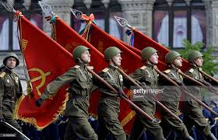
Victory Day

Slide 6

Calendar
May
2016

Slide 7
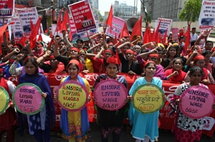
Workers Day

Slide 8
Title of the lesson
May Day

Slide 9
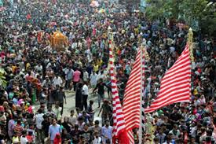
May Day or
International
Workers Day
through the
World.

Slide 10
All the privileges
Workers enjoy today.
Minimum
Wage
Safety
Law
Eight hour
Work Day

Slide 11
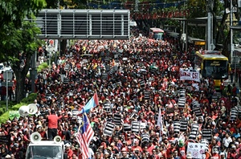
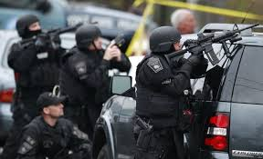
The history
0f May Day
On May first, 1886
Police Into a crowd
of strikers at the
McCormic harvester
Company in Chicago.

Slide 12
Word Meaning:
Commemorate
Struggle
Fire
Crowd

Slide 13
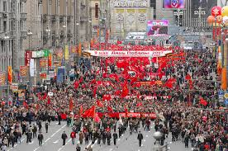
Commemorate

Slide 14
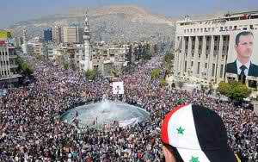
Struggle

Slide 15
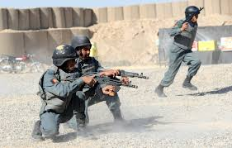
Fire

Slide 16
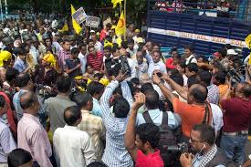
Crowd

Slide 17
Group Work
What is the significent of May Day?

Slide 18
Fill in the gap:
Working people throughout the World(a)…………
May Day. On May first ,1886 police (b)………… into a (c) ……… of stricker at the McCormic Harvester Company (d)………. . As a result at least one striker was (e) ……….. there.
Commemorate, Fired, Crowd, Chicago, Killed

Slide 19
Evaluation
(1) Where is McCormic Harvest Machine Company situated?
(2) How many people killed?

Slide 20

Home Work
Write a sammary about ‘May Day’

Slide 21

Thank You all the students.

