Slide 1
Welcome

Slide 2
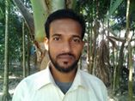
Introduction
Md Amir Hossain Patwary
Assistant Teacher (English)
Madinatul Ulum lslimea Dakhil Madrasha
Palishara,Hajigonj,Chandpur
Mobile No: 01714-315772
79hossainamir@gmail.com

Slide 3
Class-Nine
Sub:English
Unit-Three
Lesson-3

Slide 4
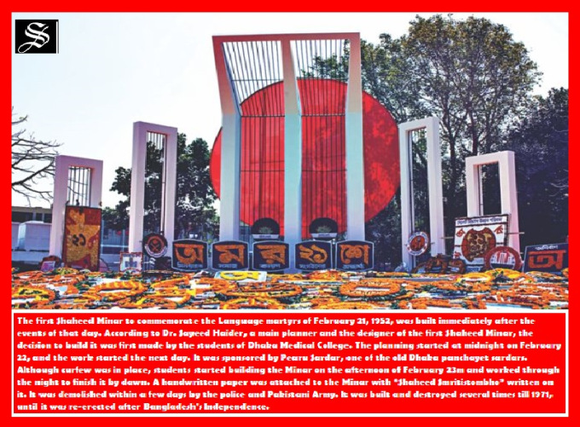
Look at the picture

Slide 5
Lesson Declaration
‘’International Mother Language Day’’

Slide 6
Learning outcomes
After complete the student will be able to-----
*talk about events and festivals.
*ask and answer questions.
*infer meanings from the context.

Slide 7
Vocabulary
memorable=
public=
declar=
Momentum=

Slide 8
Read the text
Silent
21 February is memorable day in our national history. We observe the day every year as lnternational Mother Language Day. The is holiday.On this day,we pay tribute to the martyrs wcho laid down their lives to establish Bangla as a state language in undivided Pakistan in 1952. lt is known as the Language Movement. The seed…………………………..

Slide 9
Pair Work
Match the words meanings
Words | Meanings
Tribute | to have a particular effect
Outlaw | to give in
Defy | to refuse to obey
Provoke | an act to show respect
Relent | the most exciting in time
Climax | to ban

Slide 10
Group Work
Why do we observe 21 february as the lnternational Mother Language Day?
What happened when Urdu was declared as the only state language of pakistan?
“The seed of indepence was sown on 21February1952”.Do you agree with the comment? Why?

Slide 11
Evalulation
*What day national holiday?
*Why was it built?

Slide 12
Home Work
Write a paragraph “International Mother Language Day”

Slide 13
Allah Hafez

