Slide 1
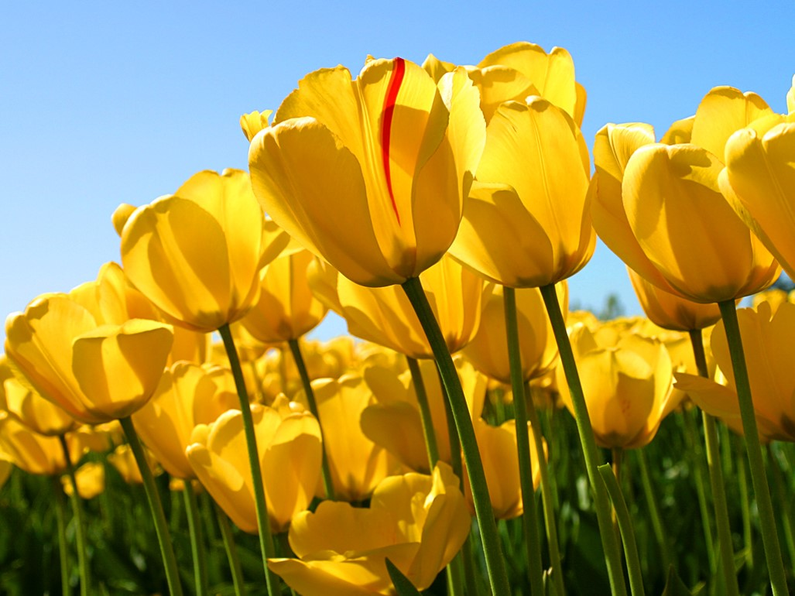
Welcome

Slide 2
Identity
Md Amir Hossain
Asst Teacher
Madinatul Ulom Islamia Madrasha
Mobil No: 01714-315772
79hossainamir@gmail.com

Slide 3
Class : Nine-Ten
Subject : English 1st paper
Time : 50 Minutes
Date : 07/06/2020

Slide 4
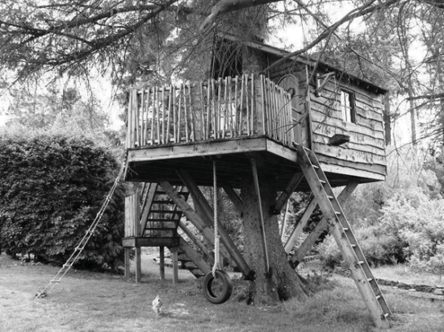
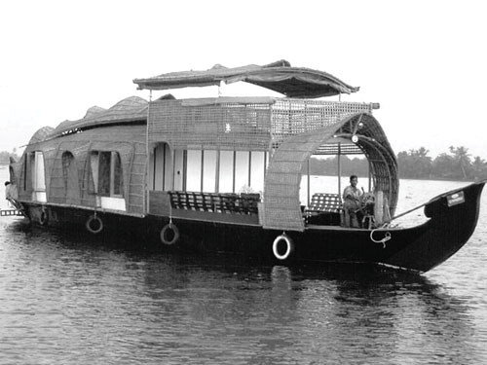
Look at the following pictures and answers the questions.
1.What do the people do in the trees and the boats?
2.Why do they do so?

Slide 5
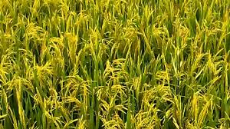
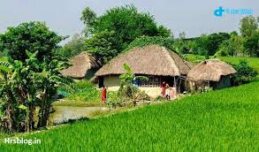
Look at the pictures and think about our lesson
What does arable land provide us?
What does house provide us?

Slide 6
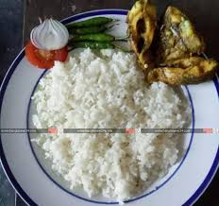
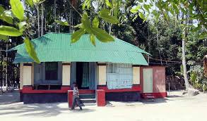
Our today’s lesson is……..
Our food and shelter
Unit: Four
Lesson :Three
Page: 55

Slide 7
Learning outcomes
After we have studied this lesson, we will be able to -----
a) ask and answer about problems,
b) seek and give suggestions,
c) find out the causes of our food and shelter problem,
d) narrate the problems of our food and shelter in writing.

Slide 8
Observe the chart and compare
 | Bangladesh | Sri Lanka | India | China
Land area | 1,47,570 sq km | 65,600 sq km | 32,87,590 sq km | 96,00,000 sq km
Population | 150m | 20m | 1.15b | 1.33b
Density of population | 1000 | 332 | 382 | 133
Birth rate (Per 1000) | 20.1 | 17.42 | 22.22 | 12.29
Death rate (Per1000) | 6.1 | 5.92 | 7.48 | 7.03
Growth rate | 1.40% | 0.7% | 1.41% | 0.5%
If Our population grows such a high rate , we will acutely face food, shelter,…………………………..problems and so on.

Slide 9
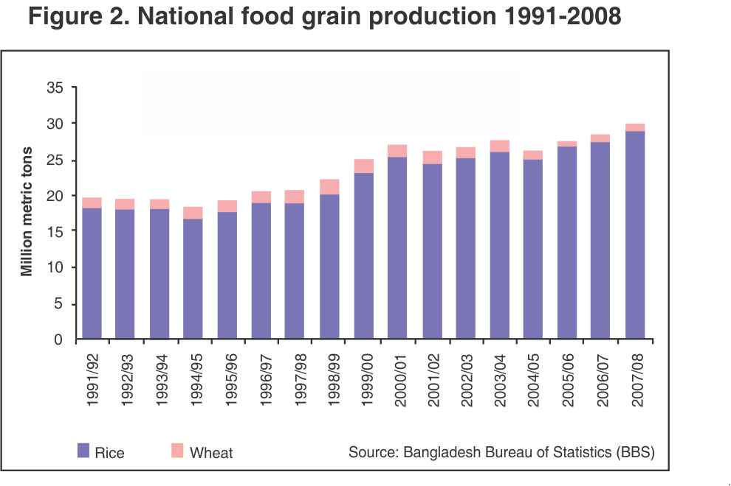
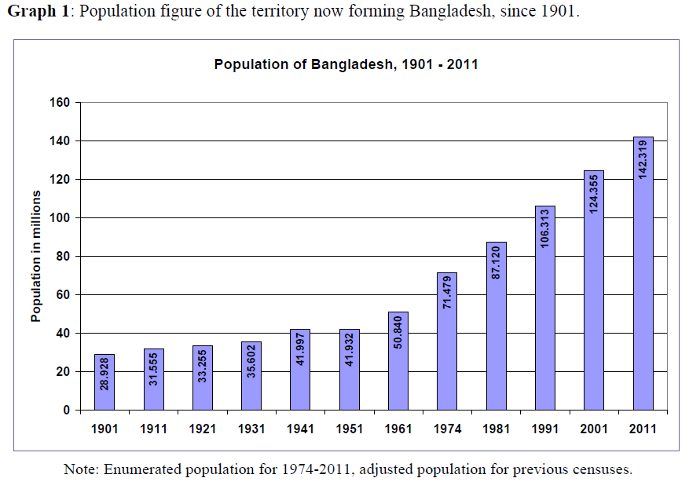
Observe and think about the charts.
Population growth chart
Food grain production chart
Population growth is higher than food production.

Slide 10
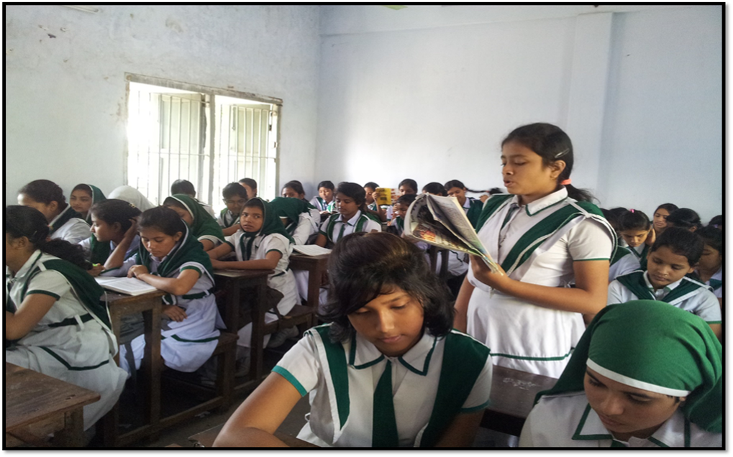
Silent reading
The class coming up……

Slide 11
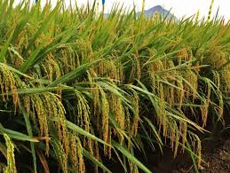
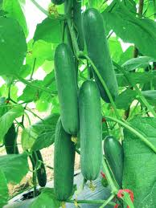
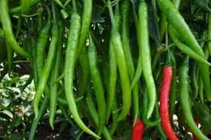
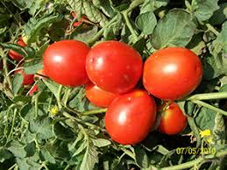
If our population grows such a high rate, the scarcity of food will be a serious problem.
Our agriculturists have developed hybrid crops but it cannot keep pace with increasing population.

Slide 12
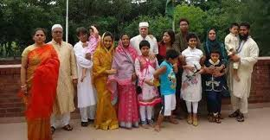
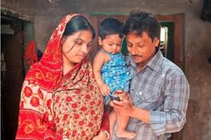
Families are growing larger in size.
Larger families are breaking into smaller families.

Slide 13
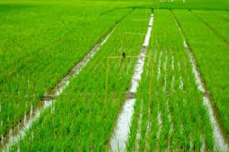
Arable land are being divided into small families.

Slide 14
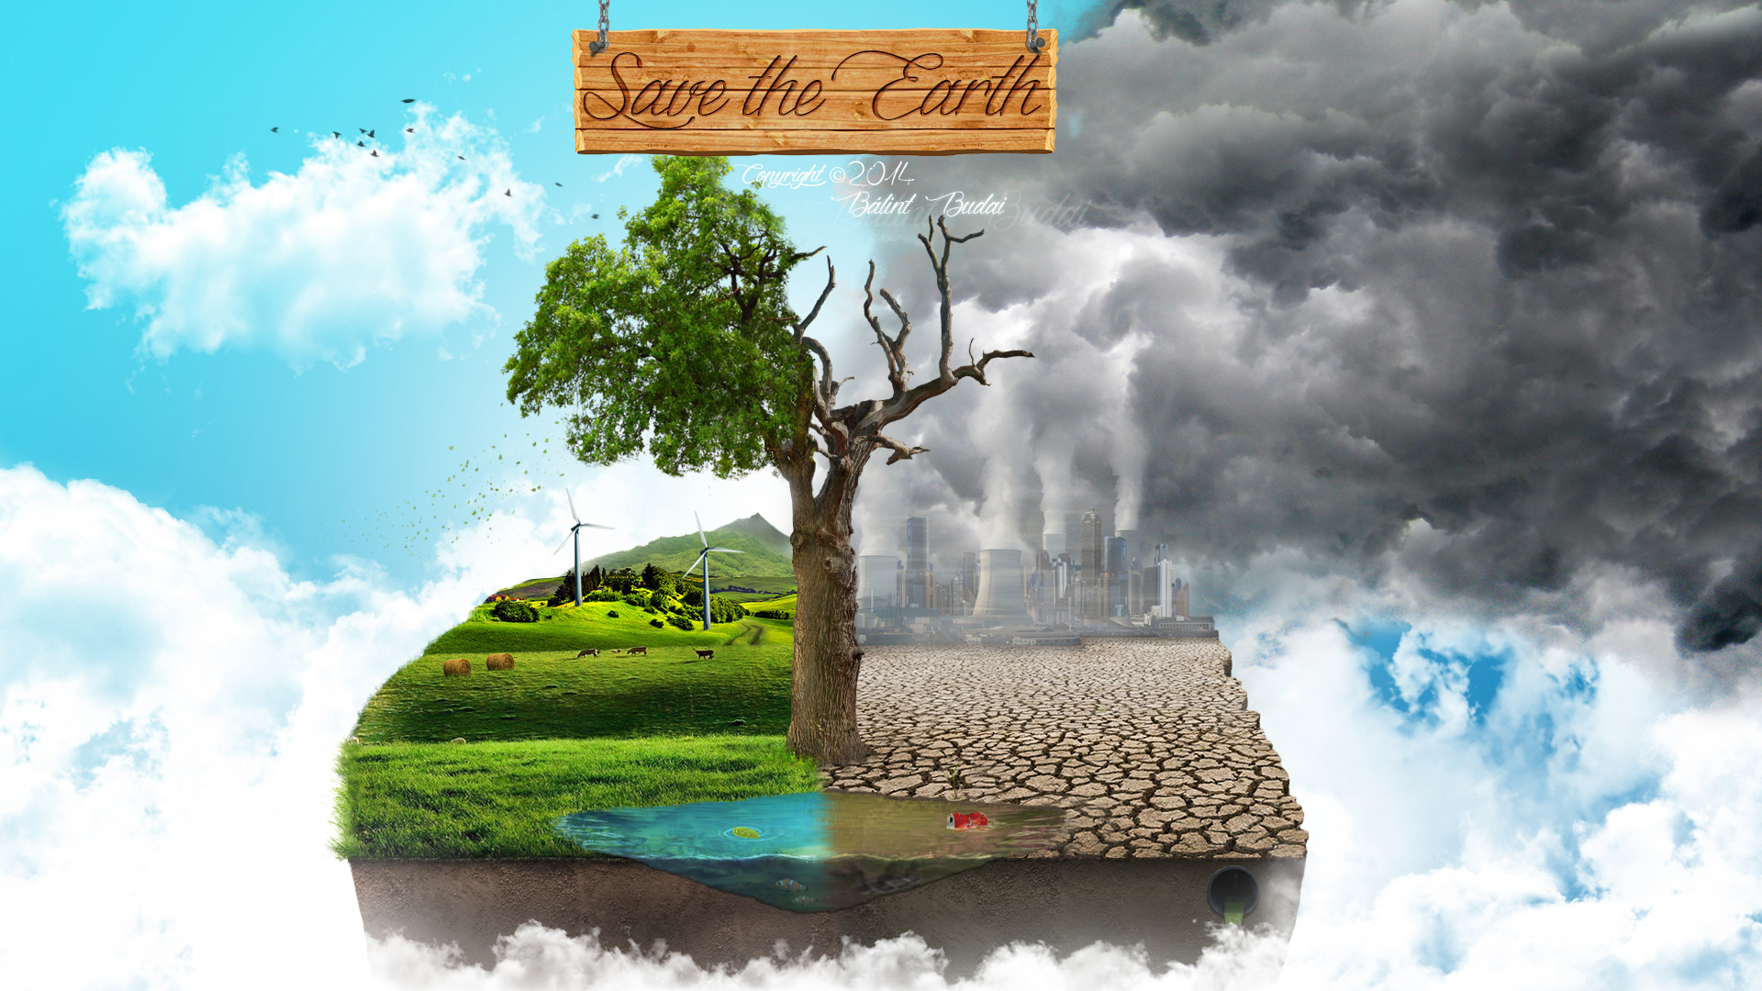
All these problems are creating serious environmental problem and our nature is losing its balance .

Slide 15
Individual work
What makes our land shrink day by day?
Describing in short.

Slide 16
Group work
Group-1
Make a list of problems that caused by over population.
Group-2
Make a list of things that Ms Chowdhury saw in her village when she was a child.

Slide 17
Evaluation
Select the best answer from the alternative.
1. The rate of increase in food production cannot keep pace with the rate of population growth.
The sentence means that the food production
a) is as much as needed.
b) is less than what is needed.
c) is more than what is needed.
d) is sufficient for the population.

Slide 18
2. How can our housing problem increase our food problem?
a) After making houses, farmers do not have enough time to work in the field.
b) After making houses, farmers do not have enough money to buy food.
c) If you do not have a house, you cannot store your food.
d) For making too many houses, people are using the crop land.
3. What makes our land decrease day by day?
a) Families are growing larger in size.
b) Houses and factories are being built on it.
c) Smaller families need smaller houses.
d) Land grabbers are occupying a portion of our land.

Slide 19
4. Many people may have to live on trees, because-
a) they would like tree houses.
b) making houses on trees is less expensive.
c) they may not find land to make houses.
d) tree houses are safer during floods.
5. People are cutting trees to-
a) plant more trees.
b) keep the environment clean.
c) make articles of furniture.
d) grow crops or make houses.

Slide 20
Home work
Write a composition about your village or locality. Describe any change in the things you have noticed over the years such as houses, fields, trees, plants, etc.

Slide 21
Good bye

