Slide 1
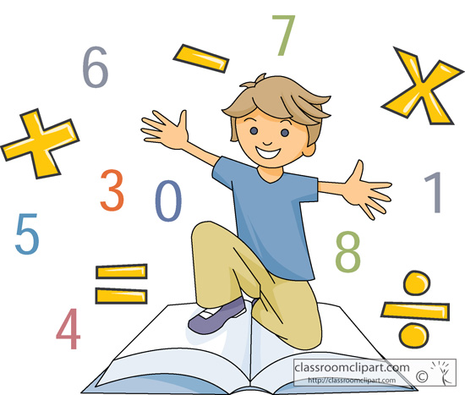
Welcome to Online Math Class

Slide 2
Teacher’s Information
Md. Hasan-ul-Bari
Lecturer, Mathematics
Millennium Scholastic School & College
Jahangirabad Cantonment, Bogura.
Cell No.: 01716103858, 01769129001
E-mail: hubari1976@gmail.com

Slide 3
Lesson’s Information
Class : IX
Chapter : Five (Exercise-5.1)
Subject : Mathematics
Period : 1st
Time: 9:30-10:00 am
Date: 06/06/2020

Slide 4
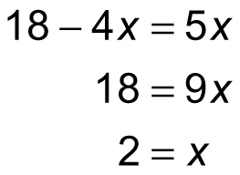
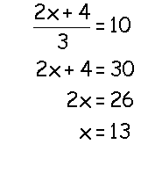
Observe the following Mathematical Sentences:

Slide 5
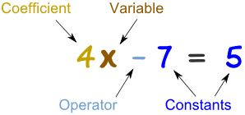
Can you tell what type of mathematical sentence/equation is shown above?

Slide 6
Topic = ?
Equation in One Variable

Slide 7
Learning Outcomes /Objectives
At the end of the lesson, the students
will be able to ………..
Define equation and Identity
Find out the differences of equation and identity
Define linear equation in one variable
Solve linear equations

Slide 8
Compare

Slide 10
Degree of an equation

Slide 15
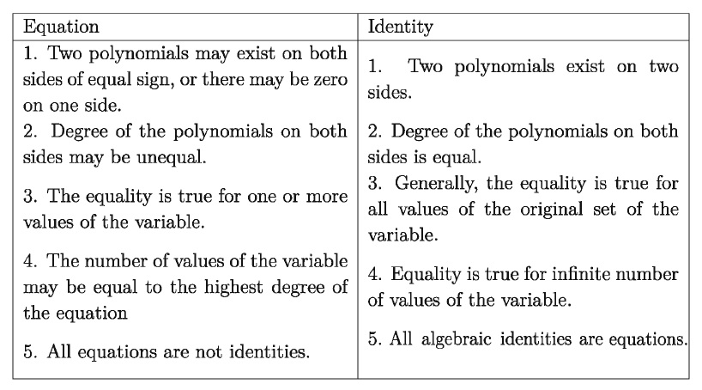
Difference between Equation and Identity

Slide 16
Solve
[by transposition]

Slide 17
So, the required solution is

Slide 18
Individual Work
Solve:

Slide 19
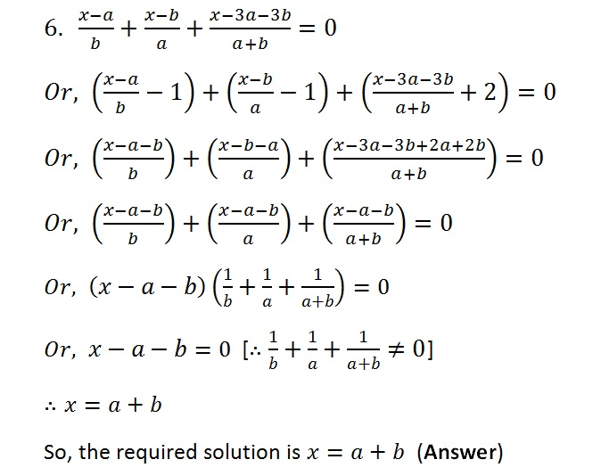
Solve:

Slide 20
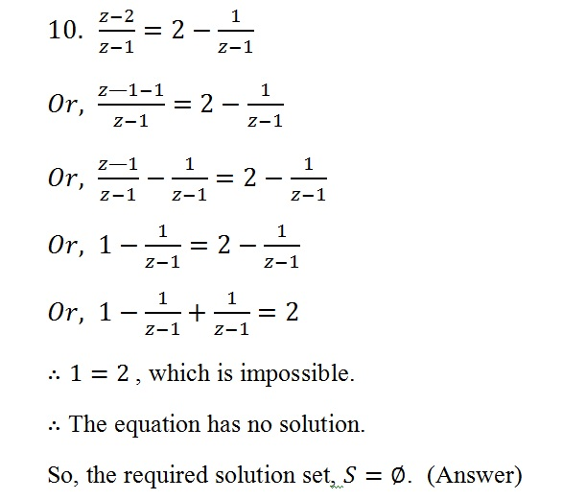
Find the Solution set:

Slide 21
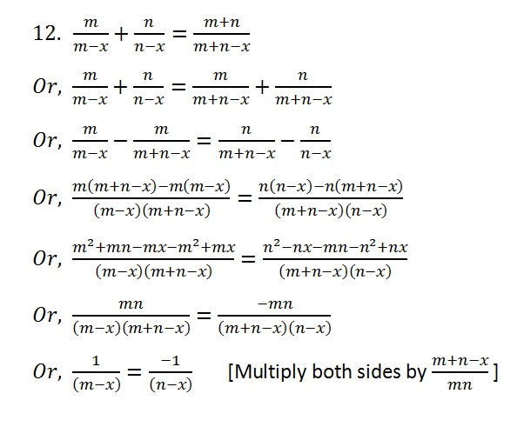
Find the Solution set:

Slide 22
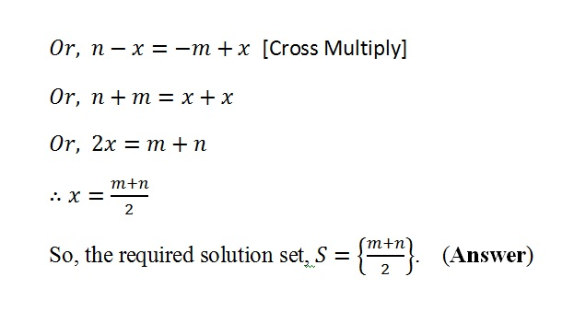
Find the Solution set:

Slide 23
Group Work
Find the Solution set:

Slide 24
Evaluation
1. What is algebraic equation?
What is identity?
Write the main difference of equation and identity.

Slide 25
Home Work
Solve:

