Slide 1
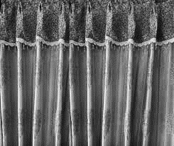
From the Directorate of Technical Education Bangladesh
Wel Come to
Nanyang Polytechnic International
Singapore
Notes:
Ending slide.

Slide 2
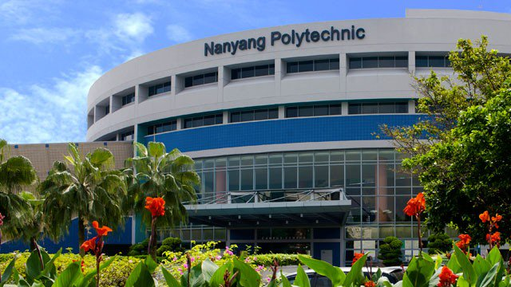
WELCOME
TO
PLAN OF ACTION (POA) PRESENTATION
Group(A), Batch-22
‘Innovation in Teaching & Learning
6th Batch’(06-27), November,2018
Nanyang Polytechnic International, Singapore.

Slide 3
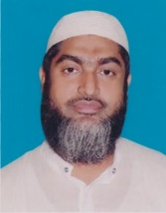
Batch-22
Group-A
Md.Habibur Rahman
Instructor(Physics)
Kishoreganj Technical school & college
Dates OF TRAINING AT NYP, SINGAPORE
6 NOV 2018 TO 26 NOV 2018
Mobile: +8801715342934
Email: mhabibur21@gmail.com

Slide 4
THREE KEY LEARNING POINTS
Design Thinking
Positive mind setup for STEM
Flipped Learning

Slide 5
JOB NAME & IT’S FUNCTION
JOB NAME: To Improve Teaching Techniques for Physics in our Institute Applying Students-centric Approach.
Function 1: Identify the Integration Percentages of the Students-centric Approach.
Function 2: Teach the Students According to their Abilities.
Function 3: Perform the Students-centric Approach of the Lessons Map.

Slide 6
INDIVIDUAL PLAN OF ACTION(POA)
Name of Participant: Md. Habibur Rahman
Instructor (Physics)
Name of Organization: Kishoreganj Technical School and College
Dates of Training at NYP, Singapore: 6 Nov 2018 to 27 Nov 2018, Group 22
Description of Key Initiatives and Action Plans:
Key Initiatives (or Project) | Action Plan | Deliverables &/or KPIs | Timeline/ Schedule
To Improve Teaching Techniques for Physics in our Institute Applying Students-centric Approach. | 1.Identify the Integration Percentages of the Students-centric Approach. 2.Teach the Students According to their Abilities. 3.Perform the Lessons Plan Map. According to Students-centric Approach | 1. A series of Min-Test of Students. 2. A Complete set of Lesson Plan Map, MM materials, Apps , Assignment, Test 3. A Video Clip, Feed-back,Group work & Smart Homework. | January , 2019 to March 2019 for Part-1

Slide 7
TASK OF JOB FUNCTION
Task 1: Match the Instructional Steps with the Integrated of LTP Materials.
Task 2: Identify the Instructional Steps of LTP .
Task 3: Find the Respective LTP Activities for each Instructional Brain-based.

Slide 8
May Allah bless you all.
Notes:
Ending slide.

Slide 9
THANKS A LOT
Made by
Md.Habibur Rahman
Instructor(Physics)
Kishoreganj Technical school & college
Mobile: +8801715342934
Email: mhabibur21@gmail.com

