Slide 2
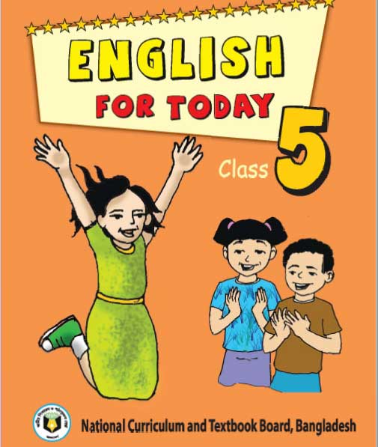
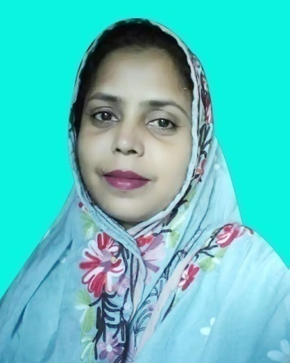
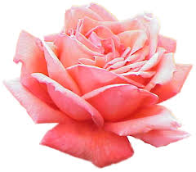
Presented by
Mira Rokeya Khatun
(Assistant teacher)
Rarishal govt.primary school.
Lakhai, Habigonj.
Class:Five
Unit:15
( Happy Birthday )
Time: 45 minutes

Slide 3
Learning outcomes
By end of the lesson students will be able---
To Read the text with correct pronunciation,
spelling and intonation.
1
2
To tell how a birthday is celebrated.
3
To write a short simple composition.

Slide 4
Let’s watch a video.
Discuss with students about video.
Do you understand what may be our today’s lesson?

Slide 5
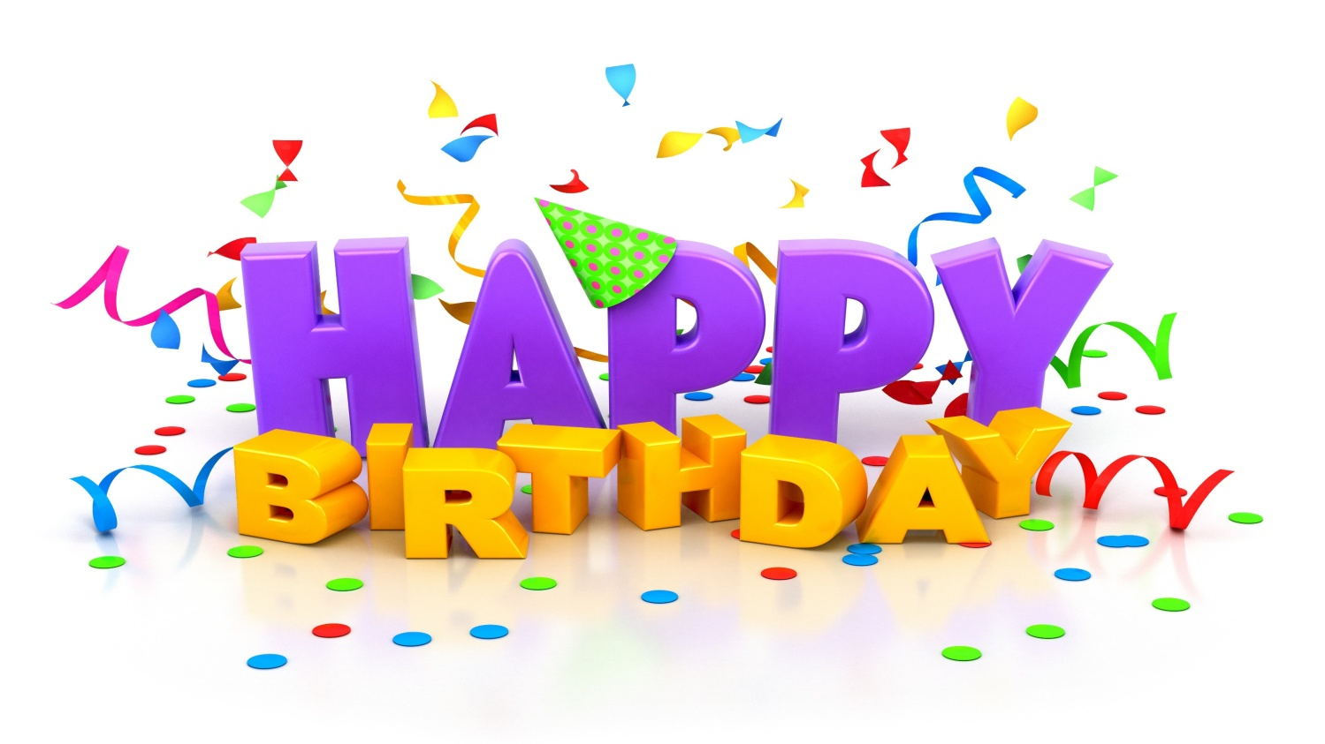
Today’s lesson

Slide 6
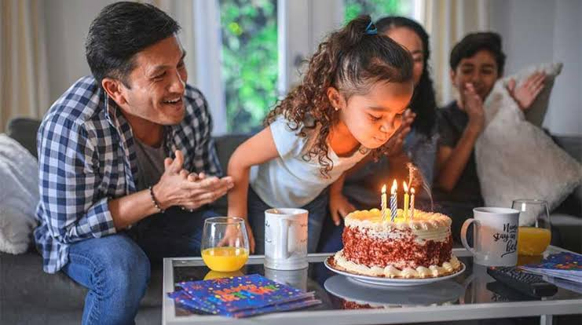
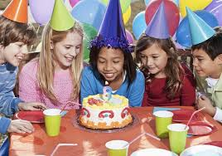
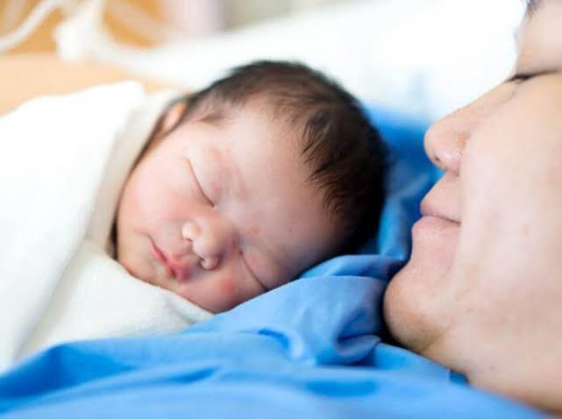
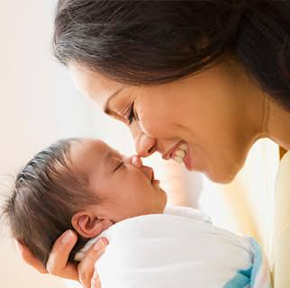
Look at the pictures.
It’s one’s Birthday.
This is the date when the person was born.
A person’s birthday is a special day.

Slide 7
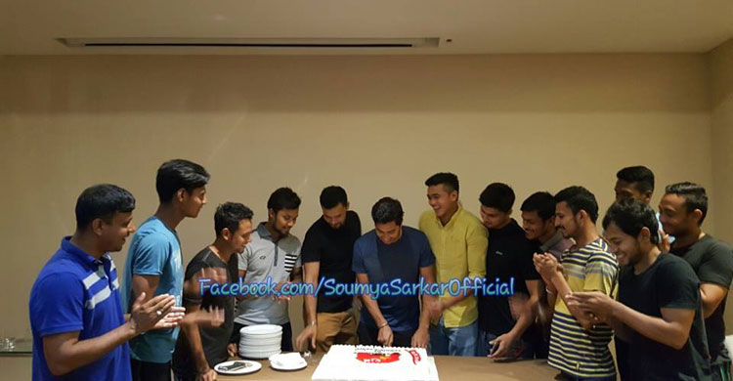
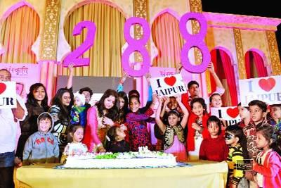
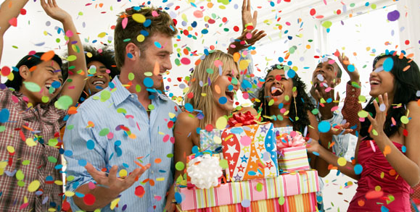
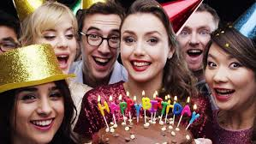
People around the world celebrate birthdays in different ways.

Slide 8
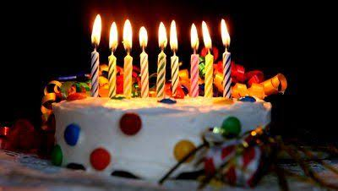
There are candles on the cake.

Slide 9
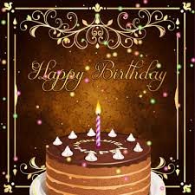
There is one candle for each year of the person’s life.

Slide 10
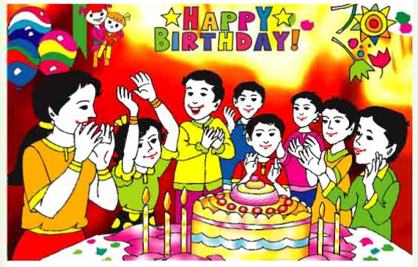
People sing a song for the person.

Slide 11
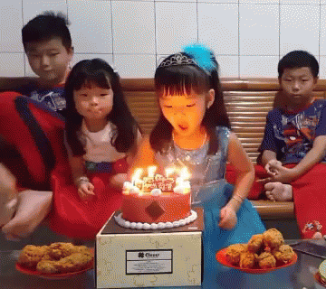
At end of the song, the person blows out the candles.

Slide 12
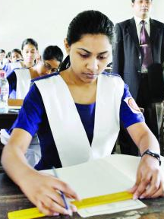
Individual work
Match the answer
Read the sentences. Write T for true or F for false.
A birthday is the date when a person was born. -------
On a birthday cake, there is one candle for each year of a child’s age. -------
People celebrate birthdays in the same way around the world. -------
T
T
F

Slide 13
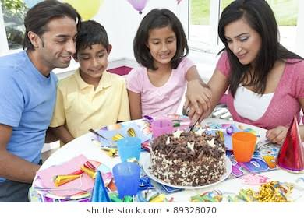
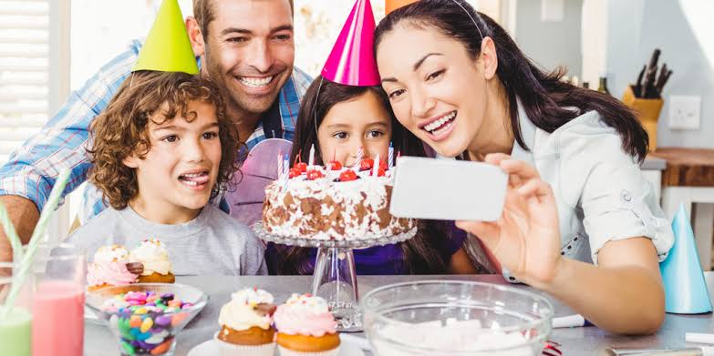
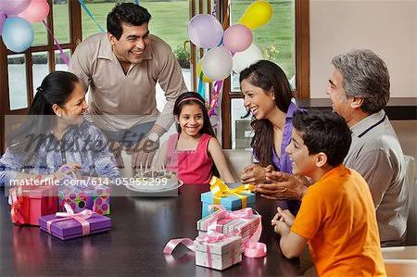
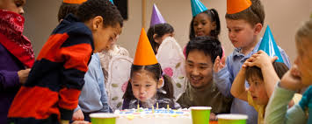
In some countries, there is often a party for a child’s birthday.
The child’s friends come to the home

Slide 14
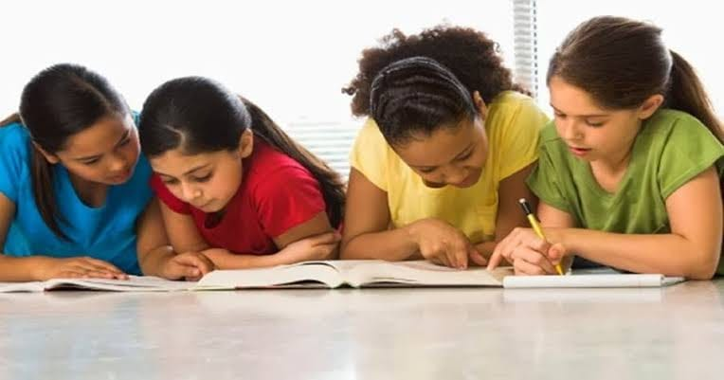
Pair work
1. What is a special day for a person?
2. What will people do in his birthday?
3. What the person do at the end of the birthday song?

Slide 15
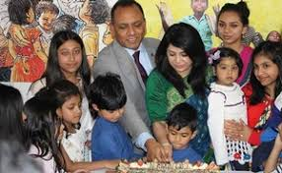
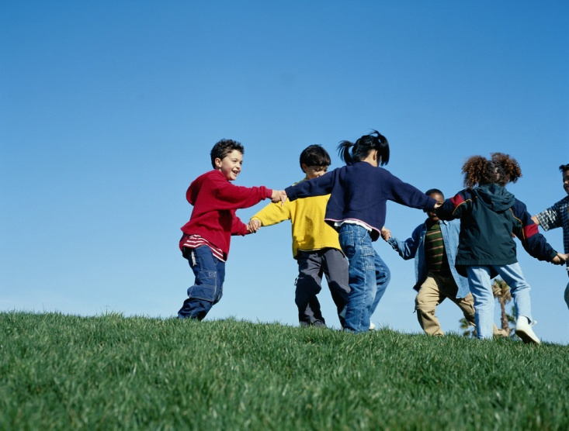
The most important thing is to enjoy the day and spend time with friends and family.

Slide 16
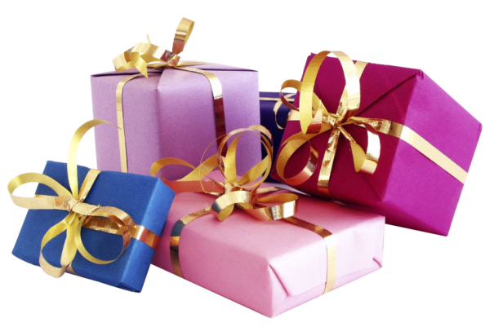
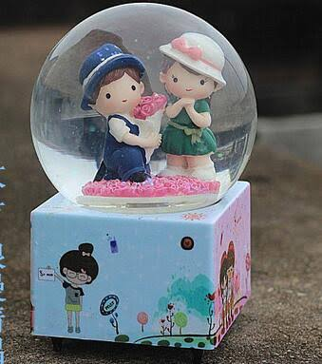
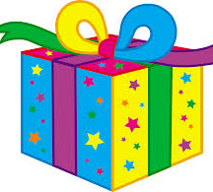
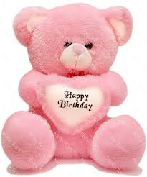
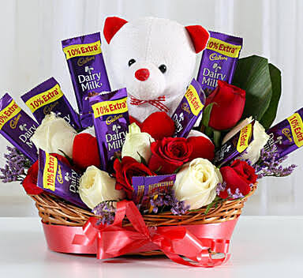
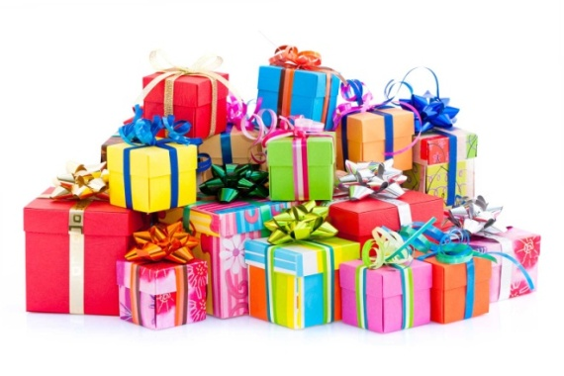
Birthday gift

Slide 17
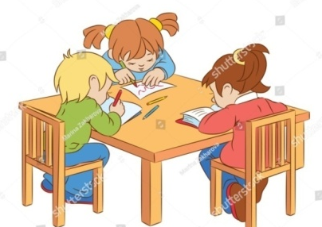
Group work
1. Do people around the world celebrate birthday in the same way ?
2. How many candles are put on the cake and why ?
3. How do people celebrate birthday in most of the country ?
4.What do people bring to a birthday

Slide 18
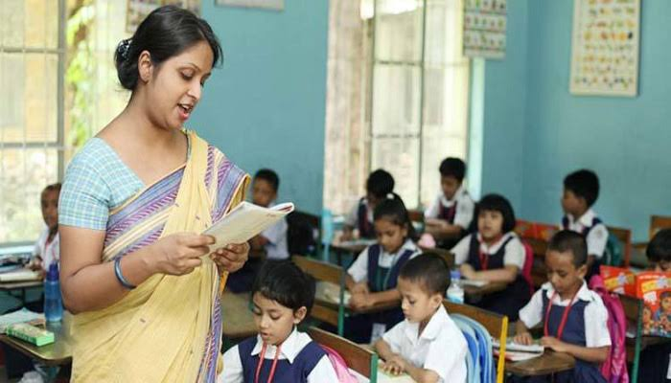
Teacher’s loud reading and discuss the lesson.

Slide 19
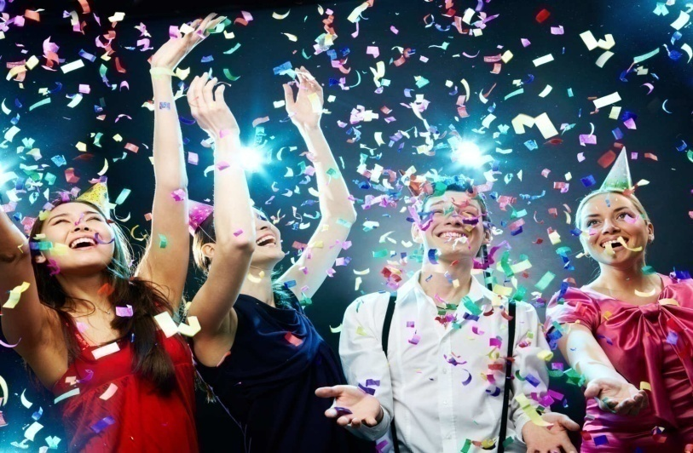
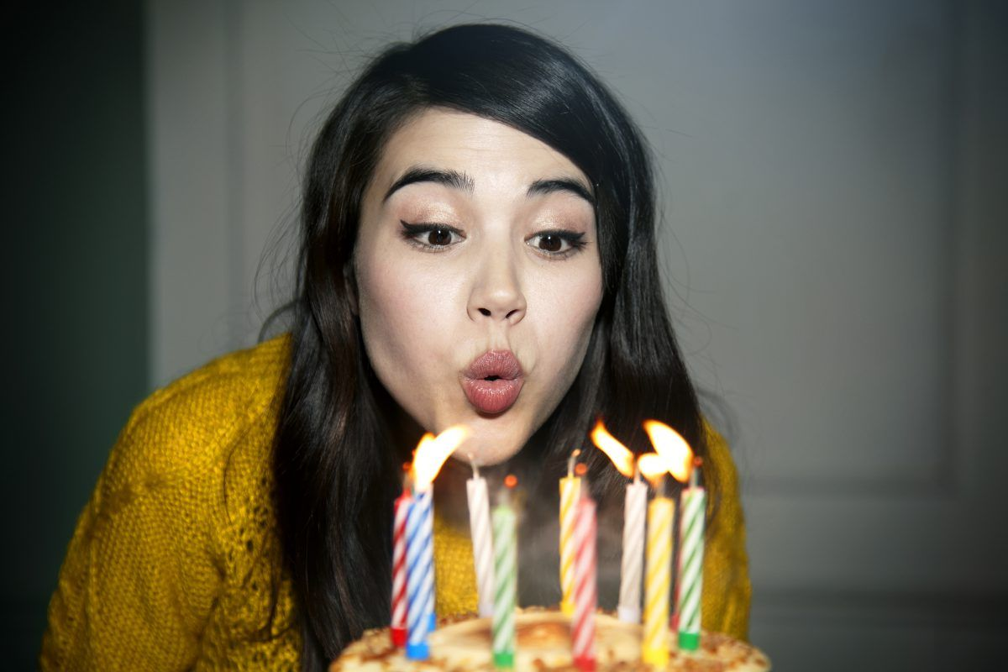
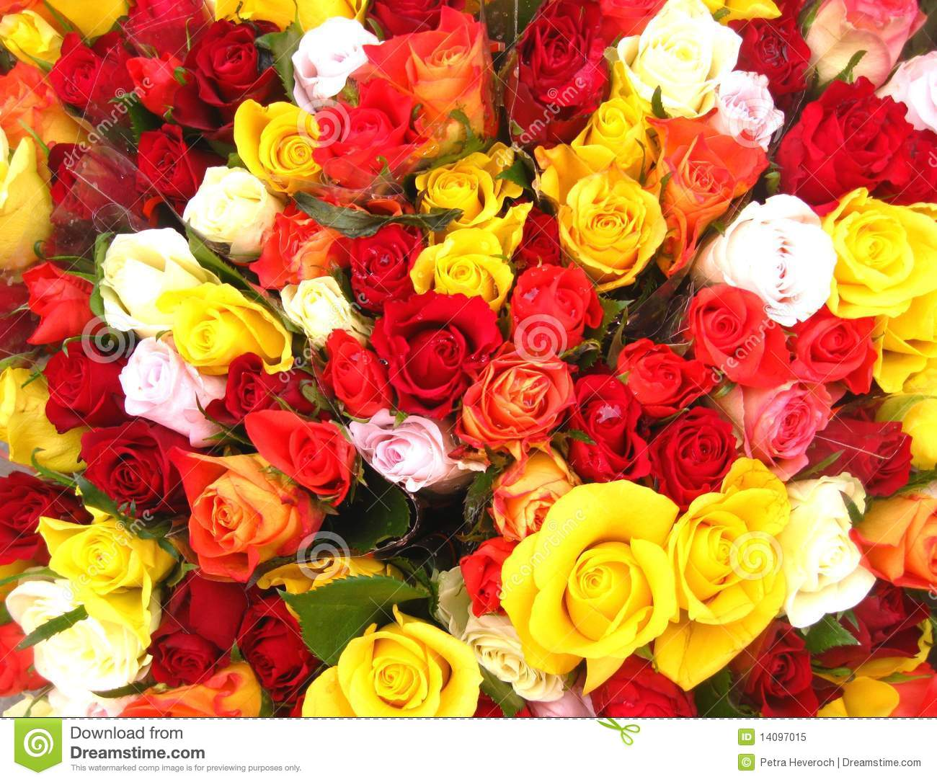
New words with sentences by using picture
Observe
Put out
Full of bright colour
Celebrate
Colourful
Blow out
I like colourful things.
She blows out the candles
They are celebrating thirty-first night.

Slide 20
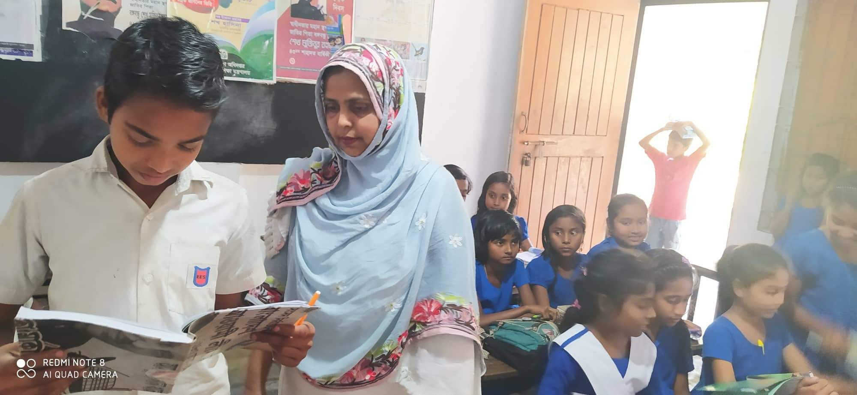
Student’s loud reading help by teacher.

Slide 21
Evaluation
Match the answer
Match the words
Column A | Column B
a) Children | 1) A given thing without payment
b) Special day | 2) Father and mother.
c)Birthday | 3) The day of a person’s birth.
d) Parents | 4) Little boys and girls
e) Enjoy | 5) A particular day.
 | 6) Feel happy.
 | 7) friends
(a+4) Children ---- Little boys and girl.
(b+ 5) Special day -- A particular day.
(C+3) Birthday ---- The day of person’s birthday.
(d+2) parents ----- Father and mother.
(f+6) Enjoy ----- fell happy.

Slide 22
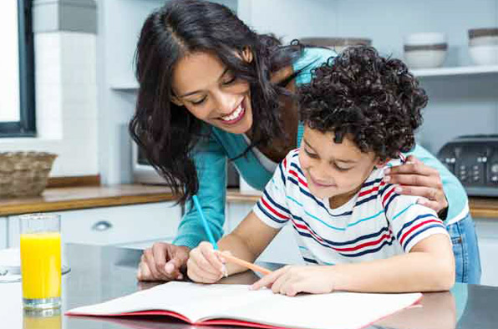
Home
work
Write 10 sentences about your birthday.

Slide 23
