Slide 1
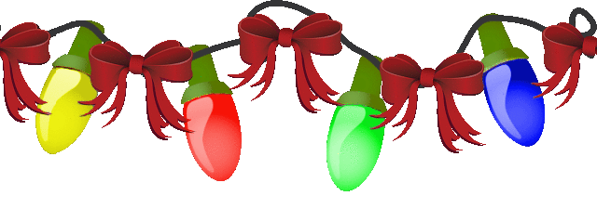

Slide 2
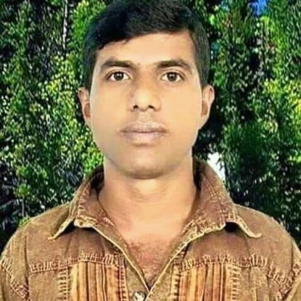
Teacher’s
Introduce
Lesson’s
Introduce
Unit: 6 ( Numbers )
Lessons: 1 – 3
Parts of lesson: Activity-A
(Look and say)
Subject: English
Class: Two
Time: 45 minutes.
Kalyan Brata Biswas
Assistant Teacher
Kayesthorail Govt. Primary School
Dakshin Surma, Sylhet.
Email: kalyanbratabiswas1979@gmail.com

Slide 3
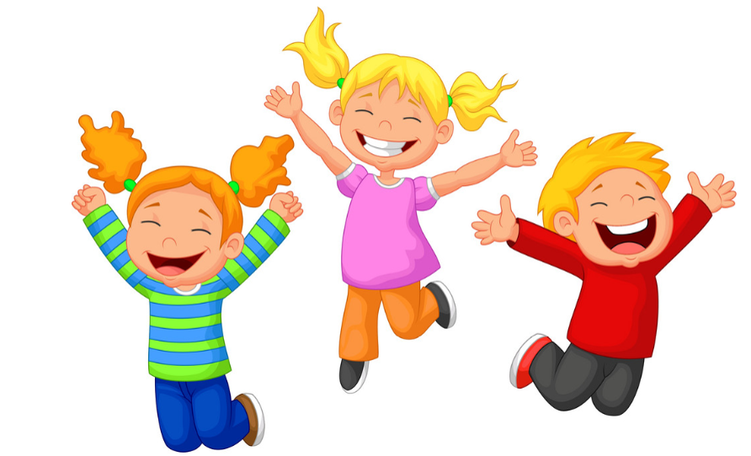
Safety environment by greetings song.
Hello! Hello!
How are you?
I’m very well, thank you. Thank you.
And how are you?
I’m very well , too.
Thank you , thank you.

Slide 4
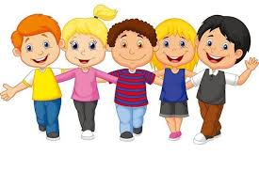
Checking homework and justify the previous lesson by the following ways:-
How many children are dancing?
How many children are reading?
How many children are dancing?

Slide 5
Today’s our lesson is
Unit-6(Numbers)
Lessons:(1-3)
Activity - A

Slide 6
LEARNING OUTCOMES
By end of the lesson students will be able to---
Listening: 1.1.1 become familiar with English sounds by listening to common English words.
Speaking: 1.1.1 repeat after the teacher simple words and phrases with proper sounds and stress.
1.1.2 say simple words and phrases with proper sounds and stress.
Reading: 1.2.1 recognize and read cardinal numbers up to 30.

Slide 7
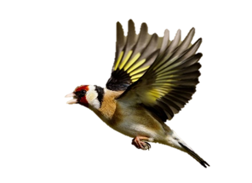
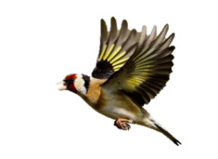
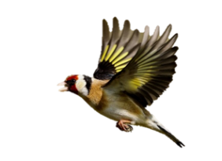
Look and say.
What are these?
How many birds?
How many birds?
How many birds?

Slide 8
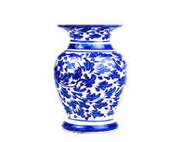
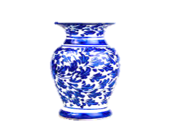
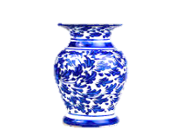
Look and say.
How many vases are there?
What are these?
8
g
h
t
e
i
9
n
i
n
e
10
t
e
n
Notes:
Repeat 2/3/4

Slide 9
Now open your book at page 12 and see the activity- A( Look and say).
How many oranges?
8
9
10
eight
nine
ten
Repeat after me.
Spell out the words.
Techniques: SGW

Slide 10
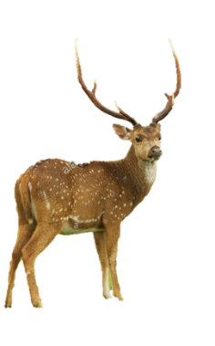
Pair work.
How many deer in the pictures?
One more.

Slide 11
Dear students look and say.
How many fishes are there in your English book at page no-12?
2. How many pencils are there in your English book at page-12 ?
3. How many ants are there in your English book at page-12?

Slide 12
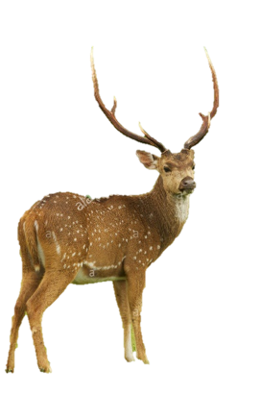
Now look at the picture and say how many
deer in the below picture?
9
10
8

Slide 13
Look at the picture and say how many flowers in the picture?
9
10
8

Slide 14
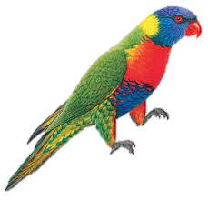
Dear students count and say how many parrots in the below picture?
.
8
9
10

Slide 15
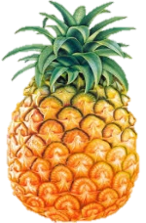
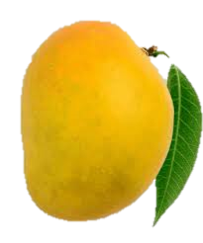
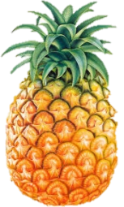
Count and say
Let’s see the right answer.
8
10
9
10
8
9

Slide 16
Read and say.
eight
ten
nine
nine
eight
ten
ten
nine
eight
Marking weak students and taking to care.

Slide 17
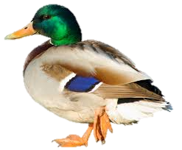
One Day One Word
How many ducks in the picture?
আট।
eight
Spell out the word - SGW

Slide 18
Find out the letters which are made by a word.
n
i
u
e
m
n
k
o
i
The right word is -------------.
enin
neni
nine
enni

Slide 19
Say the missing letter.
t- n
-en
te-
ten
দশ।
Write the word in your exercise book.

Slide 20
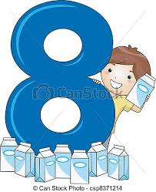
Dear students look at the below picture and re-arrange the following letters which will be make a meaningful word.
i
e
h
g
t
The meaningful word is………………

Slide 21
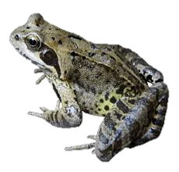
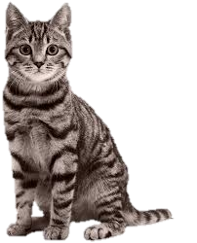
Evaluation
Q. How many frogs in the picture?
Q. How many cats in the picture?

Slide 22
Home work
Page no-12 activity-A will be well read.

Slide 23
That’s all for today.
Thanks.
See to tomorrow.
Bye.

