Slide 1
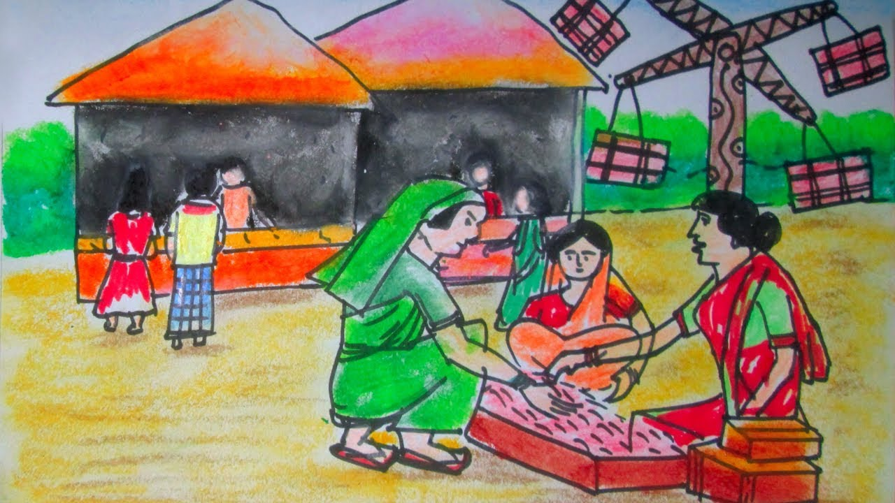
Welcome

Slide 2
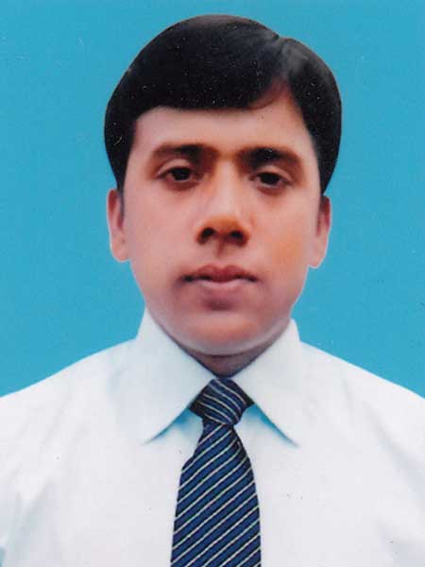
About me and Book
Md. Robiul Islam
English For Today
Class Eight
Unit – Five
Lesson- One
Assistant Teacher English
Pioneer Girls’ High School, Khulna.
E-mail. robittck@gmail.com
ICT4E Ambassador

Slide 3
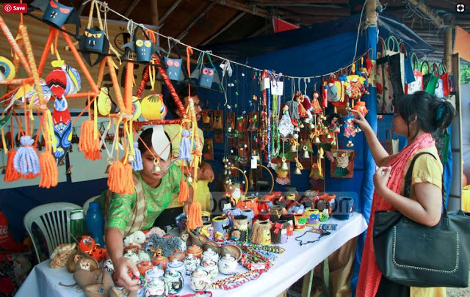
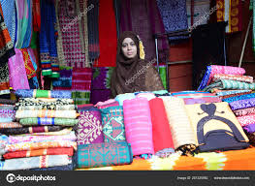

Slide 4
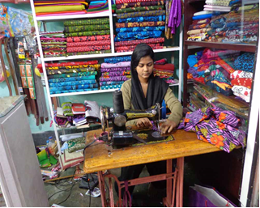
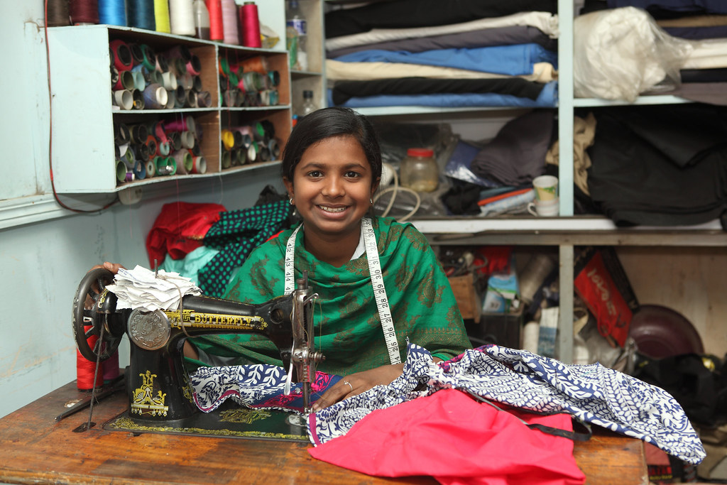

Slide 5
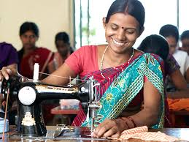
Look at the pictures and discuss in pairs.
What are they doing?

Slide 6
Today we are going to read about -
Making a difference
“The beginning”

Slide 7
After we have studied this unit, we will be able to -
Read and understand texts through silent reading.
Infer meaning from context.
Ask and answer questions.

Slide 8
Extraordinary
Adjective
Remarkable,Uncommon
Shamima is an extraordinary woman.
Antonym
Ordinary

Slide 9
Determination
Noun
Appraise, Imposition
Shamima’s will power and determination made her extraordinary.
Antonym
Weakness

Slide 10
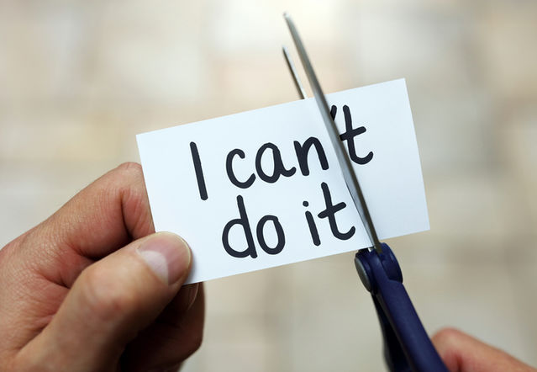
Will - power
Noun
Will
Shamima has will- power which makes him unique.
Antonym
Weakness

Slide 11
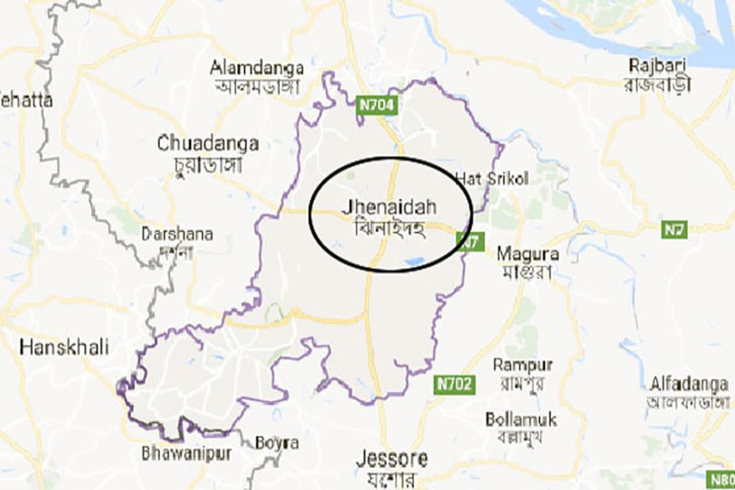
A. Read the text and tick the best answers to the following questions.
There is a small village called Bhabanipur in Jhenaidah. It is a typical Bangladeshi village.

Slide 12
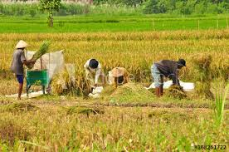
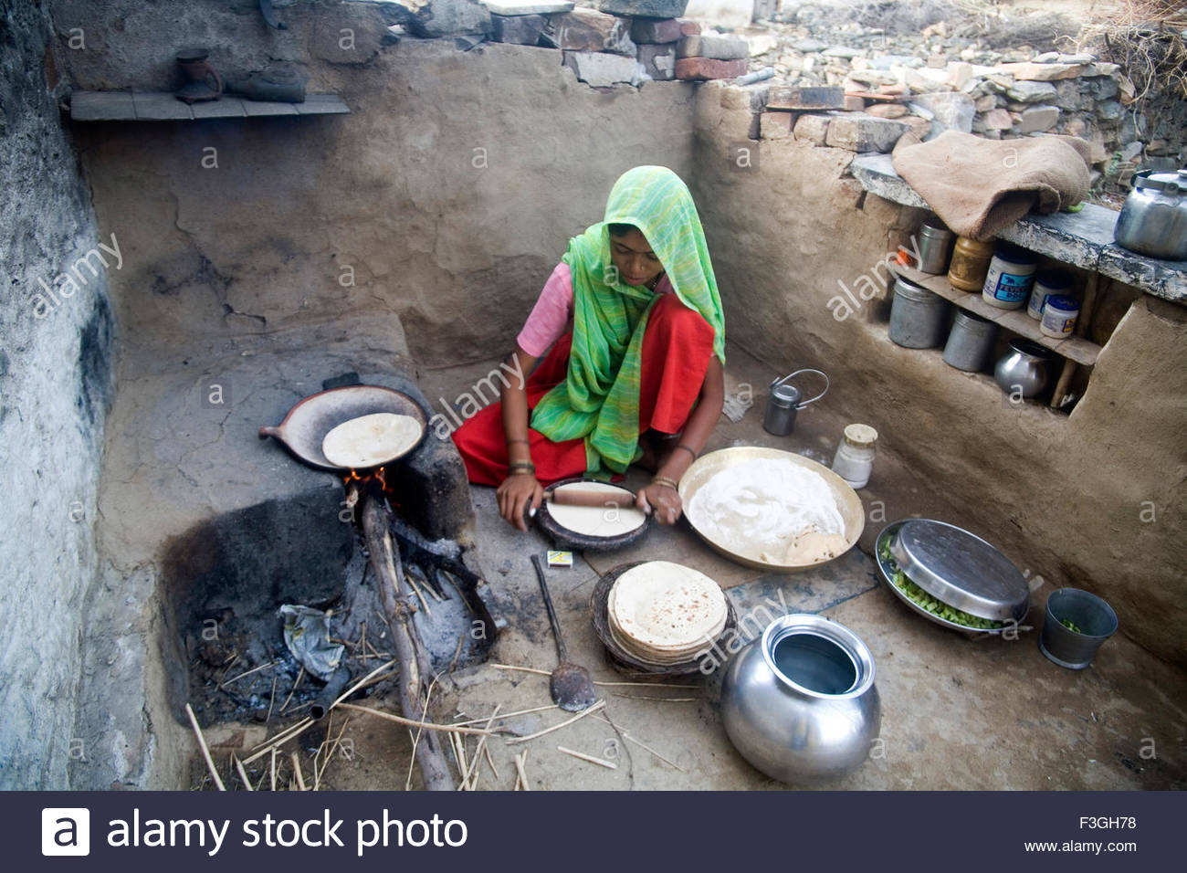
People here spend their day –to- day life mostly working in the fields and doing household work.

Slide 13
In this ordinary village , there lives an extraordinary woman named Shamima Akhter Maya. Shamima’s will power and determination have made her extraordinary. She has seen the most cruel aspect of life.
Shamima Akhter Maya

Slide 14
But the cruelty could not defeat her spirit. She has come out as a winner, defying all the odds of life.

Slide 15
Shamima is now 32 years old. She has only one son named Ashikur Rahman Kanok.

Slide 16
She runs a small boutique called “Oikko Nari Kollayan Shangstha” in her village. Let’s hear from Shamima, how she succeeded in setting up her boutique.

Slide 17
Bhabanipur is a typical Bangladeshi village.
The underlined word means.
a) unusual
b) usual
c) famous
d) infamous
2. Shamima is an extraordinary person.
Here the underlined word means.
a) common
b) simple
c) amazing
d) normal

Slide 18
B. Read the text again. Now match the phrases with the meanings.
1. Day –to-day life | unkind happenings in life.
2. Household word | become victorious.
3. Cruel aspects of life | everyday life.
4. Come out as a winner | difficulties of life.
5. All the odds of life | having all the regular features of Bangladeshi village.
6. Typical Bangladeshi village | domestic chores.

Slide 19
Read the text again and answer the following questions.
1. What type of village does Shamima live in?
2. What do the people of “Bhabanipur” village usually do?
3. What has Shamima done to make herself extraordinary?

Slide 20
Grammatical Task
Present Continuous Tense
Structure
Subject + Am/Is/Are+ Verb+ ing+ Object
Example
The sun is rising in the East.

Slide 21
Home Work
1. Write a paragraph about “Shamima” from your imagination.

Slide 22
Thank You

