Slide 1
Welcome

Slide 2
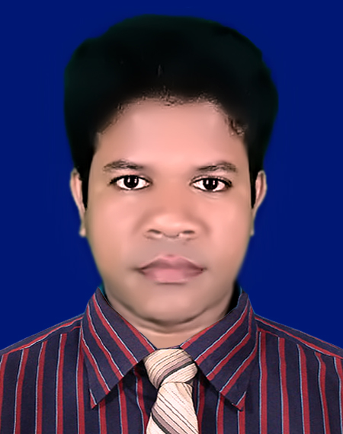
IDENTITY
Azizul Fakir
Assistant teacher
Dighijan Secondary School
Nazirpur, Pirojpur.
Email: azizul.nk@gmail.com
Mobile: 01710745128
Unit – Three
Lesson - 1

Slide 3
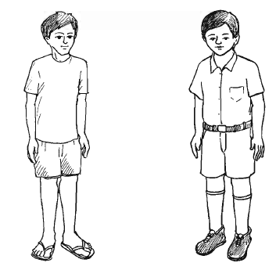
Look the picture carefully.
What do you see in the picture?
L
R
The boy in the left is unhealthy.
Now can you complete the sentence? ‘ _____ is wealth?’
Which boy is unhealthy?
Health
Which boy looks healthy?
The boy in the right looks healthy.
We see here tow boys in the picture

Slide 4
This is a healthy man
Our topic?
Health
Unit – 3
Lesson - 1
So

Slide 5
Learning outcomes
After completing the lesson students will be able to
infer meaning from the context
1
2
talk about the picture and read the text.
3
write answer the questions
choose the best answer
4
5
fill the gap from listening CD

Slide 6
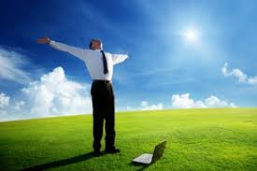
Key word
disease
noun
Meaning
an illness effecting humans of caused by infection.
Good heath means healthy body free from diseases

Slide 7
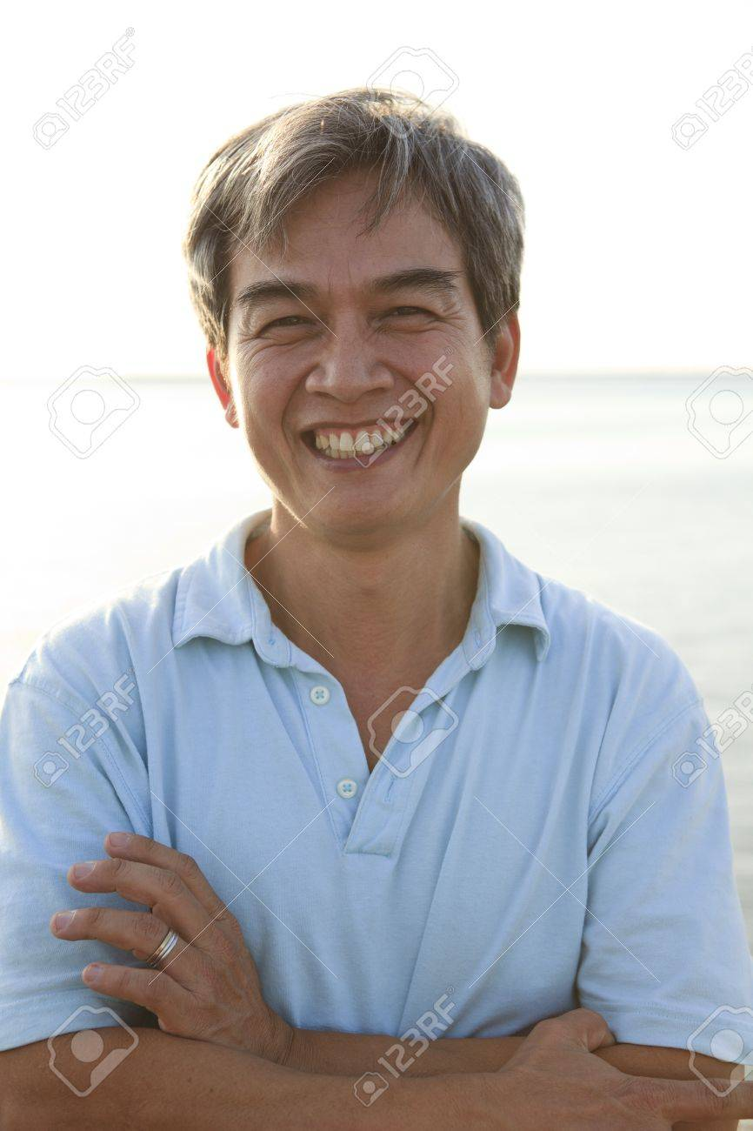
Key word
essential
adj
Meaning
completely necessary
Good heath is essential for everyone to lead a happy life

Slide 8
Key word
concentrate
verb
Meaning
think intensively about something
If we are not in good health, we can not concentrate on any activity in our life.

Slide 9
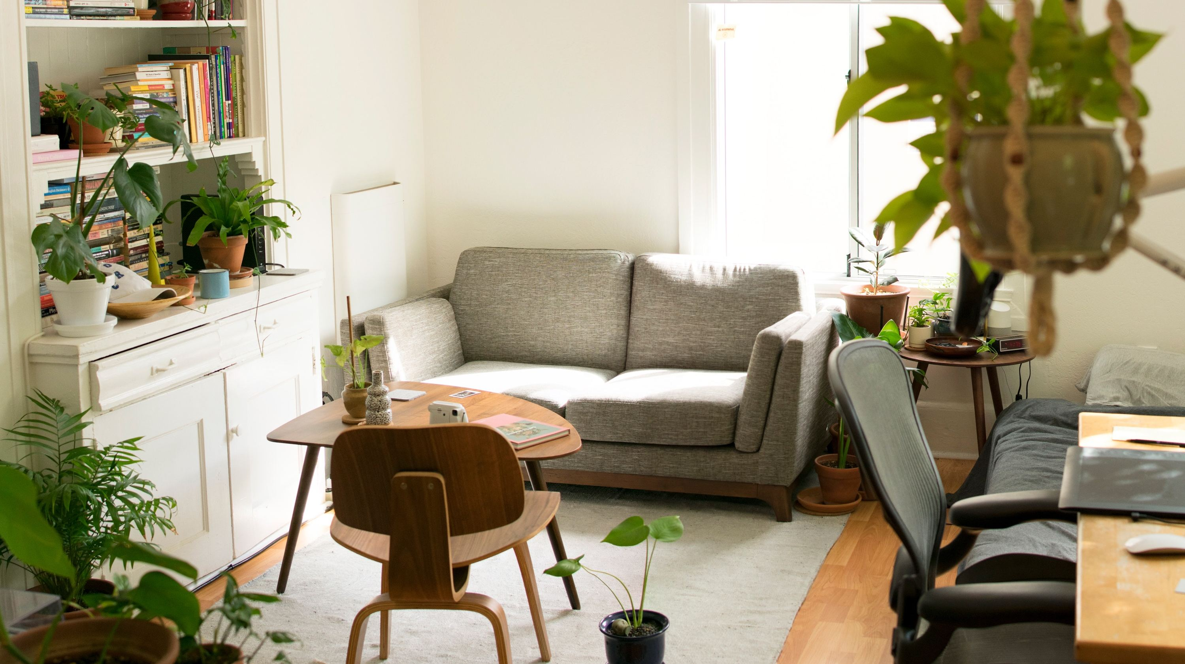
Key word
possession
noun
Meaning
belongings something
Health is equally valuable as gold or any other personal possessions.

Slide 10
Open at page 9 in your text book and read the passage carefully.
Health is the condition of our body and mind. It may be good or bad. Good health means healthy body free from diseases. It is essential for everyone to lead a happy life. If we are not in good health, we can not concentrate on any activity of our life.
A proverb goes, “Health is Wealth”. It means health is equally valuable as gold or any other personal possessions. We may have vast wealth and property, but if we are not healthy we can not enjoy them.
To keep ourselves healthy, we have to do certain things. We have to take a balanced diet. We must exercise regularly to keep our body fit for work. There is an old saying: ‘Early to bed and early rise
Makes a man healthy, wealthy and wise.’
So, we should not keep late hours. We should go to bed early at night and rise early in the morning. Peace of mind is another condition for good health. So we must not worry over small things of life.

Slide 11
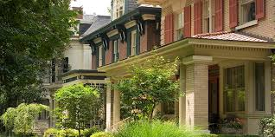
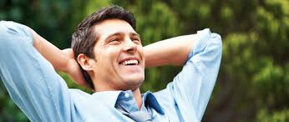
What do you see in the pictures?
Look at the pictures carefully
Personal possessions
Concentration
Happy life
Health is the condition of our body and mind. It may be good or bad. Good health means healthy body free from diseases. It is essential for everyone to lead a happy life. If we are not in good health, we can not concentrate on any activity of our life.

Slide 12
Individual works 3mins.
Answer the following questions.
Q1. What is health?
Q1. What is good health?
Check your answer
Ans1. Health is the condition of our body and mind.
Ans2. Good health means the healthy body free from disease.

Slide 13
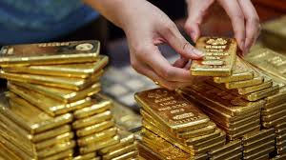
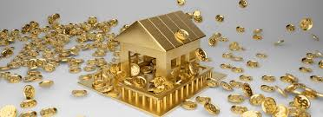
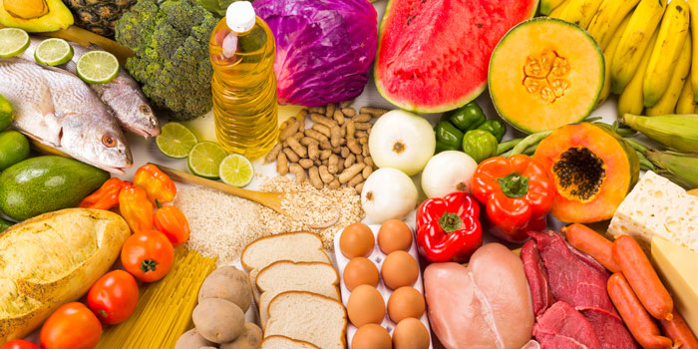
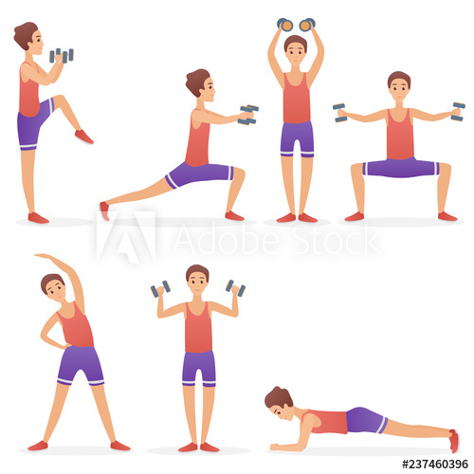
Look the pictures carefully
Do you like gold or wealth?
What do you see in the pictures?
Dear students, what do you like most? – wealth or health?
Gold
Wealth
Balanced diet
Exercise regularly
A proverb goes, “Health is Wealth”. It means health is equally valuable as gold or any other personal possessions. We may have vast wealth and property, but if we are not healthy we can not enjoy them.
To keep ourselves healthy, we have to do certain things. We have to take a balanced diet. We must exercise regularly to keep our body fit for work.

Slide 14
Pair works 5mins.
Answer the following questions.
Q1. Why is good health essential for us?
Q2. Why is physical exercise necessary?
Check your answer
Ans1: Good health is essential for us to lead a
healthy and happy life.
Ans2: Physical exercise is necessary to keep our
body fit for work.

Slide 15
Dear students, lets watch a video.
Dear students, do you go early to bed and early to rise?
When do you go to bed?
When do you get up?
There is an old saying: ‘Early to bed and early rise
Makes a man healthy, wealthy and wise.’
So, we should not keep late hours. We should go to bed early at night and rise early in the morning. Peace of mind is another condition for good health. So we must not worry over small things of life.

Slide 16
Group work
6 mins
Answer the following questions
Q1. What is the meaning of proverb, ‘Health is wealth’?
Q2. What do you understand by ‘Good Health’?
Check your answers
Ans1. The meaning of proverb ‘Health is wealth’ is health is equally valuable
as gold or any other personal possessions. This is said because one can
not enjoy one’s vast wealth unless one possess good health.
Ans2. By ‘Good Health’ we mean healthy body free from diseases. It refers to
soundness of body and mind.

Slide 17
A healthy person is one who ----
i. is physically and mentally sound ii. eats good food iii. has a lot of
wealth. iv. is over wealth
(b) The phrase ‘to keep late hours’ means----
i. to go to bed late ii. to wake up late in the morning iii. to do things
late always iv. to be late for the class
(c) We need to eat -----
i. rich food ii. balanced diet iii. little food iv. lot of food
(d) Possession means ----
i. estate ii. foundation iii. state iv. step
(e) Essential means -----
i. rare ii. avoidable iii. uncommon iv. necessary
(f) Disease –free body is recognized as ---
i. health ii. poor health iii. sound health iv. bad health
(g) To keep ourselves healthy, we have to take ----
i. physical exercise ii. balanced diet iii. rich food iv. Both (i) and (ii)
Tick the best answer.
$$$$
$$$$
$$$$
$$$$
$$$$
$$$$
$$$$

Slide 18
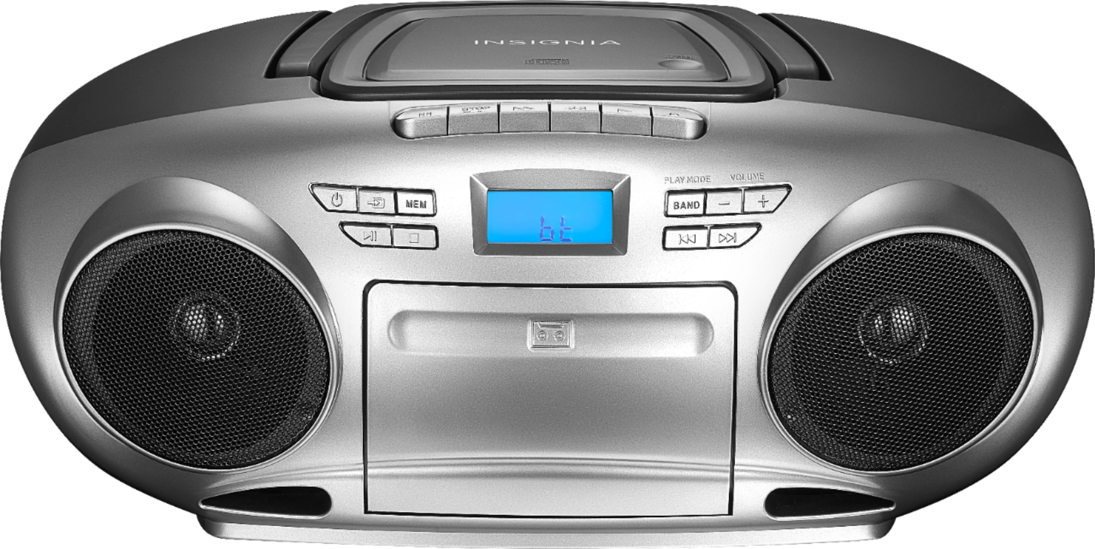
Now fill the passage from your listening.
Evaluation
Listen to the CD
Good health means healthy body free from (a) --- . It is the most precious (b) ---of a man’s life. Money, wealth property everything is useless to an (c) ----man. So, everyone should follow the rules of health to (d) ---- a healthy life. Eating a (e) ---- diet and taking regular physical exercise come first in the matter of following the rules of health.

Slide 19
Check your answers
Good health means healthy body free from (a) diseases. It is the most precious (b) possession of a man’s life. Money, wealth property everything is useless to an (c) unhealthy man. So, everyone should follow the rules of health to (d) maintain a healthy life. Eating a (e) balanced diet and taking regular physical exercise come first in the matter of following the rules of health.

Slide 20
Homework
Stay home
Stay safe
Write the main idea of the text you have read.

Slide 21
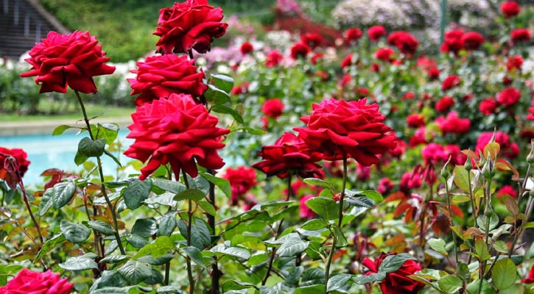
Thanks

