Slide 1
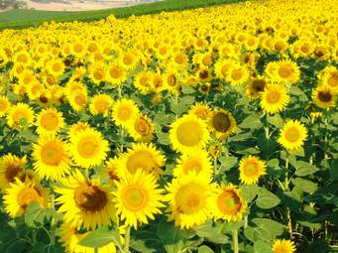
WELCOME

Slide 2
Presented by-
Md.Ali Hossain Pathan
Assistant Teacher
Chowra Nayabari Gps.
Kaligonj, Gazipur.

Slide 3
Lesson Identity
Class:two
Subject: English
Unit:Three
Lesson:4-5(A)

Slide 4
Learning outcomes
At the end of the lesson students will be able to :
Listening
1.1.1 become familiar with English sounds listening to common English words.
Speaking
1.1.1 repeat after the teacher simple words and phrases with proper sounds and stress .
1.1.2 say simple words and phrases with proper sounds and stress.
Reading
1.2.1 recognize and read the alphabet both small and capital(non-cursive).
1.3.1 recognize and read the names of objects having the same initial and final sounds.

Slide 5
Let’s see the video.
https://www.youtube.com/watch?v=wDeZMAcuVyk
Link
Alphabet song.

Slide 6
Today’s lesson
Alphabet
Kk---Oo

Slide 7
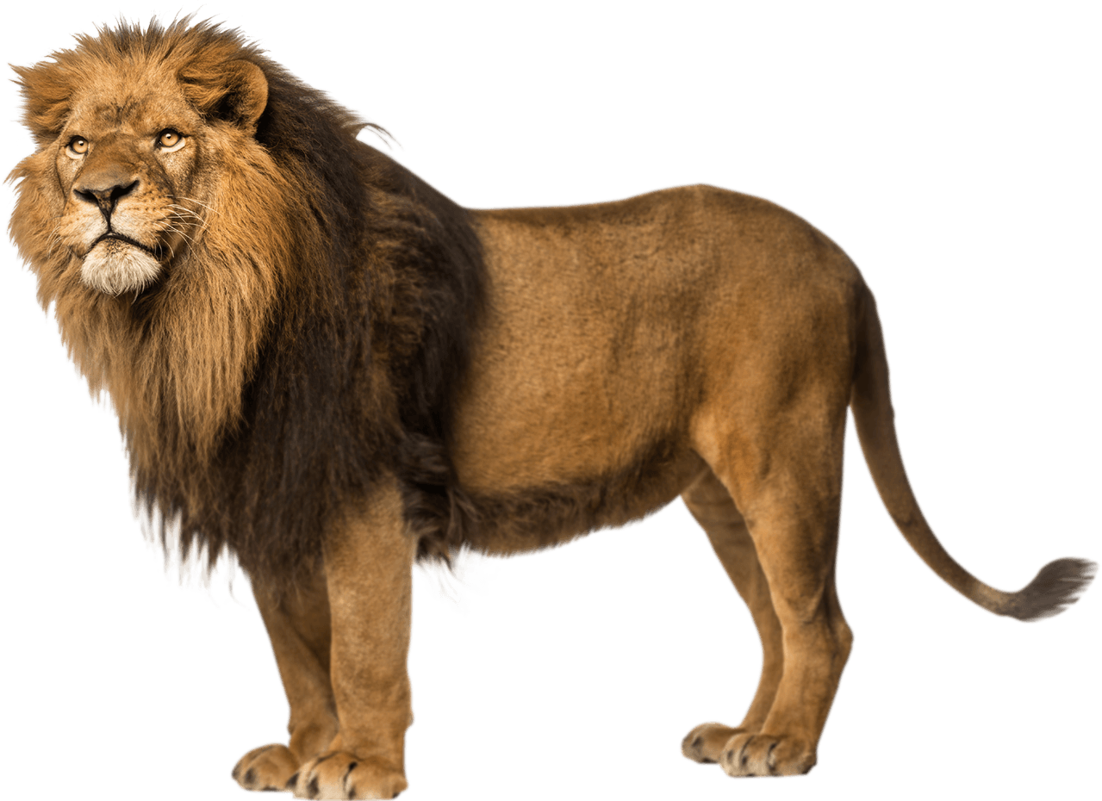
What is this?
What is this?
Kite
Lion

Slide 8
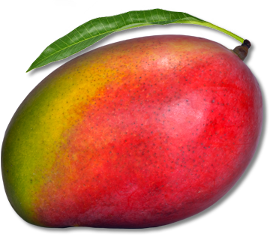
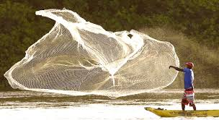
What is this?
What is this?
Mango
Net

Slide 9
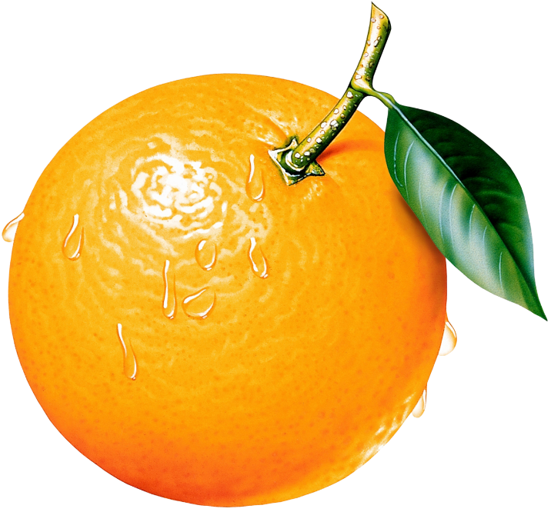
What is this?
Orange

Slide 10
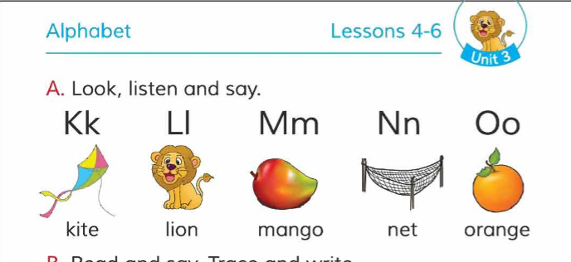
My dear student’s. Open your English book at page 2 and look activity A.

Slide 11
Loud reading by the teacher.
K kite | L lion
M mango | N net
O orange

Slide 12
Look at the picture’s and fill in the gaps.
IW
mango
kite
net
lion
orange

Slide 13
WCW
What can you see ?
kite
What is the letter’s name?
Kk
k
What is the letter’s sound?

Slide 14
WCW
What can you see ?
lion
What is the letter’s name?
l
Ll
What is the letter’s sound?

Slide 15
WCW
What can you see ?
mango
What is the letter’s name?
m
Mm
What is the letter’s sound?

Slide 16
WCW
What can you see ?
net
What is the letter’s name?
n
Nn
What is the letter’s sound?

Slide 17
WCW
What can you see ?
orange
What is the letter’s name?
Oo
o
What is the letter’s sound?

Slide 18
Match the words with the letter
PW
Kk
orange
Ll
net
kite
Mm
lion
Nn
Oo
mango

Slide 19
Evaluation
What is this ?
kite
What is this ?
net
What is this ?
orange

Slide 20
Evaluation.
Fill in the blanks.
Kk
Ll
Mm
Nn
Oo

Slide 21
Thank You

