Slide 1
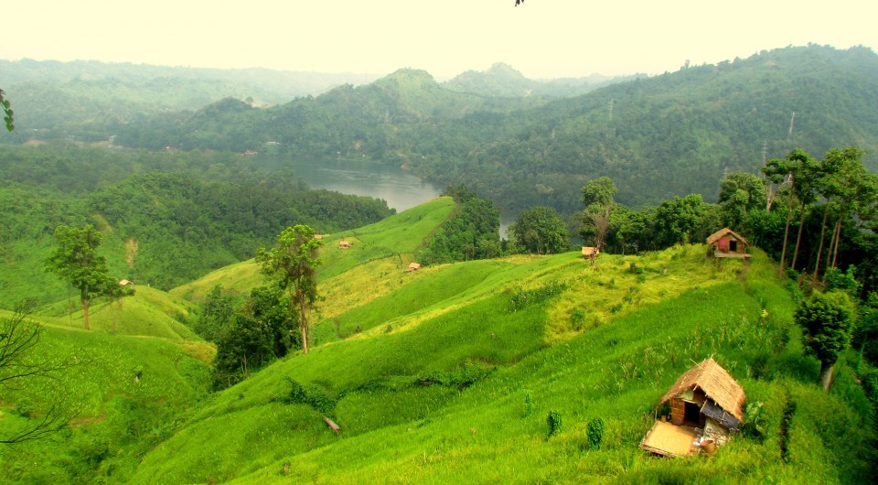
WELCOME

Slide 2
INTRODUCTION
Class: Eight
Sub: English 1st Paper
Hosne Ara
Assistant Teacher (Eng)
Kumarkhali M. N. Pilot Model High School
Kumarkhali

Slide 3
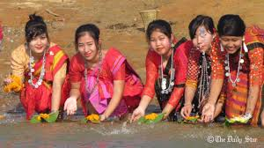
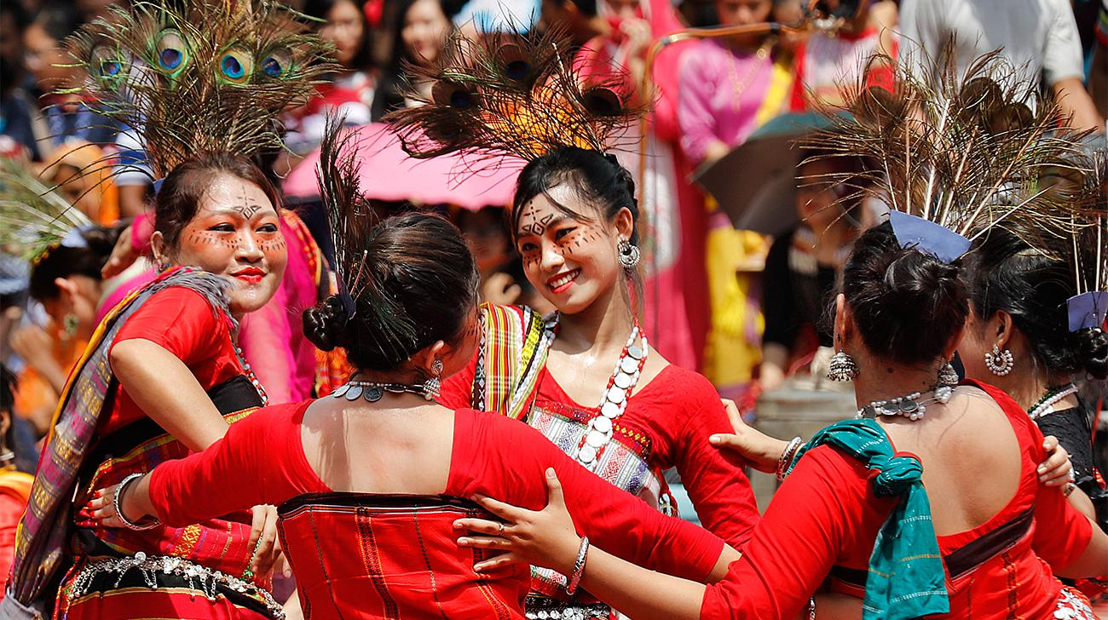
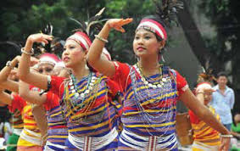
Let’s see some pictures

Slide 4
Our Ethnic Friends(1)
Unit- 1, Lesson-3

Slide 5
Objectives
By the end of the lesson SS will be able to….
Tell the meaning of some new words
Ask and answer some questions
Identify different ethnic people
Summarise the passage

Slide 6
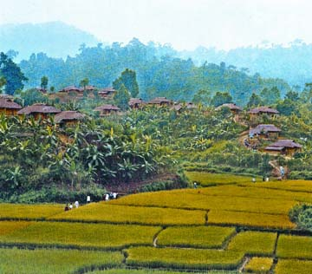
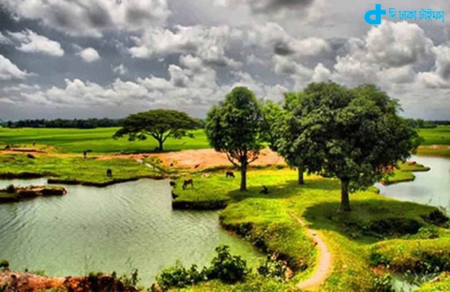
Vocabulary
Ethnic
Racial, National
Area
Region
Rural
Rustic

Slide 7
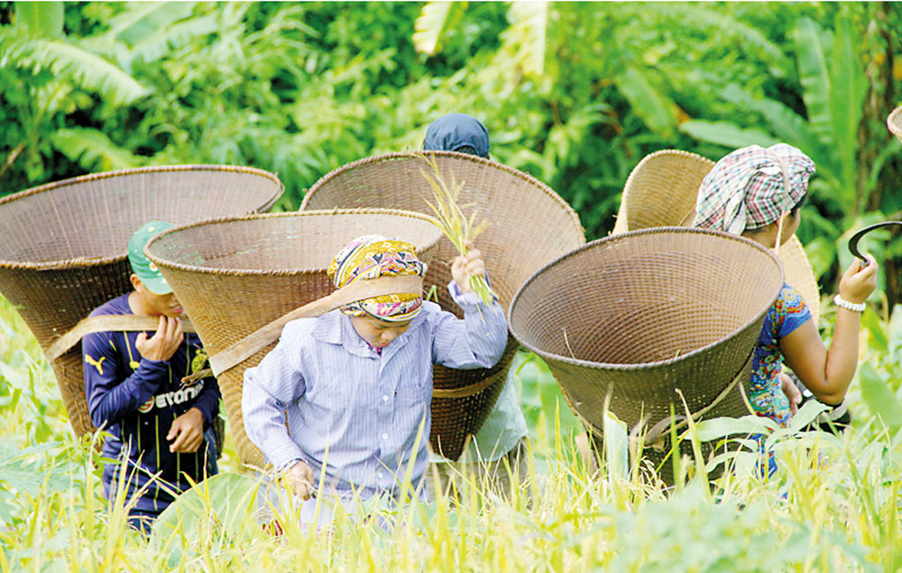
Our Ethnic Friends
hold an important place in the culture of our country

Slide 8
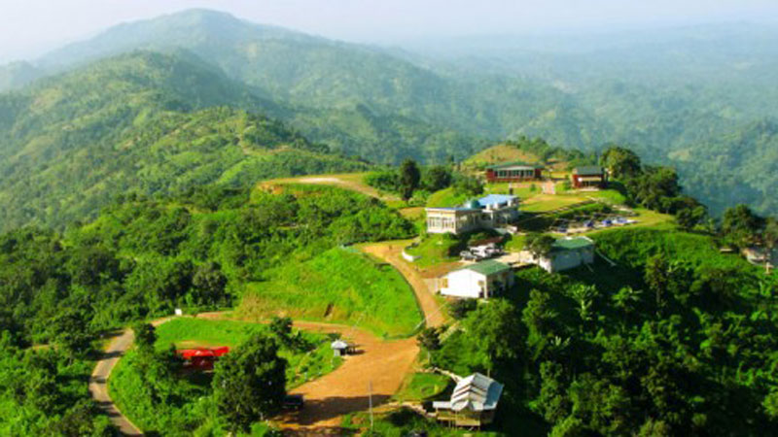
Majority of them live
Chattogram Hill Tracts
Mymensingh
Rajshahi
Sylhet
Others live

Slide 9
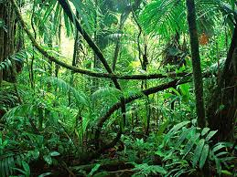
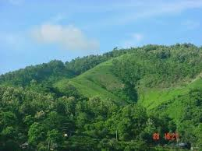
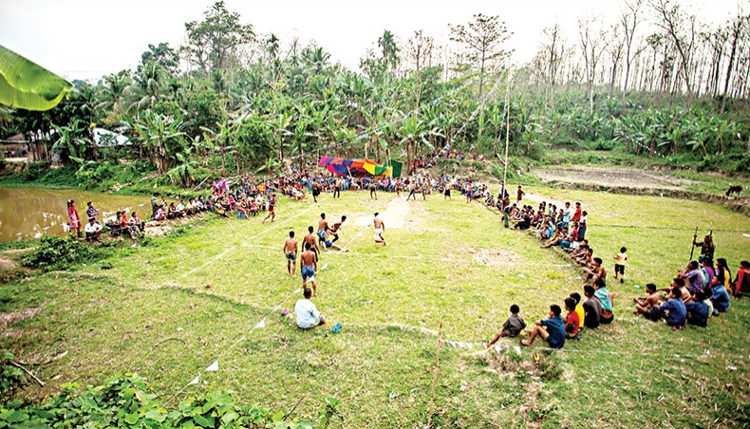
Forest
Hill
Living Place
Rural areas

Slide 10
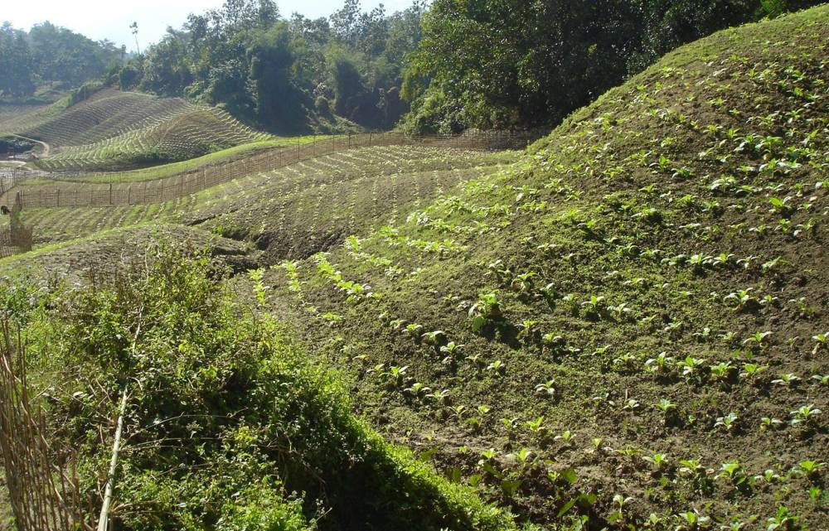
Profession
Most of them are farmers
They do jhum cultivation

Slide 11
Religion
Hindu
Buddhist
Christian
Language --They speak their own mother tongues

Slide 12
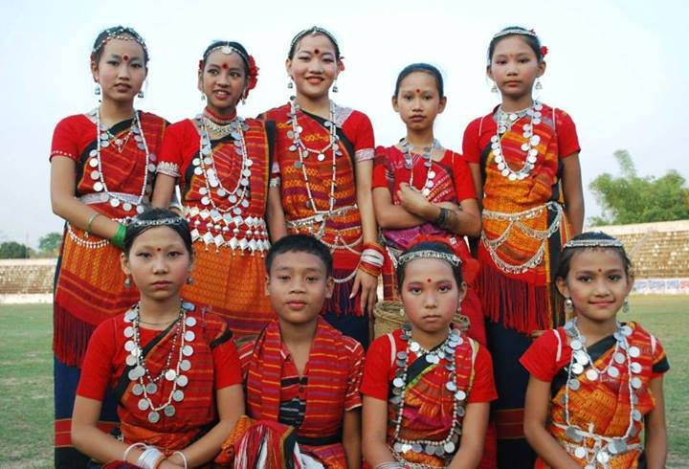
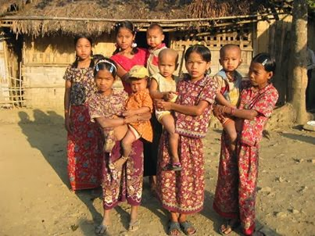
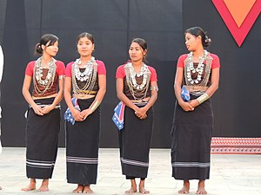
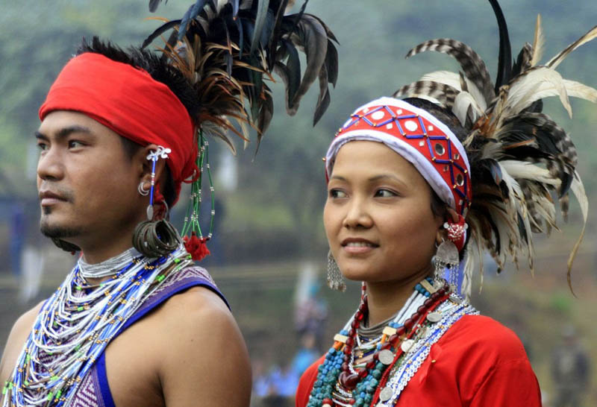
Ethnic People
Living Place
Chakma
Marma
Hill Tracts
Tipperas
Moorangs

Slide 13
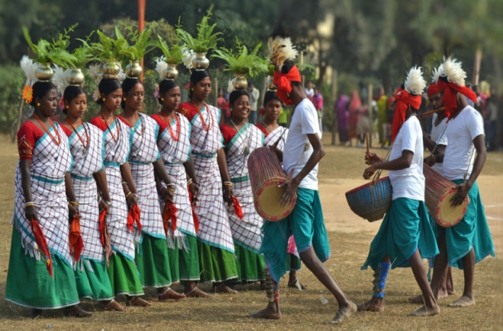
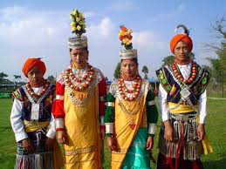
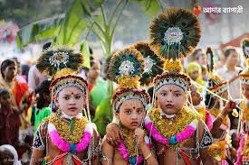
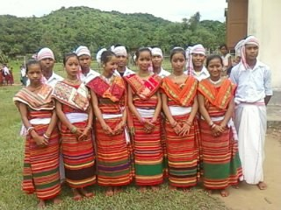
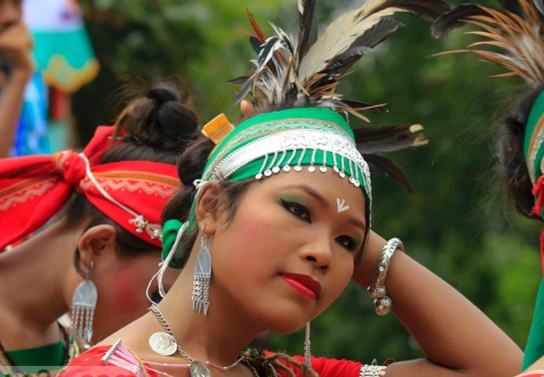
Rajshahi
Santals
Live in
Sylhet
Khasias
Monipuris
Mymensingh
Hajangs
Garo

Slide 14
Pair Work
Read the text silently and answer the following questions
Write down the name of six ethnic groups and their living places in Bangladesh

Slide 15
Evaluation
Where do you find the Marmas?
What language do they speak at home?
Who live in Rajshahi?
Where do they do jhum cultivation?

Slide 16
Home work
Write a summary of the passage
“Our Ethnic Friends”

Slide 17
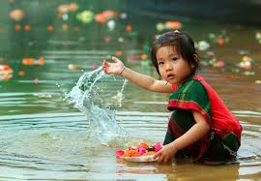
SEE YOU AGAIN

