Slide 1
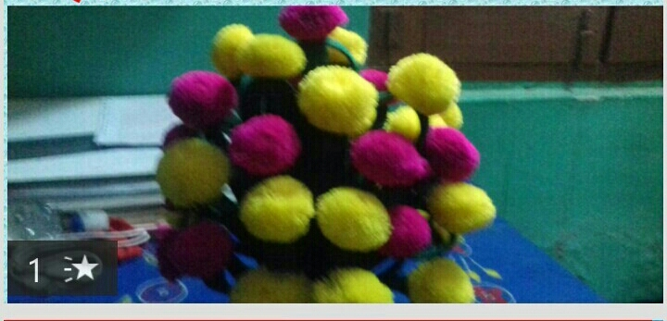
Welcome to all.

Slide 2
TEACHER IDENTITY
Lesson Identity
English 2nd Paper
Class: Six
Title : Transformation of Sentence (Assertive to Interrogative )
Time: 45m
MD.NAZRUL ISLAM
ASSISTANT TEACHER
KATIPUR KALINAGAR HIGH SCHOOL ,PORSHA, NAOGAON.
Nazrul.kkhs@gmail.com

Slide 3
Read the following sentences
Karim is a student of class 6.
He is a regular student.
He is an honest boy.
He respects the teachers.
Everybody loves him.
Nobody dislikes him.
What kind of Sentences Are these ?
ASSERTIVE

Slide 4
Today our Topic is ASSERTIVE TO INTERROGATIVE Sentence.

Slide 5
Learning outcomes:
By the end of the lesson students will be able to
Identify The Assertive and interrogative sentence.
Narrate how to change into interrogative sentence
to change interrogative sentence from Assertive sentence.

Slide 6
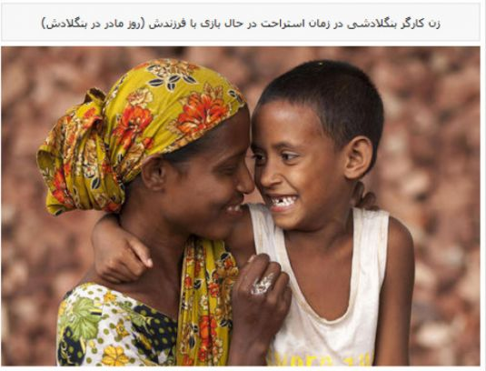
Every mother loves her child (interrogative)
Who doesn‘t love her child ?
Who doesn‘t will be used in lieu of Every /Some+related word such as body/one/mother....
But if there is auxiliary verb does won‘t be used.

Slide 7
Nobody likes her (interrogative )
Who likes her ?
Who will be used in lieu of No+related word such as body/one........

Slide 8
They are reading.
aren’t the reading ?
If there is auxiliary verb, it will be used at the beginning. If the statement is affirmative interrogative will be negative,if negative interrogative will be affirmative.

Slide 9
They read in a primary school.
Don’t they read in a primary school?
Don’t /doesn‘t /didn‘t according to subject &verb, will be used if the statement is with main verb .

Slide 10
Evaluation
Individual work
Transformation the following sentences into interrogative.
Every body respects him.
No one can do it.
You must obey your parents.
They went to Dhaka.
He has done the work.

Slide 11
THANK YOU ALL

