Slide 1
Welcome to My Multimedia Classroom

Slide 2
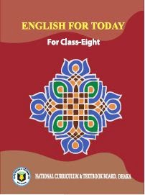
Teachers information
SABUJ MISTRY
AST:TEACHER
ID NO:341
BETKA MAHMUDIA DAKIL MADRASHA
Class : viii
Leason 2
Subject : English 1st paper

Slide 3
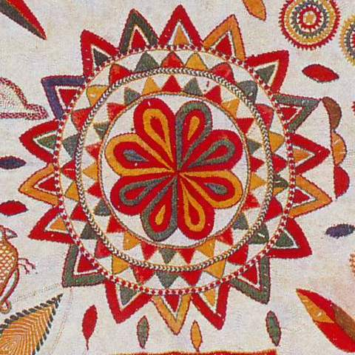
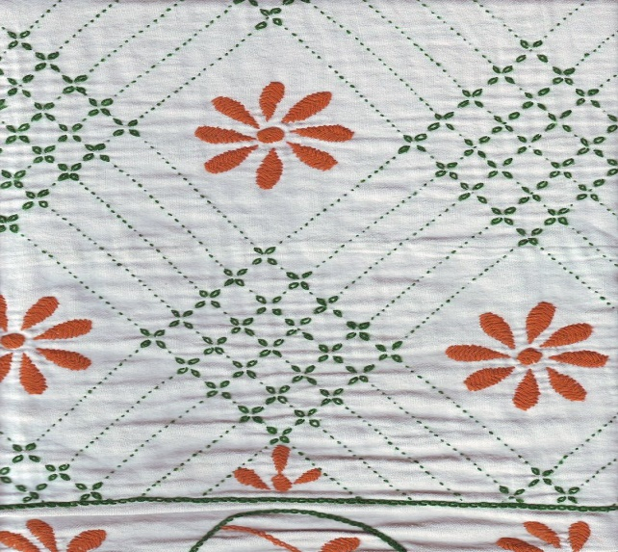
1. What is called it?

Slide 4
Today we are going to read about-
Nakshi Kantha

Slide 5
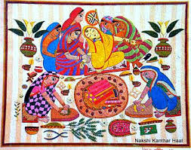
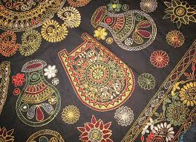
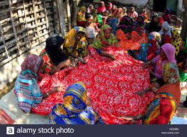
Look at the pictures and questions. Then ask and answer the questions with your partner.
1. What do you see in the picture?
2. What is called it?

Slide 6
Famous district for Nakshi Kantha
Nakshi Kantha
Mymensingh
Jamalpur
Rajshahi
Faridpur
Bogura
Jashore

Slide 7
Learning Outcomes;
After we have studied this lesson, we will be able to :
be familiar with Nakshi Kantha.
improve our vocabulary .
Understand text by silent reading.
write a paragraph about Nakshi Kantha

Slide 8
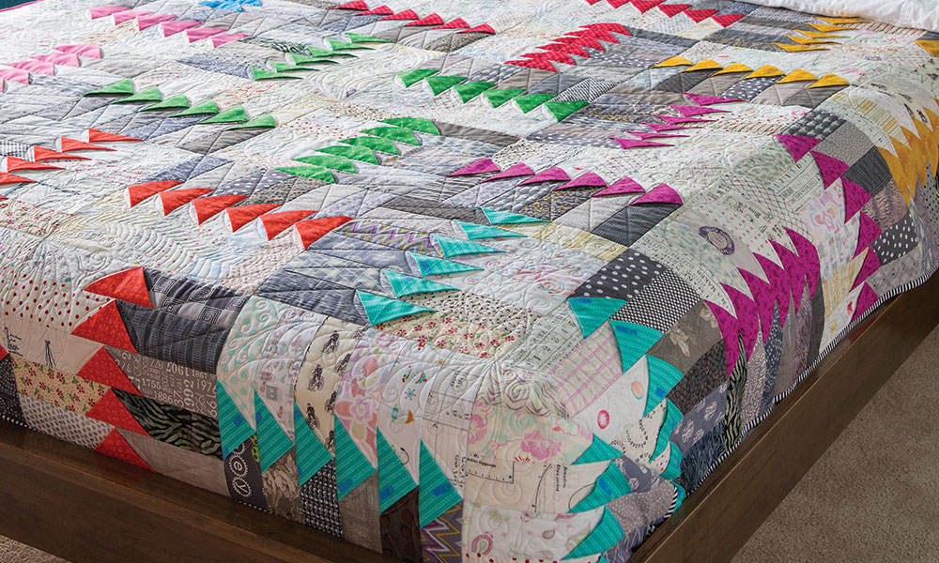
Let’s see the key words of the passage
Key Words
Quilt
Quilt
a knitted or fabric bedspread with decorative stitching

Slide 9
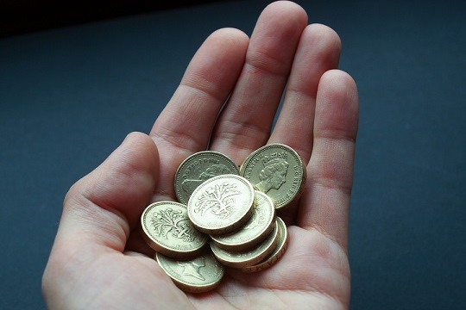
Key word
Commercially
in a way that is concerned with buying, selling, and making a profit.

Slide 10
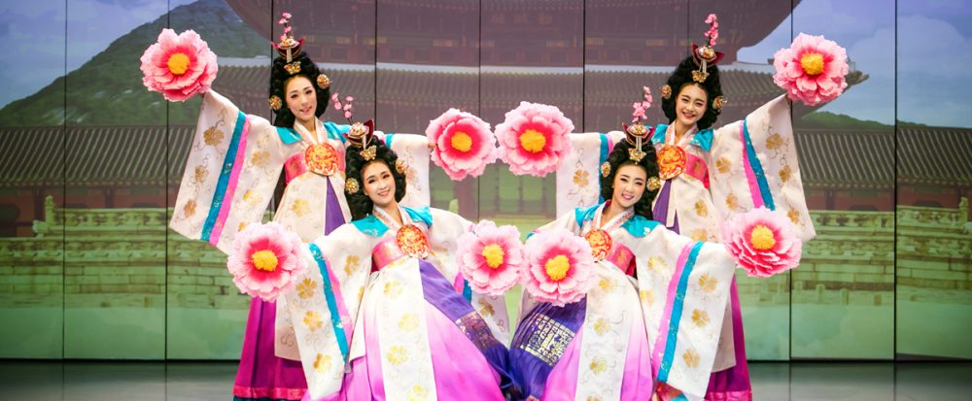
Key word
Traditionaly
existing in or as part of a tradition; long-established

Slide 11
Individual Work
Complete the following sentences with the clues given
quilt
rural
Bengali
Patterns
years
expensive
1 Naksha means artistic ----------------
2 The name was taken from a --------------- word ------------
3 The art has been practiced in -------------- Bengal for --------
4 Nakshi kanthas are now sold in ------------- shop
5 Nakshi Kanthas are a kind of -------

Slide 12
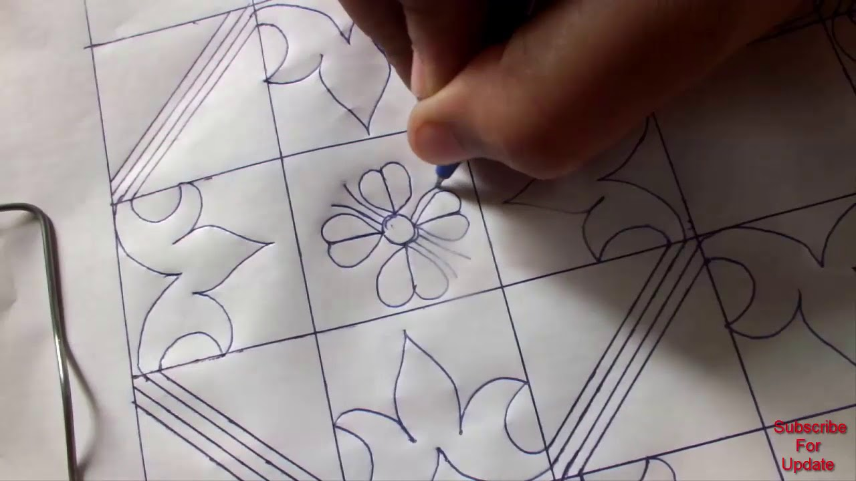
Home Work
Write a paragraph about
“How to make a Nakshi Kantha”.

