Slide 1
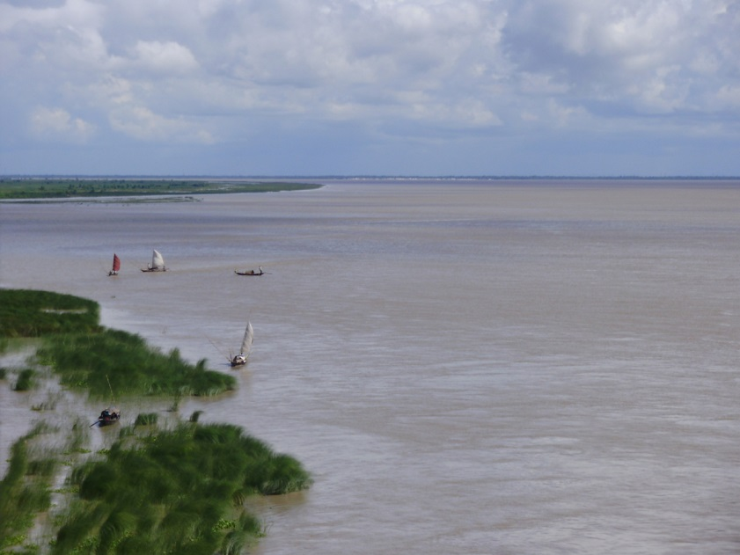
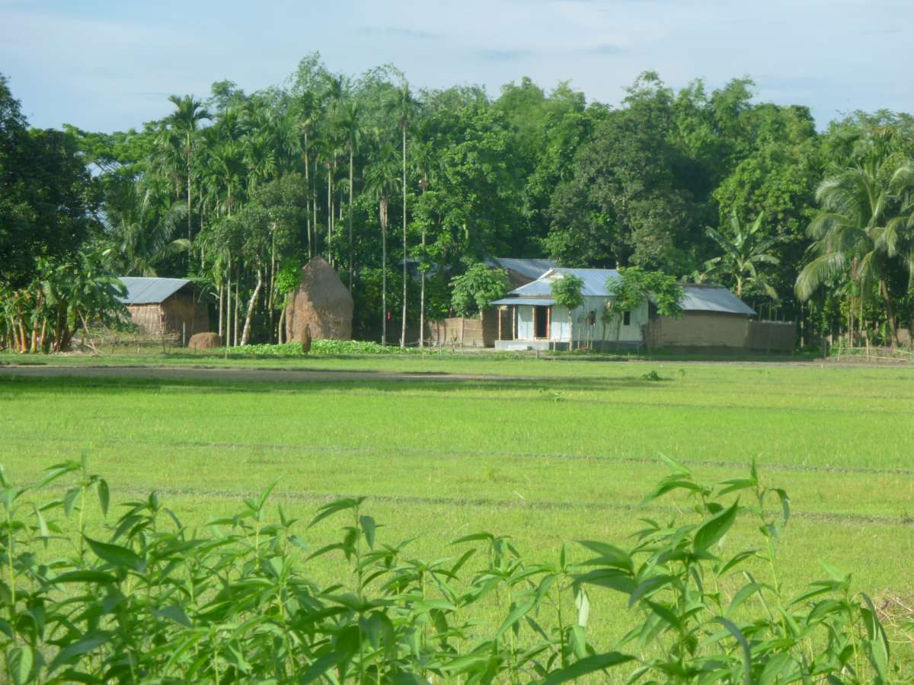
W
E
L
C
O
M
E

Slide 2
Introduction
Kazi Umme Kulchum
Assistant Teacher
Suapara G.K High School
Shahrasti,Chandpur.

Slide 3
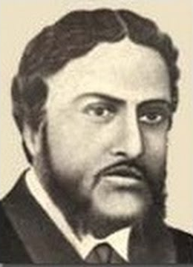
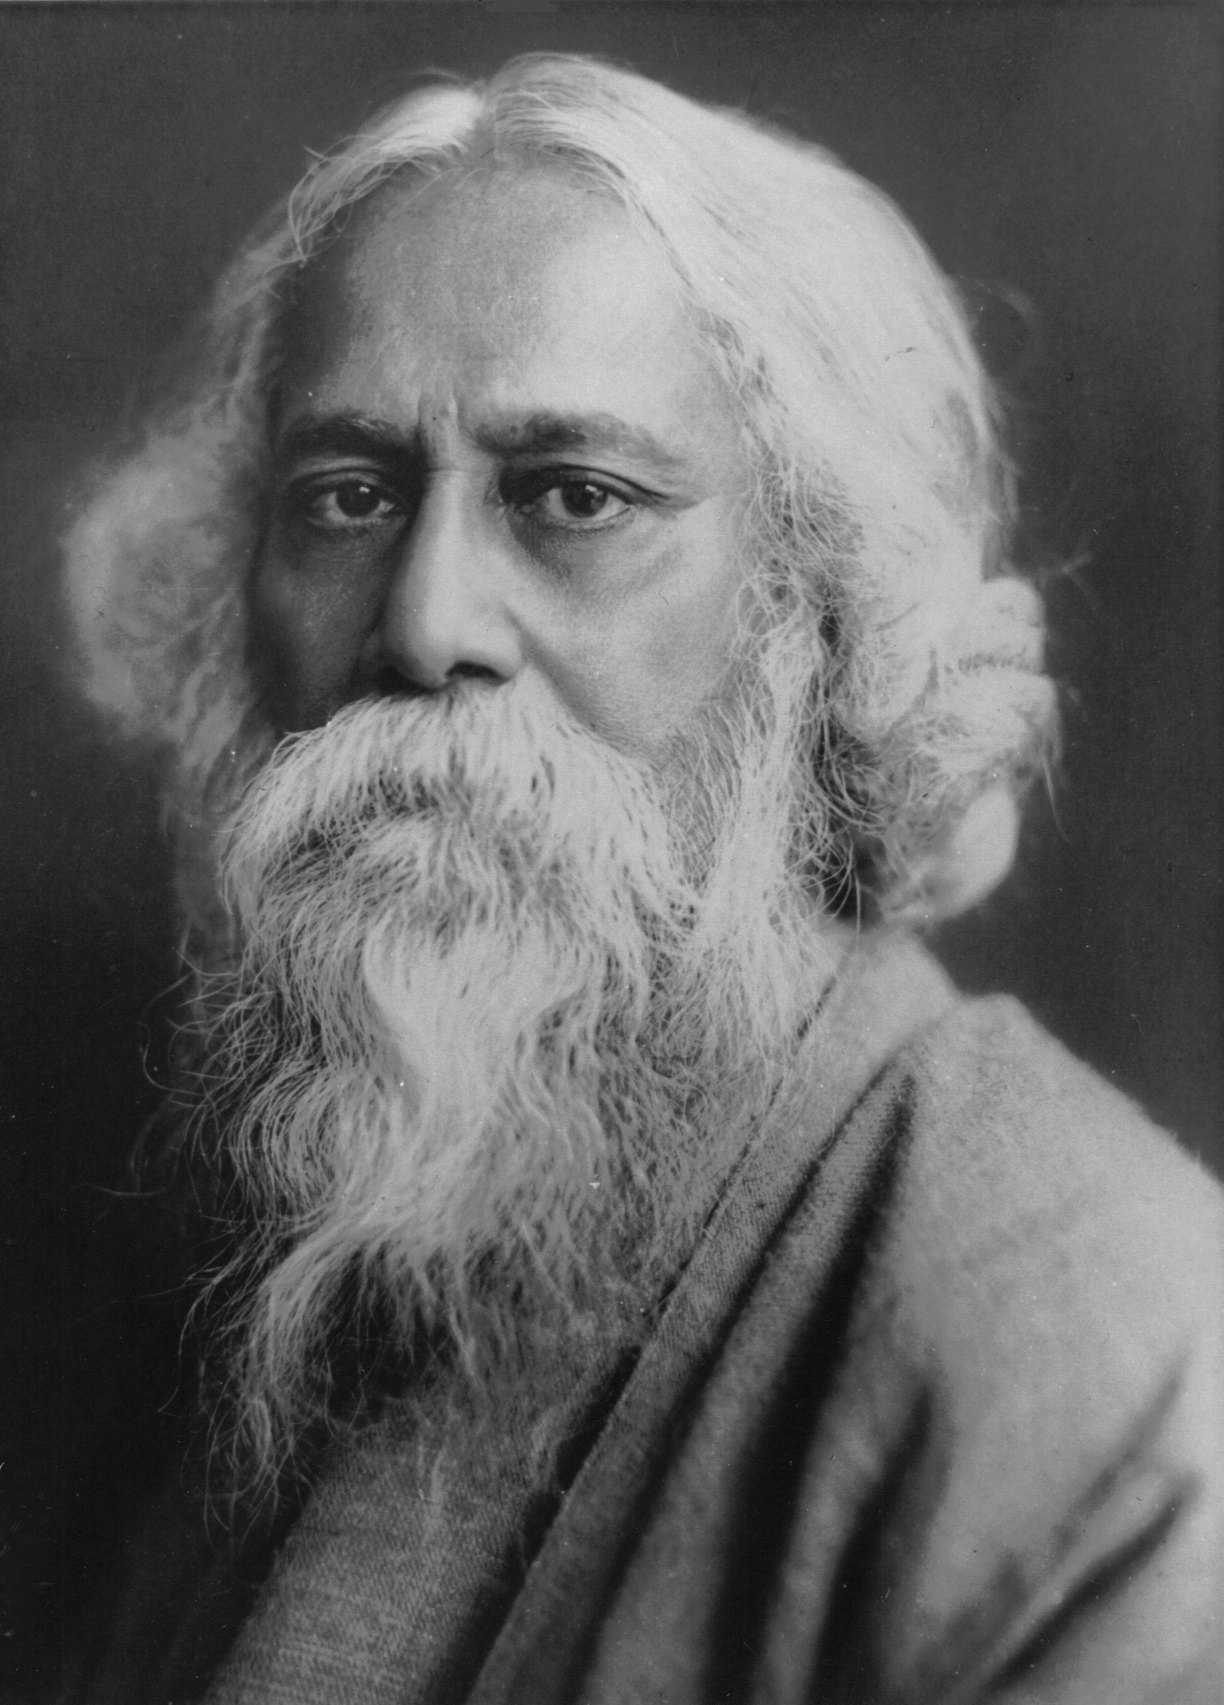
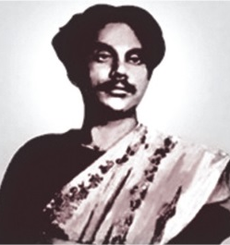
Who is the sonnet writer out of them?
Michael Madhusudan Dutt

Slide 4
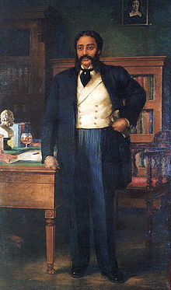
took education from Europe
Some information about Michael Madhusudan Dutt
felt for his motherland and returned home
wanted to be like an Englishman
not appreciated for his deeds
wrote many English poems and dramas

Slide 5
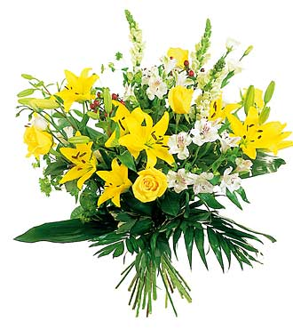
Today our topic is
The return of the native
Unit- 12
Lesson- 3

Slide 6
Learning Outcomes Of The Lesson
After this lesson the students will be able to-
1. talk about the pictures.
2. read and a text and find out information.

Slide 7
Listen to the audio about Michael Mahusudan Dutt and choose the best answer.
1. Michael Madhusudan Dutt’ father was a _______ .
a) doctor b) teacher c) business man d) lawyer
$$$$
2. He was a pioneer of __________ .
a) Bengali poem b) Bengali drama
c) Bengali novel d) English drama
$$$$
3. His famous work ‘Meghnad Bodh’ is a _____ .
$$$$
a) tragic epic b) comic epic
c) tragic drama d) comic drama
4. He also wrote poems about __________ .
a) the sorrows and joys of love
b) the sorrows and affluences of love
c) the sorrows and afflictions of love
$$$$

Slide 8
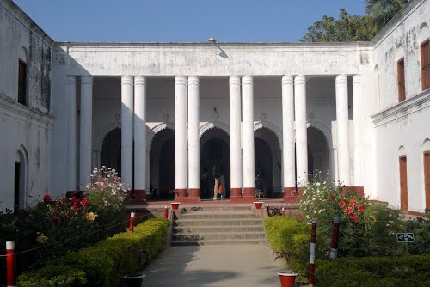
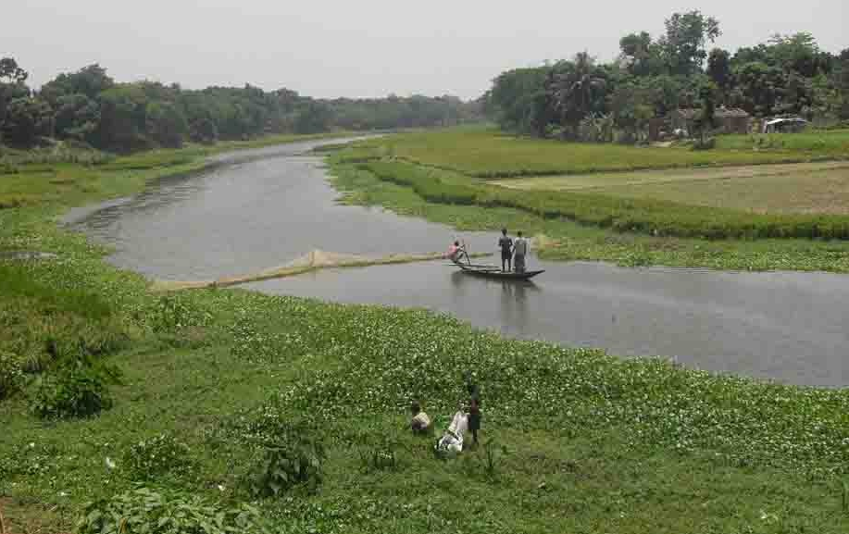
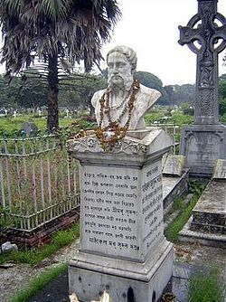
What do you see in the pictures?
Michael Madhusudan Dutt’s residence
Kopotaksha river
His statue
Notes:
The teacher can ask the students to describe the pictures.

Slide 9
Read the text in the book and write the answers of the following questions.
Q 1. How was the reaction of Michael Madhusudan Dutt’s family when he took Christianity?
Q 2. What was his attitude to his root in his adolescence?
Q 3. Why did he compose “Kopotaksha Nad”?

Slide 10
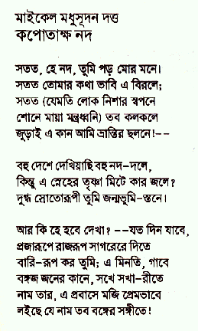
Read some information on Michael. Make questions for the statements.
a) _____________________ ?
1. Michael Madhusudan Dutt composed a sonnet in Bangla named “Kopotaksha Nad”.
Notes:
Answers may vary here.

Slide 11
Read some information on Michael. Make questions for the statements.
b) ____________________________ ?
2. His famous satiric drama is “Buro Shaliker Ghare Row”.
Notes:
Answers may vary here.

Slide 12
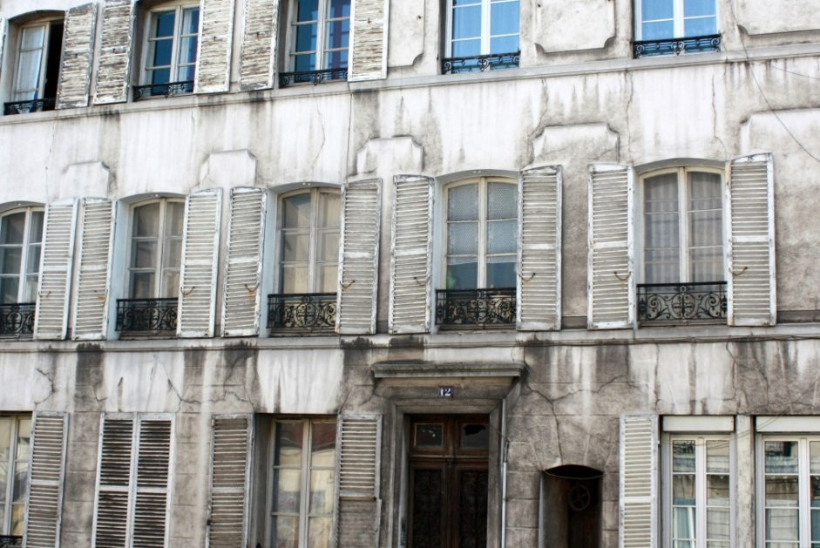
Read some information on Michael. Make questions for the statements.
c) ____________ ?
3. He lived at 12 Rue Des Chantiers, 78000 Versailles, France.
d) ___________________________ ?
3. His days in Europe were not good.
Notes:
Answers may vary here.

Slide 13
Pair work
Go to the text book section C. Make questions for the statements given there.

Slide 14
Evaluation
1.Where did Madhusudan born?
2.What was he famous for?

Slide 15
Home work
How the story of Michael is related to the unit theme Roots.

Slide 16
Thank You All

