Slide 1
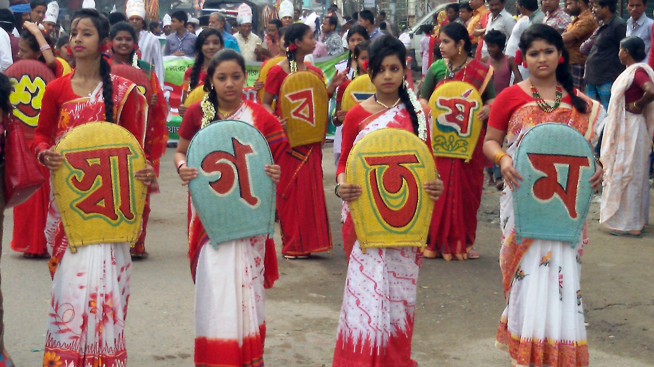

Slide 2
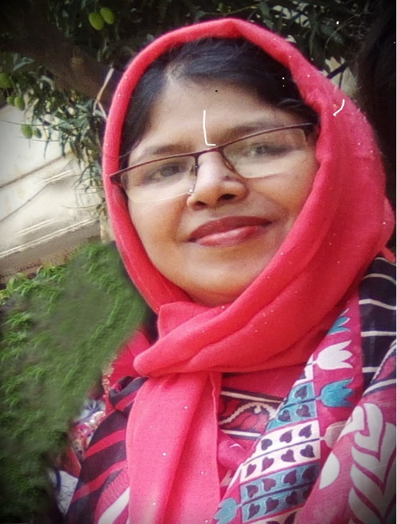
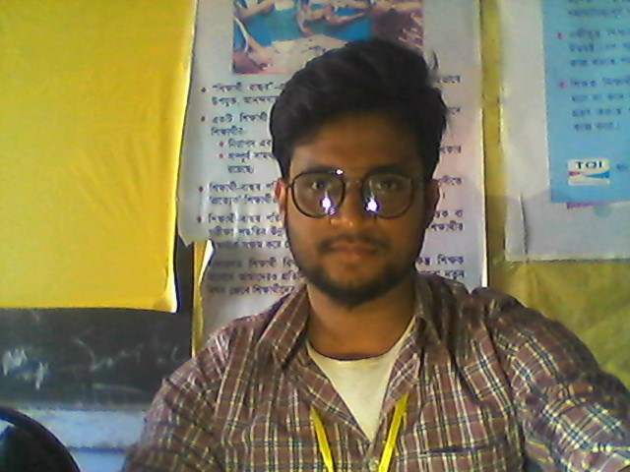
IDENTITY OF TEACHER:
ASMA HUQ
Asst. teacher,English.
Motijheel Govt. Girls’ High School,Dhaka.
EDITING BY RIYAJUL ISLAM
Assistant Teacher ( English)
K M Zakir Hossain Jr Girls School
Muksudpur , Gopalganj

Slide 3
INTRODUCTION OF THE LESSON:
CLASS:NINE
SUBJECT : ENGLISH 1ST
UNIT : THREE
LESSON : SIX

Slide 4
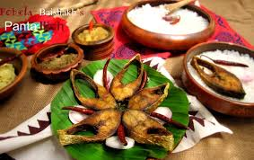
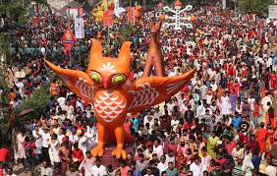
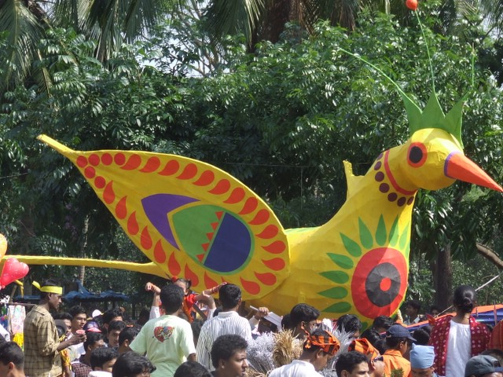
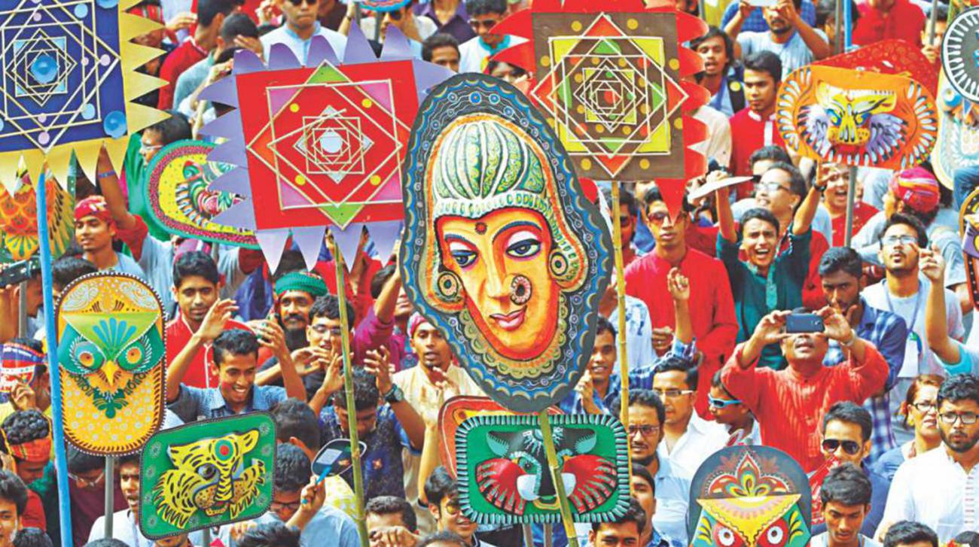
See the pictures:

Slide 5
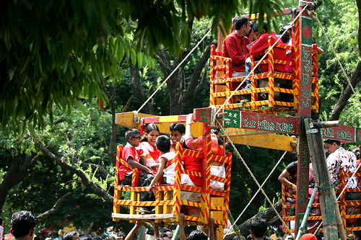
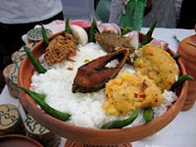
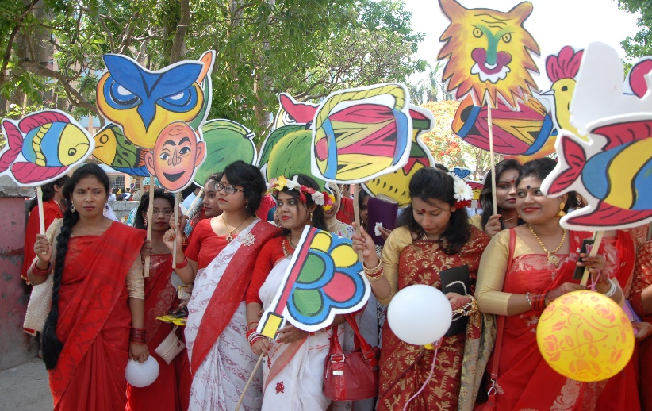
TODAY WE ARE GOING TO READ ABOUT
‘PHOHELA BOISHAKH’

Slide 6
LEARNING OUTCOMES:
After reading the lesson students
will be able to--
Talk about events and festivals
Ask and answer questions.

Slide 7
LETS WATCH A VIDEO

Slide 8
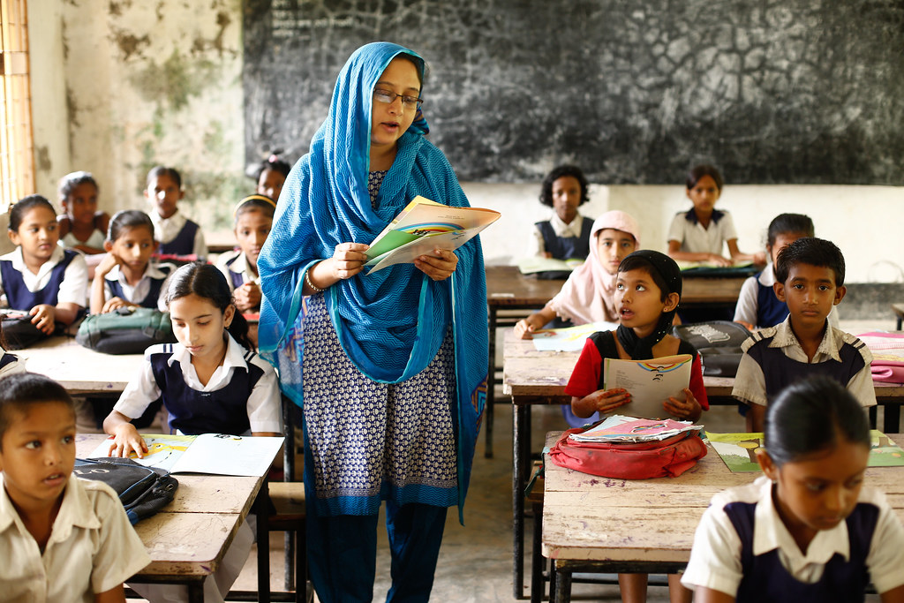
Loud reading

Slide 9
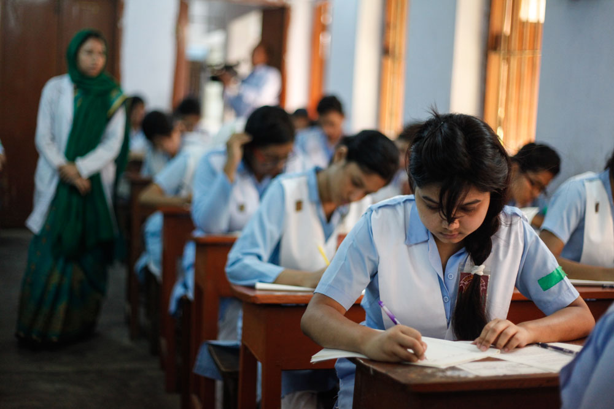
SILENT READING
Read the text at page 39 silently.

Slide 10
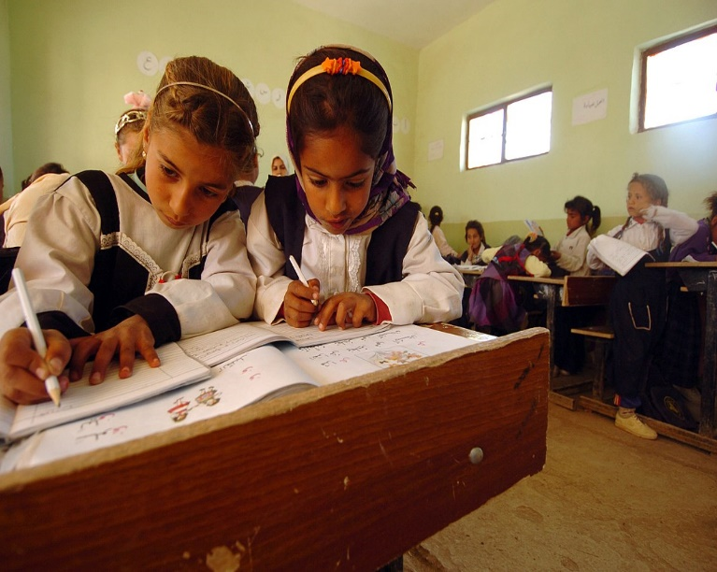
PAIR WORK:
Choose the correct answer from the following alternatives:
1.The word ‘special’means --------
Typical (b) normal
(c) Particular (d) definite
2.What does the word ‘unity’in the passage refer to?
Similarity (b) oneness
(c) same (d) unilateral

Slide 11
GROUP WORK:
I. How is Pohela Boishakh celebrated?
2.Describe the singnificance of Pohela Boishakh.

Slide 12
EVALUATION:
Fill in each blank with suitable word:
1.----- brings out a colourful procession.
2.On Pohela Boishakh people ----- traditional food.
3.The day is ----- all over the country.
Answer:
1.The Institute od Fine Arts 2.take 3. observed

Slide 13
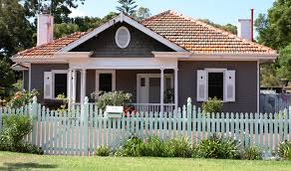
HOME WORK
Write a letter to your friend describing your experience of celebrating Pohela Boishakh .

Slide 14
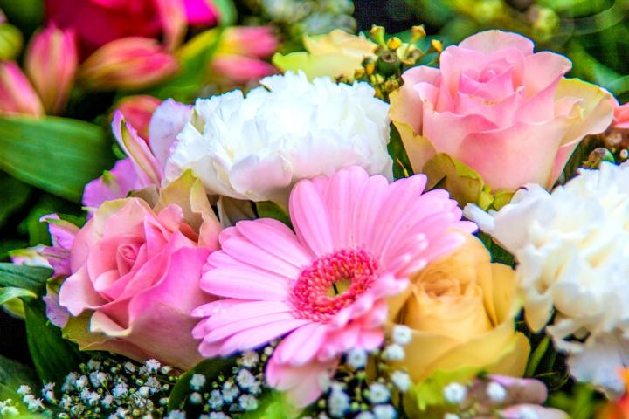
THANK YOU

