Slide 1
W
E
L
C
O
M
E
Notes:
The picture of Chittagong Hill Tracks.

Slide 2
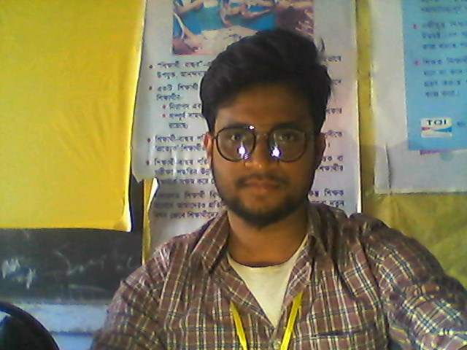
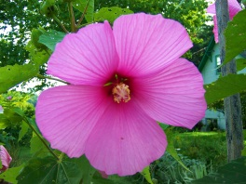
INTRODUCTION
RIYAJUL ISLAM
Assistant Teacher ( English)
K M Zakir Hossain Jr Girls School
Muksudpur , Gopalganj
CLASS: NINE-TEN
SUBJECT: ENGLISH 1ST PAPER

Slide 3
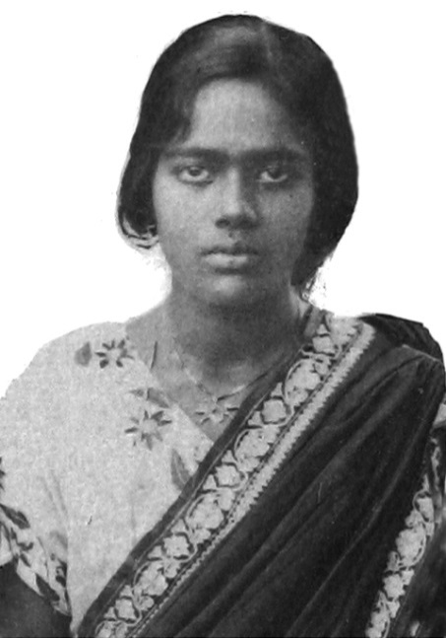
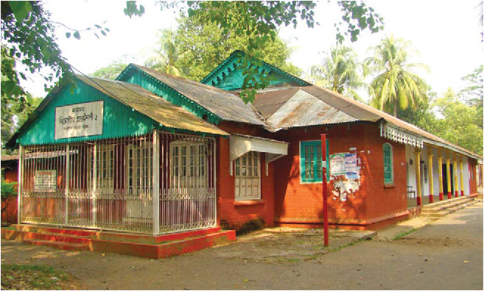
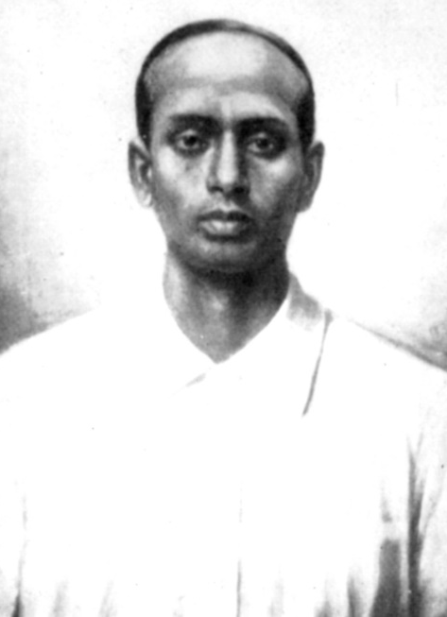
What do you know about them? Why are they well known?
Pritilota
Pahartali European Club
Surya Sen
Notes:
After the students talk about the pictures, the teacher can show their names and tell few information about the pictures, not in details.

Slide 4
Today our topic
They had dreams 1 (Pritilata)
Unit- 10
Lesson- 3

Slide 5
Learning Outcomes Of The Lesson
After this lesson the students will be able to-
1. talk about pictures.
2. listen for specific information.
3. read a text and find out information.
4. write about a person.

Slide 6
Lets watch a video about Reflection art of Pritilata--

Slide 7
Choose the best answer.
1. Pritilota’s father was a ___________.
a) teacher b) doctor c) clerk d) engineer
$$$$
2. When did she pass her matriculation?
a) in 1921 b) in 1927 c) in 1929 d) in 1932
$$$$
3. The Chhatri Sangha was led by ____________ .
a) Lila Nag b) Pritilata c) Kalayani Das d) Lata Nag
$$$$

Slide 8
Individual work
Read the text in the book and match the words in column A with the meanings in column B.

Slide 9
Read the text in the book and write the answers of the following questions.
Q 1. What did Pritilata dream for?
Q 2. Who was the mastermind of attacking of the Pahartali European Club?
Q 3. Why was the sign “Dogs and Indians not allowed” notorious?
Q 4. How did Pritilata prove that women can work like men?
Notes:
Answer may vary here.

Slide 10
Homework
Mention the name of a woman who is your ideal. Why is she your ideal? Write it in ten sentences.

Slide 11
Thank You

