Slide 1
My dear teachers who will use the content in their own classroom may explain all the words if needed.
My dear teachers are requested to follow the notes
given below the slides. Please give your like, comments and ratings to see my content.

Slide 2
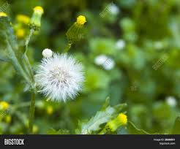
GOOD MORNING EVERY BODY

Slide 3
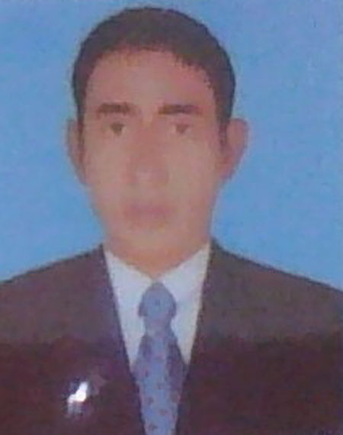
TEACHER IDENTITY
Md: Abdul Matin. Senior Assistant Teacher(English)
Raghunathpur high School
Nawabganj,Dinajpur
E-mail: abmatin1977@gmail.com
Phone:01823385723
UNIT:18
Lesson:10
E,F,T :Seven
(Grammar)
Topic :Tree plantation
Time :45
Date :14/03/2020

Slide 4
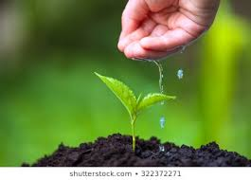
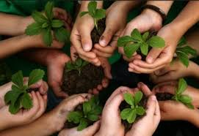
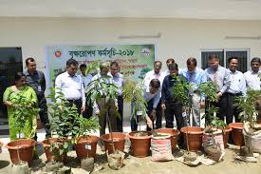
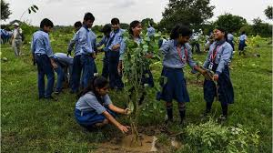

Slide 5
LESSON DICLARATION
So Today’s Our Lesson is ‘’TREE PLANTATION. ‘’

Slide 6
LEARNING OUTCOMES
By the end of lesson students will be able to learn …
1. Students say the usefulness of trees
2. Students tell the bad effect of cutting trees
3. Students ask and answer the questions
4. Students make a dialogue on tree plantation

Slide 7
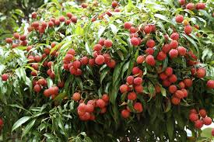
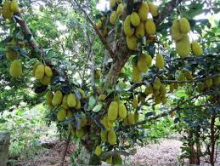
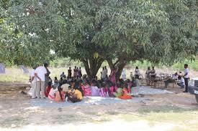
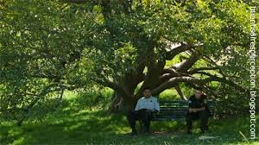
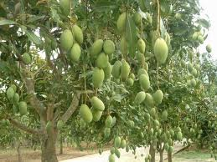
Trees give us shadow, Fruits, and Oxygen .

Slide 8
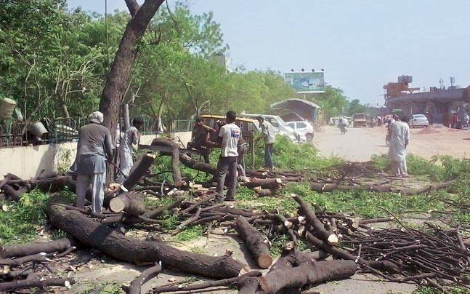
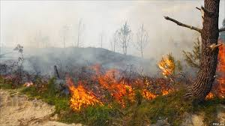
Cutting trees and Burning forest.

Slide 9
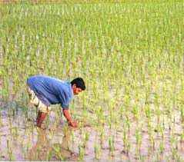
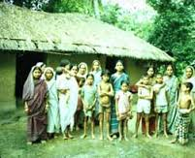
People need more foods and shelters

Slide 10
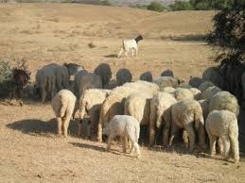
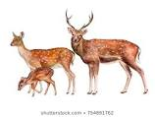
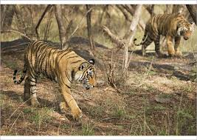
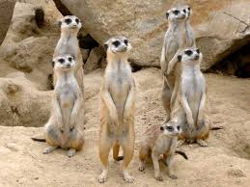
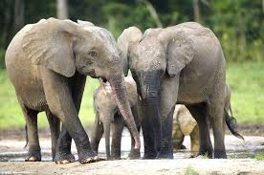
World animals are in great danger

Slide 11
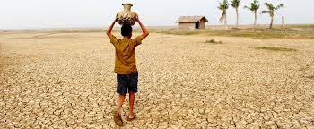
The country will turn into desert and destoryed.

Slide 12
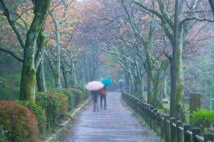
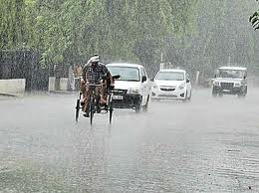
June- July is the best time for tree plantation in our country.

Slide 13
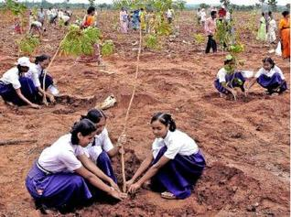
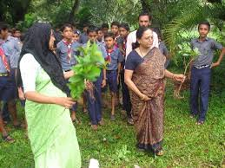
Let’s plant trees
Our slogan should be plant trees and save the environment also country.

Slide 14
Group work’s
Group
A
Group
B
Students will make dialogue on tree plantation with his partner.

Slide 15
Evaluation
a) What is tree plantation ?
b) What do trees give us ?
c) What is the bad effect of cutting trees ?

Slide 16
HOME WORK’S
Write a paragraph about ‘’ Tree plantation’’ (Five Sentences)

Slide 17
THANK’S

