Slide 1
Welcome

Slide 2
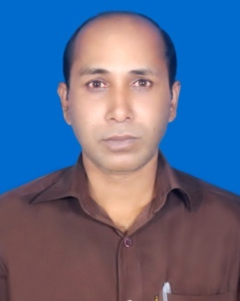
Manufacturer
Amor Kumar Mondol
Assistant Teacher
Goalunda Ideal High School
Goalunda, Rajbari
Bangladesh
Mobile : 01742-357477
Md.Bablur Rahaman
Ass.Teacher English
Alikadam Girls High School
Alikadam,bandarban
bablurrahaman2006@gmail.com
Editor
Md.Motaher Uddin Chowdhury
Assistant Molovi
Bahar Chowdhury Nuriya Dakhil Madrasah
Tingoriya tola,Moliaish,Mirsarai,Chattogram.
ID_819,Batch-28
Venu- T.T.C Chattogram
ICT Project-02
Mobile:018354345651
Email:motaher167@gmail.com

Slide 3
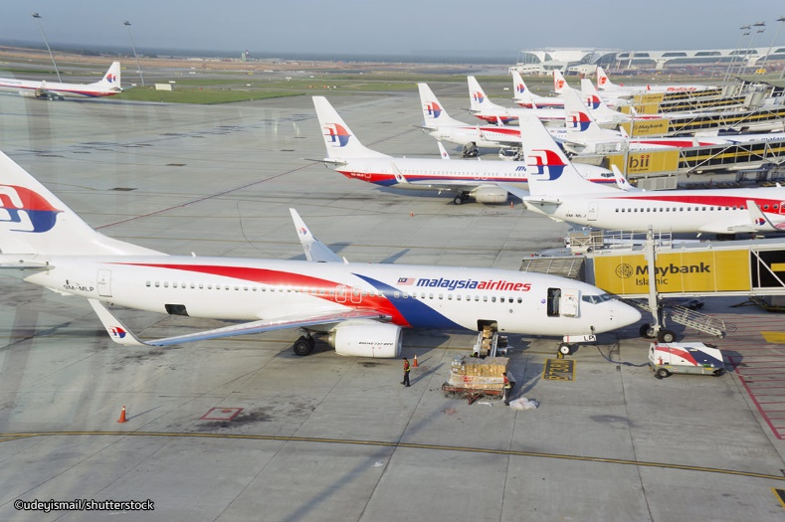
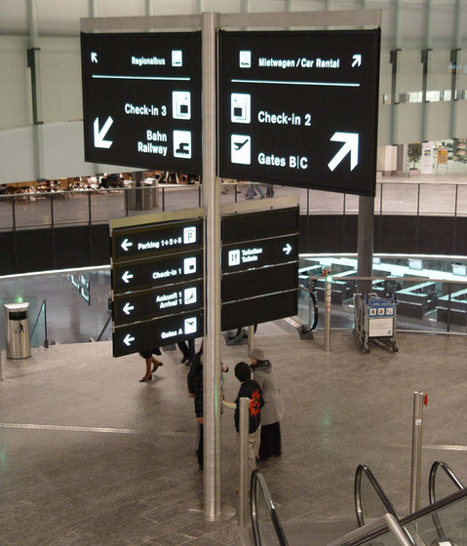
Let’s watch some picture? What types of picture this?
Airport
Air Port
Immigration room
Notes:
https://www.youtube.com/watch?v=YN4GJTA5NxM

Slide 4
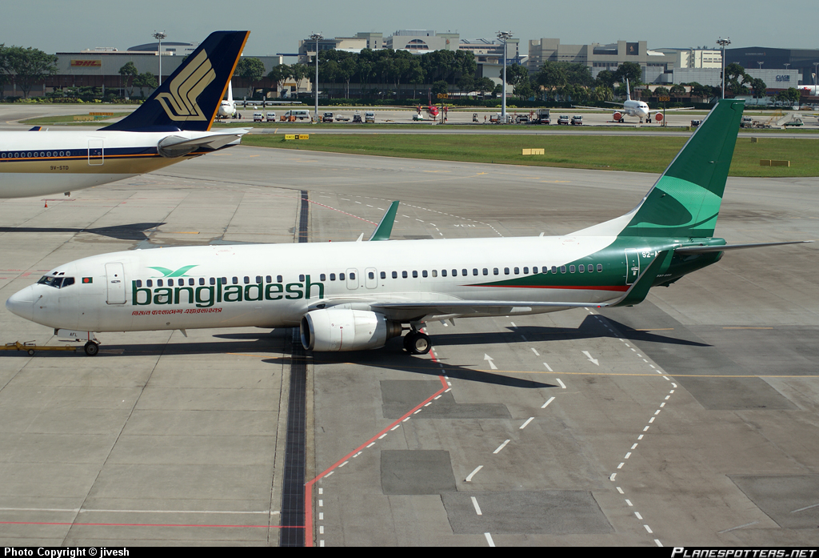
At the airport

Slide 5
Today’s our topic
At the Airport
Unit six
Lesson:-One
Class: Eight
Time:50m.

Slide 6
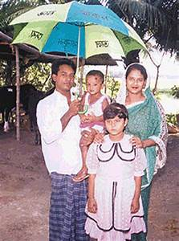
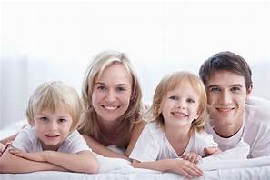
Let’s watch some picture
Do you say about them?
Jara’s family
Mita’s family

Slide 7
Learning outcomes
Ask and answer the question
Explain the story
To tell morality of the story

Slide 8
Silent Reading
Seen passage
Zara live with her parents in London. They have come to Bangladesh to visit Zara`s aunt and uncle. She is very close to her cousin Mita. Both the families have visited many interesting places together in Bangladesh. It was a great fun. Then they decided that they would visit some places outside Bangladesh too. They decided to go to Thailand. But Mita`s parents were too busy with their work, so they could not go. However, Mita was going with them.
Mita, Zara and her parents are at Hajrat Shahajalal International Airport. They are waiting in the lounge. Mita is very excited. This is her first time to board a plane. They are flying by Bangladesh Biman. Mita is hoping to have a great time in Thailand. As they wait, the two cousin start planning what they would do once they reach Bangkok. Mita`s uncle brings forms for all of them to fill in before going through the immigration. He give one to Mita and says, you have to give some information about yourself in the form. The immigration officer will check your passport and stamp it. And then you are ready to travel, ”Mita ,Zara and her parents start filling in the forms.

Slide 9
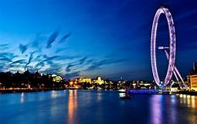
visit
journey

Slide 10
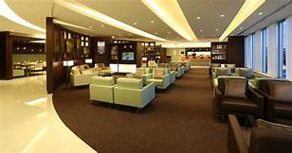
lounge
Pastime/relax

Slide 11
Group work
Answer to the flowing question
a. Both families have decided to visit some place……………….
0 some place in the town 0 historical place
0 relatives house 0 outside places
Outside plans
b. Mita is very excited because…………….
0 it is her first journey by plane 0 she is going with her family
0 her uncle is going with them 0 none of these
it is her first journey by plane
c. Who bring froms for all of them?
0 Mita`s father 0 Mita`s mother
0 Mita`s uncle 0 None of them
Mita`s uncle

Slide 12
Choice the best answers :

Slide 13
Evulation

Slide 14
Home work
Answer to question
a. Whys did Zara`s family come to Bangladeh?
b. How is the relationship between Zara and Mita?

Slide 15
Thanks to all

