Slide 2
Subject Identity
Teacher’s Identity
English for Today
Class: one
Unit : 4 Numbers
Lesson: 1-3- ( A )
Time: 45 minutes
Date: 03/ 02/ 2020
Mst. Lucky Akhter parveen
Assistant teacher
Bihari Govt.Primary School
Pirgachha, Rangpur

Slide 3
Learning outcomes
Students will be able to-
Reading: 2.1.1 recognize and read cardinal numbers up to 10
Writing: 2.1.1 write cardinal numbers up to 10 in figures.

Slide 4
Let’s enjoy the video.

Slide 5
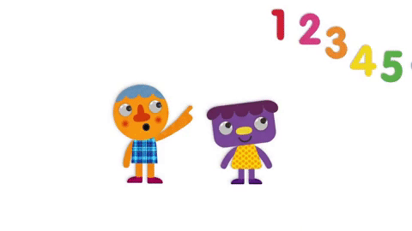
Todays lesson.
Numbers

Slide 6
Look, listen and say.
What is this?
How many balls?
ball

Slide 7
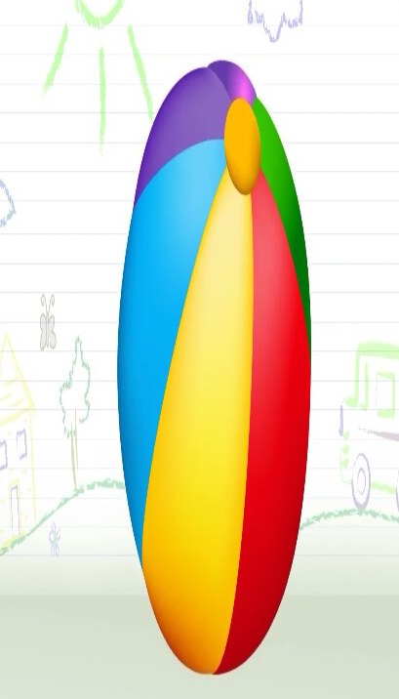
Trace in the air. Count.

Slide 8
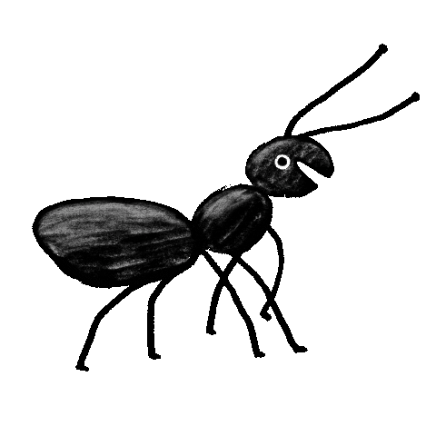
How many ants?
What is this?
Look, listen and say.
ant

Slide 9
Trace in the air. Count.

Slide 10
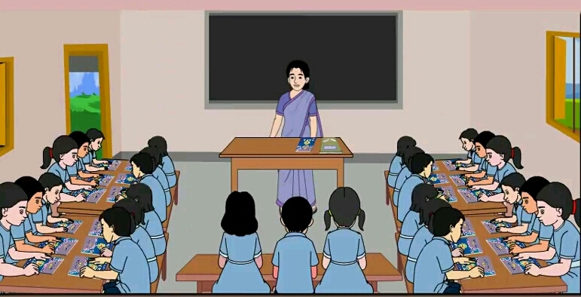
Open your English book page 8.

Slide 11
Look, listen and say.

Slide 12
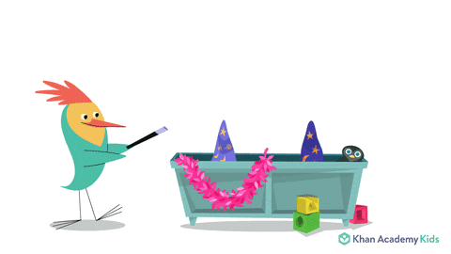
Look, listen and say.

Slide 13
Pair work. Count and read the numbers.

Slide 14
Pair work. Count and say the numbers.

Slide 15
Pair work. Trace in the air. Count.

Slide 16
Evaluation. Count and match the picture with their numbers.

