Slide 2
Teacher’s Identity
Subject Identity
English for Today
Class: one
Unit : 5
Lesson: 1-3 ( A )
Time: 45 minutes
Date: 03/ 02/ 2020
Mst. Lucky Akhter parveen
Assistant teacher
Bihari Govt.Primary School
Pirgachha, Rangpur

Slide 3
Learning outcomes
Students will be able to-
Listening: 1.1.1 become familiar with English sounds by listening to command English words.
Speaking: 1.1.1 repeat after the teacher simple words and phrases.
1.1.2 say simple words and phrases.

Slide 4
Let’s enjoy the audio.

Slide 5
Let’s enjoy the video.

Slide 6
Today lesson
commands

Slide 7
Look, listen and say.
window
door

Slide 8
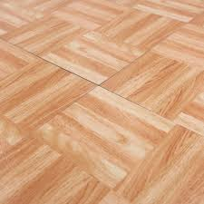
Look, listen and say.
floor
chair

Slide 9
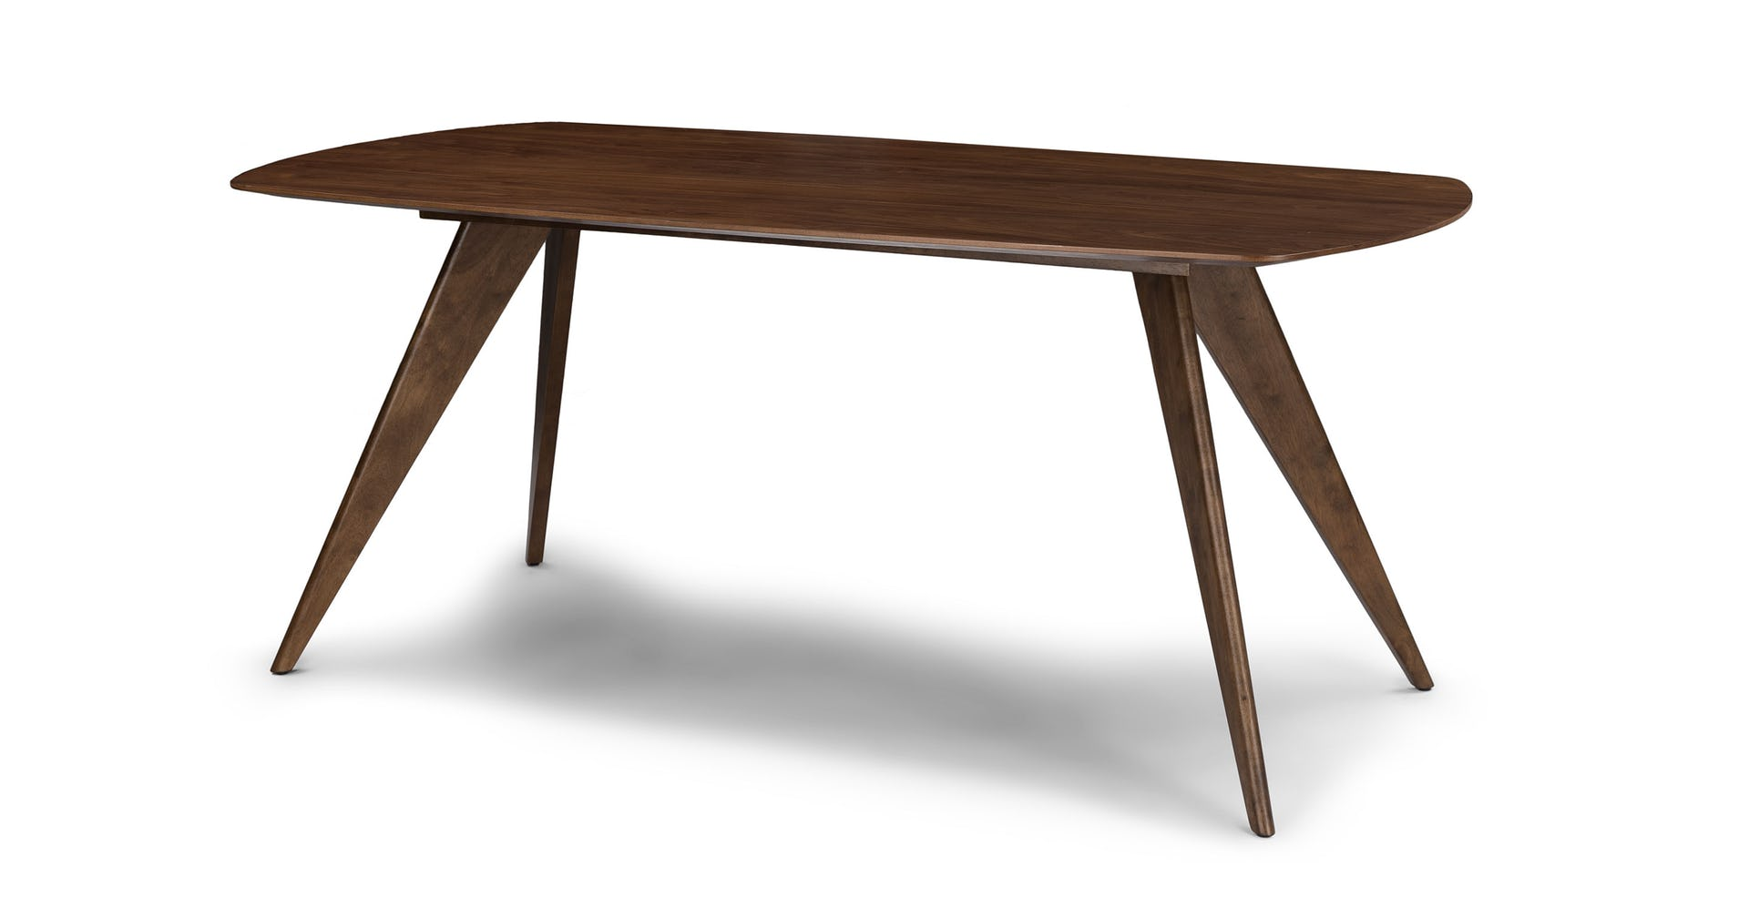
Look, listen and say.
table
book

Slide 10
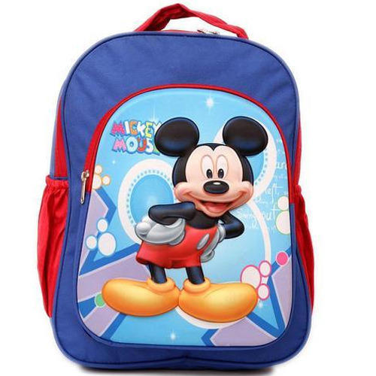
Look, listen and say.
pencil
book

Slide 11
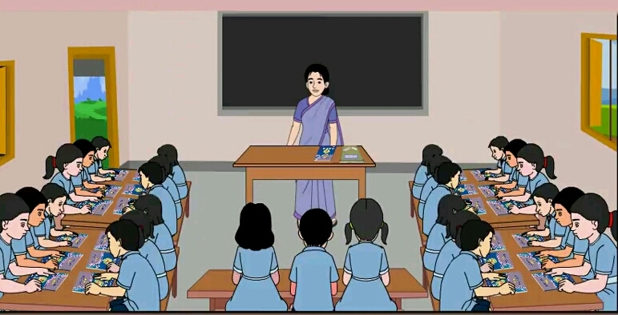
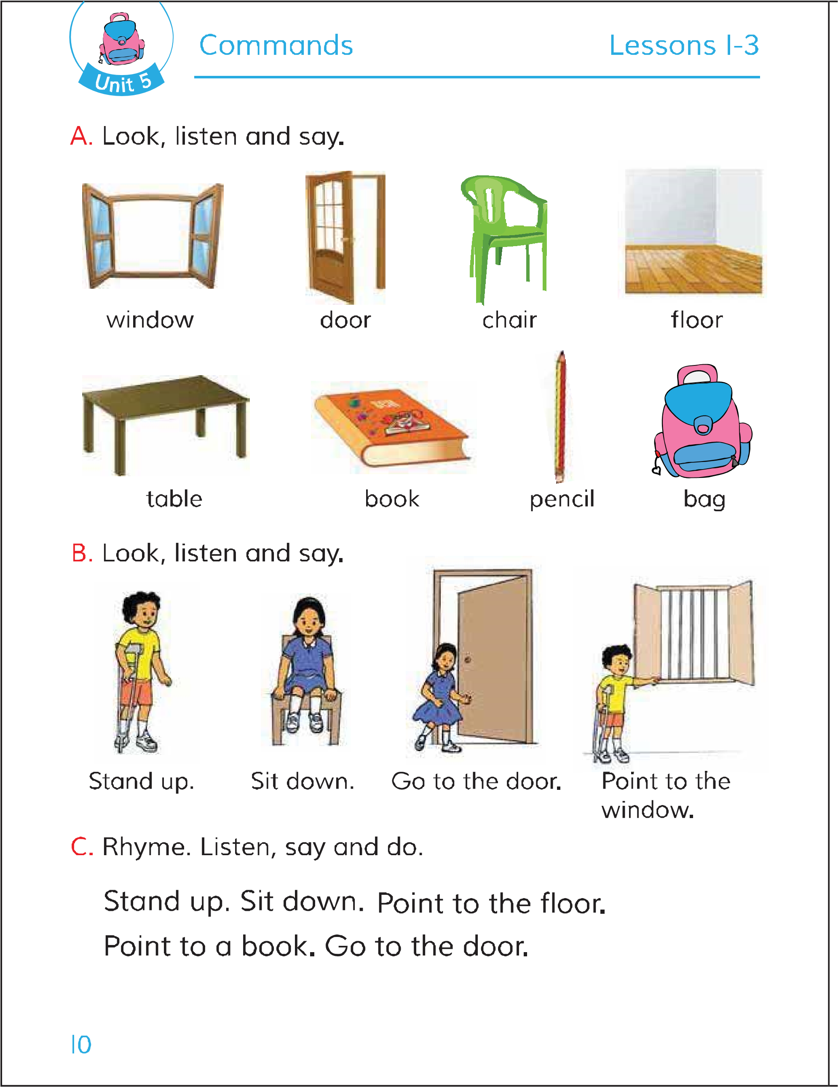
Open your English book page 10.

Slide 12
Look, listen and say.
window
door
chair
floor
table
book
pencil
bag

Slide 13
What is this?
Pair work.
pencil
bag
window
book

Slide 14
What is this?
Evaluation .
table
chair
door
floor

