Slide 2
Teacher’s Identity
Subject Identity
English for Today
Class: one
Unit : 5 commands
Lesson: 3 Rhyme ( commands)
Time: 45 minutes
Date: 02/ 01/ 2020
Mst. Lucky Akhter parveen
Assistant teacher
Bihari Govt.Primary School
Pirgachha, Rangpur

Slide 3
Learning outcomes
Students will be able to-
Listening: 1.1.1 become familiar with English sounds by listening to command English words.
4.1.1 enjoy the rhythm and music of simple rhymes.
Speaking:4.1.1 repeat rhymes after the teacher.
4.1.2 recite rhymes after the teacher.

Slide 4
What can you see in the picture?

Slide 5
Today we recite a rhyme.

Slide 6
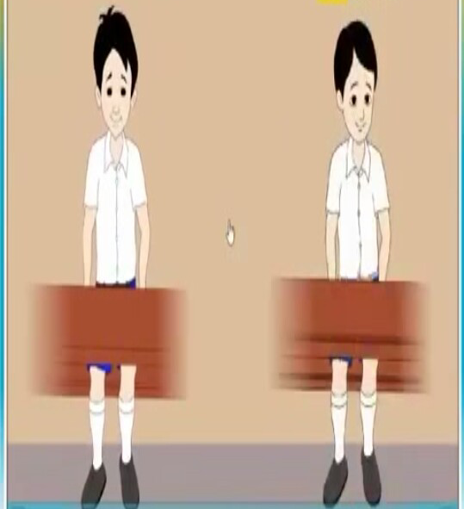
Stand up.

Slide 7
Sit down.

Slide 8
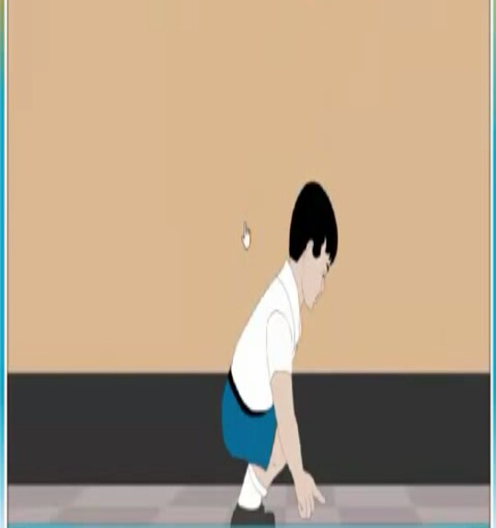
Point to the floor.

Slide 9
Point to a book.

Slide 10
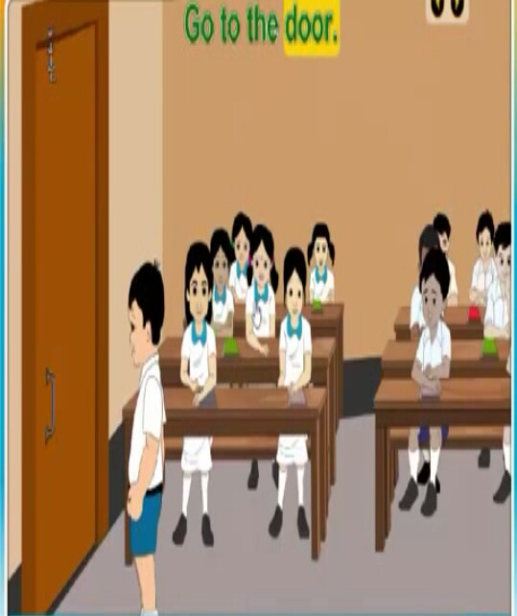
Go to the door.

Slide 11
Let’s enjoy the video .

Slide 12
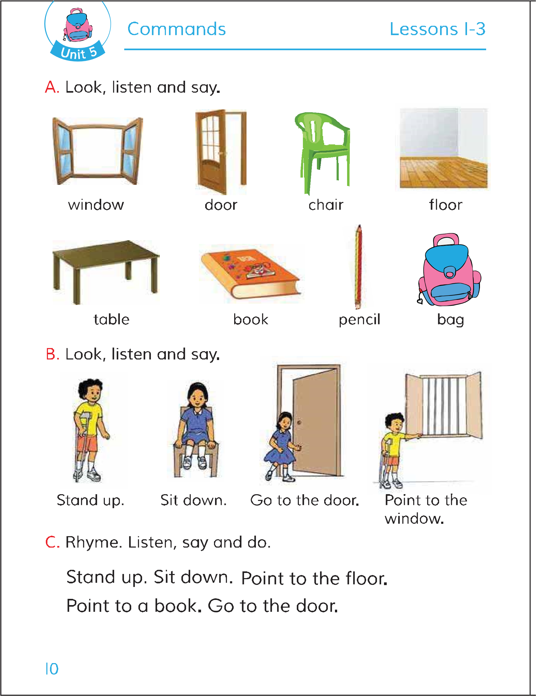
Open your English book page 10

Slide 13
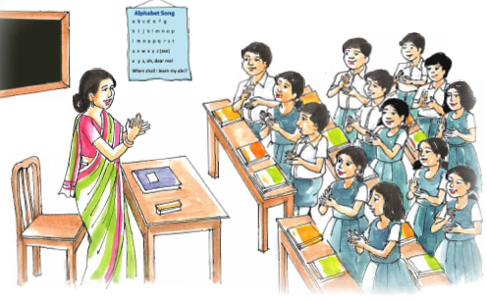
Student recite a rhyme with their teacher.

Slide 14
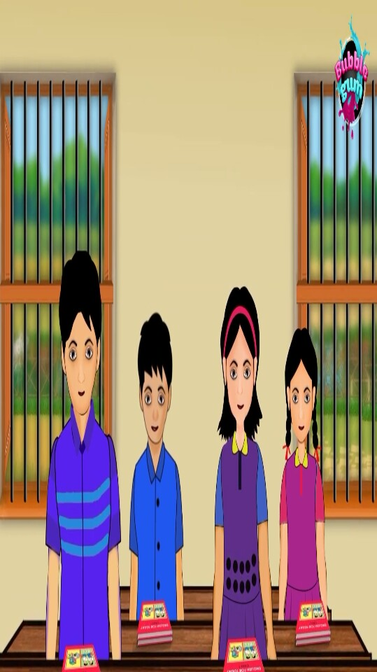
Grour work.
Recite a rhyme.

Slide 15
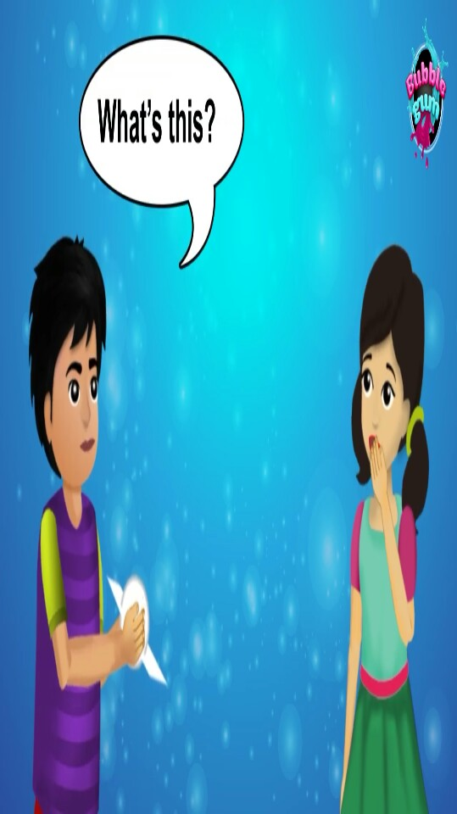
Pair work.
Recite a rhyme.

Slide 16
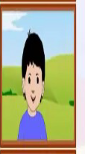
Evaluation
Recite a rhyme.

