Slide 1
WELCOME

Slide 2
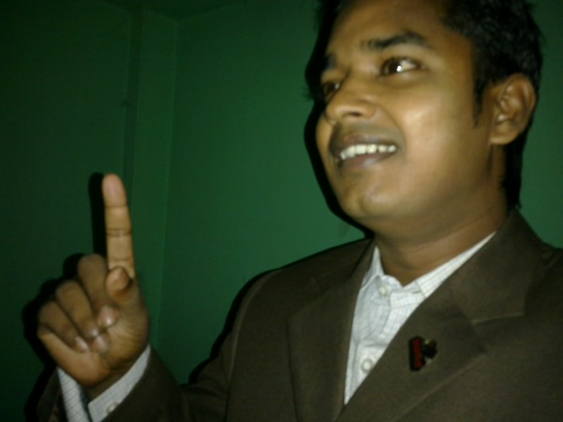
Teacher’s Identity:
Md. Rubel Haque
Assistant Teacher
Nirmoil Darazia Dakhil Madrasha
Shampur,Patnitala,Naogaon.
Mob: 01774795179

Slide 3
See and talk about the picture in pairs
3 minutes
Notes:
T will ask ss to talk about the picture in pair for two minute.
T will monitor.
T will elicit their ans.

Slide 4
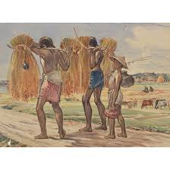
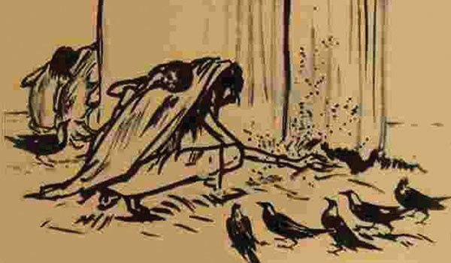

Slide 5
English 1st paper
Class: Nine
Unit: Seven
Time: 45 minutes

Slide 6
Learning Outcome
After Completing this lesson, students will be able to
1. Tell about the text for specific information.
2. Point out the works of Zainul Abedin

Slide 7
See and talk about the picture in pairs
3 minutes
Notes:
T will ask ss to talk about the picture in pair for two minute.
T will monitor.
T will elicit their ans.

Slide 8
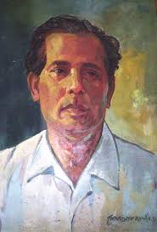
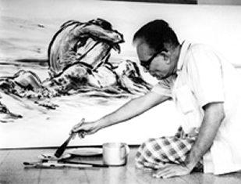
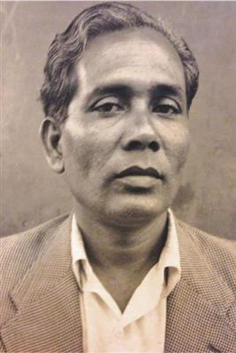

Slide 9
1. What do you see in the picture? 2. Do you know this man? 3. What do you know about his?

Slide 10
Our Title is “The Great Artist.” Lesson:6

Slide 11
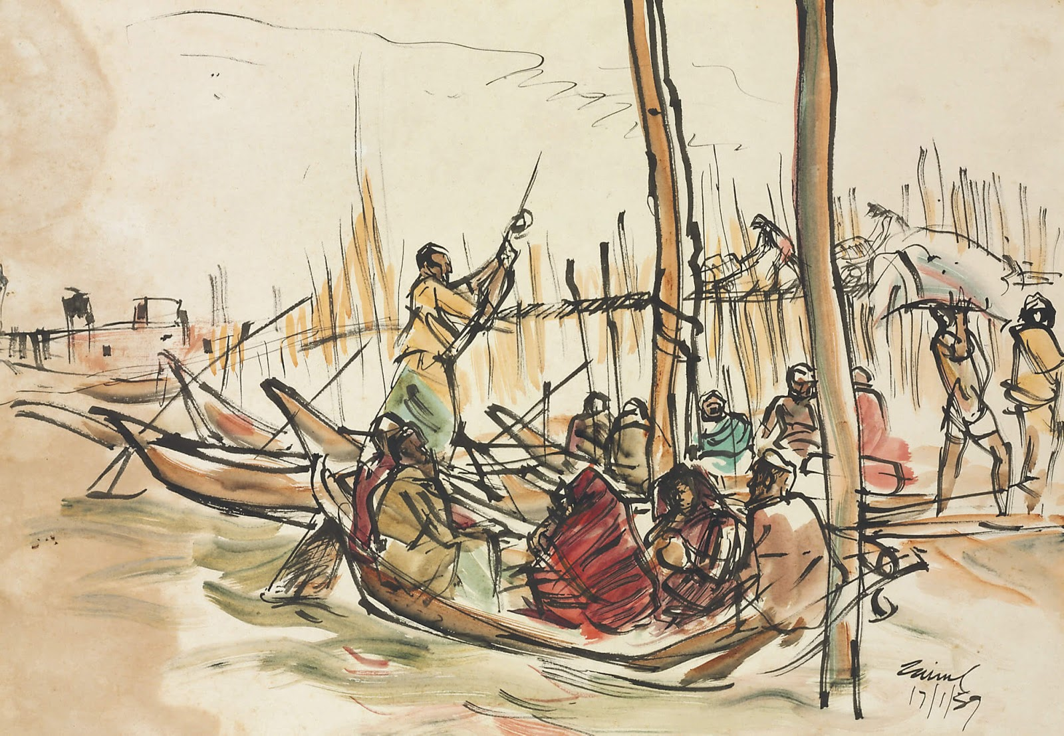
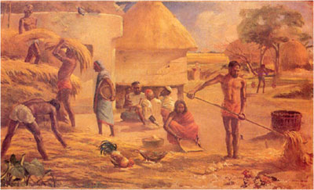
He often passed his time by drawing pictures beside the Padma.

Slide 12
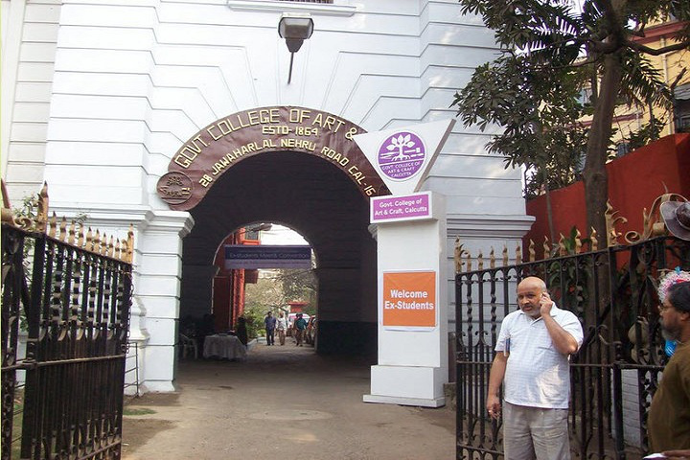
He graduated with first position in first class in 1938 from Govt. College of Art, Kolkata.

Slide 13
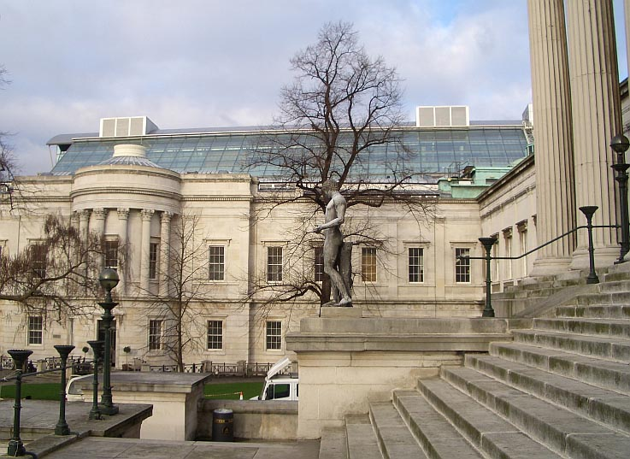
He was appointed as a teacher “The Slade School of Arts” London in 1951-52

Slide 14
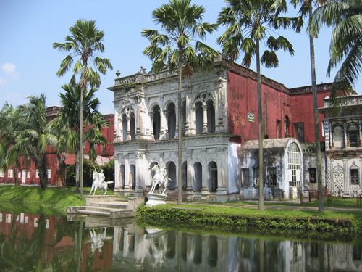
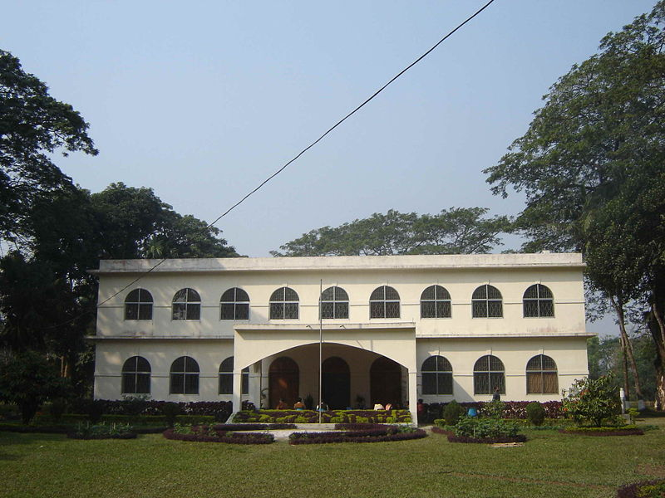
Institutions Founded By Zainul Abedin
Zainul Abedin Shangrahasala in Mymensingh
Folk Art Museum at Sonargaon

Slide 15
Let’s learn some key words

Slide 16
Famine:
A time when there is little food in a region.
Sketch:
A drawing made very quickly.
Charcoal
A black substance made by burning wood.
Starvation
Suffering or death caused by lack of food

Slide 17
Biography of Zainul Abedin at a glance
Artist
The first principal of the first art school in Dhaka
He was referred to as Shilpacharya
Graduated from Calcutta Art School
Born on 29th December,1914
Got Governor’s gold medal
Died on 28th May,1976

Slide 18
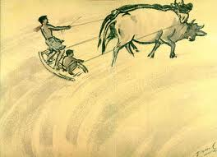
Pair Work
Describe the pictures in pairs and make a dialogue.

Slide 19
Evaluation
Who is considered the founding father of Bangladeshi art?
Name some famous paintings of Zainul Abedin.
Where did he found the Folk Art Museum?

Slide 20
Homework
Write a paragraph about Shilpacharya Zainul Abedin within 70 words using the following clues.
born -- drawing -- school – father of -- artistic - beauty

Slide 21
Thanks to all

