Slide 1
WEL COME

Slide 2
Introduction of the teacher
Teacher’s Name: Md. Tajul Islam
Assist Teacher
Assim Kutira G.P School
Fulbaria,Mymensingh
ICT Batch-6
PTI,Mymensingh

Slide 3
Introduction of the lesson
Class-5 , Uni-1
Title of the lesson : Hello !
Today’s lesson :A. Read and Say :
Time : 40 Minutes

Slide 4
Learning Outcomes
By the end of the lesson the student will be able-
Litening :1.3- to recognize which words in a sentences are stressed.
Speaking :1.1- to say words ,sounds,stress and intonation.
Reading :1.5- to read words,phrases and sentences in the text with proper pronounciation,stress and intonation.

Slide 5
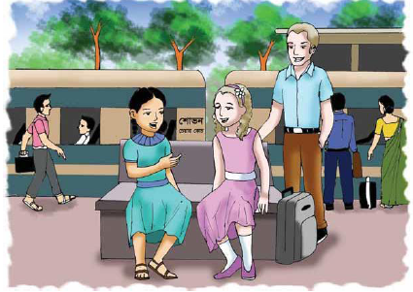
Creating safe environment
showing picture
What can we see in the picture?

Slide 6
Review of the lesson
What did we learn in the last class ?
Notes:
Can anybody say this ?

Slide 7
Today’s Lesson :
Today we will learn –
Hello !
What do Sima and Jessica disscuss with each other ?
Notes:
Ok.

Slide 8
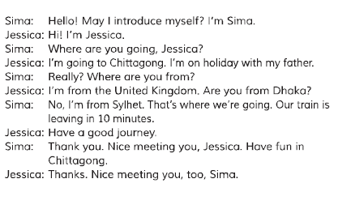
Now everybody opens your text book page at page 2

Slide 9
New words
introduction
really
holiday
meeting
leaving

Slide 10
Teacher’s Reading
Notes:
Follow me. Read with me. Say with me.

Slide 11
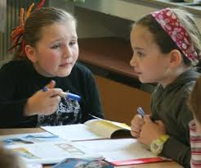
Pair work
Notes:
Make in pairs.Act this again and again

Slide 12
Individual work
Read the text silently.
Notes:
Read the words,phrases and .intonation correct stress and intonation

Slide 13
Assesment
Where is Jessica going ?
Where is Sima going ?
Notes:
Who can say first? Raise your hand. Ok. Thank you.Fine.Well.Very well.

Slide 14
Home work
Write five sentences about yourself.

Slide 15
Fare well
No more today.
Take care of your health.
See you the next class.
Ok
Notes:
No more today.Bye.Take care of your health. See you the next class.

Slide 16
THANK YOU

