Slide 1
WELCOME TO THE ENGLISH CLASS
IN THE YEAR OF MUJIB 100
Edited

Slide 2
TEACHER CONTACTS
Edited
MD.MOSTAFIZUR RAHMAN
ASSISTANT TEACHER (COMPUTER)
MOHAMMADPUR ADORSHA HIGH SCHOOL
GANGNI,MEHERPUR
CELL PHONE NO-01922314170

Slide 3
ENGLISH FIRST PAPER
CLASS :NINE,UNIT-7, LESSON-1
TIME:40 MINUTES
Edited

Slide 4
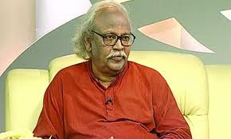
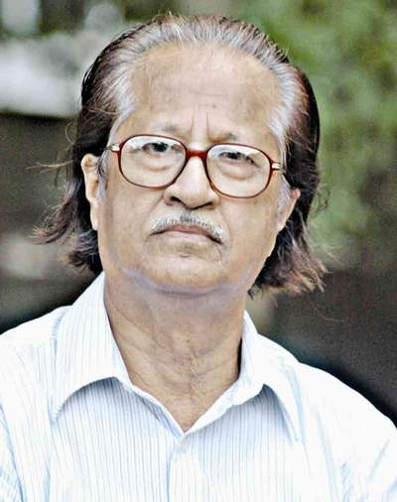
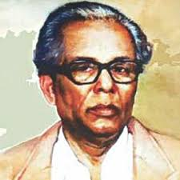
LET’S WATCH SOME PICTURES
RAFIQUAN NABI
MOSTOFA MONOAR
Edited
ZAINUL ABEDIN

Slide 5
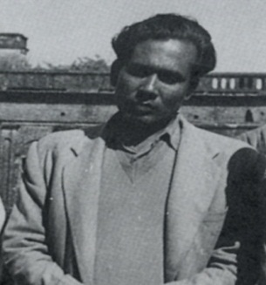
DECLARATION OF TOPIC
“ZAINUL ABEDIN” THE GREAT ARTIST
Edited

Slide 6
LEARNING OUTCOMES
Edited
STUDENTS WILL SAY ABOUT ZAINUL ABEDIN…..
1. LIFE.
2.CONTRIBUTION.
3.ACHIEVEMENT.

Slide 7
ZAINUL ABEDIN, THE GREAT ARTIST
Edited
BORN : 29 DECEMBER 1914
PLACE- KISHORGONG : SITUATED ON THE BANK OF BRAHMAPOTRA RIVER.
GRADUATION: KOLKATA ART COLLEGE
RESULT: 1ST CLASS
PASSED AWAY : 28 MAY 1976

Slide 8
PROFESSIONS
Edited
TEACHER : KALKATA ART COLLEGE WHILE A STUDENT.
PROFESSOR : SLADE ART SCHOOL , LONDON.
FOUNNDER PRINCIPAL: DHAKA ART COLLEGE.
PRESIDENT : BANGLA ACADEMY.

Slide 9
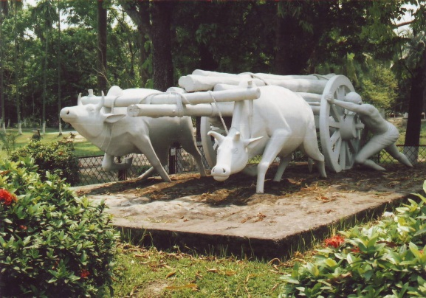
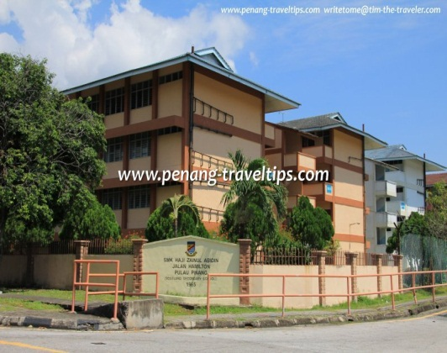
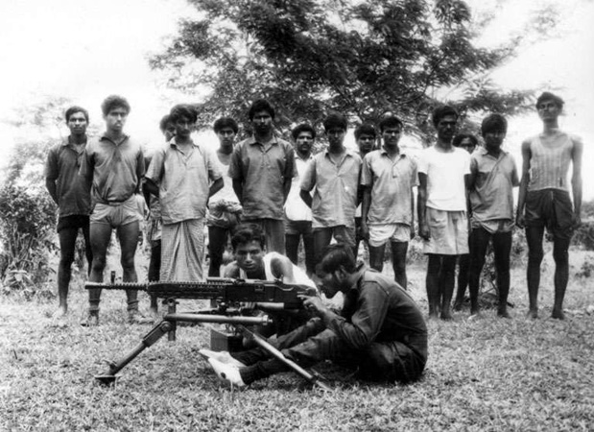
CONTRIBUTIONS
Edited
FOKL ART MUSEUM SONARGOAN.
ZAINUL ART GALARY MYMENSING.
FREEDOM FIGHTER
COVER PAGE DESIGN.

Slide 10
ACHIEVEMENT
Edited
“THE GOVERNORS GOLD MADEL” ALL - INDIA EXHIVISION 1938.
SHILPACHARAYA-“GREAT TEACHER OF ART” AND PIONEER IN BANGLADESHI MODERN ART.
NATIONAL PROFESSOR=FIRST NATIONAL PROFESSOR OF BANGLADESH’75.

Slide 11
INDIVIDUAL WORK
Edited
1. WHICH DICTRICT WAS ZAINUL ABEDIN BORN IN ?
1. ANSWER- KISHOREGONJ .
2. WHO IS THE PIONEER OF BANGLADESHI MODERN ART ?
2. ANSWER – ZAINUL ABEDIN .
3. WHICH RIVER PLAYED A VITAL ROLE IN HIS PAINTINGS ?
3.ANSWER - BRAHMAPUTRA RIVER .

Slide 12
GROUP WORK
a)WHAT THE MEANING OF “Shilpacharya”?
b)WHERE DID HE GRADUATE ?
c)WHERE IS ZAINUL GALARY SITUATED?
Edited

Slide 13
ANSWERS
1.GREAT TEACHER OF ART
2.ZAINUL ABEDIN GRADUATED IN
GOVERNMENT SCHOOL OF ART,CALCUTTA.
3.ZAINUL ABEDIN ART GALLARY
AT MYMENSINGH IN BANGLADESH.

Slide 14
HOME WORK
Edited
Each one will write about Zainul Abedin in 150 words.

Slide 15
THANK YOU
Edited
VERY MUCH

