Slide 1
WELCOME

Slide 2
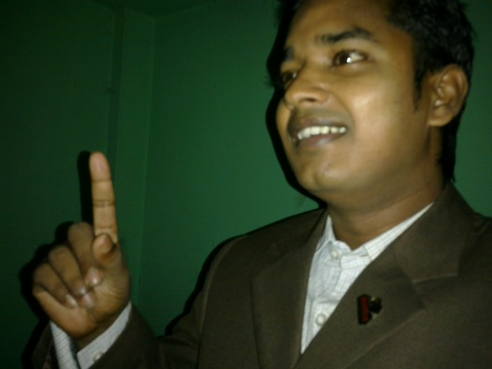
Teacher’s Identity:
Md. Rubel Haque
Assistant Teacher
Nirmoil Darazia Dakhil Madrasha
Shampur,Patnitala,Naogaon.
Mob: 01774795179
Subject: English For Today
Class: IX

Slide 3
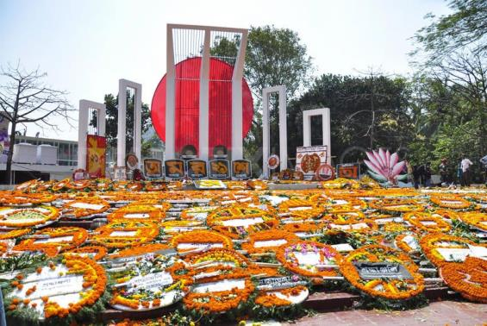
1. What is this?
2. What’s the picture about?
3. Where is it situated?

Slide 4
Let’s watch a video

Slide 5
Our today’s lesson is-
International Mother Language Day

Slide 6
By the end of the lesson SS will be able to----
Speak about some word’s meaning.
Read the text silently.
Complete a chart.
Match some words with their meanings.
Answer some questions.

Slide 7
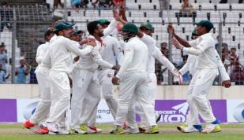
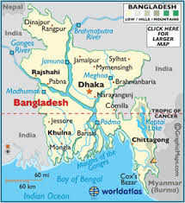
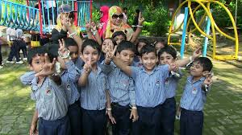
Memorable
Unforgettable
relating to the whole of a country
National
holiday
Off day

Slide 8
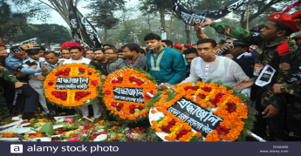
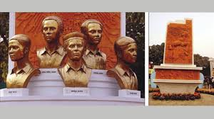
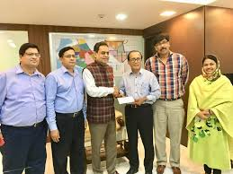
Do something to show respect.
Tribute
A person who laid down his/her life for country.
Martyr
To set up something.
Establish

Slide 9
Read the text silently and try to understand.

Slide 10
Complete the chart carefully in pair.
Time | What happened
1948
1952

Slide 11
Match the words with their meanings in group
Words | Meanings
tribute climax defy provide | to refuse to obey to give in an act to show respect or admiration the most exciting point in time

Slide 12
Match these answers with your answers
Words | Meanings
tribute climax defy provide | an act to show respect or admiration the most exciting point in time to refuse to obey to give in

Slide 13
Evaluation
Who is Mohammad Ali Jinnah?
When the seed of the Language Movement was sown?
Who brought out a peaceful protest procession?

Slide 14
Homework
As a student, you observe 21 February as the International Mother Language Day- Why? Express your opinion in short.

Slide 15
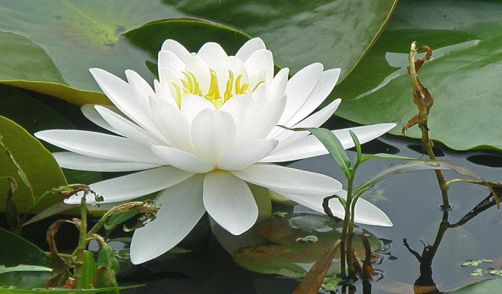
Thanks to all

