Slide 1
WELCOME

Slide 2
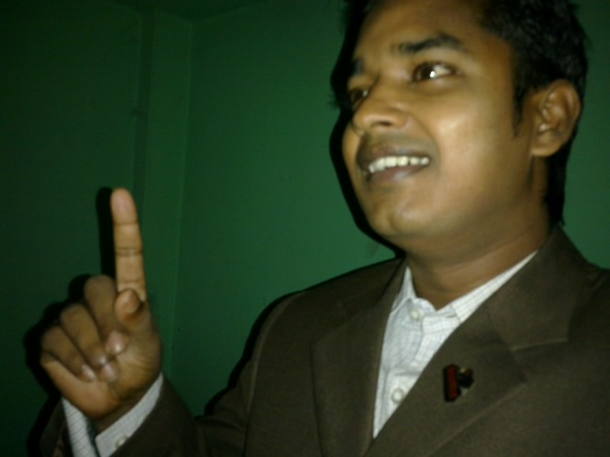
Teacher’s Identity:
Md. Robel Haque
Assistant Teacher
Nirmoil Darazia Dakhil Madrasha
Shampur,Patnitala,Naogaon.
Mob: 01774795179

Slide 3
ENGLISH SECOND PAPER
CLASS - 10
Time – 50 minutes

Slide 4
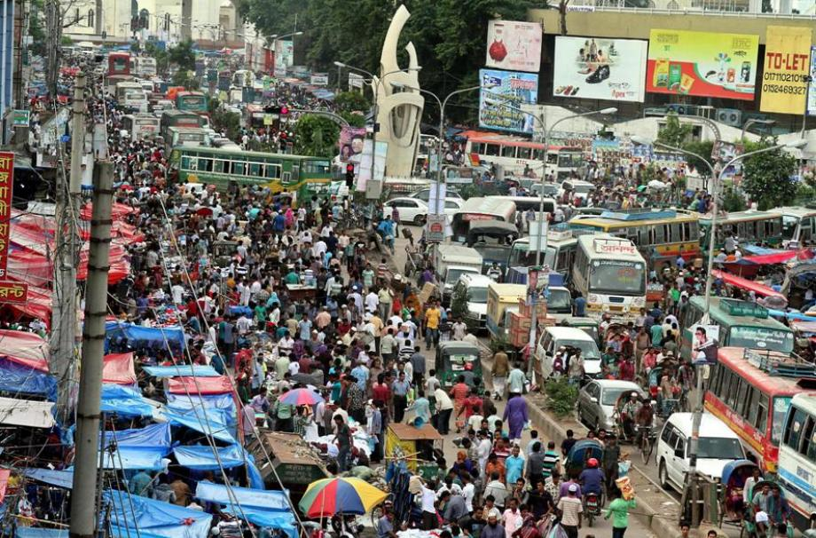
See the picture and guess what is happening here

Slide 5
Our today’s lesson is-
a paragraph and it is-
Traffic Jam

Slide 6
After we have studied this lesson we will be able to----
1. Ask and answer questions
2. Know information
3. Practice writing
4. Write a paragraph

Slide 7
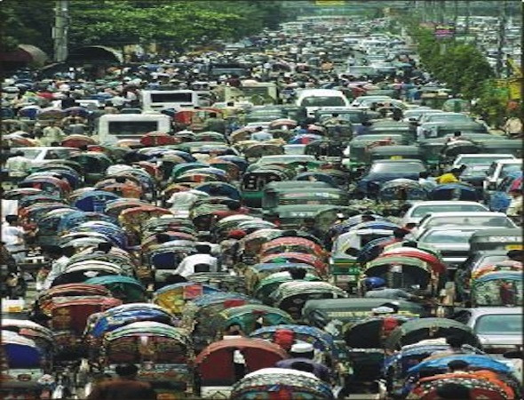
What is a traffic jam?
Traffic jam is a situation in which a long line of vehicles on a road have stopped moving or are moving very slowly.

Slide 8
GROUP WORK
Traffic Jam
Cause
Sufferings
Remedy

Slide 9
Let’s know about cause of Traffic jam
Lots of Rickshaws
Wrong parking
Sweet will driving
Narrow Roads
Unnecessary overtaking

Slide 10
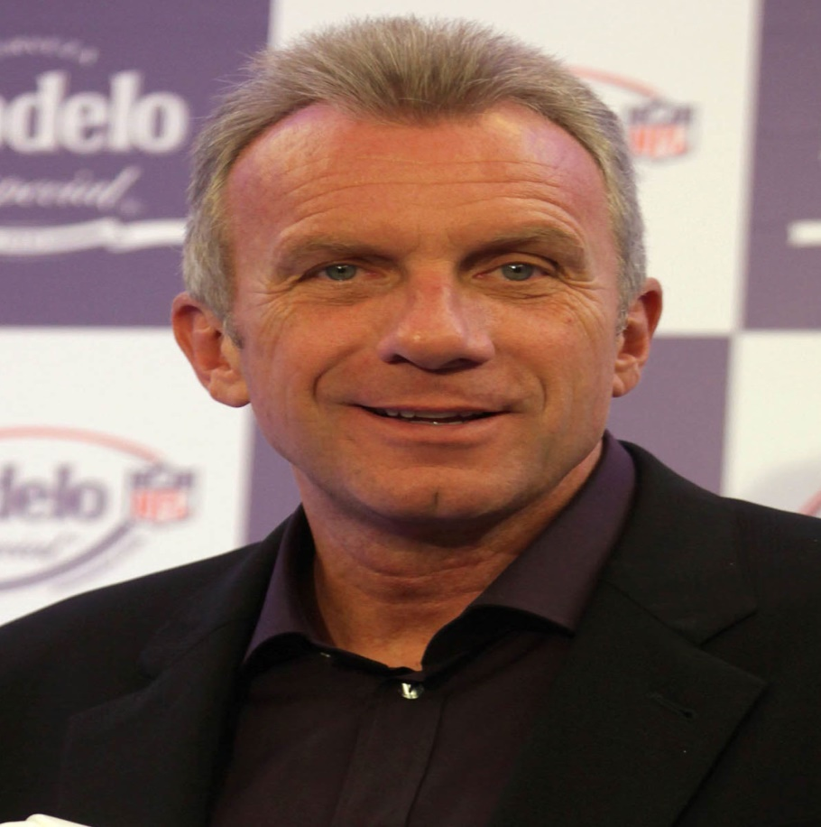
There is nothing worse for me than sitting in a traffic. - Joe Montana
Joseph Clifford Montana Jr., nicknamed Joe Cool and The Comeback Kid, is a former American football quarterback

Slide 11
Let’s know about sufferings of Traffic jam
Wait on
Kill valuable time
Students delay in reaching class
Serious patients’ problem
Economic drawbacks

Slide 12
According to Accident Research Institute of BUET
``traffic jam in Dhaka ends up around 50 lakh working hours every day and the average speed of Vehicles during rush hours has come down to 5kmph. This traffic jam causes an annual loss of 20,000 crore taka (2 billion dollar)".

Slide 13
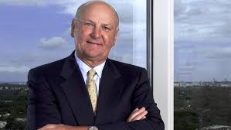
``We can't make any money sitting in traffic“, says Wayne Huigenga.
Harry Wayne Huizenga Sr. was an American businessman and entrepreneur. He founded AutoNation, Waste Management, Inc.

Slide 14
Let’s know about remedy from Traffic jam
Public Transport
Broaden roads
One way movement
More traffic polices
Punishment

Slide 15
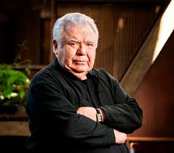
``If you provide good alternatives for public transport, you won't have traffic problems“ - Jaime Lerner.
Jaime Lerner is a Brazilian politician.

Slide 16
INDIVIDUAL WORK

Slide 17
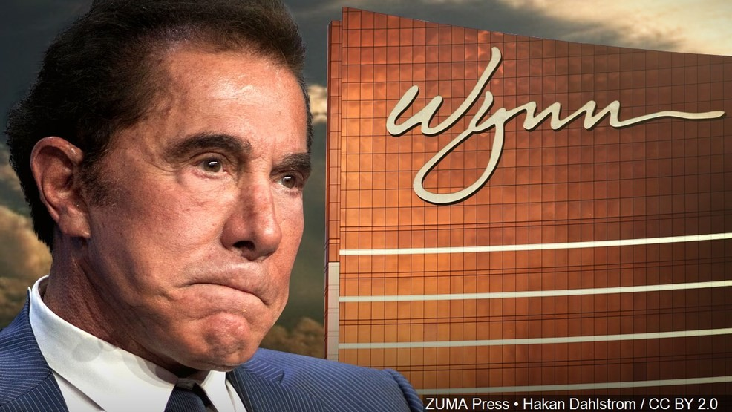
``If I complain about a traffic jam, I have no one to blame but myself"
- Steve Wynn
Stephen Alan Wynn is an American real estate businessman and art collector.

Slide 18
Home work
Write a paragraph on
“ A Traffic Jam.”

Slide 19
Homework
Write a paragraph on
“ A Traffic Jam.”

Slide 20
THANK YOU ALL

