Slide 1
WELCOME

Slide 2
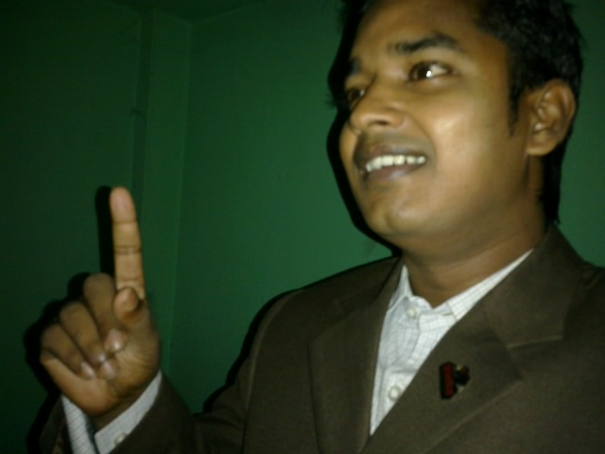
Teacher’s Identity:
Md. Robel Haque
Assistant Teacher
Nirmoil Darazia Dakhil Madrasha
Shampur,Patnitala,Naogaon.
Mob: 01774795179

Slide 3
Subject : English 1st Paper
Class : Nine & Ten
Time: 50 Minutes

Slide 4
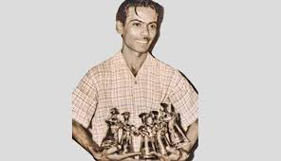
See the picture and guess the picture

Slide 5
Our today’s lesson is-
Zahir Raihan

Slide 6
After this lesson the students will be able to-
1. talk about pictures.
2. listen for specific information.
3. read a text and find out information.
4. write about a person.
5. infer the word meaning from the text.

Slide 7
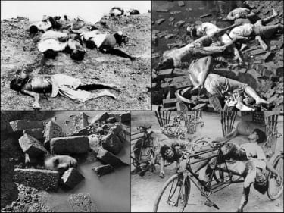
VOCABULARY
Arrested
confined
Autocratic
Willful
Genocide
Mass murder

Slide 8
Birth 19 August 1935
Died on 30 January 1972
Birth place Feni district
In 1971 joined he Liberation war.
Joined the procession on 21February 1952
He toke part in the mass movement in 1969
His legendary film Jibon Theky Neya based on Language Movement

Slide 9
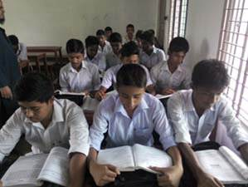
B. Read the text…
Silent Reading
Read the passage carefully then answer the questions that have given section ‘B’

Slide 10
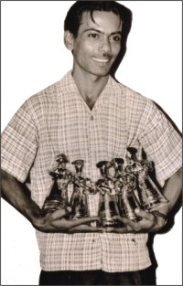
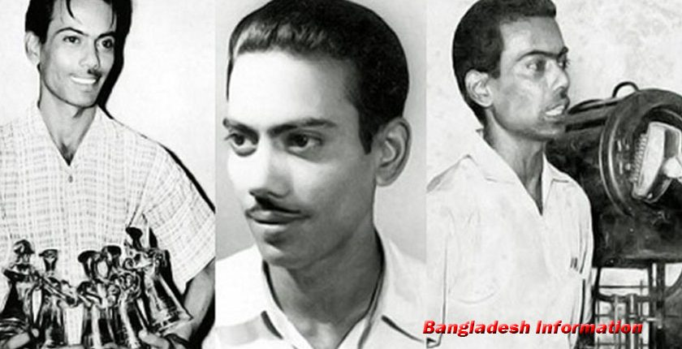
See the picture and guess the pictures

Slide 11
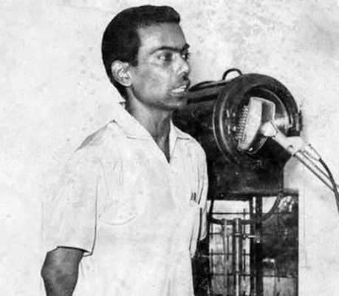
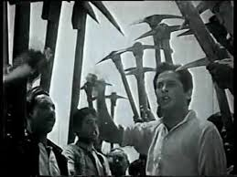
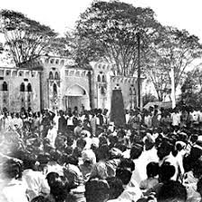
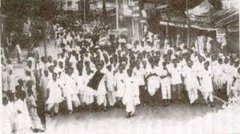
See the picture and guess the pictures

Slide 12
Individual Work
1.What was Zahir Raihan’s profession?
2. When did he participate in Language Movement?

Slide 13
See the picture and guess the pictures

Slide 14
Pair work
Read the following sentences complete them.
Zahir Raihan is famous as ……………
Raihan was imprisoned because …………..
He participated in ……………..and ……………
Jibon Theke Neya symbolizes …………………..
He donated ………………………………………

Slide 15
See the picture and guess the pictures

Slide 16
Group work
Read the text in A again and complete the questions given below
1.Why is Zahir Raihan consider a freedom fighter though he was a film maker?
2.How does the title of the lesson fit to the story of Zahir Raihan ?

Slide 17
Evaluation
1.Who is Zahir Raihan ?
2.Why was Zahir Raihan arrested and imprisoned?
3.What was the contribution of Zahir Raihan in the Liberation War ?

Slide 18
Home work
Write a paragraph on Zahir Raihan.

Slide 19
Homework
Write a paragraph on Zahir Raihan.

Slide 20
Thanks to all

