Slide 1
WELCOME

Slide 2
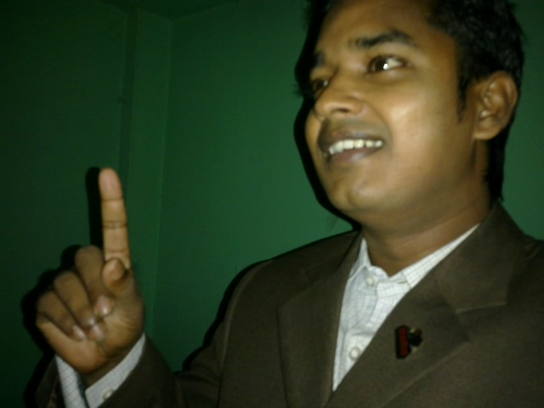
Teacher’s Identity:
Md. Rubel Haque
Assistant Teacher
Nirmoil Darazia Dakhil Madrasha
Shampur,Patnitala,Naogaon.
Mob: 01774795179

Slide 3
Classes:Nine & Ten.
Sub: “English For Today”
Part: First Part.

Slide 4
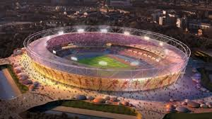
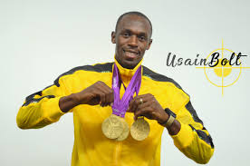
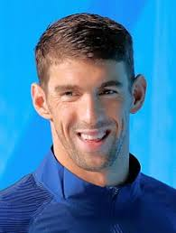
What do you know about them? Why are they well known?
Usain Bolt !
On the 2012 London Olympics
Michael Phelps !
Do you want to read more about them?

Slide 5
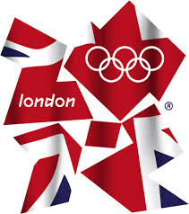
Truly, to tell about any famous personality in the world, we have to read more about them.

Slide 6
Today our topic is
“Reading really helps!”

Slide 7
After this lesson the students will be able to-
1. talk about pictures.
2. listen for specific information.
3. read a text and find out information.
4. write about a person.
5. infer the word meaning from the text.

Slide 8
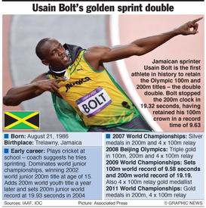
The most successful sprinter
Bolt was born in August 21. 1986 at Trelawny in Jamaica.
In 2012 on “London Olympics”, he was just 25 years old.
In early age, he plays cricket and his coach suggested him for sprinting. In 2002 he was dominated world junior championships, winning world junior 200m title and adds 200m world youth title later a year he got junior world record at 19.93 seconds in 2004.
In 2007 world championship he got silver medals.
He also dominated the 2008 Beijing Games, got triple gold. In London Bolt was the third man to repeat as a 100m gold medalist and the first as a 200m gold medalist, and he broke his own Olympics record by running the 100m in 9.63 seconds. The fasted man in the world.
In 2009 he got gold medals on relay sprints. In 2011 he also got gold medals in 200m, and relay.
In 2012 at London he got gold in six Olympic finals he won six gold medals. As a legend there is no telling how long he can be on top of the sprinting world.

Slide 9
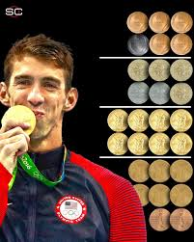
The most successful swimmer
Michael Phelps !
Phelps was born in June 30, 1985 at Baltimore, Maryland, United States.
In 2012 on “London Olympics”, he was just 26 years old.
He took place on men's 4 × 100 meter freestyle relay event at the 2008 Olympic Games on 10–11 August at the Beijing National Aquatics Center in Beijing, China.
The men's 4 × 200 meter freestyle relay event at the 2012 Summer Olympics took place on 31 July at the London Aquatics Centre in London, United Kingdom
Phelps is the most decorated Olympian ever, with 22 overall medals. 19 golds, two silver, two bronze. London was Phelps’ grand final. He won four golds and two silvers in seven events, and he says he’ll never race again. Phelps was already a legend by doing his past works.

Slide 10
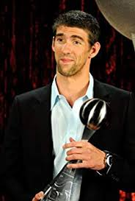
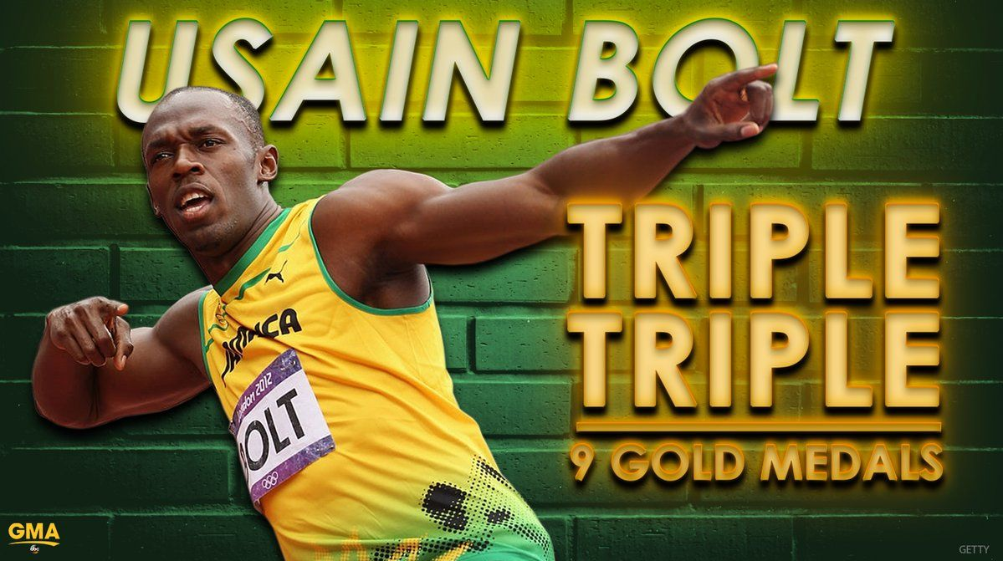
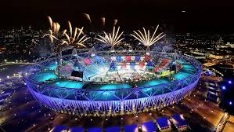
Work in pairs.
Decide
Who’s better between these two bests?

Slide 11
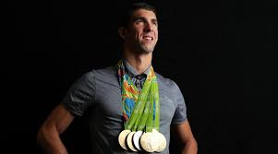
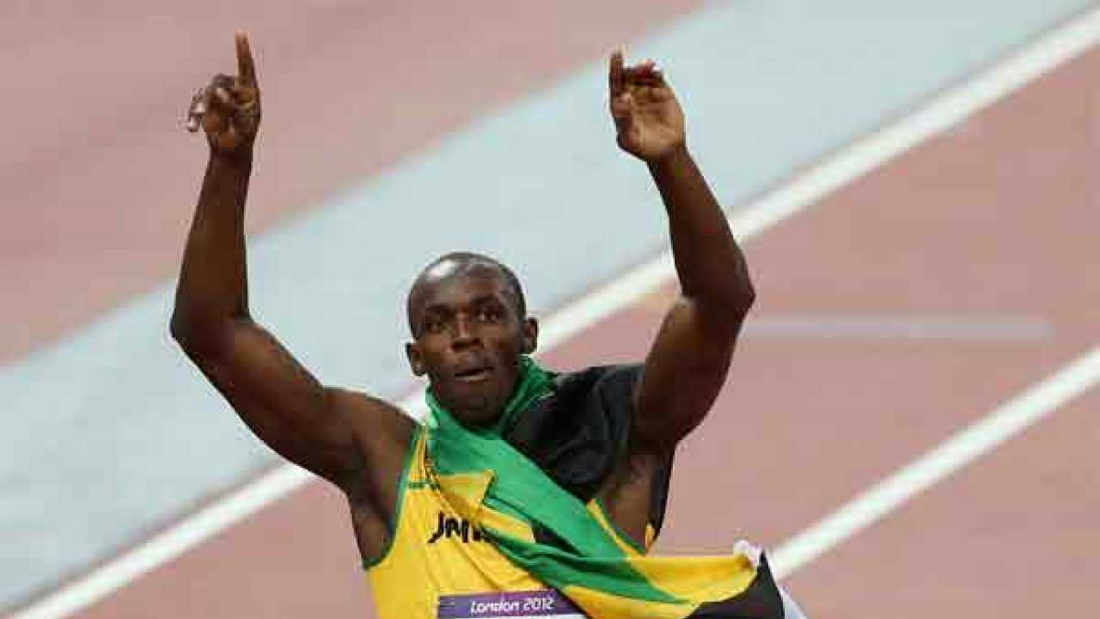
Give arguments in favour of your decisions with a individual short note about their life and achievements.

Slide 12
Homework
Make a chart about themselves with the comparisons.

Slide 13
Thank You All

