Slide 1
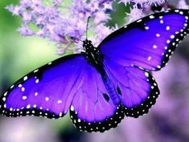
WELCOME

Slide 2
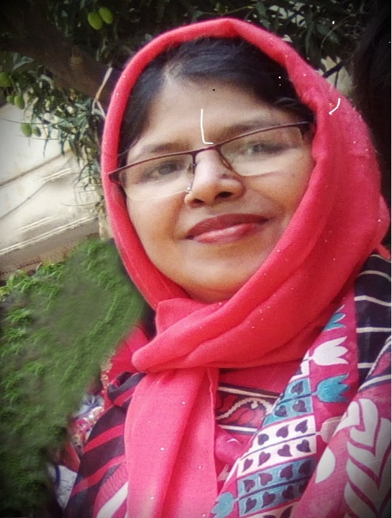
IDENTITY OF TEACHER:
ASMA HUQ
Asst. teacher,English.
Motijheel Govt. Girls’ High School,Dhaka.

Slide 3
INTRODUCTION OF THE LESSON:
SUBJECT : ENGLISH FIRST PAPER
UNIT : THREE
LESSON : SIX

Slide 4
LEARNING OUTCOMES:
After reading the lesson students
will be able to
Talk about events and festivals
Ask and answer questions

Slide 5
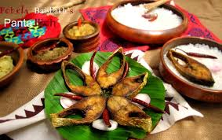
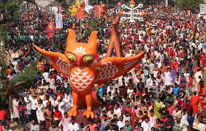
See the pictures:

Slide 6
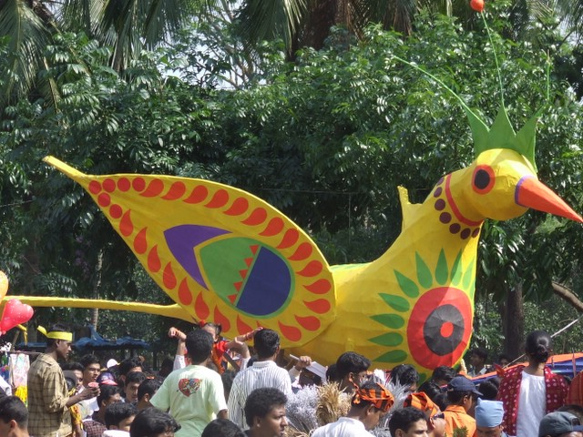

Slide 7
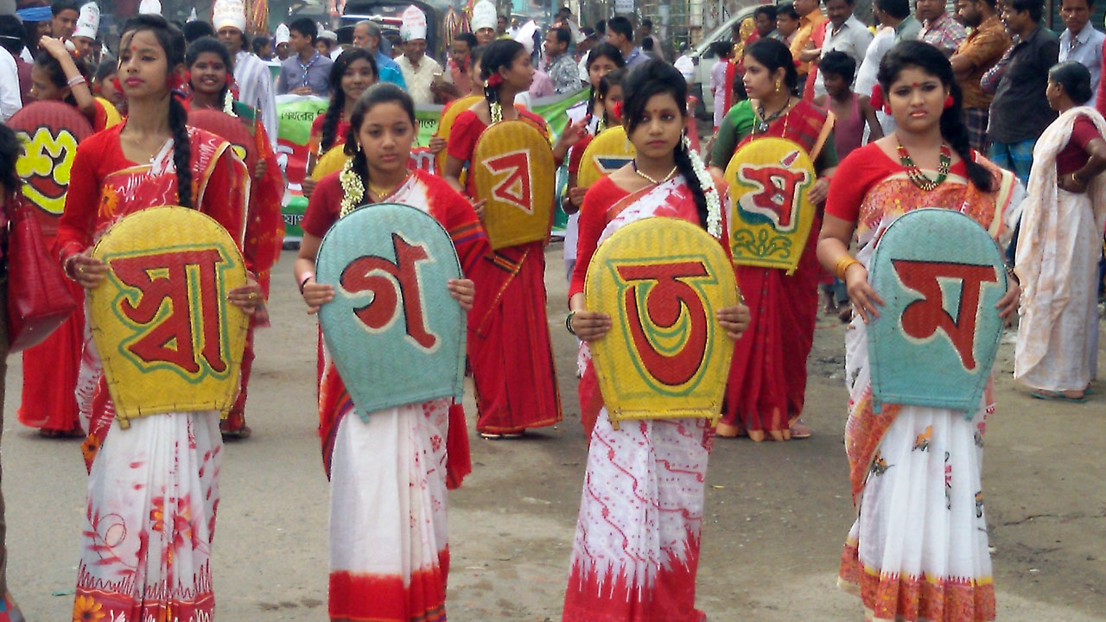

Slide 8
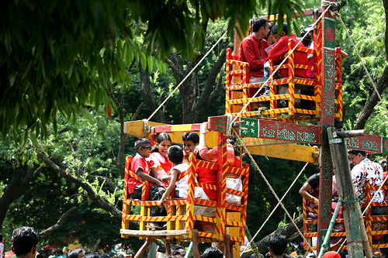
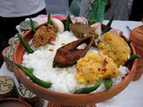
TODAY WE ARE GOING TO READ ABOUT
‘PHOHELA BOISHAKH’

Slide 9
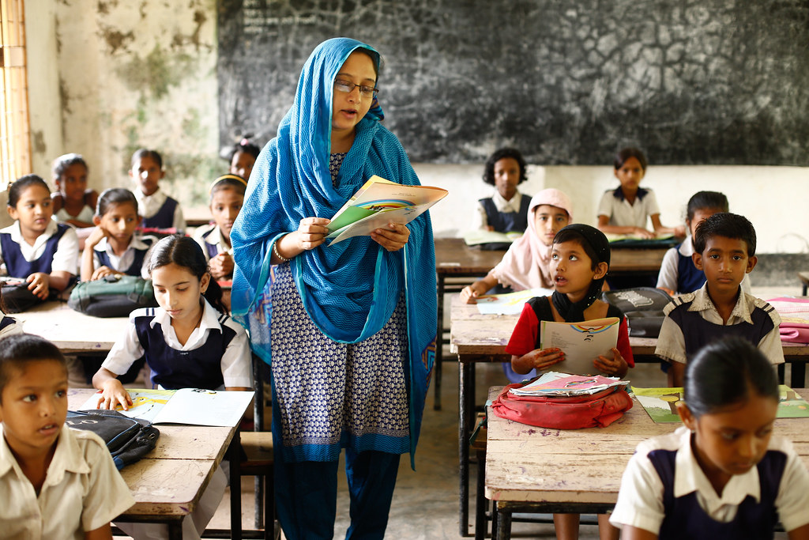
Loud reading

Slide 10
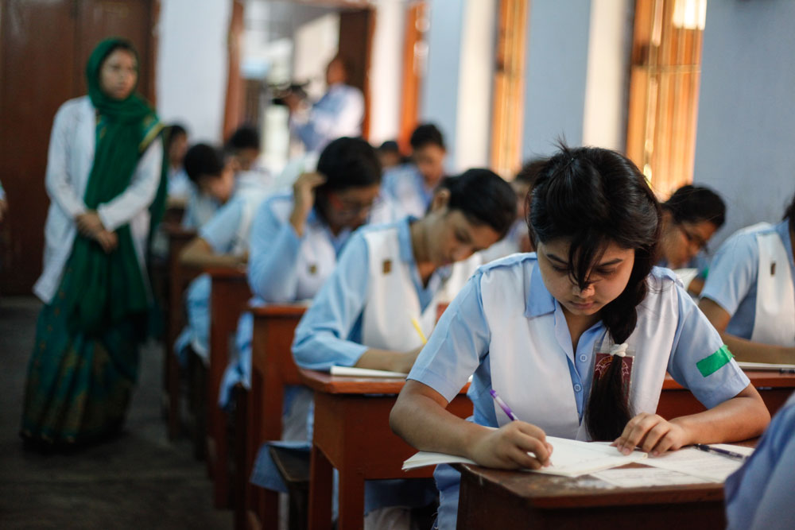
SILENT READING
Read the text at page 39 silently.

Slide 11
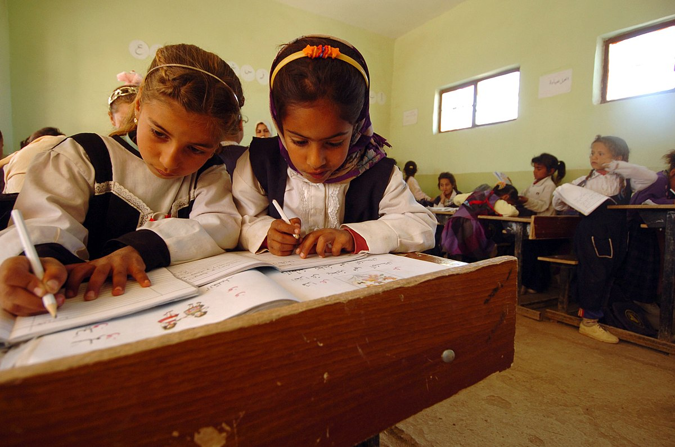
PAIR WORK:
Choose the correct answer from the following alternatives:
1.The word ‘special’means --------
Typical (b) normal (c) particular (d) definite
2.What does the word ‘unity’in the passage refer to?
Similarity (b) oneness
(c) same (d) unilateral

Slide 12
GROUP WORK:
I. How is Pohela Boishakh celebrated?
2.Describe the singnificance of Pohela Boishakh.

Slide 13
EVALUATION:
Fill in each blank with sutible word:
1.----- brings out a colourful prpcession.
2.On Pohela Boishakh people ----- traditional food.
3.The day is ----- all over the country.
Answer:
1.The Institute od Fine Arts 2.take 3. observed

Slide 14
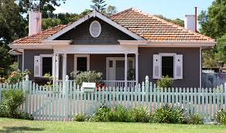
HOME WORK
Write a letter to your friend describing your experience of celebrating Pohela Boishakh .
.

Slide 15
THANK YOU

