Slide 1
Welcome

Slide 2
TEACHER’S IDENTITY:
ASMA HUQ
B.A.(Hons.),M.A.(English),M.Ed.
Asst.Teacher (English)
Motijheel Govt. Girls’ High School
Dhaka

Slide 3
Identity of the lesson :
Class : Nine
Subject : English for Today
Unit : Five
Lesson : Two

Slide 4
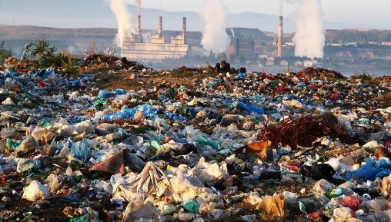
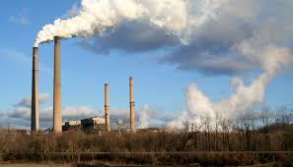
SEE THE PICTURES

Slide 5
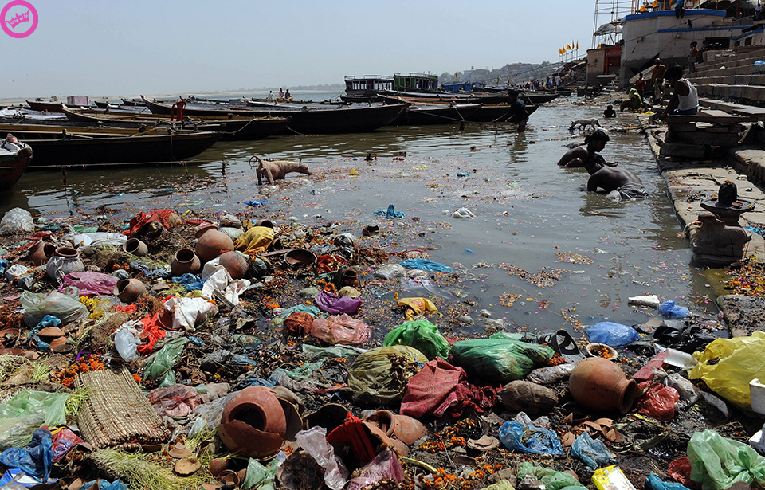
Today our topic is:
N
Enviromental Pollution

Slide 6
Aims and objectives of the lesson:
After reading the lesson students will be able to
(a) think about problems and their sollutions.
(b) develop their reading skill.
(c) develop their writing skill.

Slide 7
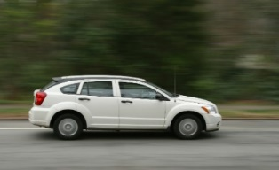
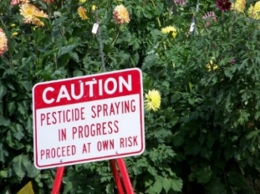
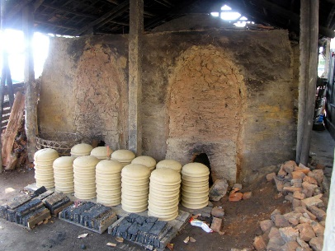
VOCABULARY:
Erosion ---- Decay
Automobile ---
Kiln ---- Cooker, Oven
Pesticide ---- Chemical
substances to kill
insects

Slide 8
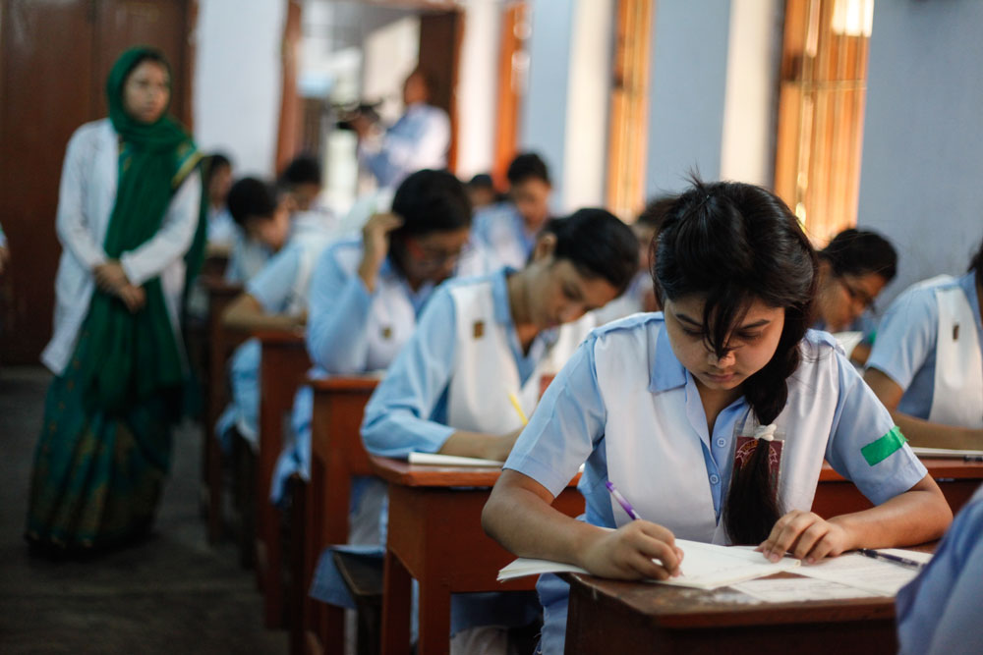
Silent reading activity:
Read the text at page 59-60 silently

Slide 9
PAIR WORK
Fill in the gaps with suitable words:
The environment in our planet are facing (a) ---- day by day and we are responsible for (b) ----
crisis.By reusing our (c) ----commodities and by reclying it we can save the earth.
Answer:
(a) Problems (b) this (c) used

Slide 10
EVALUATION:
(a) What are the causes of air pollution?
(b) How can we prevent water pollution?

Slide 11
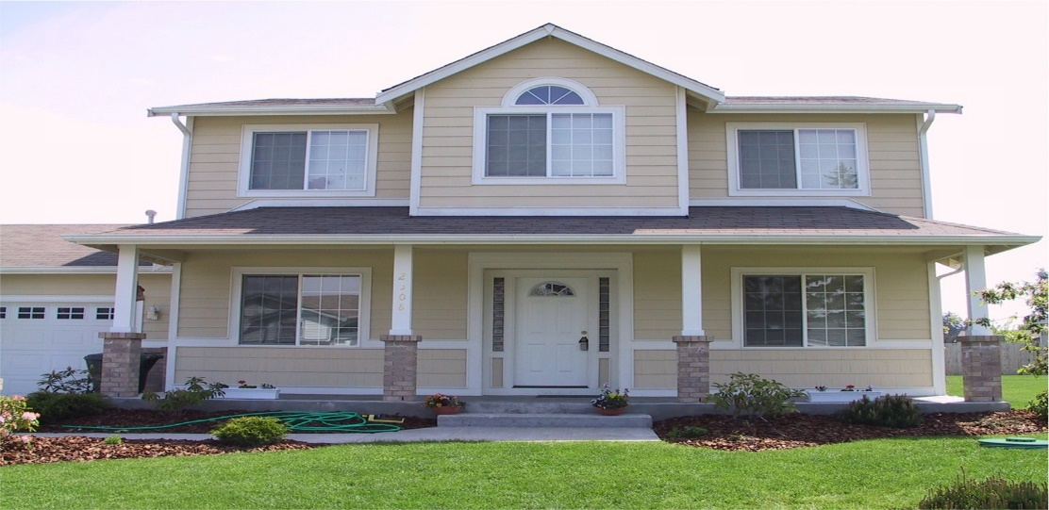
Home Work
Write a paragraph on
‘Environmental Pollution’
Notes:
P P

Slide 12
THE END
THE END

Slide 13
GOOD BYE

