Slide 1
WELCOME

Slide 2
Teacher’s Identity:
Md. Robel Haque
Assistant Teacher
Nirmoil Darazia Dakhil Madrasha
Shampur,Patnitala,Naogaon.
Mob: 01774795179
ENGLISH FOR TODAY
CLASS : Nine

Slide 3
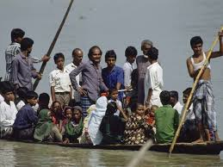
Where can you find this kind of boat ?
Why does the boatman carry passengers across a river ?
Why do people use country boats ?
What about the picture?
Discuss with your partner then answer the following questions.
Notes:
This slide only for mind set up. Teacher can ask another questions for grow class arrange.

Slide 4
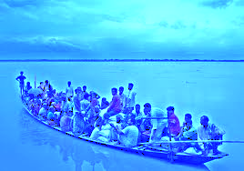
So today we’ll discuss about
The ferry boat.

Slide 5
Learning outcomes
After completing this lesson, students will be able to-
ask and tell about problems.
seek and give suggestions.
listen for specific information.
narrate something in writing.

Slide 6
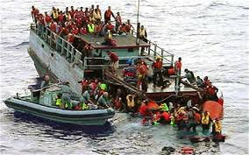
Discuss in pair. What were the causes of this accident? And say how we can avoid it.
Notes:
Showing the video teacher can ask question to the whole class. SS will raise their hands. Teacher can ask 5/6 students to narrate the video.

Slide 7
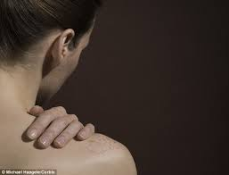
Shoulder
Can you make a sentence with the word “shoulder”.
Often country people carry their bags on shoulder.
Meaning
(Click here)
A organ of human body
Notes:
At first teacher will show the words then ask his/her students to tell the meaning and making sentences. If they fail teacher will show the picture again. For feedback click on meaning button.

Slide 8
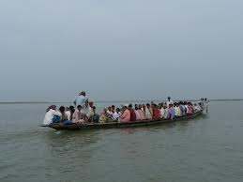
Cross the river
Key word
They are crossing the river by boat.
Can you make a sentence with the word “cross the river”.
Meaning
(Click here)
To go another side of a river.
Notes:
At first teacher will show the words then ask his/her students to tell the meaning and making sentences. If they fail teacher will show the picture again. For feedback click on meaning button.

Slide 9
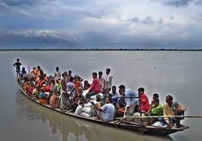
Ferry boat
Key word
Can you make a sentence with the word “ferry boat”.
After shopping they are returning home by a ferry boat.
A kind of boat by that`s people cross the river to paying fare.
Meaning
(Click here)
Notes:
At first teacher will show the words then ask his/her students to tell the meaning and making sentences. If they fail teacher will show the picture again. For feedback click on meaning button.

Slide 10
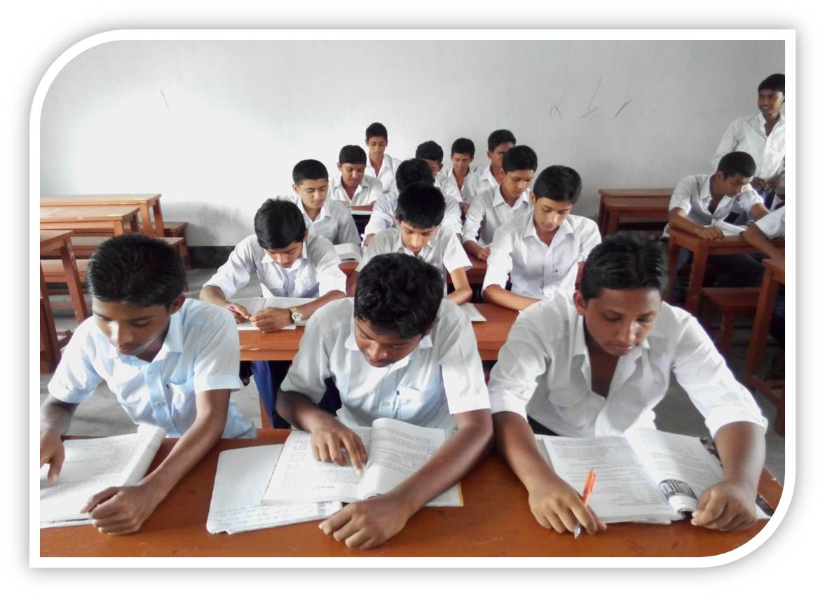
Individual Work
Read the text silently then answer the multiple choices questions that has given in the text.
Notes:
Teacher will monitor the class and can help them.

Slide 11
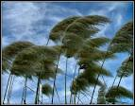
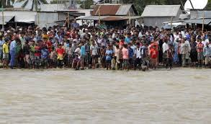
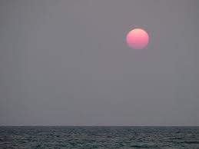
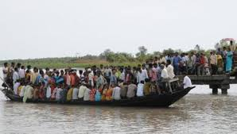
Pair works
Look at the pictures and guess why do many people have little or no patience in situations as in the ferry boat?
Notes:
Students will see the pictures, they can discusses it with their partner and will write minimum five sentences, teacher also can help them if necessary.

Slide 12
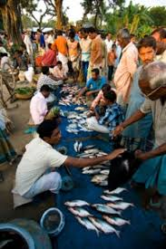
Group Work
Guess if we have too many buyers of fish in the market, what is likely to happen?
Notes:
Teacher cam make easy specially for the girl students.

Slide 13
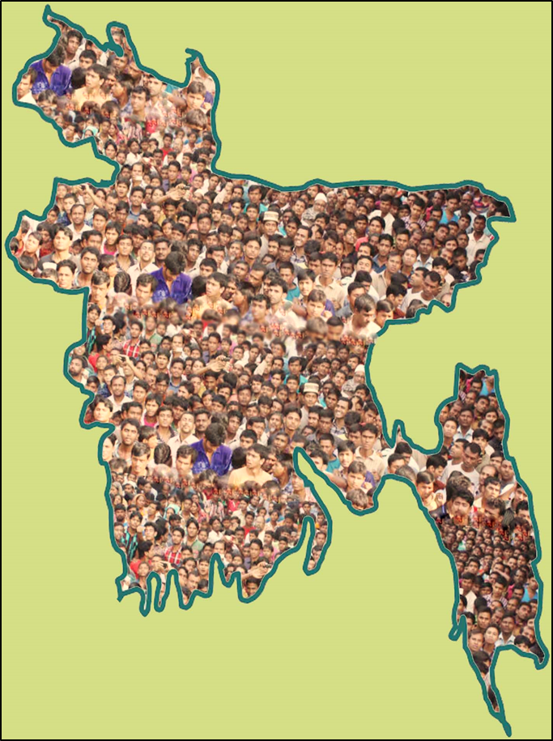
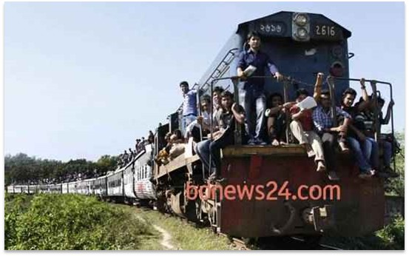
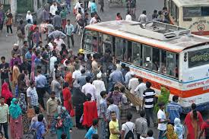
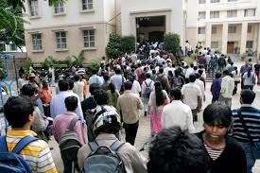
Population problems?
Look at the above pictures and guess if we have too many people in a town, bus and train then what will happen?
Notes:
Teacher can discusses about our population problems.

Slide 14
Homework
Write a paragraph sentences about ‘The ferry accident.’

Slide 15
Thanks to all
Notes:
Teacher can use any other language.

