Slide 1

Dear Students

Slide 2
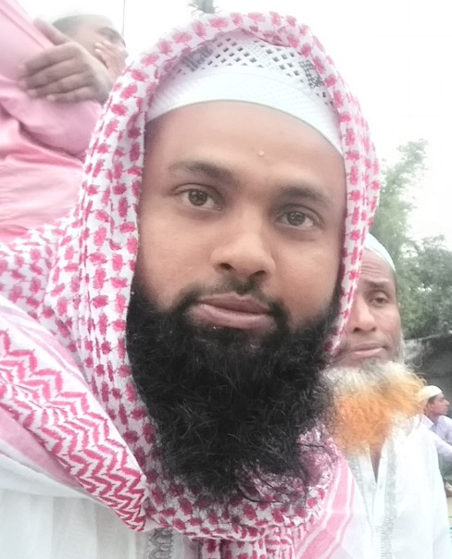
Introduction
Class-IX-X
English 2nd Paper
Md. Jakirul Islam
Assistant Teacher, English
Shaitshala Adarsha High School & College
Notes:
Identity of teacher & class.

Slide 3
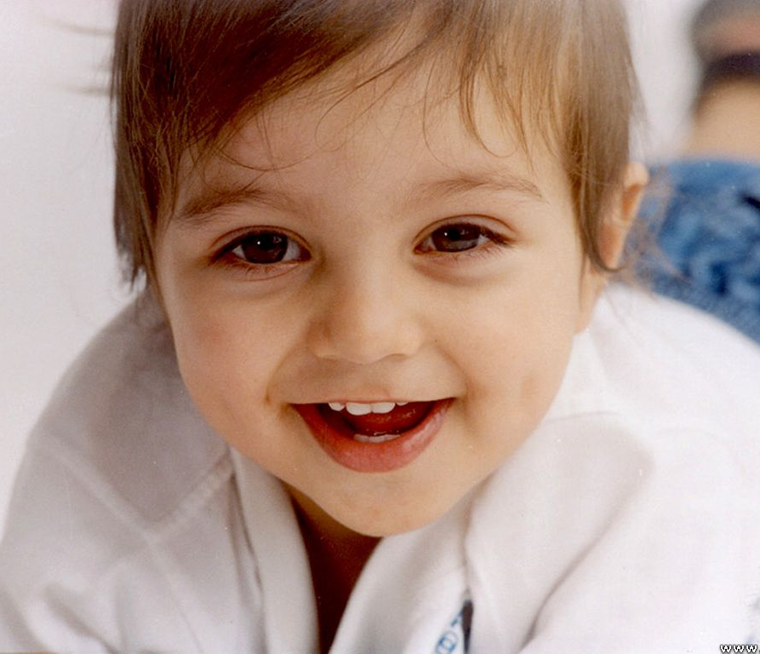
Remember
If the reporting verb is in present & future tense, there will be no change of the verb of the reported speech.
He says, “ My mother loves me more than her life.”
Direct speech
Indirect speech
He says that his mother loves him more than her life.
Notes:
Practice & implementation of verb & adverb shown through example.

Slide 4
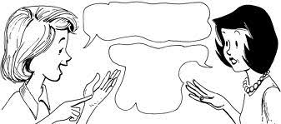
What fruits do you like, Sumi?
I like mango, and date. What do
You like,
Rani?
Rani asked Sumi what fruits she (Sumi) liked.
Sumi replied that she liked mango and date and asked her/Rani what she liked.
What can be Today’s lesson?
Notes:
Definition of speech.

Slide 5
Today’s lesson is:
Direct Speech &
Indirect Speech
in Passage
Notes:
Lesson declaration.

Slide 6
Learning outcomes
After the end of this lesson, learners will be able to---
Convert direct speech into indirect in passage.
Notes:
Target of today’s class.

Slide 7
Flash Back

Slide 8

” I want to feel free as the flowers.”
Direct speech
Indirect speech
He told that he wanted to feel free as the flowers.
Notes:
Practice & implementation of verb & adverb shown through example.

Slide 9
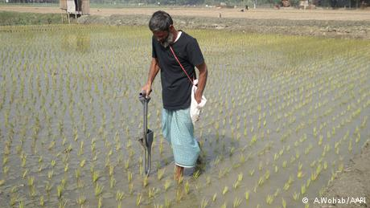
He said to me, “ I was working in the field.”
Direct speech
Indirect speech
He told that he had been working in the field.
Notes:
Practice through example.

Slide 10
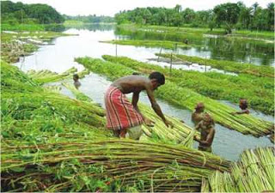
He said, ‘’We have finished our work.”
Direct speech
Indirect speech
He said that they had finished their work.
Notes:
Practice & implementation of verb & adverb shown through example.

Slide 11
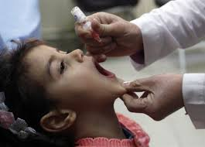
Shima said, “I took medicine yesterday.”
Direct speech
Indirect speech
Shima said that she had taken medicine the previous day.
Notes:
Practice & implementation of verb & adverb shown through example.

Slide 12
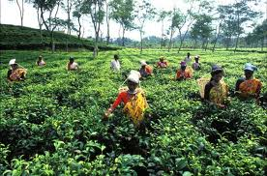
The worker says, “we work in the tea garden.”
Direct speech
Indirect speech
The worker says that they work in the tea garden.
Notes:
Practice & implementation of verb & adverb shown through example.

Slide 13
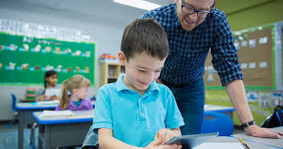
The speeches of ‘the teacher’
The speeches of ‘I’
The teacher said to me, “Do you understand the point?” “Yes,” said I. “But I have some other problems.” “Then come to my room in the afternoon. I am busy now,” said he. “Thank you, sir,” said I. “I will come on time today. Should I need to bring any book?” “No,” said the teacher.
The teacher said to me, “Do you understand the point?” “Yes,” said I. “But I have some other problems.” “Then come to my room in the afternoon. I am busy now,” said he. “Thank you, sir,” said I. “I will come on time today. Should I need to bring any book?” “No,” said the teacher.

Slide 14
The teacher said to me, “Do you understand the point?”
The teacher asked me if I understood the point.
“Yes,” said I. “But I have some other problems.”
I replied in the affirmative and added that I had some other problem.
Let’s divide the speeches.
“Then come to my room in the afternoon. I am busy now,” said he.
He told me then to go to his room in the afternoon and added that he was busy then.
“Thank you, sir,” said I. “I will come on time today. Should I need to bring any book?”
I respectfully thanked the teacher/him and added that I would go on time that day and also asked if I should need to bring any book.
“No,” said the teacher.
The teacher replied in the negative.

Slide 15
The teacher said to me, “Do you understand the point?” “Yes,” said I. “But I have some other problems.” “Then come to my room in the afternoon. I am busy now,” said he. “Thank you, sir,” said I. “I will come on time today. Should I need to bring any book?” “No,” said the teacher.
The teacher asked me if I understood the point.
I replied in the affirmative and added that I had some other problem.
He told me then to go to his room in the afternoon and added that he was busy then.
I respectfully thanked the teacher/him and added that I would go on time that day and also asked if I should need to bring any book.
The teacher replied in the negative.

Slide 16
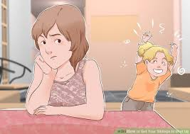
The speeches of ‘Sanjida’
The speeches of ‘her brother’
Sanjida said to her brother, “Where are you going?” “I am going to play cricket.” “ It is time to read. Don’t go now,” said she. “I will not read now because I have an important match today,” said he.
Sanjida said to her brother, “Where are you going?” “I am going to play cricket.” “ It is time to read. Don’t go now,” said she. “I will not read now because I have an important match today,” said he.

Slide 17
Sanjida said to her brother, “Where are you going?”
Sanjida asked her brother where he was going.
“I am going to play cricket.”
Let’s divide the speeches.
He replied that he was going to play cricket.
“ It is time to read. Don’t go now,” said she.
She told that it was time to read and forbade to go then.
“I will not read now because I have an important match today,” said he.
He told that he would not read then because he had an important match that day.

Slide 18
Sanjida said to her brother, “Where are you going?” “I am going to play cricket.” “ It is time to read. Don’t go now,” said she. “I will not read now because I have an important match today,” said he.
Sanjida asked her brother where he was going.
He replied that he was going to play cricket.
She told that it was time to read and forbade to go then.
He told that he would not read then because he had an important match that day.

Slide 19
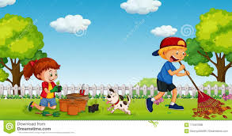
The speeches of ‘Rina’
The speeches of ‘Hasan’
“What a beautiful garden it is! Have you made this garden, Hasan?” said Rina. “Yes, I have made it myself. Gardening is my hobby,” said Hasan. “What is your hobby?” “My hobby is reading books,” said Rina.
“What a beautiful garden it is! Have you made this garden, Hasan?” said Rina. “Yes, I have made it myself. Gardening is my hobby,” said Hasan. “What is your hobby?” “My hobby is reading books,” said Rina.

Slide 20
“What a beautiful garden it is! Have you made this garden, Hasan?” said Rina.
Rina exclaimed with joy that it was a beautiful garden and asked Hasan if he had made that garden.
Let’s divide the speeches.
“Yes, I have made it myself. Gardening is my hobby,” said Hasan. “What is your hobby?”
Hasan replied in the affirmative that he had made it himself and added that gardening was his hobby and asked what her hobby was.
“My hobby is reading books,” said Rina.
Rina replied that her hobby was reading books.

Slide 21
“What a beautiful garden it is! Have you made this garden, Hasan?” said Rina. “Yes, I have made it myself. Gardening is my hobby,” said Hasan. “What is your hobby?” “My hobby is reading books,” said Rina.
Rina exclaimed with joy that it was a beautiful garden and asked Hasan if he had made that garden.
Hasan replied in the affirmative that he had made it himself and added that gardening was his hobby and asked what her hobby was.
Rina replied that her hobby was reading books.

Slide 22
Group Work 8 min
For Group-A
The new teacher entered the classroom and said, “Can you tell me what I should do now?” “No, sir,” said one of the students. The teacher smiled and said, “Try to guess.” “You should introduce yourself to us,” another student said. “Thank you,” said the teacher. “You are really brilliant.”
For Group-B
Mina said to Rina, “When does your Test Examination commence?” “It commences on 9 November,’’ said she. “Your Test Examination is knocking at the door and you don’t have a lot of time,” said Mina. “You’re right,” said Rina.

Slide 23
The new teacher entered the classroom and said, “Can you tell me what I should do now?” “No, sir,” said one of the students. The teacher smiled and said, “Try to guess.” “You should introduce yourself to us,” another student said. “Thank you,” said the teacher. “You are really brilliant.”
Answer
The new teacher entered the classroom and asked students if they could tell him what he should do then.
One of the students respectfully replied in the negative.
The teacher smiled and told (them/students) to try to guess.
The teacher smiled and told (them/students) to try to guess.
Another student told that he should introduce himself to them.
The teacher thanked him and told that he was really brilliant.

Slide 24
The new teacher entered the classroom and said, “Can you tell me what I should do now?” “No, sir,” said one of the students. The teacher smiled and said, “Try to guess.” “You should introduce yourself to us,” another student said. “Thank you,” said the teacher. “You are really brilliant.”
Answer
Mina asked Rina when her Test Examination commenced.
She replied that it commenced on 9 November.
Mina told that her Test Examination was knocking at the door and she didn’t have a lot of time.
Rina told (Mina) that she was right.

Slide 25
“Have you read the book? Where did you go yesterday?” asked Fahim.
“I have lost the book which you gave me. I went to bazar to buy that book but I did not find it”, said Kamal.
“Don’t worry”, said Fahim. “It’s nothing.”
“Thank you, my friend.”
Fahim asked Kamal if he (K) had read the book and also asked where he (K) had gone the previous day.
Kamal replied that he had lost the book which he (F) had given him and added that he had gone to bazar to by that book but he had not found it.
Fahim told Kamal not to worry and added that it was nothing.
Kamal thanked Fahim/him.

Slide 26
My mother said, “Why do you not practise spoken English? Don’t you know that it’s an international language? Do you know that about half of the people of the world speak in English?” “Yes”, I said. “But it is hard to learn.”
My mother asked me why I did not practise spoken English and also asked if I didn’t know that it is an international language and again asked if I knew that about half of the people of the world spoke in English.
I replied in the affirmative but told that it was hard to learn.

Slide 27
“Why are you putting the food into your pocket, sir? Why don’t you eat?” asked the nobleman. “I’m doing the right thing. My dress deserves these rich dishes”, replied Sheikh Sadi. “I don’t understand what you mean to say”, said the nobleman. “And I am sorry.”

Slide 28
Home work
Notes:
Assignment at home.

Slide 29
“Have you done your home-works?” The mother said to the daughter. “No, I’ve forgotten”, said the daughter. “That’s bad. You must be more careful about your home-works. By doing so, you can’t expect to do well in your studies”, said the mother.
“How lovely the toy is! I’ll buy it”, said Tonim. “No, it is not durable. Tomorrow we will visit another village fair. Then you can buy another toy. Let’s go now”, said mother. “You must buy me a good toy”, said Tonim. “Yes”, replied she.
The teacher said to the boy, “Do you think that honesty is the best policy?” The boy said, “Yes, sir. I think so.” “Then learn to be honest from your boyhood”, said the teacher. “Thank you, sir”, said the boy. May Allah grant you a long life”, said the teacher to the boy.

Slide 30


