Slide 1
WELCOME

Slide 2
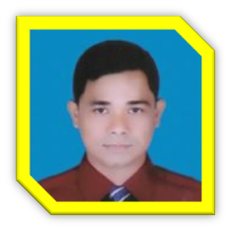
Identity
Hare krisna singha Assistant teacher Nowdabash K.M.S.C High School Hatibandha. Lalmonirhat
English For Today
Class : Six.

Slide 3
LOOK AT THE PICTURES
This picture is about a conversation.
Do you know what about the pictures ?
Notes:
Showing the picture teacher can ask the question to the whole class. SS will raise their hands. Teacher can ask 5/6 students to narrate the picture.

Slide 4
Lesson declaration
So, Today we`ll discuss about a conversation -
Where are you from ?
Lesson : 4,

Slide 5
Lesson outcomes
By the end of this lesson students will be
able to –
# recognize word and stress on words in sentences.
# talk about people, places and familiar objects in short and simple sentences
# ask and answer questions.

Slide 6
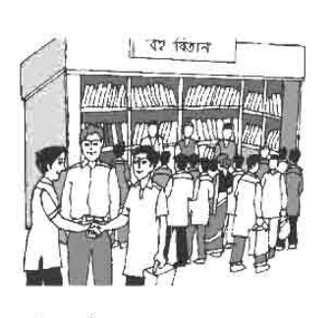
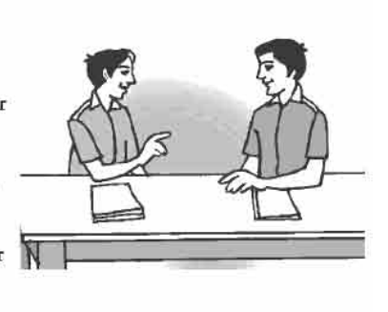
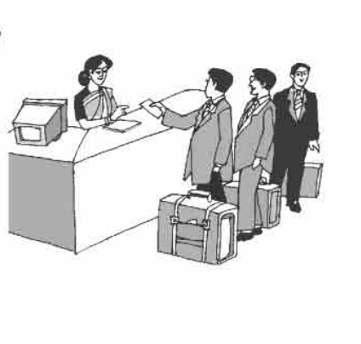
Presentation.
Open your book , Lesson – 4.
Follow the conversations then practice in pairs.
Notes:
Teacher can read the conversations loudly and can discuss the conversations. When students will read and practice the conversations teacher may help them. After reading or discussing teacher can call 2/3 pairs in front of class for practice.

Slide 7
Language Focus –Follow the conversation
Australia
I am from Sylhet.
Where do you come from, Sajed?
Where do you come from, Mr. Smith?
Notes:
After showing the conversation teacher can ask his/her students to practice in pair.

Slide 8
Joy asks
“Where do you come from, Sajed?” What could Joy ask him instead? ---
Thanks, Joy , My birth place is Sylhet.
(Joy could ask )
Where is your birth place, Sajed ?

Slide 9
Language Focus
Notice that sometimes the answer to “Where do you come from?” or “Where are you from?” is the name of the country one belongs to. But when both the speakers are from the same country, the question would obviously mean what part of the country one belongs to.
Notes:
Teacher can discuss about the questions form.

Slide 10
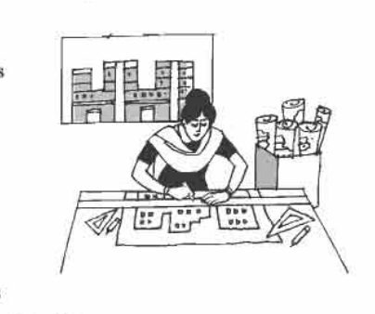
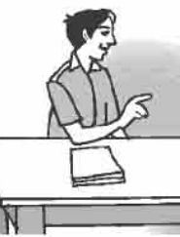
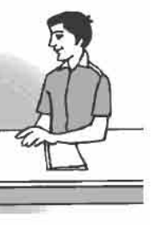
Look at the picture and follow the conversation.
Now, she is designing a school building.
Thanks Akash, She is an architect.
What is she doing at the moment ?
What does your cousin do, Mamun ?

Slide 11
Language Focus.
Notice the difference between “What do you do?” and “What are you doing?” `What do you do?’ means the same as `What’s your profession?’ On the other hand, `What are you doing’ refers to what you are doing at the moment, or to something you are doing around that time.
Use of what do/does --and where do/does --
When subject is 3rd person singular number then we use does. Otherwise we use do.
Example :
What do you do ? / Where do you come from ?
What does he do ? / Where does he come from ?
Notes:
Teacher can discuss about the form of interrogative sentence in present tense and other tenses.

Slide 12
Key words
When two or more person met together.
Meet
Akash : I am nice to meet you, James.
Notes:
First, the word can be shown. The SS can be asked to pronounce the word. If it is needed teacher can help. Then the picture can be shown and asked to guess the meaning. Then the meaning can be shown. Then they can be asked to make a sentence. Teacher can show the sentence for the feedback.

Slide 13
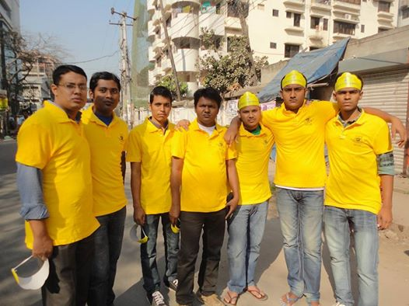
Key words
A person who designs or plans building etc.
Architect
They are a set of architect.
Notes:
First, the word can be shown. The SS can be asked to pronounce the word. If it is needed teacher can help. Then the picture can be shown and asked to guess the meaning. Then the meaning can be shown. Then they can be asked to make a sentence. Teacher can show the sentence for the feedback.

Slide 14
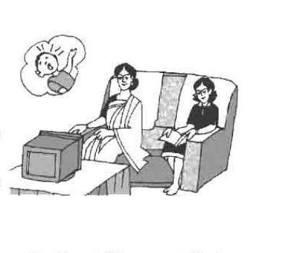
Key words
Watch
Observe / look at
Rabeya Begum is watching TV.
Notes:
First, the word can be shown. The SS can be asked to pronounce the word. If it is needed teacher can help. Then the picture can be shown and asked to guess the meaning. Then the meaning can be shown. Then they can be asked to make a sentence. Teacher can show the sentence for the feedback.

Slide 15
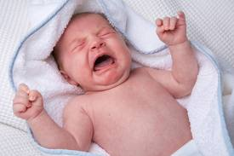
Key words
Scream
Crying at the top of voice.
The baby is crying at the top of its voice.
Notes:
First, the word can be shown. The SS can be asked to pronounce the word. If it is needed teacher can help. Then the picture can be shown and asked to guess the meaning. Then the meaning can be shown. Then they can be asked to make a sentence. Teacher can show the sentence for the feedback.

Slide 16
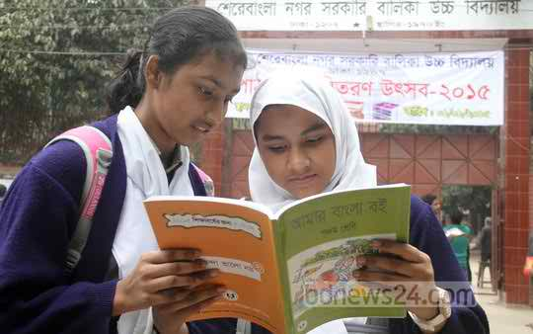
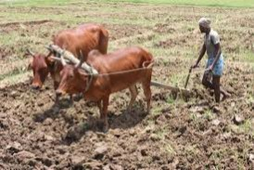
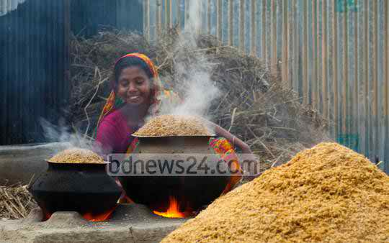
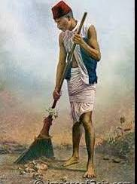
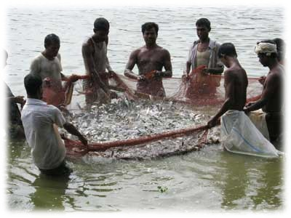
Pair works
Look at the pictures and write about what each person’s profession is, and what he or she is doing at the moment.
Notes:
Teacher can evaluate it by orally or written from the SS.

Slide 17
HOME WORK
Meet with five persons at your home and write down, what are they and what are they doing? at that moment.

Slide 18
THE END

