Slide 1
WELCOME
Notes:
Welcome slide.

Slide 2
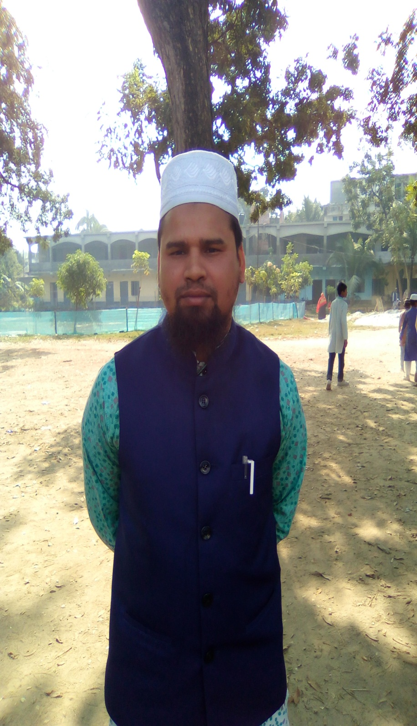
Introduction
Md. Farid Uddin Assistant Teacher(English)
Dupchanchia D.S Fazil Madrasah
Presentation made for class
English 2nd paper
Nine & Ten
Notes:
Identity of the teacher and subject & class

Slide 3
Watch video, get excited.
Notes:
Suspension

Slide 4
The performance that the skeleton shows is very amazing.
The performance of the skeleton is very amazing.
What kind of change have you followed by the sentences?
Complex to simple
Notes:
Leading to the lesson.

Slide 5
So Our Today’s Lesson is -
Transformation of sentence
Complex to Simple
Notes:
Lesson declaration.

Slide 6
Learning outcomes
At the end of the lesson we will be able to—
change from complex to simple sentence
Notes:
Students will be able to change into simple from different items of complex sentence.

Slide 7
Notes:
To involve the students to the lesson.

Slide 8
Complex (Though/Although) to simple
Though/Although the cuckoo looks ugly, it sings sweetly.
In spite of looking ugly the cuckoo sings sweetly.
In spite of ugliness the cuckoo sings sweetly.
Structure: 1. In spite of + v₄ +adjective + principal clause
Structure: 2. In spite of +noun + principal clause
Structure: 3. In spite of + being + adjective + principal clause.
Notes:
V₄ means verb+ing. The Main subject is to be added with principal clause, like ‘the cuckoo’ in stead of ‘it’ If there is ‘be’ verb though/although, follow structure No-3

Slide 9
Complex (Who /Which/That in present tense) to simple
Structure: Subject + v₄+ Ex.words +principal clause.
The tree that stands before the house has grown old.
The tree standing before the house has grown old.
Subject
V₄
Ex.wrd
Principal clause
The tree that stands before the house has grown old.
Notes:
Present tense focused here.

Slide 10
The woman who is begging from door to door is a blind.
Make it simple following the structure below.
Structure: Subject + v₄+ Ex. words +principal clause.
The woman begging from door to door is a blind.
The pigeon which is flying in the sky is looking beautiful (simple).
Notes:
V _{4 I mean verb + ing}

Slide 11
Complex (Who /Which/That in past tense) to simple.
If the sentence is in past tense, relative
pronoun will be removed to make it simple.
The car which I bought last year was cheap.
The car I bought last year was cheap.
The book which was published in 2015 got good market. (Simple)
The book published in 2015 got good market.
Notes:
Use of past tense focused here.

Slide 12
If the complex sentence is formed with ‘wh word’
+ be verb + adjective, the structure will be-
A/An + adjective + noun +verb + extension.
Subject
verb
extension
Follow
The student who is studious can shine in life.
A studious student can shine in life.
Subject
verb
extension
Notes:
Another use of simple sentence.

Slide 13
Change the sentences into simple.
1. This is the scenery which is beautiful.
2. The lake that stands before the hill looks wonderful.
3. The scenery which was created long past presents a nice view.
4. The scenery which is looking excellent gives a wonderful feeling.
5.. The scenery that charms us much can refresh our minds.
6. Though he is short, he is dangerous.
7. Although he looks laughing, he is a cheat.
8. Though he has a lot of money, he is very greedy.
9. Although he talks much, he is a fool.
10. Though he appears simple, he acts complex.
Notes:
Evaluation/feed back

Slide 14
Good Bye

