Slide 1
Concerning
Dear colleagues,
By this time you have followed two contents on simple to complex. But this is the 2nd content on ‘Complex to Simple’. Another content on the same subject will be made. In case of finding any lacking recover it yourself. Otherwise you may contact with me in 01717220115.
Your near and dear one
Hasan Cambrian.

Slide 2
Welcome

Slide 3
Introduction
Md. Hasan Hafizur Rahman
Lecturer & Head of the Department (English)
Building-5
Cambrian School & College,Dhaka
Presentation made for class IX-X
English second Paper
Grammar

Slide 4
When it is morning, he gets up from sleep.
In the morning he gets up from sleep.
As he studies well, he will get A+.
Studying well, he will get A+.
What kind of change have you followed?
Complex to simple

Slide 5
Our today’s lesson is
Transformation of sentence
Simple to complex

Slide 6
Learning outcomes
After we have studied this lesson, we will be able to…
change from complex to simple

Slide 7
Complex sentence of As/Since/When with action verb will take the change as follows
V₄ (Verb +ing) +extension + principal clause
When the thief saw the police, he ran away.
Seeing the police he ran away.
V₄
extension
Principal clause
Since Mustafiz played well, he got the award (Make it simple).
As he got a handsome amount, he bought a car (Make it simple).

Slide 8
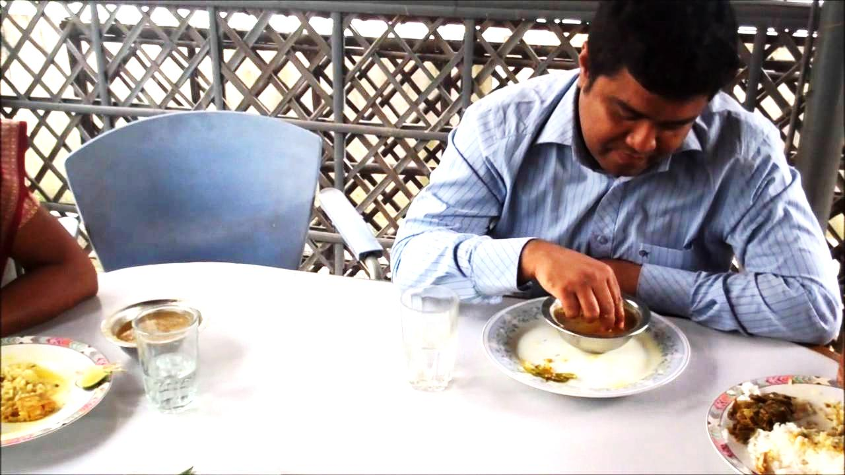
As/Since/When with Indefinite/continuous form will take the change as follows
At the time of + possessive + v₄+extension + principal clause
When I was eating supper, the phone rang.
At the time of my eating supper the phone rang.
Change the sentences from complex to simple.
As I was going to London, I took my passport .
Since I was sleeping, I switched my mobile off .
When they play football, we enjoy it.
When I read at home, my mother serves me light foods.
I remain keep and quiet when I say my prayer.
Notes:
Use of ‘at the time of’ in continuous & indefinite form of tenses.

Slide 9
As/Since/When with be verb (with same subject) will take the change as follows
Being +extension + principal clause with main subject
As the boy is poor, he has to do hard work for his family.
Being poor the boy has to do hard work for his family.
Change the sentences from complex to simple.
1. Since the boy was meritorious, he made a good result.
2. As the man is old, he cannot bear the load of the bundle.
3. Since the baby is cute, everyone likes him very much.
4. When he was small, he was considered a minor to attend the party.
5. As he is an wise man, he is respected everywhere.
Notes:
Use of same subject and feed back taken here.

Slide 10
As/Since/When with be verb (with different subjects) will take the change as follows
First subject +being +extension + principal clause
Since the weather is very cold, there is no birds or animals in the area.
The weather being very cold there is no birds or animals in the area.
As the weather was unbearable, we left the place very soon (Simple).
Since the weather was too cold, no living being can stay here at all (Simple).
Notes:
‘Be’ verb is the main focus here.

Slide 11
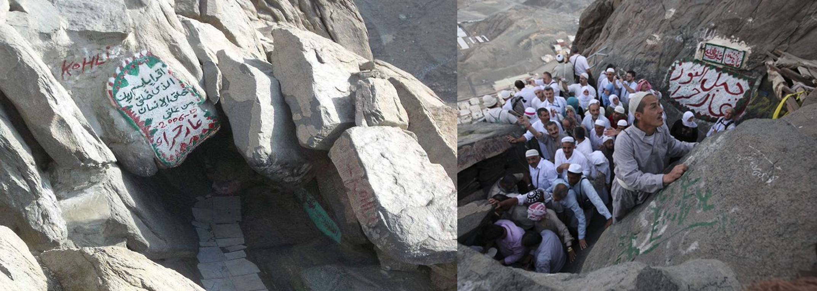
If the complex is of As/Since/When with day, daylight, night, 10am, structure will be--
At + noon, day, daylight, night, 10am + principal clause
Cave Hira
Jabal-E-nur
When it was daylight, we all came out of the cave.
At daylight we all came out of the cave.
Notes:
Use of ‘At’ in some several places.

Slide 12
The moon shines when it is night.
The moon shines at night.
Change the sentences into simple
1. I go to school when it is 10 am.
2. The sun shines when it is day.
3. When it is 11 pm I go to bed.
4. We take our lunch when it is noon.
5. We went to the station when it was night.
Notes:
Teaching and feed back.

Slide 13
If ‘when, means season (Spring, Winter, Summer Autumn, year) simple’s structure will be --
In + season’s name/year +principal clause
When it is spring, the cuckoo sings.
In spring, the cuckoo sings.
Notes:
Showing ‘when’ as season & year.

Slide 14
If ‘when’ means morning, afternoon, evening, structure will be--
In the + morning/afternoon/evening + principal clause.
When it is morning, lily blooms.
In the morning, lily blooms.
Change the sentences into simple.
We play when it is afternoon.
When it is evening, birds return to their nests.
We can take a fresh air when it is morning.
Notes:
Showing ‘when’ as 3 times of the day. Feed back/evaluation.

Slide 15
If ‘when’ means age, the structure will be--
At the age of + age quantity + principal clause.
When they were 10, they swam in the village pond.
At the age of 6 they swam in the village pond.
Notes:
If we mean ‘when’ as age we have to follow this.

Slide 16
Home Task
Make 10 complex sentences and
change them into simple at your own.
See you again.
Notes:
Ending slide

Slide 17
Acknowledgement
We would like to express our cordial gratitude to the Ministry of Education, Directorate of Secondary & Higher Education, NCTB, A2i and the panel of honorable editors ( Md. Jahangir Hasan, Assistant Professor (English) TTC, Rangpur, Ranjit Poddar, Associate Professor (English) TTC, Dhaka, and Urmila Khaled, Assistant Professor (English) TTC, Dhaka, to enrich the contents.

