Slide 1
Notes for the colleagues
Dear colleagues,
It is very difficult to apply all the rules of narration exclusively. Here sense & notion is a factor. If we apply our sense and notion to change speech, it may be correct also. So, I like to request you to apply the best method to teach speech to the learners as you like. We know that “Teacher himself is the best method.”
To make the content effective in the class room, please see the instructions below every page.

Slide 2
Welcome to my
class dear students
Notes:
Welcome slide

Slide 3
Introduction
Md. Hasan Hafizur Rahman
Lecturer & Head of the Department (English)
Cambrian School & College, Campus-5,
Dhaka.
Class-IX-X
English 2nd Paper
Notes:
Introduction of teacher & class.

Slide 4
Let’s enjoy a video
Notes:
You have to wait 5 seconds.

Slide 5
She said, “How funny the cat is!”
She exclaimed with joy that
the cat was very funny.
Notes:
Suspension on exclamatory with ‘how’

Slide 6
“What a dreadful danger the tsunami is!”
They exclaimed with sorrow that the tsunami was a great dreadful danger.
Notes:
Suspension on exclamatory with ‘how’

Slide 7
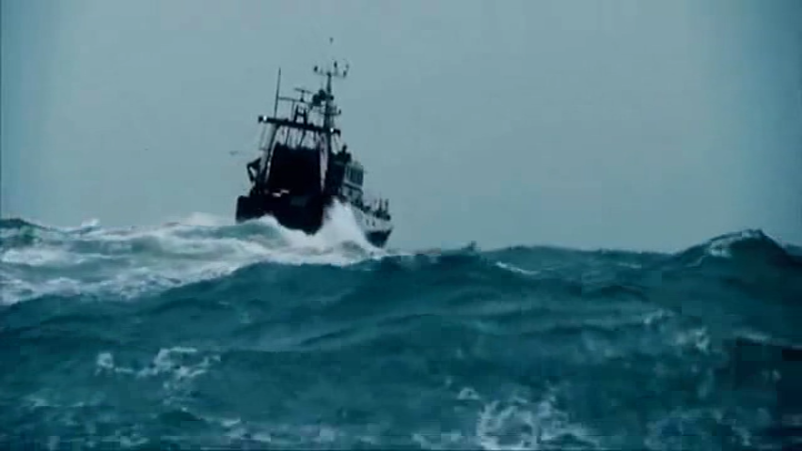
“How awesome the sea storm is!”
We exclaimed with wonder that the sea storm was a great awesome
Notes:
Use of ‘exclaimed with’

Slide 8
Can you guess what we are
going to discuss in our class?
Direct and indirect speech of exclamatory sentences.
Notes:
Taking out today’s subject from the students.

Slide 9
Our Today’s lesson is-
How to change the speech of Exclamatory sentences.
Unit-7, Lesson-1
Notes:
Lesson declaration.

Slide 10
Learning objectives
After completing this lesson, students will be able to---
define exclamatory sentences.
identify the structures of changing speech.
change direct speech into indirect.
Notes:
Target of this class.

Slide 11
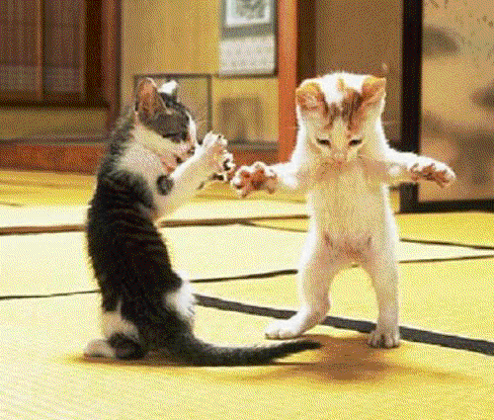
What have you meant by the pictures?
Something strange, amazing, pathetic & wonderful
What is exclamatory sentence?
Exclamatory sentence we mean something strange, amazing, pathetic & wonderful
Notes:
Definition of exclamatory sentence through asking question about the pictures.

Slide 12
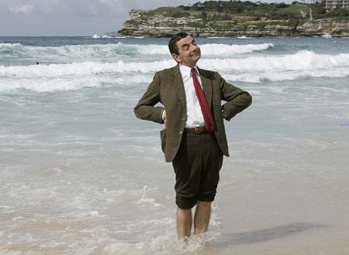
“What a funny picture it is!” Ripon said.
Ripon exclaimed with joy that it was a very funny picture.
Notes:
Leading to indirect (Exclamatory)

Slide 13
Follow
What a beautiful scenery it is!
How ferocious the tiger is!
There are two categories
of Exclamatory sentence
Exclamatory with What
Exclamatory with How
What a big river the Padma is!
How brilliant the boy is!
Notes:
Teacher may find out two categories of exclamatory sentences from the students showing the two sentences above.

Slide 14
He said to me, “How pathetic the scenery is!”
He exclaimed with sorrow that the scenery was very pathetic.
Notes:
Showing the use of exclaimed with sorrow.

Slide 15
He said to me, “ What a nice scenery it is!”
He exclaimed with joy that it was a very nice scenery.
He said to me, “ Alas! I am undone.”
He exclaimed with sorrow that he was undone.
Subject + exclaimed with joy/sorrow/wonder + that + assertive form of reported speech (past form)+.
What is the structure of changing exclamatory sentence from direct to indirect.
Notes:
Basic to change exclamatory from direct to indirect.

Slide 16
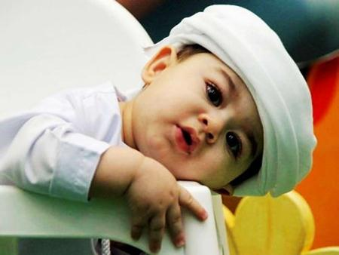
She said, “How cute the baby looks!”
She exclaimed with joy that the baby looked very cute.
Notes:
Use of exclaimed with joy.

Slide 17
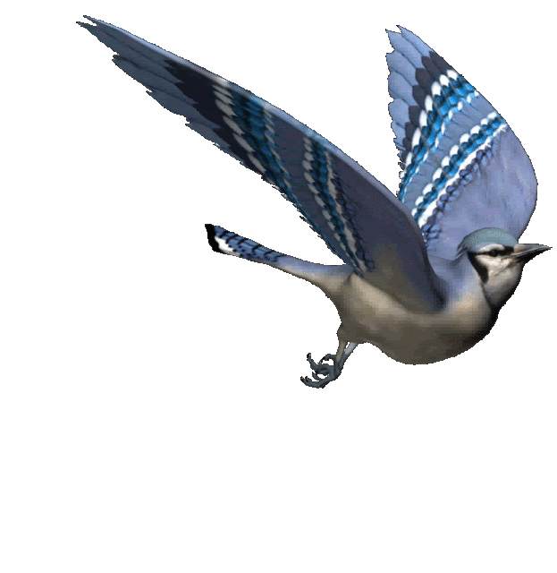
He said , ”How wonderful the bird is!”
He exclaimed with wonder that the bird was very wonderful.
Notes:
Practice on exclamatory with ‘wonder’.

Slide 18
“Oh God, What a pity!” she cried.
She cried with grief that it was a great pity.
Notes:
Related reporting verb may be used on situation. Such as cried with grief.

Slide 19
He said , ”Hurrah! We have won the match.”
He exclaimed with joy that they had won the match.
Notes:
Practice on exclamatory with exclamation word ‘Hurrah’

Slide 20
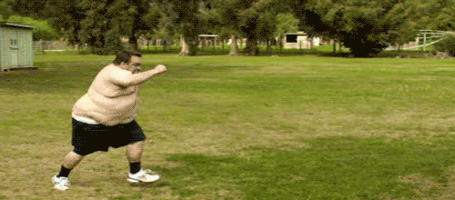
He said , ”What an interesting event it is!”
He exclaimed with joy that it was a very interesting event.
Notes:
Practice on exclamatory with ‘what’. Students may be excited with joy.

Slide 21
Pair Work
Write five exclamatory sentences with ‘What & How’, then make them indirect and write the structures of the speeches you changed.
Notes:
Revision through pair work.

Slide 22
Thank you all.
Continue to passage narration next
Notes:
Ending greeting.

Slide 23
Acknowledgement
We would like to express our cordial gratitude to the Ministry of Education, Directorate of Secondary & Higher Education, NCTB, A2i and the panel of honorable editors ( Md. Jahangir Hasan, Assistant Professor (English) TTC, Rangpur, Ranjit Poddar, Associate Professor (English) TTC, Dhaka, and Urmila Khaled, Assistant Professor (English) TTC, Dhaka, to enrich the contents.

