Slide 1
Dear colleagues,
It is very difficult to apply all the rules of narration exclusively. Here sense & notion is a factor. If we apply our sense and notion to change speech, it may be correct also. So, I like to request you to apply the best method to teach speech to the learners as you like. We know that “Teacher himself is the best method.”
To make the content effective in the class room, please see the instructions below every page.
Notes:
Notes for the teachers.

Slide 2
Welcome Students
You are most welcome to this class dear students.
Notes:
Welcome slide

Slide 3
Introduction
Md. Hasan Hafizur Rahman
Lecturer & Head of the Department (English)
Cambrian School & College, Campus-5,
Dhaka.
Class-IX-X
English 2nd Paper
Notes:
Introduction of teacher & class.

Slide 4
He said , “Do you like marshal art?”
He asked if I liked marshal art.
Notes:
Suspension on interrogative with ‘yes/no’ question.

Slide 5
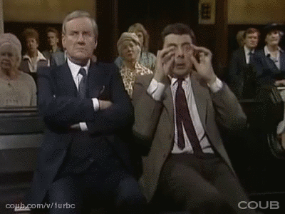
The man said to Mr. Bean,
” Why do you disturb me?”
The man asked Mr.Bean why he disturbed him.
Notes:
Suspension on interrogative with ‘wh’ question.

Slide 6
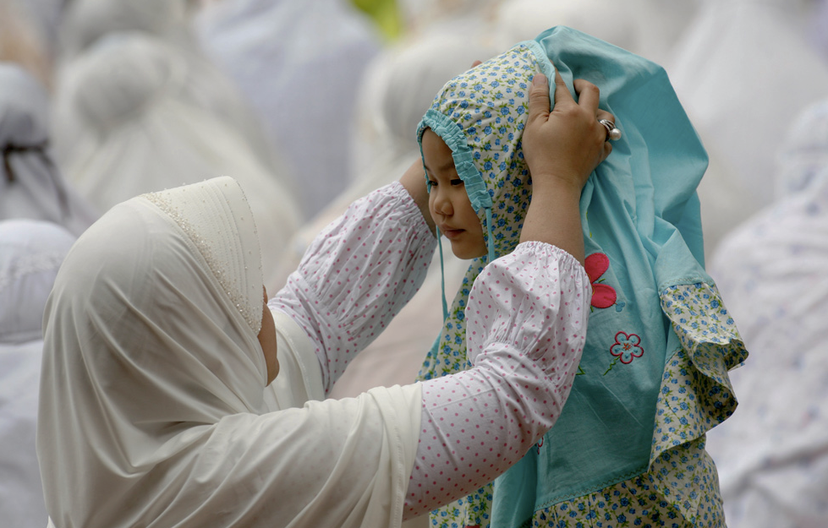
Mother said, “May Allah bless my child.”
Mother prayed that Allah might bless her child.
Notes:
Suspension on optative sentence.

Slide 7
Can you guess what we are
going to discuss in our class?
Direct and indirect speech of Interrogative and optative sentences.
Notes:
Taking out today’s subject from the stuents.

Slide 8
Our Today’s lesson is-
How to change the speech of Interrogative and Optative sentences.
Unit-7, Lesson-1
Notes:
Lesson declaration.

Slide 9
Learning objectives
After completing this lesson, students will be able to---
define interrogative and optative sentence
identify the structures of changing speech
change direct speech into indirect
Notes:
Target of this class.

Slide 10
What is Interrogative sentence?
The sentence which is used to know something is interrogative sentence.
Notes:
Definition of interrogative sentence.

Slide 11
Follow
Do you like to follow your parents?
What is the aim of your life?
There are two categories
of Interrogative sentence
Yes/No Question
Wh Question
Are you well?
Who is he?
Notes:
Teacher may find out ‘yes/no & wh’ question from the students showing the two sentences above.

Slide 12
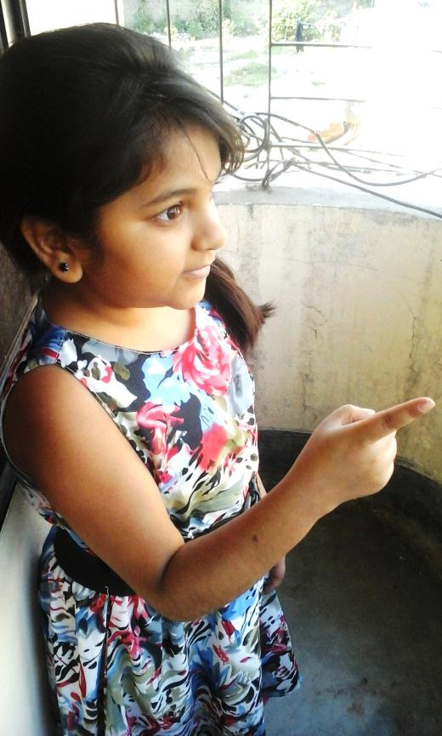
“Do you like my song?” Asha said to Tasha.
Asha asked Tasha if she liked her song.
How to change ‘Yes/No’ question from direct to indirect speech.
Subject + asked + object + if/whether+ subject + verb + extension.
Notes:
Teaching structure how to change direct into indirect form of interrogative with ‘yes/no’ question.

Slide 13
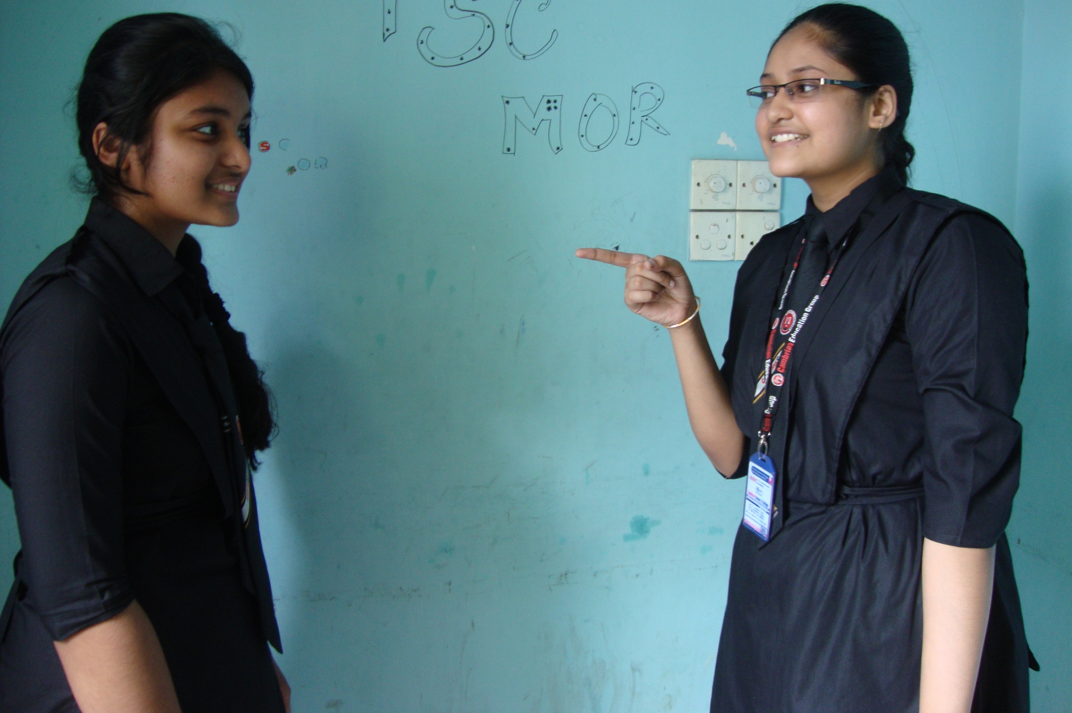
Iffat said to Aiko, “What kind of song does Asha sing?”
Iffat asked Aiko what kind of song Asha sang.
Notes:
Teacher will ask the students to change it into indirect then show it for check.

Slide 14
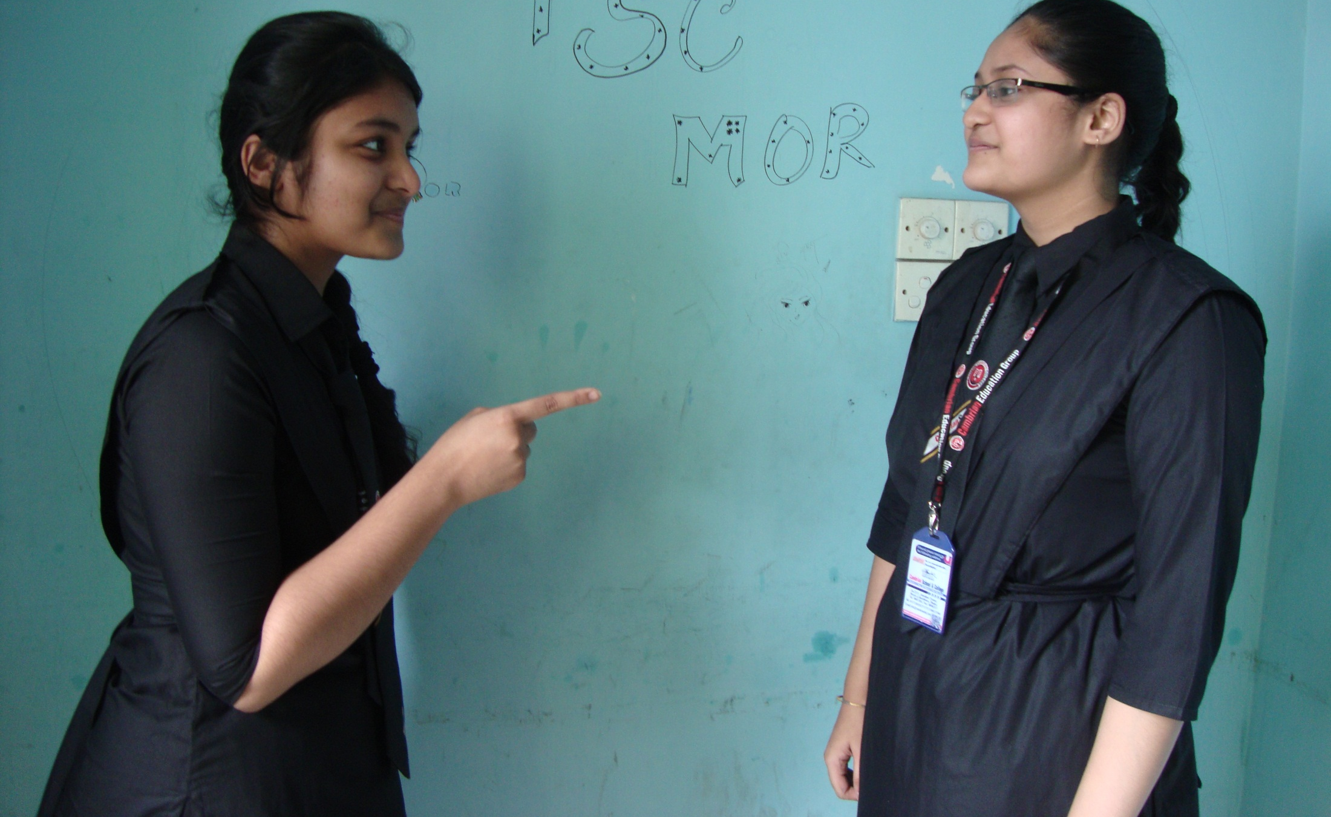
“Does she sing folk song?” said Aiko.
Aiko asked/wanted to know if she sang folk song.
Notes:
Teacher will ask the students to change it into indirect then show it for check.

Slide 15
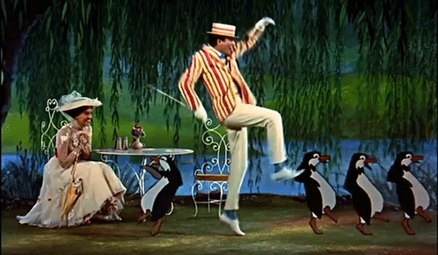
The woman said, “ How does the man dance with the penguins?”
The woman asked how the man danced with penguin.
How to change ‘Wh’ question from direct to indirect speech.
Subject + asked +object + ‘Wh’ word + subject + verb + extension .
Notes:
Teaching structure how to change direct into indirect form of interrogative with ‘wh’ question.

Slide 16
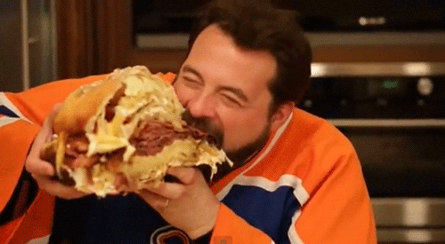
What and how is the man eating? asked he.
He asked/wanted to know what and how the man was eating.
Notes:
Introducing ‘wh’ question narration solving.

Slide 17
Let’s practice.
Mother said,” Have you done your home work?”
The doctor said to the patient, “What is your problem?”
The man said to me, ” Would you give me your pen?”
He said to me, “Can you solve the problem?”
The headmaster said to the boy, ” Do you obey your parents?”
The father said to the son, ”Are you sure to get A+ in the annual exam?”
The son said to his mother, ” How can I overcome the situation?”
Notes:
Class activities.

Slide 18
Notes:
Definition of optative sentence through asking question about the picture.

Slide 19
“May Allah bless my mother,” said the son.
How to change an optative sentence from direct to indirect speech.
Subject + prayed/wished + that + subject + might + V₁ + extension.
The son prayed that Allah might bless his mother.
Notes:
Structure how to change optative from direct to indirect.

Slide 20
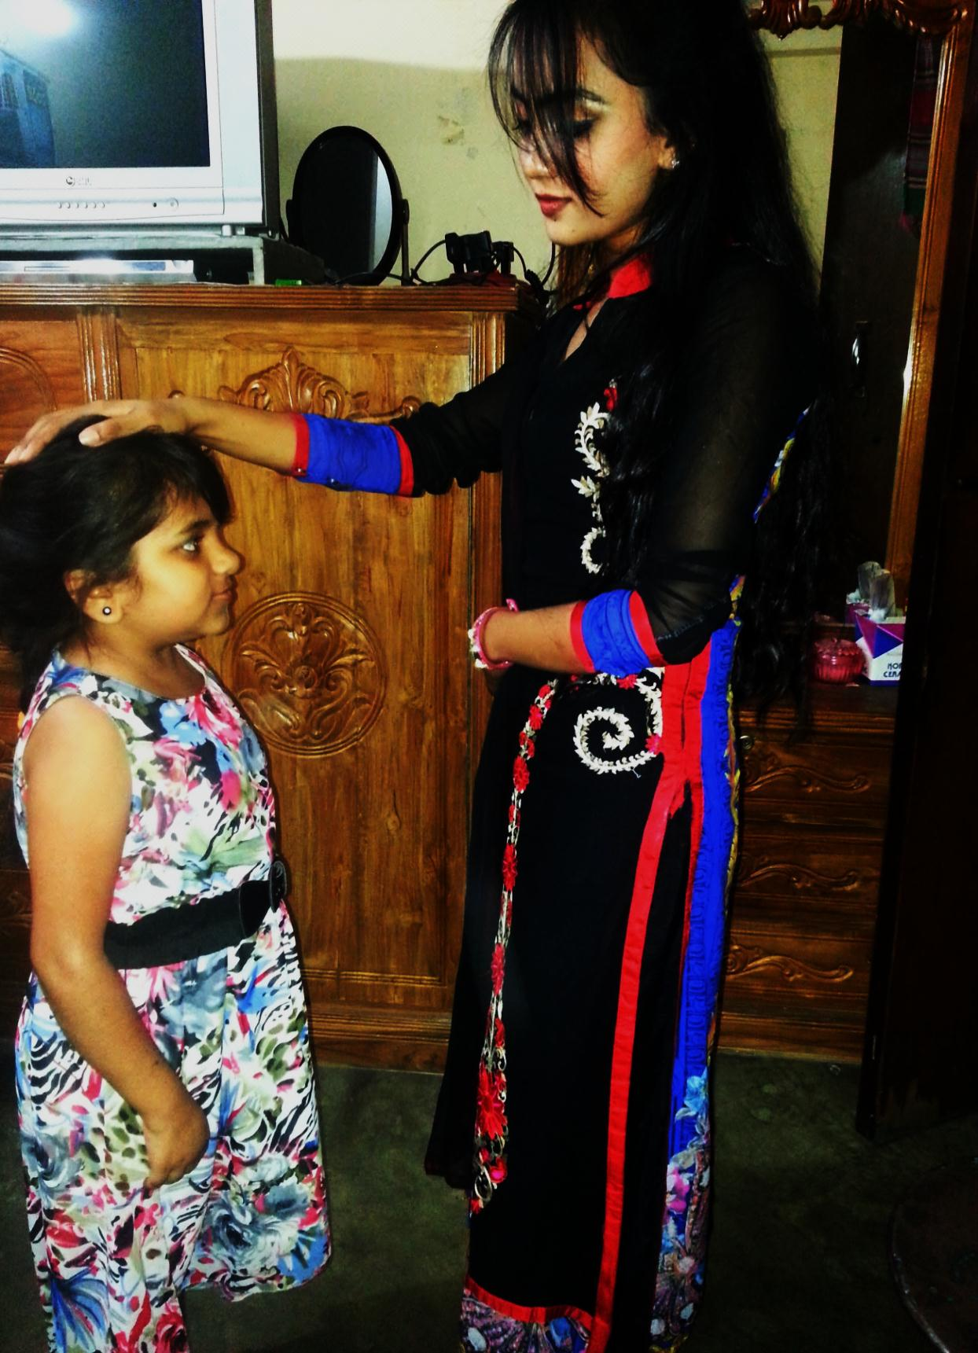
Jhuma said to Asha,” May you be happy.”
Jhuma wished that Asha might be happy.”
“Long live Bangladesh.”
We wished that Bangladesh might live long.
He said, “ Happy birthday to you.”
He wished me happy birthday.
Above rule is not effective here.
Subject + wished + object + ....
Notes:
Use of ‘wished’ & optative sentence without reporting verb. Teacher may discuss the last one to make it understand the students.

Slide 21
“Good Morning my friends. he greeted.
He greeted his friends good morning.
Notes:
How to change ‘good morning’ into indirect speech.

Slide 22
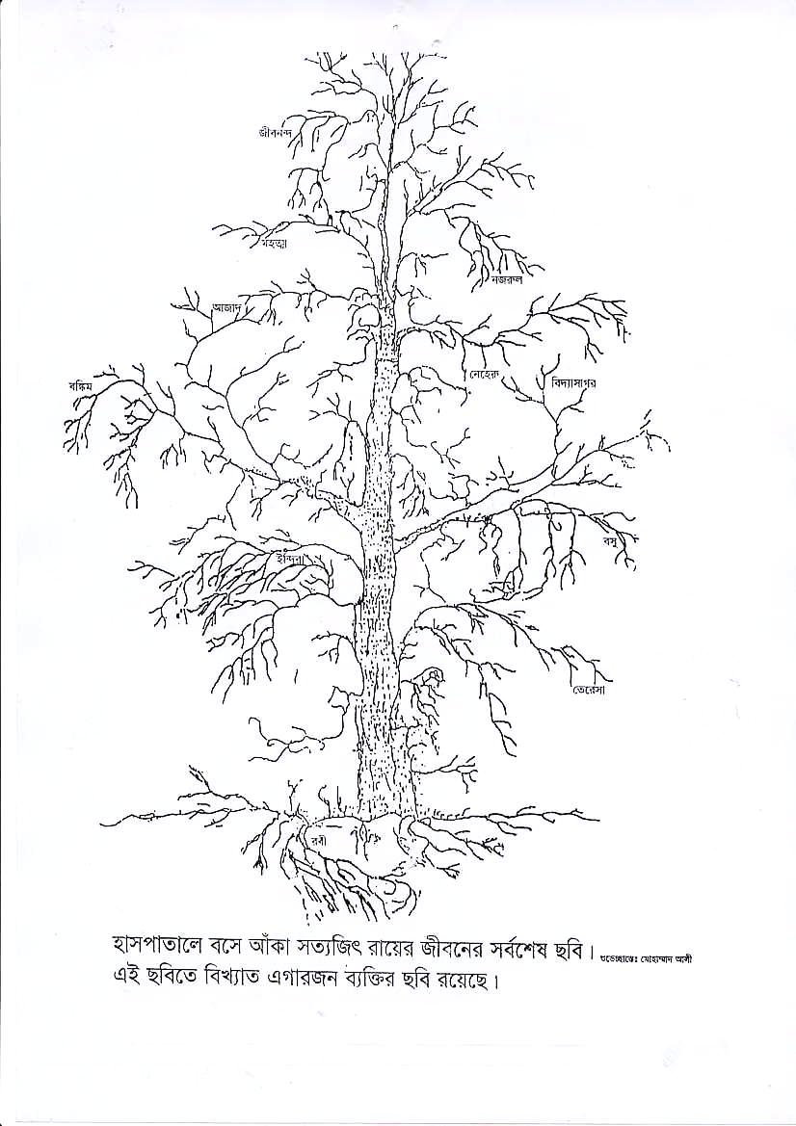
Pair Work
Make five questions with ‘yes/no’ and ‘wh’ on the tree and then change them into indirect speech.
Notes:
Brain storming activities.

Slide 23
Home Work
“Why did you call me yesterday?’’ ask Sumon.
Sumon said, “Have you forgotten that you promised to accompany me to go to Cox’sbazar?”
Now write more four interrogative sentences like the above and write all their indirect forms and structures you learnt from the class.
Notes:
Work to do at home.

Slide 24
May Allah bless you all
Welcome Students
Continue to passage narration next
Notes:
Ending greeting.

Slide 25
Acknowledgement
We would like to express our cordial gratitude to the Ministry of Education, Directorate of Secondary & Higher Education, NCTB, A2i and the panel of honorable editors ( Md. Jahangir Hasan, Assistant Professor (English) TTC, Rangpur, Ranjit Poddar, Associate Professor (English) TTC, Dhaka, and Urmila Khaled, Assistant Professor (English) TTC, Dhaka, to enrich the contents.

